Slide 1
Simulation results for OBSS R-TWT management
Date: 2024-09-03
Authors:
Name | Affiliation | Address | Phone | Email
Patrice NEZOU | Canon Research Centre France |  |  | patrice.nezou@crf.canon.fr
Pascal VIGER |  |  |  | pascal.viger@crf.canon.fr
Mikael LORGEOUX |  |  |  | mickael.lorgeoux@crf.canon.fr
Stéphane BARON |  |  |  | stephane.baron@crf.canon.fr
Yara YAACOUB

Slide 2
Abstract
MAP coordinated R-TWT SP protection has been discussed for a long time.
In this contribution, we provide simulation results and proposals about R-TWT SP management in a 11bn network.

Slide 3
OBSS R-TWT Concept and medium access management
Many contributions already discussed about the coordinated medium access between APs based on r-TWT feature. (e.g. [1][2][3])
The main concept of the OBSS R-TWT is to set up an OBSS service period (SP) in neighbouring BSS(s) when a r-TWT SP is initiated in the current BSS.
All initiated SPs must be synchronized to be efficient.[1]
The other main point driving the efficiency of the OBSS R-TWT is the coordinated medium access. Several rules may be applied on the neighboring BSSs to optimize the medium access during the SPs:
OBSS TWT element forbids the stations of the neighboring BSSs to access the medium during the OBSS SPs. [2]
OBSS TWT element adjusts the EDCA parameters of the neighboring BSSs to penalize the medium access mechanism of all STAs of the neighboring BSSs.[3]
OBSS TWT element indicates a temporary operating channel modifications for stations of the neighboring BSSs.
E.g channel switch Announcement, DSO, NPCA …[4]
Next slides propose simulation results for multiple use cases.
Notes:
1- CRF2199a P4 L5 : “the first and second TWT SPs may start simultaneously, meaning their starting times are fully aligned in time.”
2- CRF2199a P4 L35-37 : “the OBSS TWT element forbids the stations of the second BSS to access the medium during the second TWT SPs”
3- CRF2199a P5 L22-247: “the OBSS TWT element includes an OBSS EDCA Parameter Set, different from a legacy EDCA Parameter Set, to be applied by the stations of the second BSS to contend for access to the medium during the second TWT SPs.
4- CRF2199a P5 L1 : “the OBSS TWT element indicates a temporary operating channel for stations of the second BSS to switch to the temporary operating channel for their communication during the second TWT SP.”
CRF2199a P44 L21 : “Channel Switch Announcement…. Secondary Channel Access (SCA) operation, … Dynamic Sub-band Operation (DSO).”

Slide 4
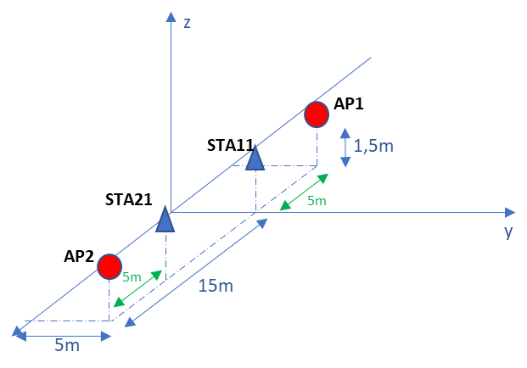
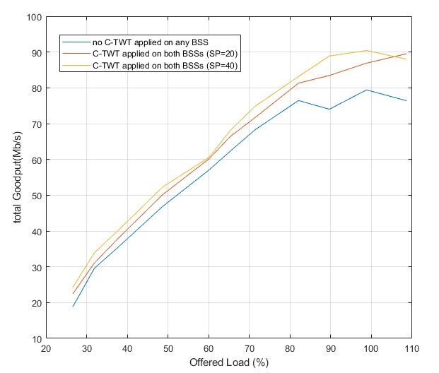
Use case 1: Global throughput study
Simulation use case and assumptions:
2 BSSs with no hidden nodes – Each BSS is composed of an AP and a STA.
MCS set to 6 (131,6 Mbps) to fix channel capacity
An OBSS TWT SP is initiated for each beacon interval (100ms) for each BSS.
SP length: one simulation run with SP=20ms and another simulation run with SP=40ms for each AP
STA sends data frames to its AP with a CBR of 7Mbps
AP sends data frames to its associated STA with a CBR varying from 14Mbps to 121Mbps
Results and analysis
The OBSS R-TWT feature improves the global throughput mainly in a high-collided environment.
Otherwise the global throughput is almost the same as the throughput for a scenario without OBSS R-TWT feature.
More detailed simulations are needed to conclude on the interest of the OBSS R-TWT feature.
Next use cases will provide more detailed results about the throughput for each device.
Total Throughput (Mbps)

Slide 5
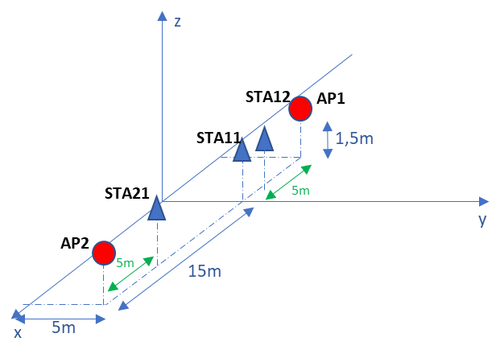
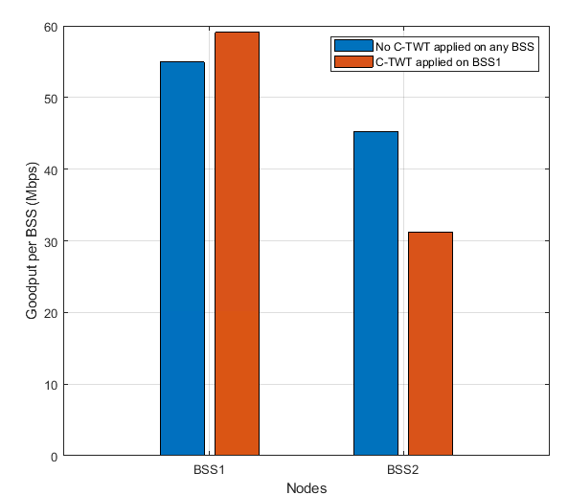
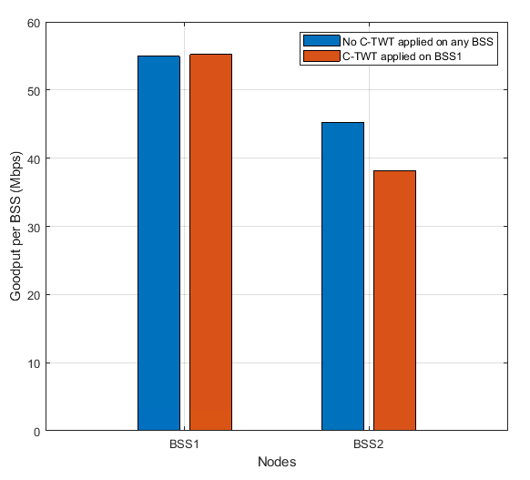
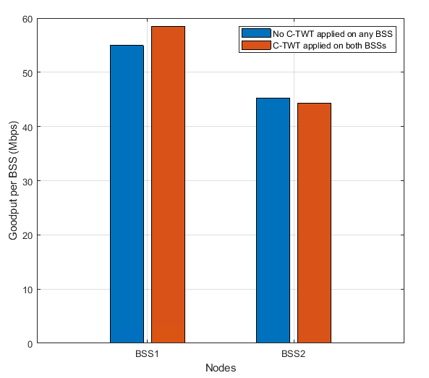
Use Case 2: Throughput per BSS
BSS1
Simulation use case and assumptions:
2 BSSs with no hidden nodes: BSS1 (AP1,STA11,STA12) – BSS2 (AP2,STA21).
MCS set to 6 (131,6 Mbps) to fix channel capacity
AP1/AP2 send data frames to its STA11/STA21 (CBR - 14Mbps – AC_VO)
STA11/STA21 send data frames to its AP1/AP2 (CBR – 87 Mbps – AC_VO)
STA12 sends data frames to its AP1 (CBR - 14Mbps – AC_VO)
Results and analysis:
Throughput drastically impacted for OBSS - Penalize AIFSN improves fairness
SP length should be tracked carefully. - Set multiple SPs improves medium sharing and throughput between BSSs
BSS2
Use case 2b: 1 SP = 40ms, OBSS AIFSN=4 for AC_VO
Use case 2c: 2 SPs = 40ms for BSS1 and 35ms for BSS2,
OBSS AIFSN=4 for AC_VO
Use case2a: 1 SP = 40ms, medium access forbidden for BSS2
Throughput per BSS (Mbps)
Throughput per BSS (Mbps)
Throughput per BSS (Mbps)

Slide 6
OBSS R-TWT : Simulation Analysis and learnings
OBSS R-TWT mechanism should be applied between a low number of BSSs to minimize the impact on the medium access.
OBSS R-TWT SPs should be defined carefully. The length of the SP should be adapted to the global bandwidth needs of all BSSs, especially when strong medium access rules are applied to the interfering BSSs. If the bandwidth allocated to each of participating APs and its corresponding BSSs is not tracked, spectrum efficiency is drastically decreased.
Medium access rules should not be too strong. It is better to penalize EDCA parameters (such as increasing AIFSN value) of the interfering BSSs, instead of forbidding medium access.
Finally, due to the impact in term of throughput for the interfering BSSs, only short OBSS R-TWT SPs should be setup and reserved only for transmitting low latency flows that require precise and periodic medium accesses.
The OBSS R-TWT remains closely linked to the fairness among BSSs.

Slide 7
Summary
This contribution analyzes the impact of OBSS R-TWT features on the spectrum efficiency.
Several key points should be considered:
Fairly tune EDCA parameters for OBSS devices and the length of the OBSS R-TWT SPs
The reciprocity of OBSS TWT schedule settings ensure fairness through the BSSs
OBSS R-TWT feature should be reserved for low-latency flows in high-collided environment.

Slide 8
References
[1] 11-23/226 Considerations for AP coordination in UHR: Coordinated Medium Access, Abdel Ajami (Qualcomm)
[2] 11-23/250 AP Coordination, Liwen Chu (NXP)
[3] 11-23/291 R-TWT Multi-AP Coordination, Kumail Haider (Meta)
[4] 11-24/742 OBSS TWT management for MAP, Pascal VIGER (Canon)

