Slide 1
On UEQM and UEQ-MCS
Date: 2024-05-06
Authors:
Name | Affiliations | Address | Phone | email
Ron Porat | Broadcom |  |  | ron.porat@broadcom.com
Qijia Liu | Broadcom

Slide 2
Introduction
UEQM and UEQ-MCS have been proposed to improve SU MIMO BF performance.
[1] compared their relative performance in a specific channel and a 4x4 configuration
We provide here new results comparing the performance of both schemes in various configurations and typical .11 channels

Slide 3
Simulation Assumptions
SVD based Tx beamforming
MIMO Configs: 2x2, 4x2, 4x4
80MHz, DNLOS, BLOS, 500 channel realizations for each MIMO config
MCS0-13 on all streams (no new MCS)
Including RF impairments and realistic CHEST
Gain numbers based on RvR simulation, which uses genie rate selection per channel realization at each SNR point (note the SNR doesn’t include the impairments)
For UEQ MCS, total number of payload bytes is the same as EQM/UEQM. But the total payload bytes are allocated to each stream, proportional to per-stream rate
While UEQM is a direct enhancement of EQM (both using one LDPC), for UEQ-MCS we show two types of results:
UEQ-MCS with strictly one LDPC per spatial stream
UEQ-MCS including EQM with one LDPC for all streams

Slide 4
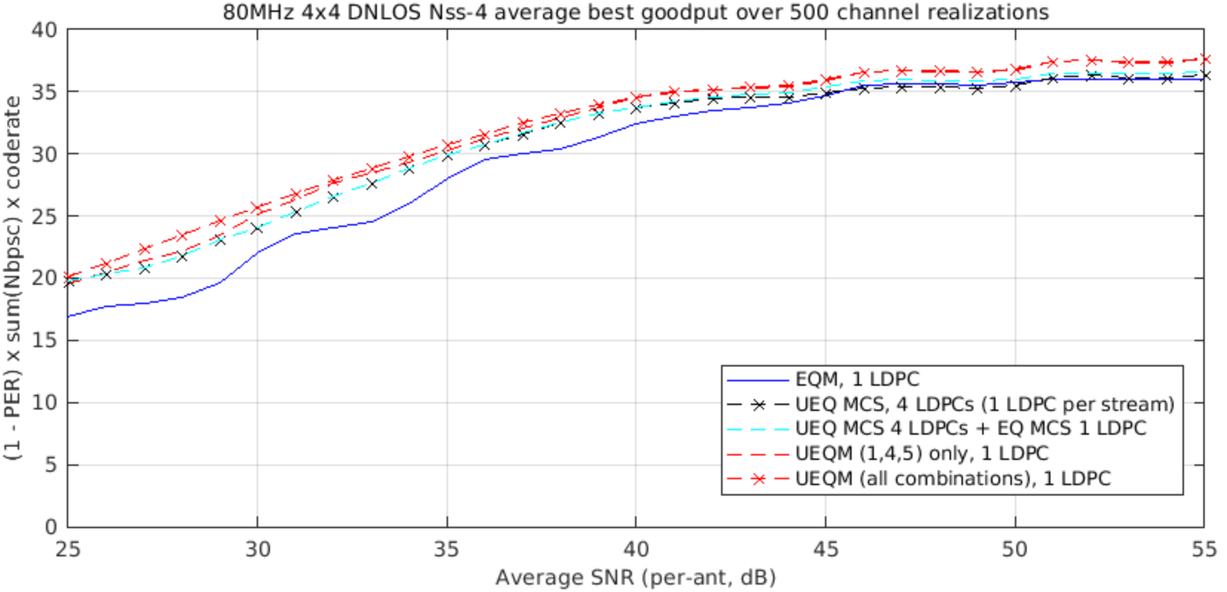
4x4 DNLOS
(*) the notation (1,4,5) is taken from [2]

Slide 5
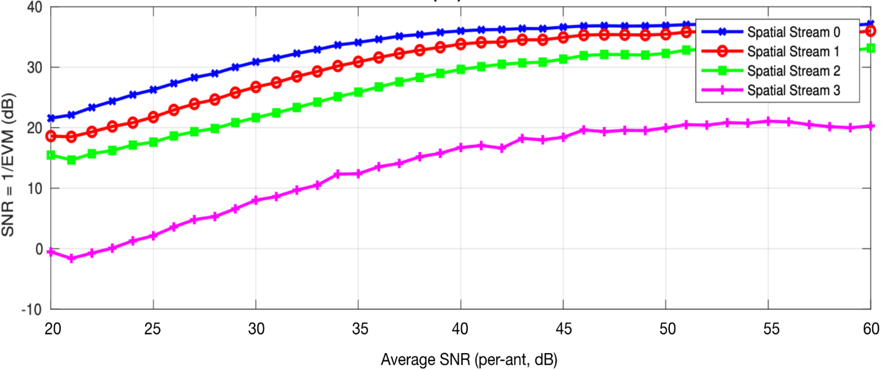
Observations
UEQM, whether all combinations or only the 3 proposed in [2] (shown below), exhibit higher Gput than UEQ-MCS. Why?
We think it’s because one LDPC protects the weakest 4th stream and enables it to use a higher QAM than would be possible if each stream had its own separate LDPC. In that sense the UEQM proposal in [2] provides full flexibility for the 4th stream {x,x-1,x-2} with equal QAM {x} for the stronger 3 streams which maximizes the performance at the high SNR.
 | Mod[stream] |  |  |  | # combinations
 | 0 | 1 | 2 | 3 | 1 | 2 | 3
0 | x | x | x | x | ✓ | ✓ | ✓
1 | x | x | x | x-1 |  |  | ✓
2 | x | x | x-1 | x-1
3 | x | x-1 | x-1 | x-1
4 | x | x | x | x-2 |  | ✓ | ✓
5 | x | x | x-1 | x-2 | ✓ | ✓ | ✓
6 | x | x-1 | x-1 | x-2
7 | x | x | x-2 | x-2
8 | x | x-1 | x-2 | x-2
9 | x | x-2 | x-2 | x-2

Slide 6
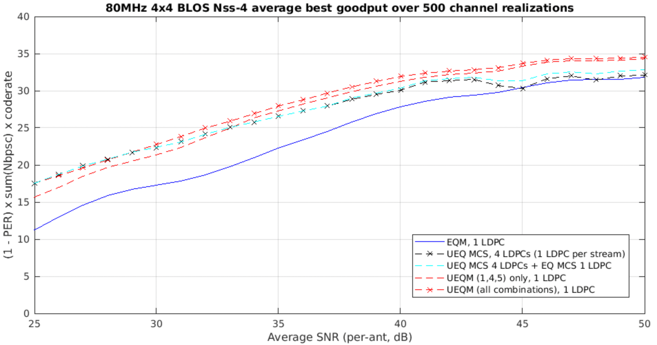
4x4 BLOS
Similar behavior as in DNLOS but bigger gap at high SNR

Slide 7
Example - MCS % Distributions for SNR=45dB
UEQM | 13 | 12 | 11 | 10 | 9 | 8 | 7 | 6
MCS[0] | 89 | 8.4 | 2.6
MCS[1] | 85 | 8.4 | 6.6
MCS[2] | 15.8 | 7.2 | 67.2 | 1.2 | 8.4 |  | 0.2
MCS[3] |  | 1 |  | 3.2 | 21 | 3 | 70.6 | 1
Spectral efficiency 33.65
UEQ MCS | 13 | 12 | 11 | 10 | 9 | 8 | 7 | 6 | 5 | 4
MCS[0] | 100
MCS[1] | 99.4 | 0.6
MCS[2] | 0.8 | 44 | 50 | 5 | 0.2
MCS[3] |  |  | 0.4 | 0.8 | 1 | 9.4 | 21 | 10.4 | 2.4 | 0.6
Spectral efficiency 30.94
For a lot of channels can’t support 4th spatial stream
UEQ MCS + EQM | 13 | 12 | 11 | 10 | 9 | 8 | 7 | 6 | 5 | 4
MCS[0] | 38.8 | 2 | 3.2 | 56
MCS[1] | 38.2 | 2.6 | 3.2 | 56
MCS[2] | 0.4 | 20.4 | 20.4 | 58.6 | 0.2
MCS[3] |  | 2 | 3.4 | 56 | 0.2 | 6.2 | 18.4 | 8 | 5.6 | 0.2
Spectral efficiency 31.59

Slide 8
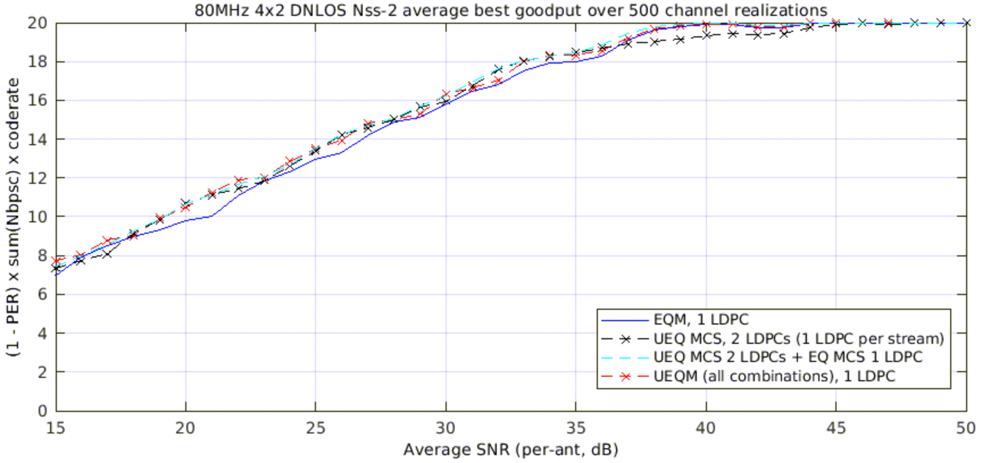
4x2 DNLOS
Observation - UEQ MCS has losses at around 40dB SNR compared with EQM and UEQM. Why?
UEQ MCS lands on MCS 13+12 there, while EQM can mostly go to MCS 13+13. This comes back to the fact that a single LDPC can help the weaker stream by combining it with the stronger stream

Slide 9
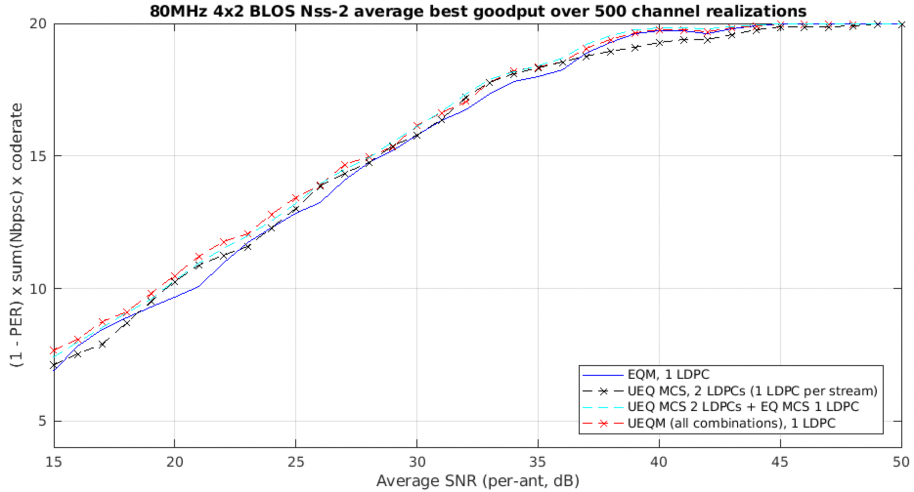
4x2 BLOS
Observation – same as in DNLOS

Slide 10
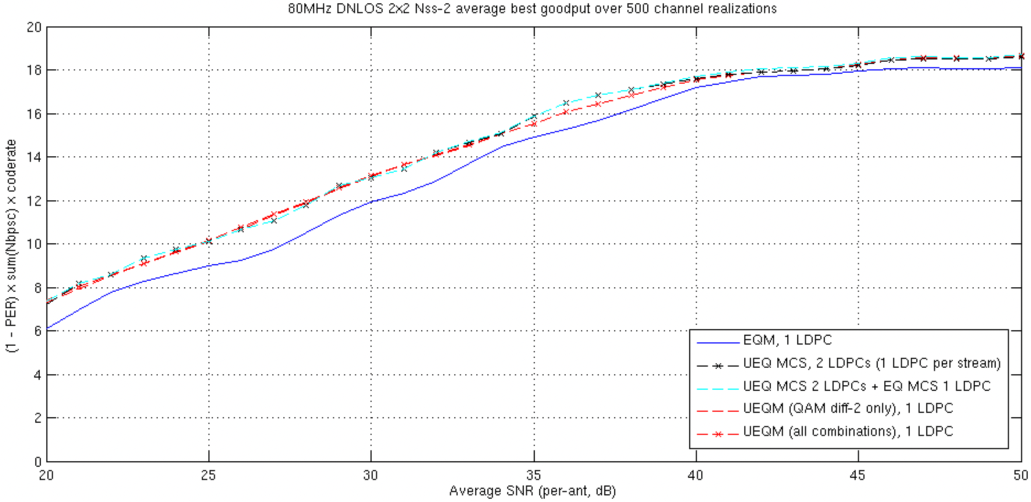
2x2 DNLOS
Observation - UEQ MCS are about the same

Slide 11
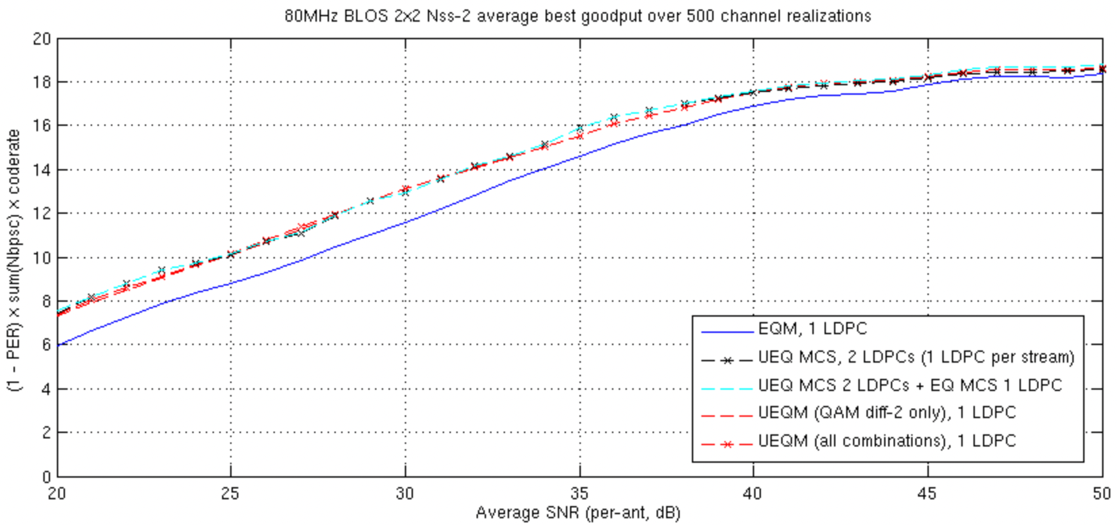
2x2 BLOS
Observation - UEQ MCS are about the same

Slide 12
Conclusions
UEQM is superior to UEQ-MCS with Nss>2 and with {Nss=2, 4x2} because one LDPC provides better protection over the strong and weak streams to enable pushing the QAM or code rate slightly higher than possible with UEQ-MCS
Not only UEQM is simpler to implement for STA because they have only one LDPC but even for AP to AP communications over with 4ss UEQM seems to provide gain over UEQ-MCS
UEQM works better with the existing EQM – easier to add and integrate
→ Recommend that 11bn adopts UEQM for MIMO+BF

Slide 13
References
[1] 11-24-0433-00 Analysis on UEQM and UEQ MCS
[2] 11-24-0507-02 UEQM Further Details

Slide 14
SP #1 (from 24/117r1)
Do you agree to add to the 11bn SFD : 11bn supports unequal modulations (UEQM) with single encoder for all spatial streams and different modulation per spatial stream for beamforming with at least 2ss
This is used for single user MIMO beamforming transmission in full bandwidth or OFDMA

