Slide 1
Sensing and Ranging in IMMW
Date: 2024-05-13
Author:
Name | Affiliation | Address | Phone | Email
Tony Xiao Han | Huawei Technologies Co., Ltd. | F3, Huawei Base, Shenzhen, China |  | Tony.hanxiao@huawei.com
Rui Du | Huawei Technologies Co., Ltd.
Narengerile | Huawei Technologies Co., Ltd.
Zhuqing Tang | Huawei Technologies Co., Ltd.
Mengshi Hu | Huawei Technologies Co., Ltd.
Yiyan Zhang | Huawei Technologies Co., Ltd.
Claudio Da Silva | Meta Platforms

Slide 2
Overview
In this contribution, we would like to consider Sensing and Ranging in IMMW.
Some general design consideration are given.

Slide 3
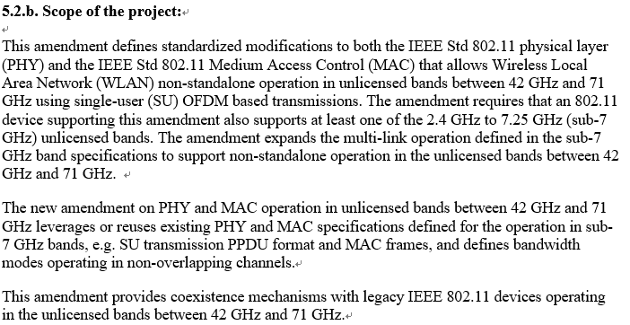
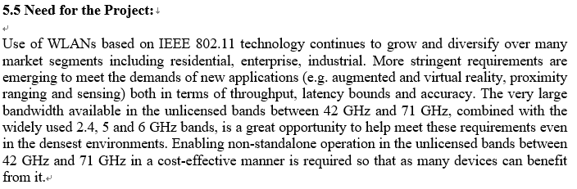
Definition
WLAN Sensing (802.11bf) ^{[1]}
WLAN Ranging (802.11az/bk) ^{[2, 3]}
WLAN sensing is the use of received WLAN signals to detect feature(s) of an intended target(s) in a given environment.
  Features = Range, velocity, angular, motion, presence or proximity, gesture, etc.
  Target = Object, human, animal, etc.
  Environment = Room, house, car, enterprise, etc.
  For Sub 7GHz (11ac/ax), and 60GHz (11ad/ay)
A Station to identify its absolute and relative position to another station or stations it’s either associated or unassociated with.
  Better accuracy with respect to the Fine Timing Measurement (FTM) protocol.
  For Sub 7GHz (11n/ac/ax), and 60GHz (11ad/ay)
IMMW ^{[4]}

Slide 4
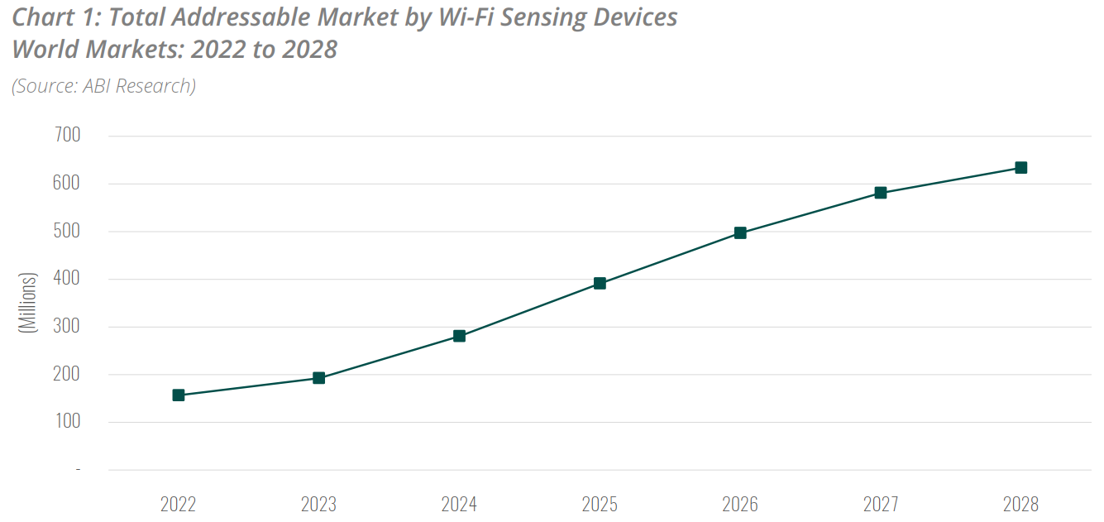
Motivation
Sensing and Ranging for IMMW
  Feature: Similar as 802.11bf/az/bk for WLAN, Sensing and Ranging also could be the unique/highlight features in IMMW
  Market: Based on the addressable market for WLAN Sensing [8], Sensing and Ranging could further enable the commercialization of IMMW
IMMW for Sensing and Ranging
  Requirement: Some use cases may need mmWave, e.g.,
    For Sensing: Audio with user tracking, fine-grained gesture recognition, etc. [7, 8]
    For Ranging: Device Proximity Detection, Nano Location in store, etc. [9]
  Current: standardized mmWave Sensing and Ranging is based on 11ad/ay
  Potential: IMMW may be a good candidate (Unified baseband for sub-7GHz and mmWave) to supplement the mmWave part, with higher commercialization possibility.
  Pre-standard (2024-2025)
  It is anticipated that there will be a rapid increase in the number of WLAN Sensing compatible devices.
  Because of the arrival of pre-standardization 802.11bf chipsets
  Official 802.11bf standardization (2025-2026)
  Additional growth is expected following the official 802.11bf Standard releases
  Well-defined requirements and market demand encourage more chipset vendors to adopt 802.11bf for their chipsets
Sub7GHz
mmWave
802.11bf
May not be implemented
Supplement
IMMW
Sub7GHz
mmWave
802.11az
Notes:
Mutual beneficial

Slide 5
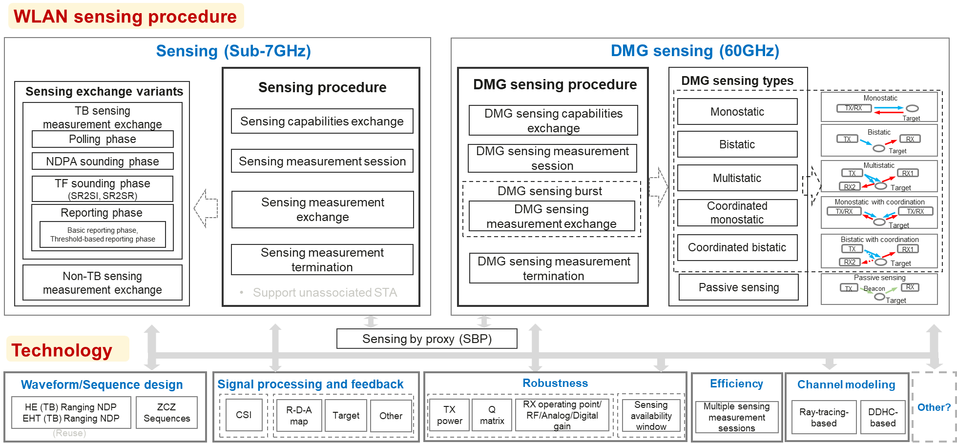
Procedure & Technology in 802.11bf ^{[5]}
Consider as baseline
No need to redesign
Consider as reference
Need to redesign IMMW sensing and only take DMG sensing as reference, but not revise based on DMG sensing
802.11bf have well defined protocol for Sensing, no need to completely redesign
Minimize redesign according to IMMW architecture
Sensing (Sub-7GHz): Consider as baseline; DMG sensing (60GHz): Consider as reference

Slide 6
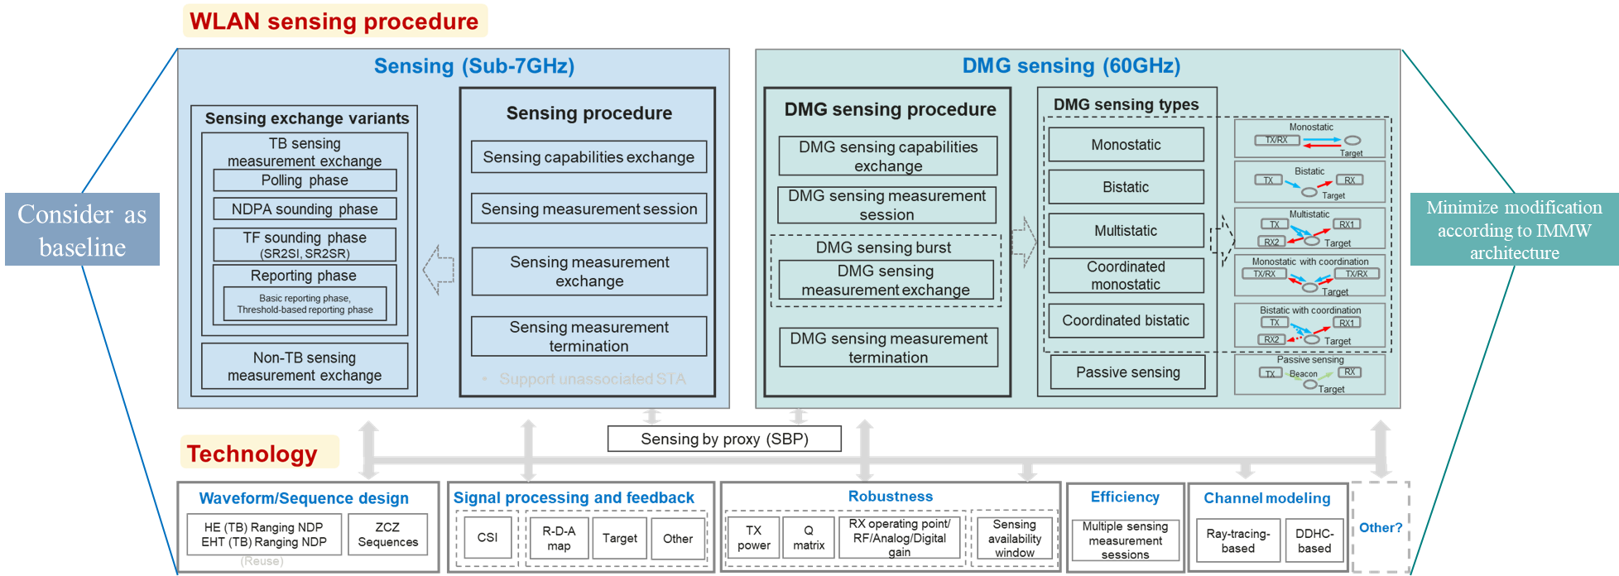
Initial design consideration (Sensing)
IMMW sensing procedure
IMMW sensing
IMMW sensing procedure
IMMW sensing types
Minimize modification of 11bf, according to IMMW architecture
Consider Multi-Link Operation
Others?
Consider really necessary types
Others?
Sensing by proxy (SBP)
Technology
Waveform/Sequence design
Signal proc & Feedback
Robustness
Efficiency
Multi-Link
Channel modeling
Other?
Reuse newly designed NDP
Other?
CSI
Other?
TX power
Q matrix
RX operating point/
RF/Analog/Digital gain
Sensing availability window or ？
Multiple sensing measurement sessions
TBD
Ray-tracing-based
DDHC-based
(Reuse)

Slide 7
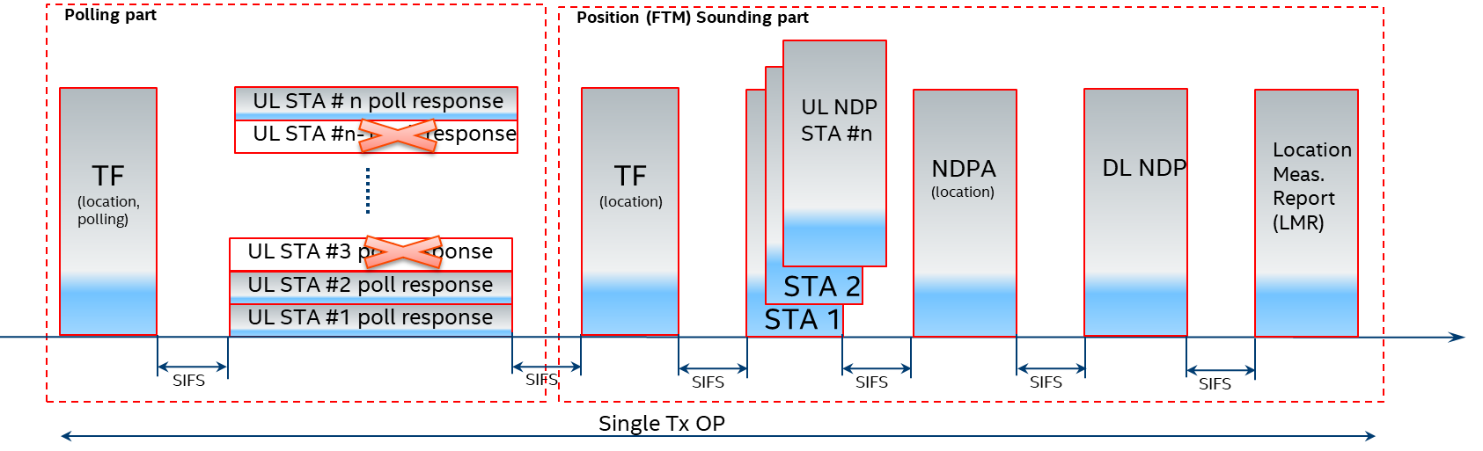
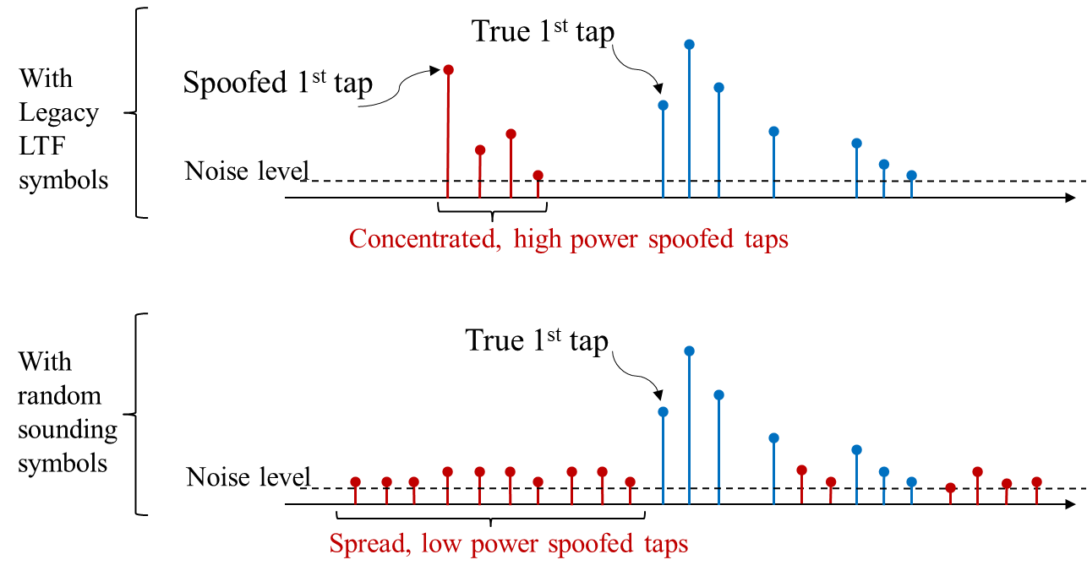
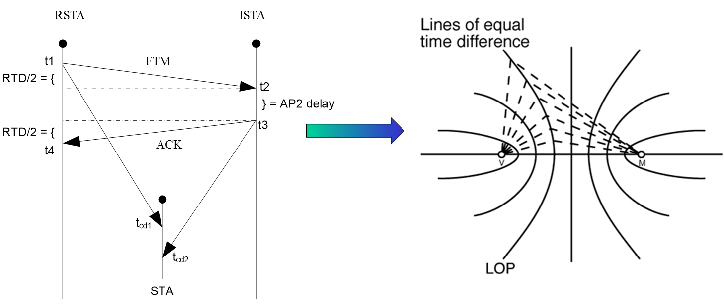
802.11az Key Radio and Positioning Techniques ^{[6]}
Medium efficient operation via dynamic (demand dependent) measurement rate.
Adaptation to next generation mainstream 802.11ax Trigger Based Operation (MIMO, Trigger Frame, NDP frame)
Authenticity and privacy and anti-spoofing mechanism via PMF in the unassociated mode and PHY level randomized measurement sequences (HE LTF sequences protection).
Improved accuracy via MIMO and larger BW available in the <7Ghz band for 11ax.
MIMO enablement for measurement for improved accuracy especially for NLOS or NNLOS conditions.
Passive location with fixed overhead independent of number of users
802.11az (bk) have well defined protocol for Ranging, we do not need to redesign it again

Slide 8
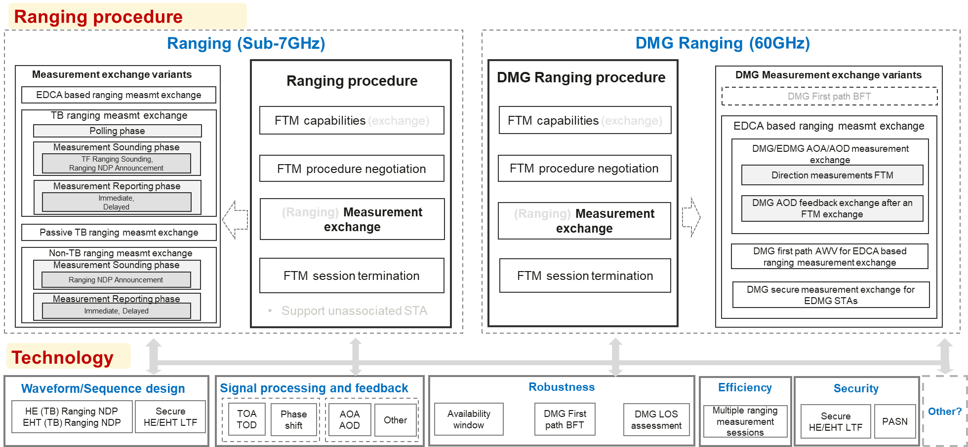
Procedure & Technology in 802.11az/bk
Consider as baseline
No need to redesign
Consider as reference
Need to redesign IMMW ranging and only take DMG ranging as reference, but not revise based on DMG ranging
802.11az/bk have well defined protocol for Ranging, no need to completely redesign
Minimize redesign according to IMMW architecture
Ranging (Sub-7GHz): Consider as baseline; DMG Ranging (60GHz): Consider as reference

Slide 9
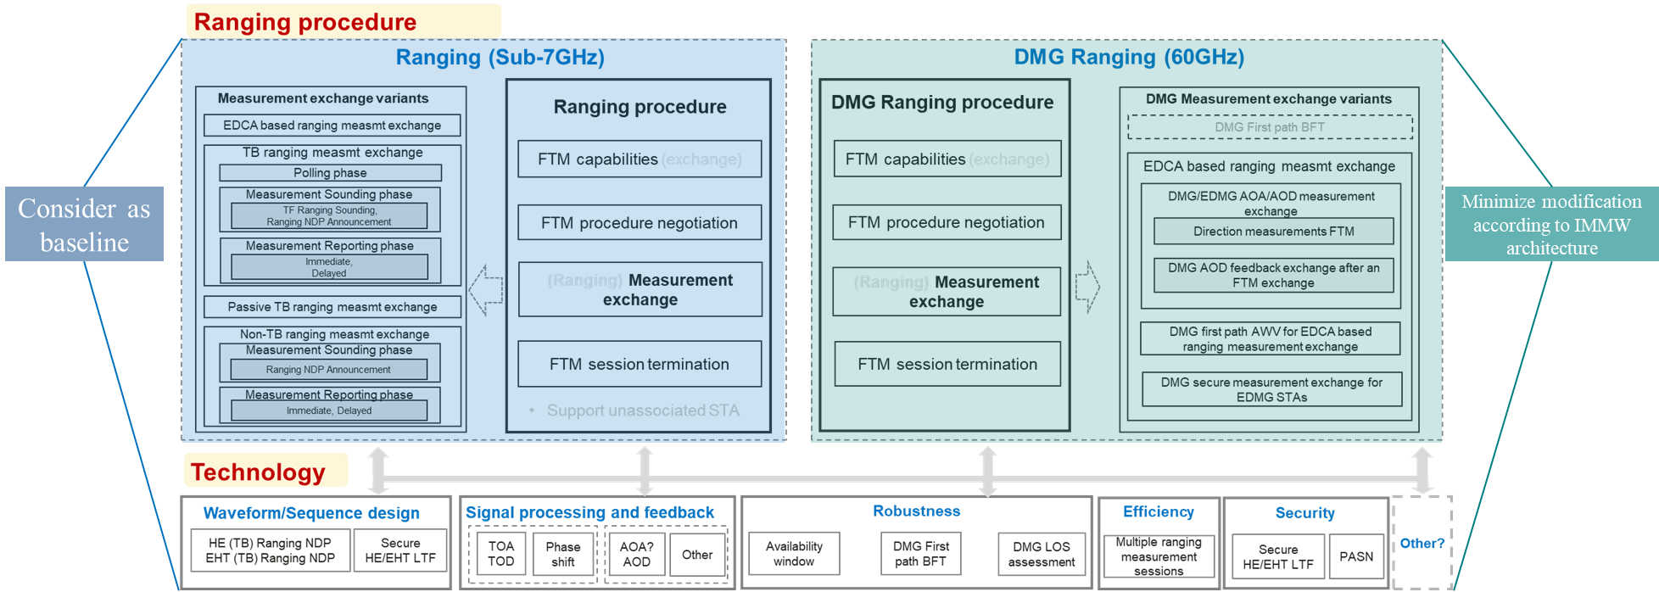
Initial design consideration (Ranging)
IMMW ranging procedure
IMMW ranging
IMMW ranging procedure
IMMW ranging
Measurement exchange variants
Minimize modification of 11az/bk, according to IMMW architecture
Consider Multi-Link Operation
Others?
Consider really necessary types
Others?
Technology
Waveform/Sequence design
Signal processing and feedback
Robustness
Efficiency
Security
Multi-Link
Other?
Reuse newly designed NDP
Secure XXX LTF
TOA
TOD
Phase shift
AOA
AOD
Other
Availability window
DMG First path BFT
DMG LOS assessment
Multiple ranging measurement sessions
Secure XXX LTF
PASN
TBD

Slide 10
Summary
There is strong motivation to add Sensing and Ranging in IMMW
  Sensing and Ranging for IMMW
  IMMW for Sensing and Ranging
In order to add Sensing and Ranging in IMMW, we could consider the following design logic
  Sensing (Sub-7GHz) in 802.11bf could be considered as baseline, but no need to redesign Sub-7GHz sensing;
  Need to redesign IMMW sensing and only take DMG sensing (60GHz) in 802.11bf as reference, but not revise based on DMG sensing
  Ranging (Sub-7GHz) in 802.11az/bk could be considered as baseline, but no need to redesign Sub-7GHz ranging;
  Need to redesign IMMW ranging and only take DMG ranging (60GHz) in 802.11az/bk as reference, but not revise based on DMG ranging
  Minimize redesign according to IMMW architecture

Slide 11
Reference
[1] https://www.ieee802.org/11/Reports/tgbf_update.htm
[2] https://www.ieee802.org/11/Reports/tgaz_update.htm
[3] https://www.ieee802.org/11/Reports/tgbk_update.htm
[4] https://mentor.ieee.org/802.11/dcn/24/11-24-0116-02-immw-immw-draft-proposed-par.docx
[5] Du R, Hua H, Xie H, Song X, Lyu Z, Hu M, Xin Y, McCann S, Montemurro M, Han TX, Xu J. An overview on IEEE 802.11 bf: WLAN sensing. arXiv preprint arXiv:2310.17661. 2023 Oct 20.
[6] http://www.kt.agh.edu.pl/~kulakowski/evolution/09_wifi2.pdf
[7] https://mentor.ieee.org/802.11/dcn/20/11-20-1712-02-00bf-wifi-sensing-use-cases.xlsx
[8] https://go.abiresearch.com/lp-the-commercial-market-value-for-wifi-sensing, Andrew Zignani, Andrew Spivey, ABI research, December 2022
[9] https://mentor.ieee.org/802.11/dcn/16/11-16-0137-04-00az-ngp-use-case-document.pptx

Slide 12
SP 1
Do you agree that sensing and ranging support/operation should be defined in IMMW?

