Slide 1
Dynamic TID-To-Link Mapping for AP MLD Power Save
Date: 2024-01-17
Authors:

Slide 2
Abstract
There are requirements and recommendations to improve the energy efficiency of APs [1-4].
Previous contributions and proposals [5-16] for scheduled, unscheduled and dynamic AP power save
  for example, utilizing TWT, SMPS, MLD, EMLSR, and limiting BW/NSS
This contribution presents a traffic aware power save protocol for AP MLD utilizing TID-To-Link Mapping
  The AP MLD can use TID-To-Link Mapping (TTLM) for traffic/TID load balancing, link disablement/enablement, and duty cycling
  Can be used together with other AP power save protocols

Slide 3
Related Work
Existing protocols and proposals mainly focus on limiting the AP’s capability in timing (TWT), frequency (BW/MLD), spatial (NSS, SMPS), power state (Active/Doze) domains [5]
  Limit the channel bandwidth, # antenna, NSS [7] or the 802.11 generation/version/feature
  BSS Termination (AP power down notification) [9]
  802.11ba WUR and Wake Up AP [11, 12]
  RAW/S-APSD/TWT with limited SP or Listen Interval [13, 14], then the AP turns into Doze state
  Unscheduled AP PS and utilize MLD: certain link in active mode and other links in PS mode [6, 7, 8, 15, 16]
  Scheduled: TWT-based duty cycling [7, 14, 16]
  Dynamic: SMPS/EMLSR for APs [7], limited AP capability (BW/NSS) [15]

Slide 4
Motivation and Proposal
Motivation:
  Traffic load and TID distribution can have different patterns during different time of the day in some scenarios such as home, shopping mall, office, warehouse, stadium, etc.
  Different TID-To-Link Mapping settings can have different impact on energy efficiency for AP MLDs.
Proposal: Dynamic TID-To-Link Mapping for AP MLD power save
  The AP MLD can adjust the TTLM, for example based on number of STAs, buffer status, channel load, traffic load of each TID/link on downlink and uplink.
  It can adapt and support different modes: load balancing, link disablement/enablement, duty cycling.
  It can be used together with other AP power save options, e.g., adjust settings such as TWT, BW, and NSS.

Slide 5
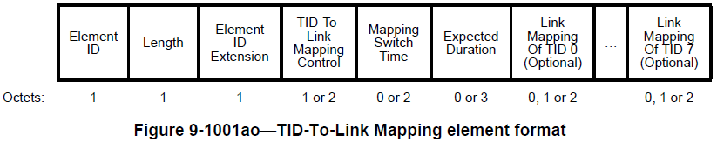
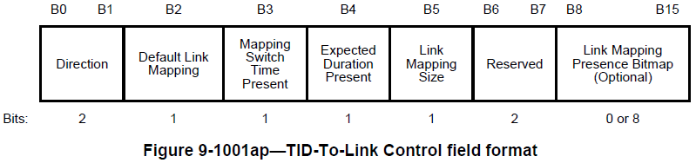
Recap: TID-To-Link Mapping for AP Power Save [17]
The AP can specify the schedule and capability (when, how long/often, what state/capability) by reusing the TID-To-Link Mapping element [17].
Schedule and link info (reuse TID-To-Link Mapping)
Power state info (for each link) |  |  |  | Extension (capability info)
ID and other info | Power state | Power state transition | … | Extension present | Supported channel width | Supported NSS | …
Repeat if applicable, or add subfields for periodic/predictable patterns

Slide 6
Dynamic TTLM for AP MLD Power Save: Mode 1
Mapping of some TID(s) to certain link(s) -> Traffic/TID load balancing between links
  Handled by MLD in UMAC, usually quick to switch
  The AP can allocate less traffic/TID on certain link(s) and reduce the BW/NSS/… for the link(s) with low traffic/channel load
  For example, high volume/priority traffic (e.g., real-time video/gaming) on high performance link(s), and low volume/priority traffic (e.g., background and IoT) on the link with low BW/NSS
  The goal is to use the suitable resources depending on traffic/TID/channel load and/or priority and to avoid or reduce contentions, collisions, and transitions (HW/SW/queue/power state/...) -> to improve the energy efficiency for AP MLDs

Slide 7
Dynamic TTLM for AP MLD Power Save: Mode 2
Mapping of all/none TIDs to certain link(s) -> link enablement/disablement, duty cycling
  Need hardware switch and other transitions, e.g., (dis/re)association, (re)setup, usually slow to switch
  In addition, for non-MLD non-AP STAs, the AP needs to perform BSS transition/termination for (dis/re)association on the disabled link(s) (35.3.7.5.2 Affiliated AP link disablement, 11be_D5.0)
  The AP MLD can disable certain link(s) for certain duration and enable the link(s) later, or change the duty cycle of certain link(s) by link disablement/enablement. STAs that know the AP MLD’s TTLM and link state can take actions accordingly.

Slide 8
Dynamic TTLM for AP MLD Power Save: Operations
AP and non-AP STA operations
  The AP can initiate a TTLM and advertise the TTLM to STAs. Non-AP STAs can negotiate a TTLM with the AP. Non-AP STAs can take proper actions based on the current/future TTLM.
  Can have a mode for a link being disabled for user data (no TID mapped to the link), while keeping up for management type operations: the AP still transmits Beacons and responds to Probe Request on the disabled link(s), unless in Doze state.
  Can have an option for a non-AP MLD to indicate which link it uses for management operations like Beacon Rx, and then the AP MLD knows if it needs to continue Beaconing or if can stop Beaconing when TTLM has disabled the link for all the STAs.

Slide 9
Dynamic TTLM for AP MLD Power Save: Operations
Can be used together with other AP power save protocols/options
  For example, the AP can gradually shift the traffic/TID load from one link to another link, and the link with reducing traffic/TID load can reduce the BW/NSS or turn to Doze state.
  Multi-AP coordination for traffic/TID load balancing and spatial/time/frequency/… resource allocation

Slide 10
802.11be TTLM Element used for AP MLD Power Save
Timing information:
  Mapping Switch Time and Expected Duration provide timing and scheduling information
  Mostly static operations, two TTLM instances allowed/required, not easy to support periodic/predictable/dynamic TTLM patterns
Link disablement/enablement:
  High transition overhead/delay, long turn-around time.
  Need BSS termination/transition for (dis/re)association for non-MLD non-AP STAs for disabled link(s)
  Unassociated non-AP STAs shall not transmit multi-link probe request, Authentication, and (Re)association Request frames on disabled link(s)
  Takes time and introduces overhead for TTLM maintenance/update, ML (re)setup, etc.

Slide 11
Potential Changes to Extend the TTLM Element
To support periodic/predictable/dynamic patterns:
  Add subfields, such as interval, persistence, and count information
  The AP can adjust the TTLM dynamically, and non-AP STAs can know the TTLM pattern and the AP’s link/power state in advance and take actions accordingly, e.g., PS mode, Probe Request, ML (re)setup.

Slide 12
Potential Changes to Extend the TTLM Element (Cont.)
To reduce transition overhead:
  Add subfields for simplified BSS/MLD operations for link disablement/enablement
  Can have a mode for a link being partially disabled for user data (no TID mapped to the link), while keeping up to support management operations, and have options for non-AP MLDs and AP MLDs to negotiate/indicate such mode on certain link(s).
  The AP can switch between Active state and Doze state quickly on certain link(s), and non-AP STAs can have reduced transition overhead for BSS transition/termination and ML (re)setup.

Slide 13
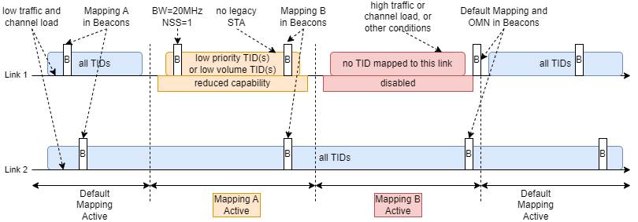
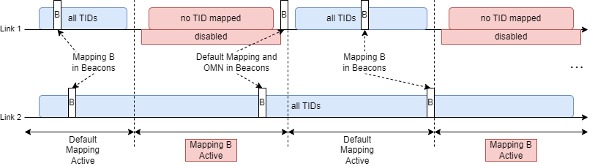
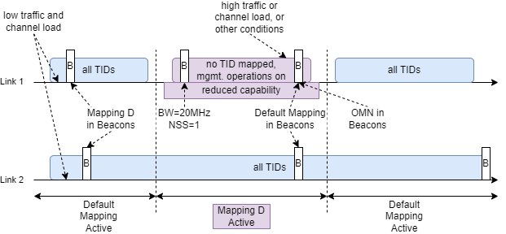
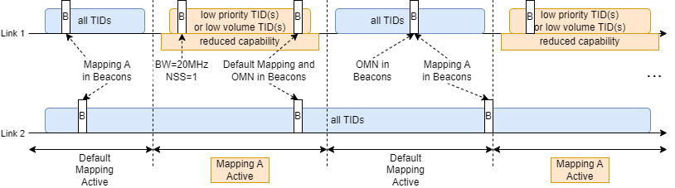
Dynamic TTLM for AP MLD Power Save: Use Cases
Load balancing and link disablement/enablement based on traffic/load
Duty cycling by link disablement/enablement
Link1 disabled for MLD user data, management operations still on
Duty cycling by traffic/TID load balance and reduced capability

Slide 14
Conclusion
This contribution presents a power save protocol for AP MLDs utilizing TID-To-Link Mapping
  Reuse TTLM for traffic load balancing, link disablement/enablement, and duty cycling to improve energy efficiency of AP MLDs
  Potentially to extend the TTLM element to support periodic/predictable/dynamic TTLM patterns and to reduce transition overhead

Slide 15
References
[1] Dorothy Stanley, Liaison statement from Wi-Fi Alliance re: energy efficiency, IEEE 802.11-23/0917r0, 2023
[2] Amelia Andersdotter, et al., 802.11 AP Power Save PAR addition proposal, IEEE 802.11-23/0244r1, 2023
[3] Amelia Andersdotter, et al., Green AP and resilience requirements for home networks, IEEE 802.11-22/1790r0, 2022
[4] Lili Hervieu, et al., A Perspective on UHR Features for Operator Residential Deployments, IEEE 802.11-22/1809r0, 2022
[5] Yongsen Ma, et al., AP Power Management, IEEE 802.11-23/1835r0, 2023
[6] Liwen Chu, et al., AP MLD power management, IEEE 802.11-23/0015r0, 2023
[7] Alfred Asterjadhi, et al., Considerations for enabling AP power save, IEEE 802.11-23/0010r0, 2023
[8] Guogang Huang, et al., Considering Unscheduled AP Power Save, IEEE 802.11-23/0225r0, 2023
[9] Stefan Aust, AP Power Saving, IEEE 802.11-11/0046r2, 2011
[10] Stefan Aust, TGah Use Case AP Power Saving in Smart Grid, IEEE 802.11-11/0273r0, 2011
[11] Xiaofei Wang, et al., AP Power Saving, IEEE 802.11-17/0728r2, 2017
[12] Xiaofei Wang, et al., On AP Power Saving Usage Model, IEEE 802.11-17/1388r2, 2017
[13] Jay Yang, et al., MLD AP Power-saving(PS) Considerations, IEEE 802.11-20/1115r6, 2020
[14] Kyumin Kang, et al., Considerations on Soft AP Power Saving, IEEE 802.11-21/0885r1, 2021
[15] George Cherian , et al., Enabling AP power save_follow up, IEEE 802.11-23/2040r1, 2023
[16] Liwen Chu, et al., AP MLD power save follow up, IEEE 802.11-23/1936, 2023
[17] Yongsen Ma, et al., AP Power Management – Follow-up, IEEE 802.11-24/0097, 2024

