Slide 1
Periodic Obfuscation
Date: 2024-03-07
Authors:

Slide 2
Abstract
802.11bi has key requirements for AID and MAC Header obfuscation for improved privacy protection in post association state.
802.11bi has got proposals to obfuscate every 15 minutes. This obfuscation interval is not sufficient to prevent STA tracking in some use cases.
This submission defines periodic obfuscation scheme which enables STAs to obfuscate AID and MAC Headers in much shorter interval and therefore provides better privacy protection.

Slide 3
Obfuscation Alternatives
Obfuscation Alternative | AID obfuscation | Obfuscation Setup Signaling | NOTE
Individual | Signaled by the AP | Obfuscation setup signaling per obfuscation | Large signaling overhead, if frequent obfuscations. Current proposal is to obfuscate every 15 minutes
Group |  | AP coordinated signaling, multiple messages per obfuscation
Periodic | BSS specific AID offset | BSS specific schedule, obfuscation at TBTT | No signaling per obfuscation
MAC Header obfuscation (XOR with offset) is the same on all alternatives

Slide 4
Proposal: BSS-Specific Periodic Obfuscation
MAC Header and AID offset are changed at a BSS specific interval, e.g., at TBTTs of TIM or DTIM Beacon
The AP and STAs may prepare the new addresses prior to offsets change
  At the offsets change, frames with old or new addresses are received for a short period

Slide 5
Proposal: AID Obfuscation
Example of AID values obfuscation:
  AP assigns a range of AID values (100 – 500) to obfuscating STAs
  Obfuscating STAs use the same BSS specific AID Offset, so there are no AID collisions
  AID_{Obfuscated} = 100 + (AID_{Assigned} + Offset) MOD 400
An associated STA may change its AID_{Assigned} by using explicit individual obfuscation

Slide 6
Proposal: MAC Header Obfuscation
All obfuscation schemes obfuscate OTA MAC Headers in the same way
  Obfuscation setup signaling and obfuscation frequency are scheme specific
MACHeader[N]_{OTA}= MACHeader[N]_{CLEAR} XOR (Offset[N] AND ObfuscationMask[N])
  The offset is created with a one-time calculation by using STA-specific key and nonce
  802.11bi specification defines the obfuscated fields, i.e., specifies the Obfuscation Mask
  N is the position of the obfuscated bit in the MAC Header
Some Frame Control fields are transmitted clear OTA to enable all receivers to detect:
  Frame type and subtype
  Whether the MAC Header includes Address 4 and HT-Control fields

Slide 7
Thank you! Benefits of the Periodic Obfuscation
Excellent STA privacy
  Obfuscated addresses, AID, SN, PN, etc. fields are very complicated to track
Throughputs and transmission delays are not affected
  Periodic obfuscation causes no additional delays to the frame transmissions or receptions
  No additional transmitted fields or additional frames
No additional wake-ups or frame transmissions that increase non-AP STA power consumption

Slide 8
ANNEX, This submission meets 16 802.11bi Requirements [23/892r3]
 | # | CPE Requirements (Inherited to BPE STAs as basic requirements)
MAC address | 12 | 11bi shall define a mechanism for a CPE Client and CPE AP to establish the CPE Client’s DS MAC Address without the CPE Client’s DS MAC Address being transmitted in the clear
 | 25 | 11bi shall define a mechanism to randomize over the air MAC address of the 11bi non-AP STA or 11bi non-AP MLD (carried in Address 1 field or Address 2 field of the MAC header) during BSS transition.(related to R6)
MAC Header | 31 | 11bi shall define a mechanism for CPE Clients and CPE APs to encrypt or obfuscate (TBD) a subset of MAC Header fields (specific fields TBD)
MAC address change while associated | 7 | 11bi shall define a mechanism for a CPE Client to initiate changing its own OTA MAC Address used with a CPE AP in Associate STA State 4 without any loss of connection.
 | 8 | 11bi shall define a mechanism for a CPE AP to initiate changing the OTA MAC Addresses of a set of associated CPE Client’s in the BSS (those CPE Clients in Associate STA State 4) without any loss of connection.
 | 9 | 11bi shall define a mechanism for a CPE Client and CPE AP to change the transmitted SN and the scrambler seed on downlink and uplink to uncorrelated new values in Associate STA State 4, without any loss of connection when the OTA MAC address of the CPE Client is changed.
 | 10 | 11bi shall define a mechanism for a CPE Client and CPE AP to change the transmitted PN on downlink and uplink to uncorrelated new values in Associate STA State 4, without any loss of connection when the OTA MAC address of the CPE Client is changed.
 | 11 | 11bi shall define a mechanism for a CPE Client and CPE AP to change the CPE Client’s AID to an uncorrelated new value in Associate STA State 4, without any loss of connection when the OTA MAC address of the CPE Client is changed.
 | # | BPE Requirement (Additional requirements for BPE STAs)
BPE AP | 19 | 11bi shall define a mechanism for a BPE Client and BPE AP to establish a BPE AP’s identifier (TBD), (48 bit-value) without the identifier being transmitted in the clear. This will likely be the same mechanism as used in Req 12.
BPE MAC address change while associated | 39 | 11bi shall define a mechanism for a BPE AP and a BPE Client to change the OTA MAC addresses, SN and PN they use for unicast transmissions.
 | 41 | BPE Clients and BPE APs shall reset the Scrambler Seed on individual and group addressed frames when a TA MAC address is changed.
BPE MAC Header | 45 | 11bi shall define a mechanism for BPE Clients and BPE APs to encrypt or obfuscate (TBD) a subset of MAC Header fields (specific fields TBD).
BPE A-Control | 46 | 11bi shall define a mechanism for BPE Clients and BPE APs to encrypt the +HTC field and the HT Control field.
BPE TID | 44 | 11bi shall define a mechanism for a BPE Client and BPE AP to obfuscate the transmitted TID to an uncorrelated new value on downlink and uplink to new values in Associate STA State 4, without any loss of connection.
BPE Group frames | 40 | 11bi shall define a mechanism for a BPE AP to obfuscate the RA, SN and PN of the group frames to avoid BPE AP tracking.
BPE AP MLD | 38 | 11bi shall define a mechanism to obfuscate affiliated BPE APs parameters so that eavesdropping STAs cannot determine that they belong to the same AP MLD.

Slide 9
ANNEX: Transmission Flow with Obfuscation
OTA MAC Headers are obfuscated
  Offset is XORred on MAC Header
  Offset is calculated by the transmitter and receiver
  BA uses the obfuscated values
The offset remains the same until explicit or periodic change
  No offset change during an ongoing TXOP, because eavesdropper would detect how the addresses change

Slide 10
ANNEX: Explicit Obfuscation Alternatives
Individual obfuscation defines signaling for an associated (State 4) STA and AP to setup a TSF time to change the MAC Header offset and AID
  The STA requests and AP accepts the obfuscation
  Obfuscation has no impact to association, BA setups, SCS, etc.
  Target is to obfuscate every ~ 10 minutes
Group obfuscation requires many steps of AP and STA coordination:
  AP advertises obfuscation time
  STA requests to obfuscate at the advertised time
  AP informs requesting STA(s) whether the obfuscation will happen, i.e., whether the number of participating STAs is over a BSS specific threshold
  At the agreed time, the MAC Headers, addresses and AIDs of the participating STAs are obfuscated
  Target is to obfuscate every ~ 10 minutes
  Large number of STAs obfuscates at the same time, which makes STA tracking more difficult

Slide 11
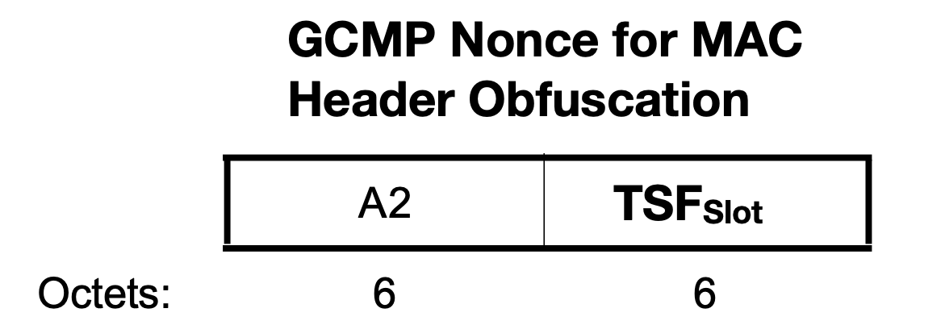
ANNEX: Offset Calculation
Offset value = GCMP256 (“802.11bi MAC Header Obfuscation. Protecting privacy of the STAs and APs” | POK | Nonce)
  CPE STA and CPE AP use Pairwise Obfuscation Key (POK) for the STA specific offset creation
  The Nonce consist of link specific:
    Transmitter OTA address (A2)
    TSF of the offset change time
  The encrypted plaintext is defined in 802.11bi specification and has value: “802.11bi MAC Header Obfuscation. Protecting privacy of the STAs and APs”

