Slide 1
Channel bonding rules in EN 301 893 & EN 303 687
Date: 2024-03-11
Authors:

Slide 2
Abstract
At present, IEEE 802.11 TGbn discusses how to improve the agility of medium access with or without using channel bonding. Among various ideas, some proposals discuss a mode of medium access that enables Stations (STAs) to continue a backoff procedure on non-primary channels in case the primary channel is detected as occupied.
In this document, we review the channel bonding schemes described in the European Harmonised Standards EN 301 893 (Wireless Access System/Radio Local Area Network, WAS/RLAN in the license-exempt 5 GHz band) [1] and EN 303 687 (WAS/RLAN in the license-exempt 6 GHz band) [2]. Furthermore, we compare these schemes with recent proposals to TGbn.

Slide 3
Harmonised Standards (HSs) & the European Union (EU)
Contribution IEEE 802.18-23/54 provides an overview to European spectrum regulation and how products may be placed on the market of the European Union (EU) resp. European Economic Area (EEA)
In a nutshell
Any product placed on the market of the EU must comply with all essential requirements
A manufacturer must sign a declaration of conformity (DoC)
A DoC may be granted by a notified body of by self-assessment
In case of self-assessment, a product must comply with all essential requirements of an HS listed in the Official Journal of the EU (OJEU)

Slide 4
Example: Harmonised Standard (HS) EN 301 893
“5 GHz WAS/RLAN; Harmonised Standard for access to radio spectrum”
Defines two modes of accessing the wireless medium
Frame Based Equipment (FBE)
Load Based Equipment (LBE)
The HS defines “channel” as a 20 MHz chunk of spectrum

Slide 5
Load Based Equipment (LBE)
A technology-neutral description of IEEE 802.11’s EDCA forms the basis of LBE
LBE may bond multiple channels according to two different options
“LBE being capable of simultaneous transmissions in adjacent or non-adjacent operating channels […] shall implement either of the following options: [see next page]”

Slide 6
Options 1 and 2
Option 1
Option 2
“LBE may use any combination/grouping of channels […] if it satisfies the channel access requirements (channel access mechanism) for an initiating device […] on each such operating channel.”
“[…] LBE that uses a combination/ grouping of adjacent channels […] may transmit on any of the operating channels, if:
the equipment satisfies the channel access requirements […] on one of the operating channels (primary operating channel) and
the equipment performs a Clear Channel Assessment (CCA) of at least 25 μs immediately before the intended transmissions on each of the other operating channels […]”

Slide 7
Option 2—In at nutshell
Option 2 describes the IEEE 802.11 channel bonding scheme using a full backoff on a primary channel and additional “PIFS-checks” on secondary channels

Slide 8
Option 2—Some details
“The choice of the primary operating channel shall follow one of the following procedures:”
“The primary operating channel is chosen uniformly randomly whenever the Contention Window (CW) corresponding to a completed transmission on the current primary operating channel is set to its minimum value […].”
“The primary operating channel is arbitrarily determined and not changed more than once per second.”
“The group of adjacent channels […] shall not be changed more than once per second.”

Slide 9
Option 1—In a nutshell
The slowest backoff determines the start of a bonded transmission
“[because the device must] satisf[y] the […] channel access mechanism […] on each […] operating channel.”

Slide 10
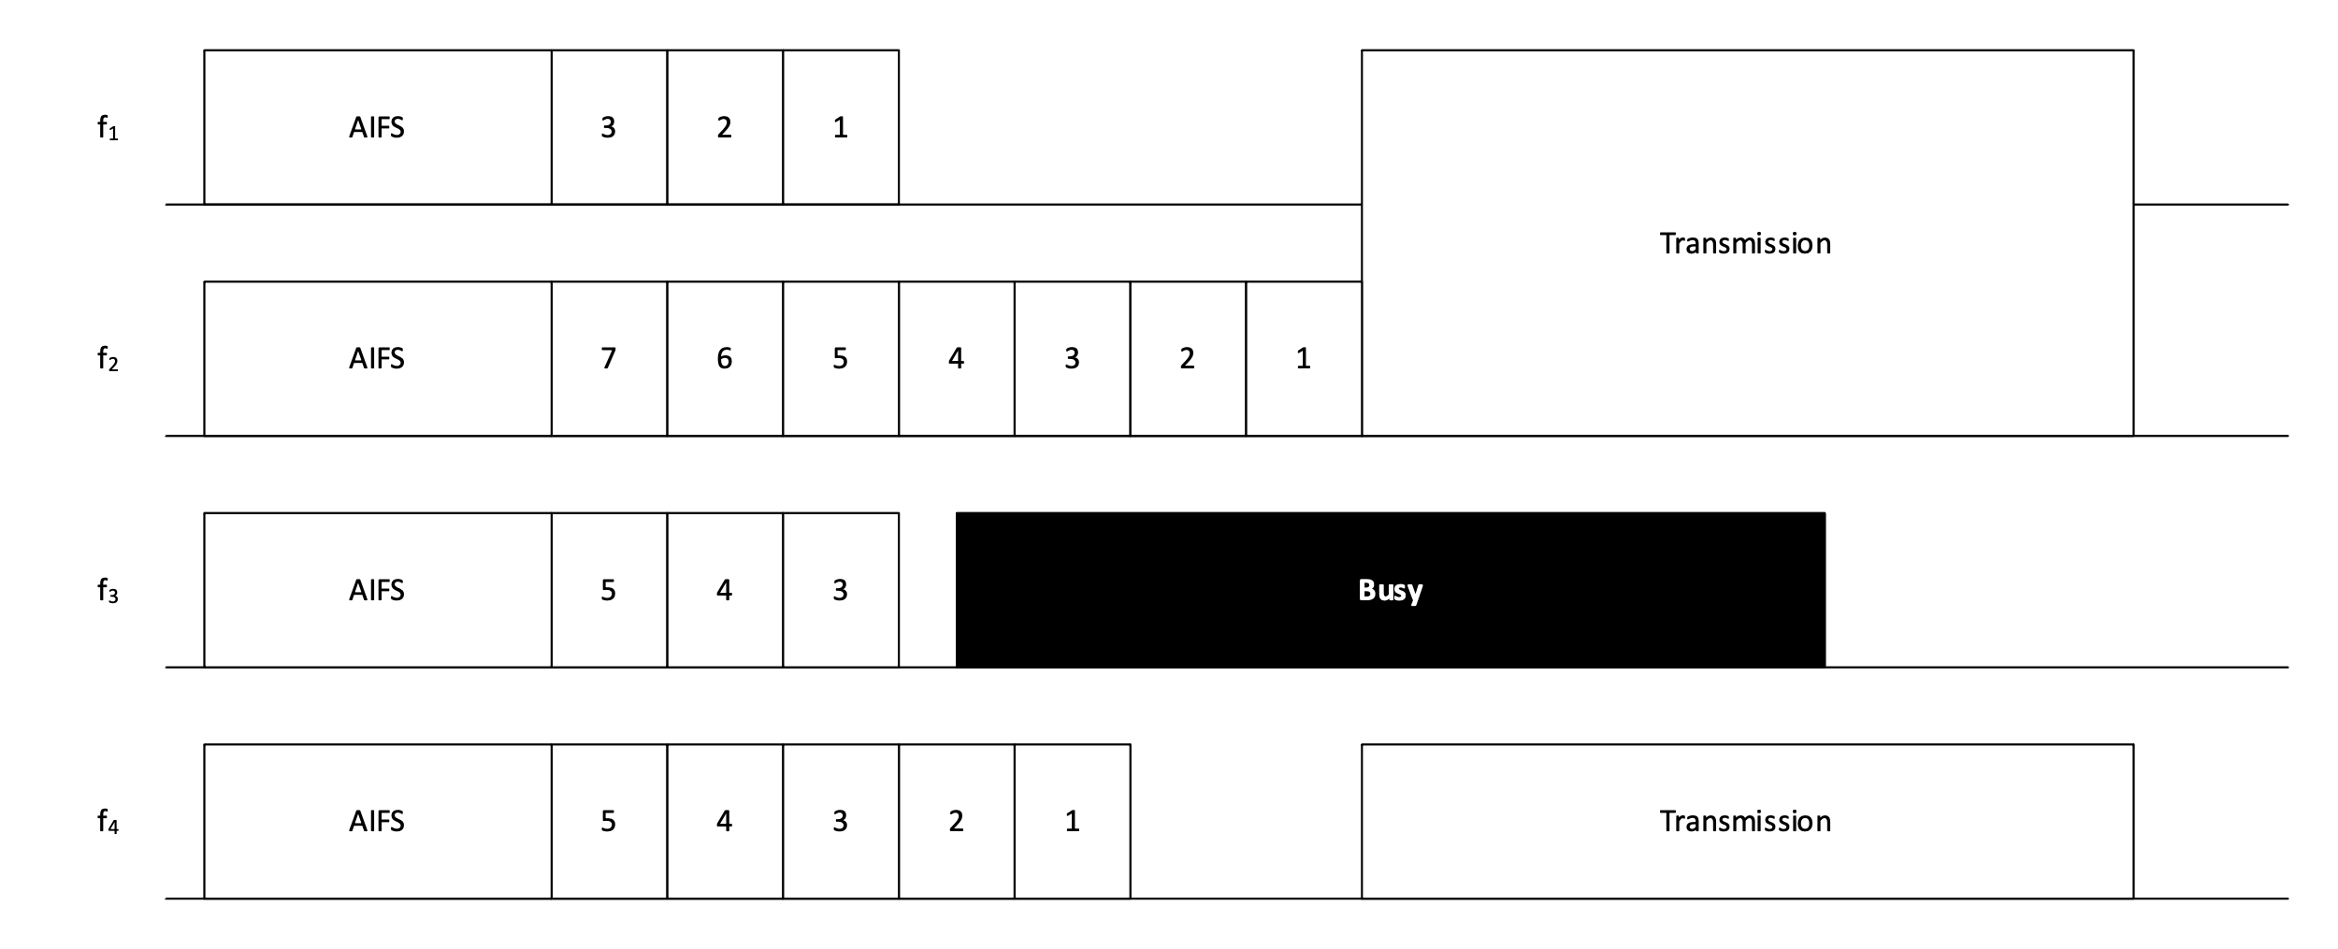
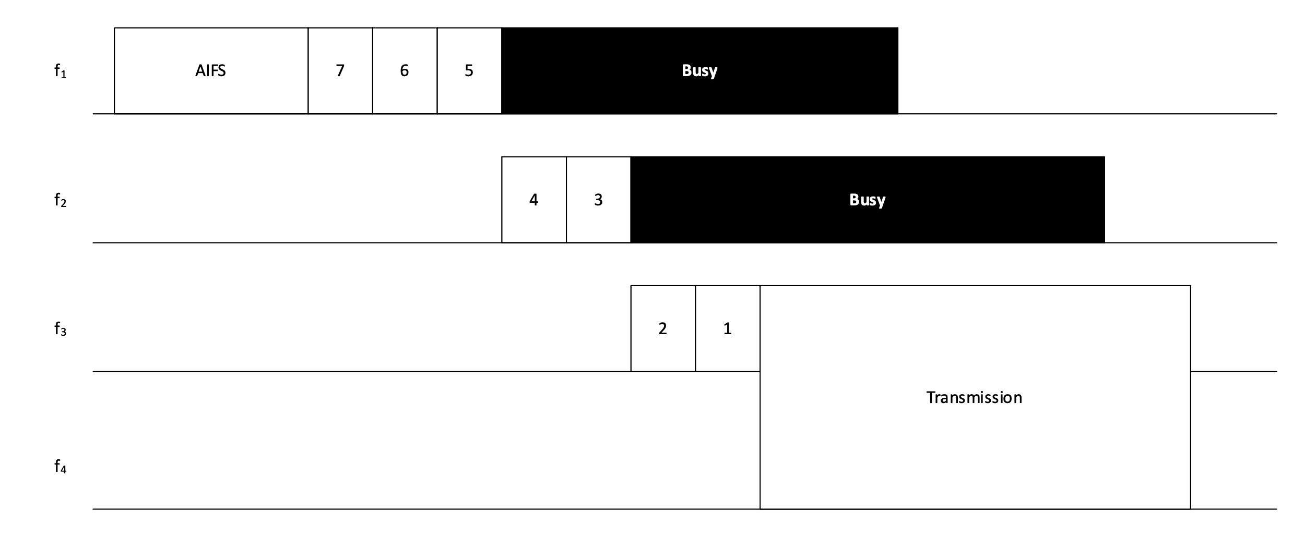
Option 1—Some details
Contiguous and non-contiguous bonding is permitted
The continuation of an interrupted backoff on a different channel is not permitted
✔️
✖️

Slide 11
Conclusion
The current versions of EN 301 893 and EN 303 687 require
… that a backoff be completed on the channel that the backoff was initiated on
… that the primary channel of a bonded transmission must not be arbitrarily changed
Compliance with these requirements is necessary to place products on the EU market
Diverging schemes might be approved by notified bodies
Changing these requirements requires consensus in ETSI’s development process

Slide 12
References
ETSI, “5 GHz WAS/RLAN; Harmonised Standard for access to radio spectrum,” draft Harmonised Standard EN 301 893, version 2.1.1, May 2017. [Online]. Available: https://www.etsi.org/deliver/etsi_en/301800_301899/301893/02.01.01_60/en_301893v020101p.pdf
ETSI, “6 GHz WAS/RLAN; Harmonised Standard for access to radio spectrum ,” Harmonised Standard EN 303 687, version 1.1.1, Jun. 2023. [Online]. Available: https://www.etsi.org/deliver/etsi_en/303600_303699/303687/01.01.01_60/en_303687v010101p.pdf

