Slide 1
TX Power Randomization
Date: 2024-05-06
Authors:

Slide 2
Abstract
Introduction to PHY Layer parameter randomization to increase CPE client privacy.

Slide 3
Background
- CPE clients otaMAC rotation is being adopted (whether individual, group or mass rotation)
- MAC Header parameters encryption is being discussed
- Layer 1 parameters are not being addressed so far

Slide 4
RSSI and otaMAC Rotation
- A simple capture on the air with a sniffer gives Radio Information for each frame. Among this information, there is an RSSI value at which the frame is received by the sniffing device.
- Rotating the otaMAC but maintaining the same Tx Power gives a non negligeable hint to an eavesdropper to connect the previous otaMAC to the next.
MAC1, -62 dBm
MAC1, -62 dBm
MAC2: -56 dBm, MAC3: -68 dBm,…
Most likely, MAC8=MAC1
Then, MAC1 stops:
MAC8, -62 dBm

Slide 5
RSSI Relates to Tx Power
- If the STA changes its TxPower, the STA’s frames RSSI change at the AP, and for all observers.
- TxPower changing is already allowed in 802.11ax (BSS coloring):
- AP uses different mechanisms to influence in-BSS and OBSS STAs Tx power
e.g. by informing OBSS PD thresholds, leading the STAs to transmit low enough over OBSS that it would not disrupt the OBSS operations
e.g. by informing OBSS STAs on the PSR (AP’s tolerance to OBSS transmissions over UL scheduled transmissions)

Slide 6
Tx Randomization Proposal
CPE STA rotates otaMAC and adjusts its Tx Power at the same time to increase its anonymity
Each 802.11 clause defines a Receiver Minimum Input Level Sensitivity per MCS and bandwidth
No operational impact if the Tx Power variation is within these limits (beamforming and MU-MIMO may require new sounding)

Slide 7
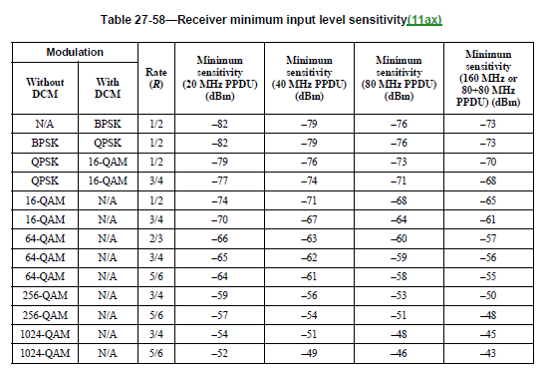
11ax Rx Minimum Input Level Sensitivity
Draft P802.11REVme_D4.2

Slide 8
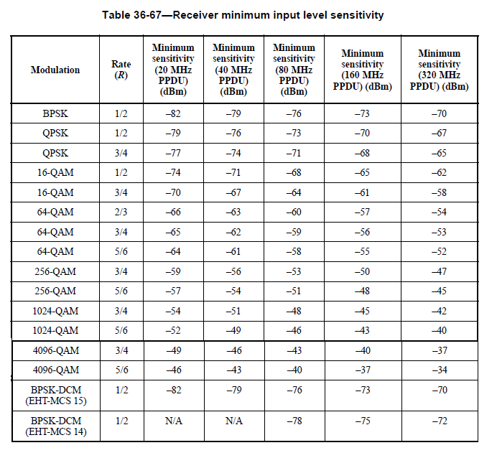
11be Rx Minimum Input Level Sensitivity
Draft P802.11be_D5.0

Slide 9
Operation AP – CPE STA
Option1 : STA driven
AP periodically informs STAs on its RSSI at the AP
STA monitors for RSSI changes
If no changes over 1-2 epochs, STA can decide to change its Tx Power within the allowed range for the MCS and bandwidth it is using
STA knows the allowed ranges not to impact rate (from tables)
AP knows a STA can variate its Tx Power at an epoch change and a new sounding may be required

Slide 10
Operation AP – CPE STA
Option2 : AP driven
AP monitors RSSI of each STA over a few epochs
If no RSSI variation (STA is stationary), the AP can suggest the STA to change its Tx Power at next (or starting from next) epoch between a given range calculated on the MCS and bandwidth
AP keeps into account the transmit power spectral density envelope, eventual beam-forming and MU-MIMO operations when calculating the range
AP knows when the change can occur, it can schedule new sounding if required

Slide 11
Straw Poll 1
Should 802.11bi consider a CPE STA-AP coordination mechanism for variating Tx Power at an epoch edge?
Yes
No
Abstain

Slide 12
Straw Poll 2
Do you prefer option 1 or option 2 as method for coordinating Tx Power variation at an epoch edge ?
Option 1 (STA driven)
Option 2 (AP driven)
Abstain

