Slide 1
Ascon: The Lightweight Cryptography As A New Cipher Choice for 802.11bn
Date: 2024-3-10
Authors:

Slide 2
About Ascon
NIST selects Ascon as the standard to protect small devices in 2023 after 4-year LWC (Light-Weight Cipher) competition (57 submissions, 3 rounds, 1 winner) [1].
Ascon provides authenticated encryption and hashing with minimal overhead.
Comparable security level as AES-128 and SHA-256 [1].
More efficient on low-end/low-power devices (Ascon-128 vs AES128-GCM) [1][2].
Up to 3-5x speed on microcontrollers
Up to 2x throughput with 0.5x energy in hardware (same throughput with smaller circuits)
A large number of detailed security performance and efficiency analysis listed in references of [1] and [2].
Notes:
https://unit42.paloaltonetworks.com/iot-threat-report-2020/

Slide 3
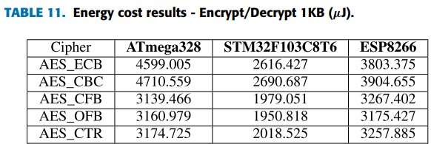
Impact on low-power IoT devices by numbers
AES-128 energy measurement: about 2.0-2.6 uJ per byte using software in the best case (see Table 11 in [3])
Capacity of lithium coin cell batteries thinner than 3mm (typically used in low-power devices): about 25-200 mAh at practical 2V [4].
If a low-power IoT device powered by a small coin cell with 25mAh energy needs to encrypt and decrypt 500 bytes per hour, these operations alone will consume the entire battery in less than one year.
Ascon can be implemented using software on MCU 3-5x less power hungry than AES128-GCM, thus can help reduce battery consumption for encryption/decryption operations significantly.
MCU1
MCU2
MCU3
Notes:
https://unit42.paloaltonetworks.com/iot-threat-report-2020/

Slide 4
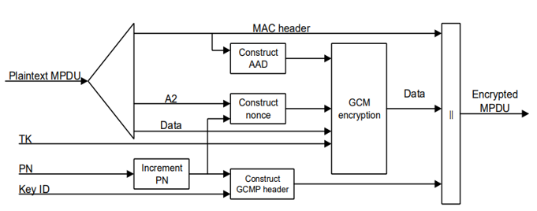
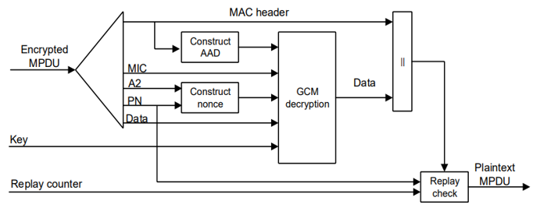
Ascon can be a drop-in replacement for AES128-GCMP in 802.11
 | AAD | Data | Nonce | Key | Tag/MIC
AES128-GCMP | 22-30 octets, 16-28 octets | Variable | 96 bits | 128 bits | 128 bits
Ascon | 0-unlimited | 0-unlimited | 128 bits (96bits+padding) | 128 bits | 128 bits
Ascon encyption
Transmitter
Ascon decyption
Receiver
Notes:
https://unit42.paloaltonetworks.com/iot-threat-report-2020/

Slide 5
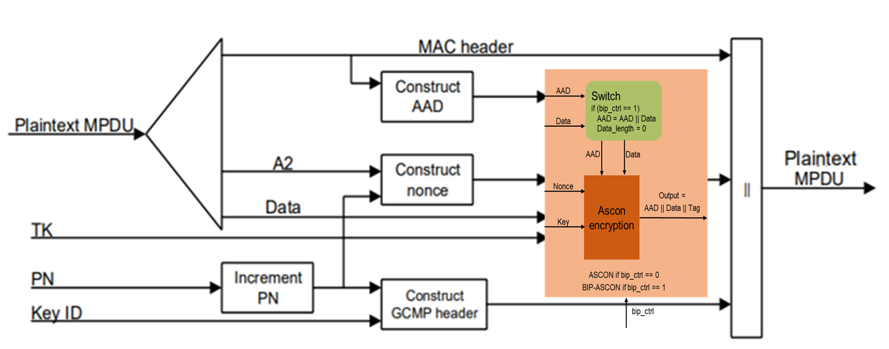
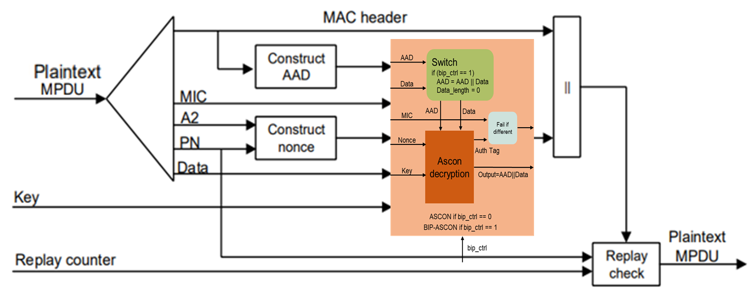
BIP-Ascon can be an alternative for BIP-GMAC128 in 802.11
The authentication-only Ascon (called BIP-Ascon) can be implemented by adding a wrapper with a control signal bip_ctrl.
Ascon encryption/decryption if bip_ctrl =0; BIP-Ascon authentication if bip_ctrl = 1.
When bip_ctrl = 1, at both the transmitter and the receiver, the wrapper circuit concatenates the AAD with the input data as the “expanded AAD”, sets the input data length as 0, and lets ASCON run through the “expanded AAD” (ASCON will output the “expanded AAD”, i.e., the AAD and the input data, without any change) and generate a 128-bit authentication tag for it.
Transmitter
Receiver
Notes:
https://unit42.paloaltonetworks.com/iot-threat-report-2020/

Slide 6
Proposal
Assign a cipher suite type number to ASCON-128 in the Cipher Suite Selector table.
Provide ASCON-128 as an optional cipher suite choice in all protocol messages where AES128-GCMP is presented for the purpose of cipher suite indication and negotiation.
Assign another cipher suite type number to BIP-ASCON-128 in the Cipher Suite Selector table.
Provide BIP-ASCON-128 as an optional cipher suite choice in all protocol messages where BIP-GMAC-128 is presented for the purpose of cipher suite indication and negotiation.
Notes:
https://unit42.paloaltonetworks.com/iot-threat-report-2020/

Slide 7
Straw polls
Do you support making ASCON-128 as an optional cipher suite choice in all protocol messages where AES128-GCMP is presented for the purpose of cipher suite indication and negotiation?
Do you support making BIP-ASCON-128 as an optional cipher suite choice in all protocol messages where BIP-GMAC-128 is presented for the purpose of cipher suite indication and negotiation?
Notes:
https://unit42.paloaltonetworks.com/iot-threat-report-2020/

Slide 8
References
Meltem Sonmez Turan, Kerry McKay, Donghoon Chang, Lawrence E. Bassham, Jinkeon Kang, Noah D. Waller, John M. Kelsey, Deukjo Hong, “NIST Internal Report 8454: Status Report on the Final Round of the NIST Lightweight Cryptography Standardization Process”, June 2023, https://nvlpubs.nist.gov/nistpubs/ir/2023/NIST.IR.8454.pdf.
Christoph Dobraunig, Maria Eichlseder, Florian Mendel, Martin Schlaeffer, “ASCON v1.2 Submission to NIST”, May 31, 2021.
Luke E. Kane, Jiaming James Chen, Rebecca Thomas, Vicky Liu, Matthew McKague, “Security and Performance in IoT: A Balancing Act”, IEEE Access, vol. 8, pp. 121969-121986, July 6, 2020.
List of battery sizes, https://en.wikipedia.org/wiki/List_of_battery_sizes
Notes:
https://unit42.paloaltonetworks.com/iot-threat-report-2020/

