Slide 1
Multi-user Triggered TXOP Sharing
Date: 2024-03-10
Authors:

Slide 2
Abstract
In 11be, triggered TXOP sharing (triggered TXS) method was adopted[1].
With triggered TXS method, an AP can share its portion of TXOP to a non-AP STA for scheduled and P2P communications.
However, with the current triggered TXS, the AP cannot share its TXOP to multiple non-AP STAs.
In this submission, multi-user triggered TXS scheme is discussed.

Slide 3
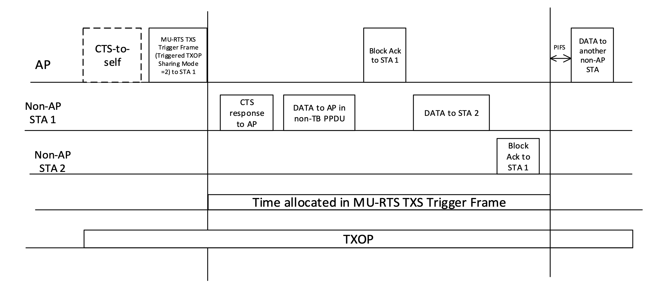
Issue
With triggered TXS, an AP can share its TXOP to non-AP STA
In the current triggered TXS, the AP cannot share TXOP to multiple non-AP STAs.
In 11bn PAR[2], needs for enhancing P2P communications exists.
“Use of WLAN P2P communications is increasing in a wide range of deployment scenarios, which are competing with infrastructure WLAN usage for the same medium resources. This requires better coordination between neighboring APs and between P2P networks.”
Example of triggered TXS Mode 2 [1]:
single-user

Slide 4
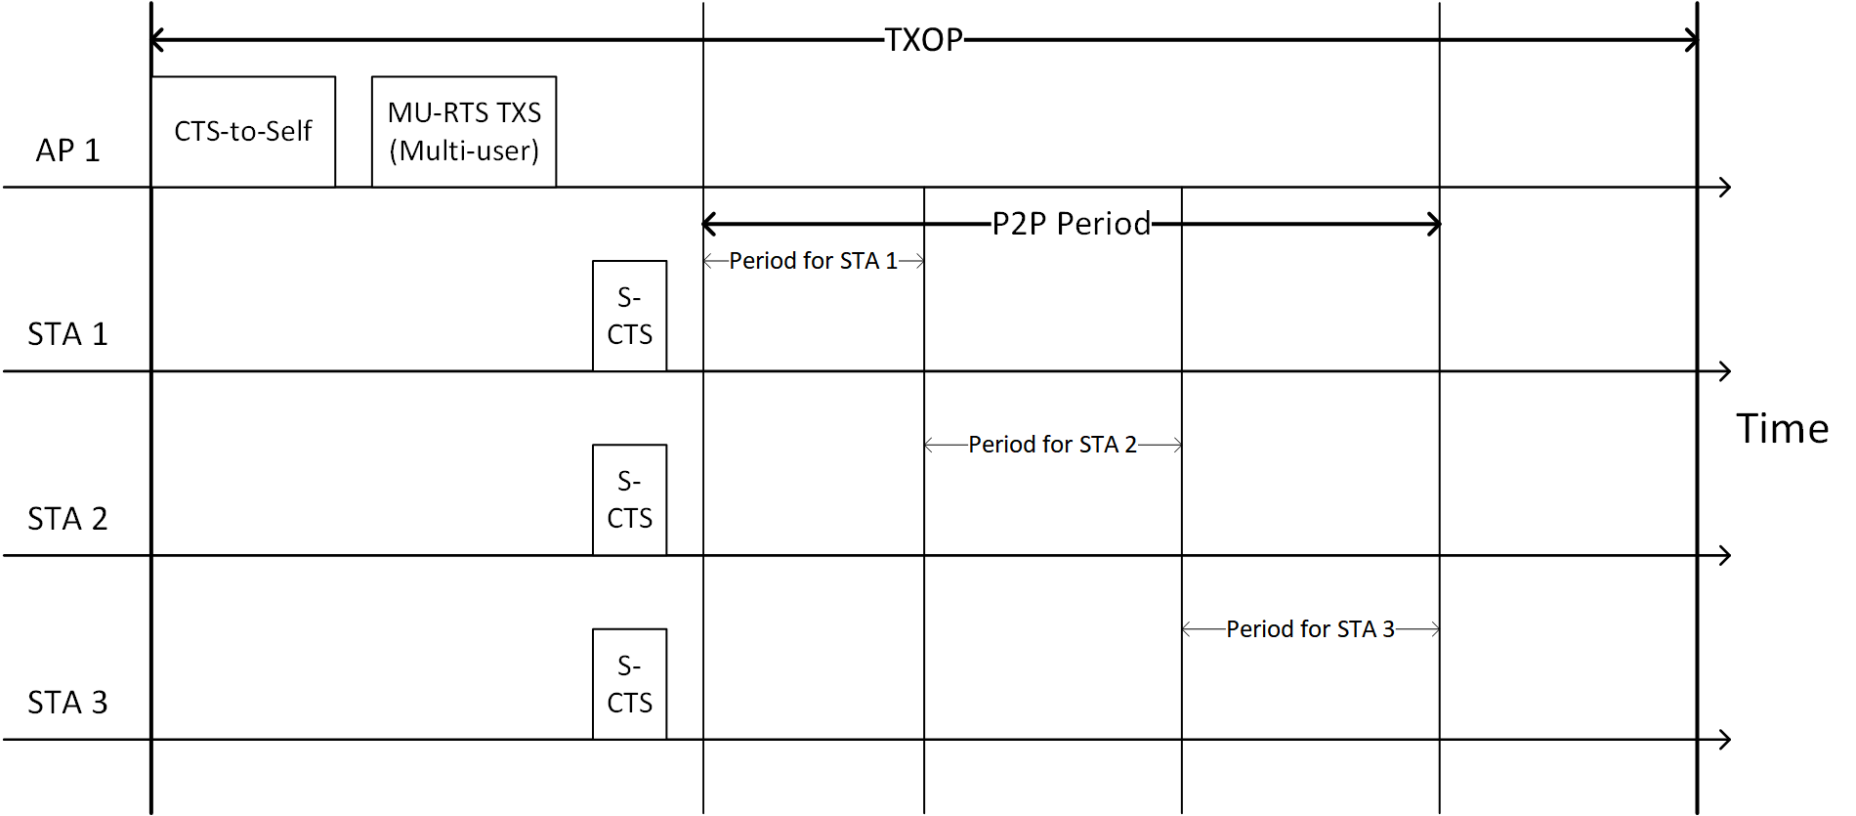
1. Multi-user Triggered TXS
MU-RTS TXS frame indicates multiple non-AP STAs
MU-RTS TXS frame can indicate each STAs’ time periods for communication. (e.g., time duration for each STAs)
Indicated STAs can use medium within the time periods.

Slide 5
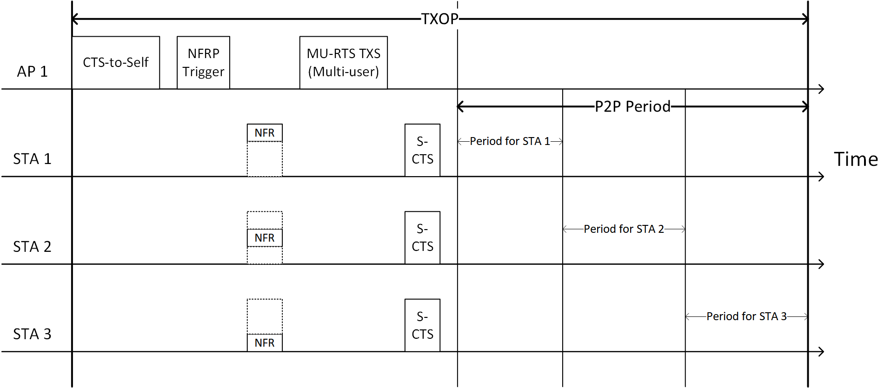
1-(1). Multi-user Triggered TXS with NFRP
An AP may not now that which non-AP STAs want to join triggered TXS
The AP can use NFRP trigger frame to obtain STAs’ information.
The AP can poll each STAs (like PCF)

Slide 6
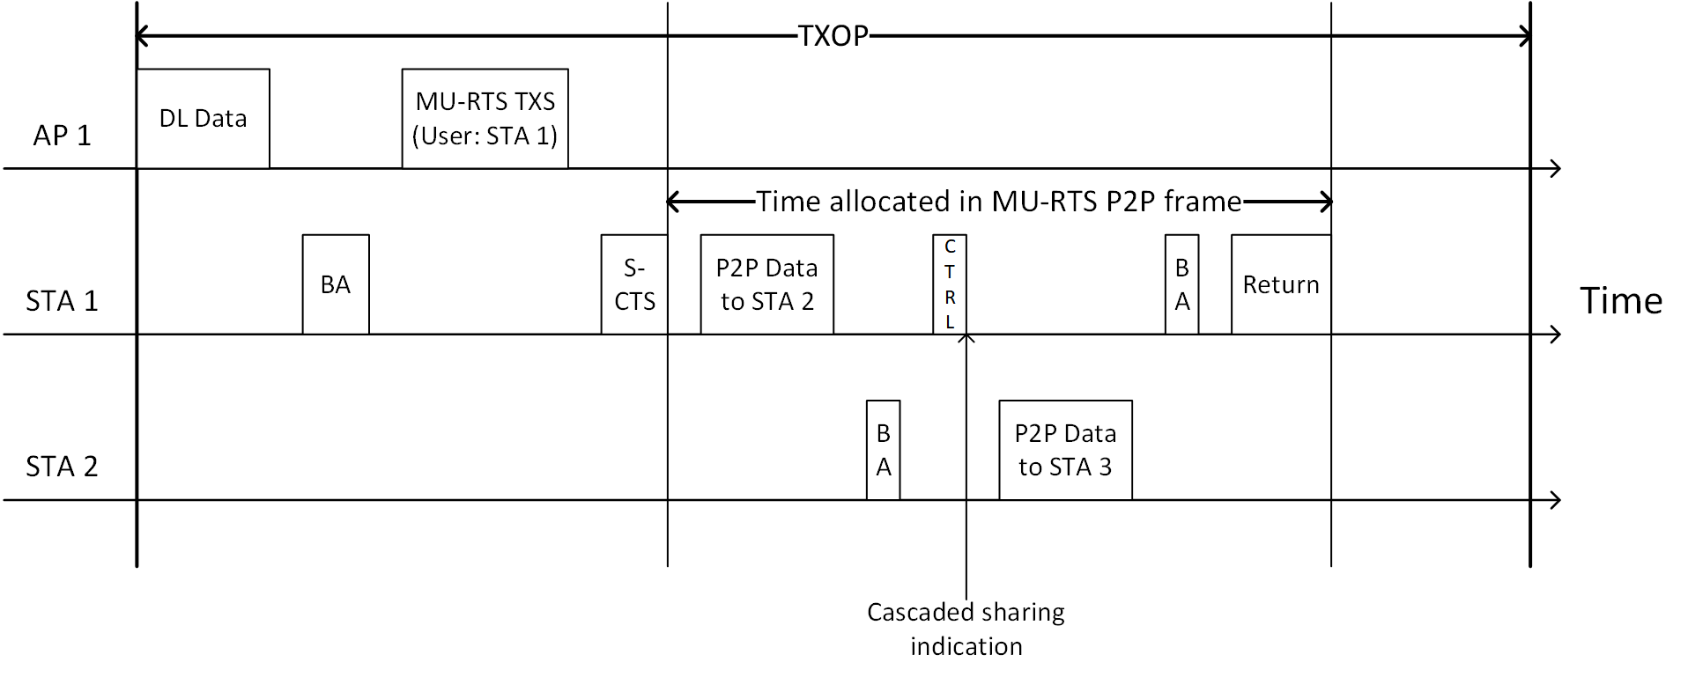
2. Cascaded TXS method
An AP can share its portion of TXOP to single non-AP STA
Same with current 11be’s operation.
The shared STA (STA 1) can share its time period to another non-AP STA (STA 2).

Slide 7
Summary
The methods for multi-user triggered TXS were proposed.
First method is allowing MU-RTS TXS frame to indicate multiple non-AP STAs
Second method is allowing shared non-AP STA to re-share its time period to another non-AP STA.
With proposing method, triggered TXS method can be enhanced.
Especially, the proposed method can be useful for frequent Peer-to-Peer communication environments in 11bn.

Slide 8
References
[1] IEEE 802.11be D5.0
[2] IEEE P802.11bn PAR: https://mentor.ieee.org/802.11/dcn/23/11-23-0480-01-0uhr-uhr-proposed-par.pdf

