Slide 1
MAP co-EDCA to improve the performance of edging STA

Slide 2
Background
Based on current 11bn PAR [1], the scope is to enhance the ultra high reliability of Wireless LAN Area Network (WLAN), where the use cases are defined for both an isolated Basic Service Set (BSS) and overlapping BSSs.
KPI: increasing the throughout by 25%,reducing latency and reducing packet losses lower by 25%.
One of direction is to improve the collision issue caused by the current EDCA channel access procedure.
In this contribution, we will analyse the collision issue in OBSS scenario and provide a possible solution to improve the reliability.

Slide 3
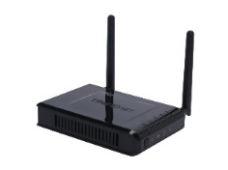
The problem of current EDCA mechanism
Performance degradation caused by OBSS interference
Precondition1: Each device in BSS and OBSS compete the TXOP independently, and the APs in the BSS and OBSS may can’t hear each other(hidden node)
Precondition2: Some STAs may be in the overlapping area (Edging STA,like STA2).
Problem: The collision issue (including RTS/CTS collision) extremely high on the Edging STA.
AP1
AP2
STA2
STA1
STA3

Slide 4
Simulation setting on the collision issue
Three Nodes(AP1,AP2, and edging STA) following conventional EDCA rule always have packets to transmit
Each node transmits a PPDU with the TXOP equal to 900us( about 100 slots) when it gains the channel access.
Total simulation time equals to 90s( about 10⁷ slots)
Focus on the output of the whole system
frame_count refers to total frames transmitted in the system
success_rate = (transmitted_frame - collided_frame)/transmitted_frame
RTS/CTS protection is not considered to avoid interference from shorter PPDU
Other interference is out of the system
Transmission failure is only caused by collision.

Slide 5
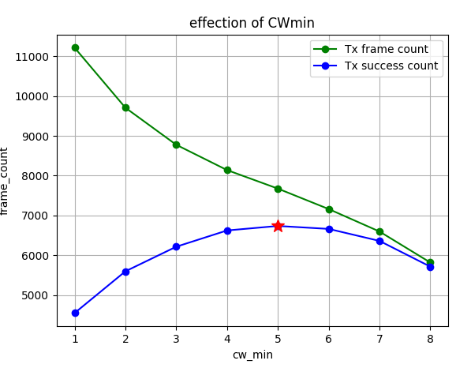
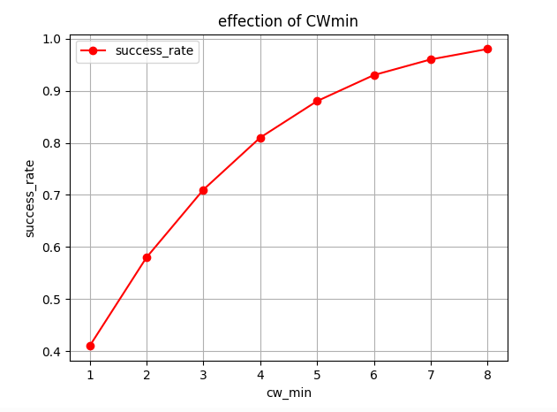
Simulation on the change of CWmin

Slide 6
Optimization
Main idea: Define a negotiated EDCA parameters approach to allow APs set EDCA parameter dynamically based on edging STA’s feedback.
Opt1:
Based on certain collision threshold,the edging STA may report the collision issue to the associated AP, and the AP decide the new EDCA parameter by themselves.
Note: STA may sense the collision issue based on STA statistic results or other solution.
Opt2:
Allowing Edging STA to provide some recommended EDCA parameter to the associated AP, and the AP make the final decision.
Opt3:
Allowing both AP and STA to start new EDCA parameter negotiation procedure to reduce the collision probability.
Further, the STA may provide some EDCA parameter signaling to the OBSS AP under MAP co-ordination scheme.

Slide 7
The following figure depicts the frame exchange on Opt3.
AP1
STA
AP2(OBSS)
EDCA negotiation request
EDCA negotiation response
EDCA parameter OBSS signaling

Slide 8
Summary
Analyze the collision of conventional EDCA mechanism.
Set a larger CWmin can improve the collision issue in OBSS case in the simulation.
Propose three options of “ EDCA parameter negotiation” to reduce collision issue caused by the OBSS interference for edging STA.

Slide 9
THANK YOU ☺

Slide 10
Reference
[1]802.11bn PAR

Slide 11
SP1
Do you agree 11bn should define a MAP co-EDCA parameters negotiation mechanism to mitigate the collision issue?
Note: the procedure may be used in both infrastructure network and MAP coordination network

