Slide 1
Improving performance of LBT-enabled NB devices
Date: 2024-03-12
Authors:

Slide 2
Abstract
This submission explores the potential for performance improvement for narrowband signals, such as Bluetooth, when using Listen-Before-Talk (LBT) as the channel access mechanism.

Slide 3
Introduction
Bluetooth is planning to enable operation in the 5 and 6GHz bands. [1]
Listen-Before-Talk (LBT) has been suggested as a channel access mechanism for Bluetooth in these bands. [2][3]
Wi-Fi channelization is typically well-defined within these spectrum bands.
This established channelization offers Bluetooth devices a unique opportunity to improve their performance while using LBT.

Slide 4

Channelization
Uses both UNII-2c and UNII-3
Uses both UNII-3 and UNII-4
Wi-Fi channels completely within UNII-3
CH 149 to CH 165
CH 144
CH 169
1 2 3 4 5 6 7 8 9 10
45 46 47 48 49 50 51 52 53 54 55 56 57 58 59 60 61 62
UNII-3, 5725-5850 MHz
2MHz

Slide 5
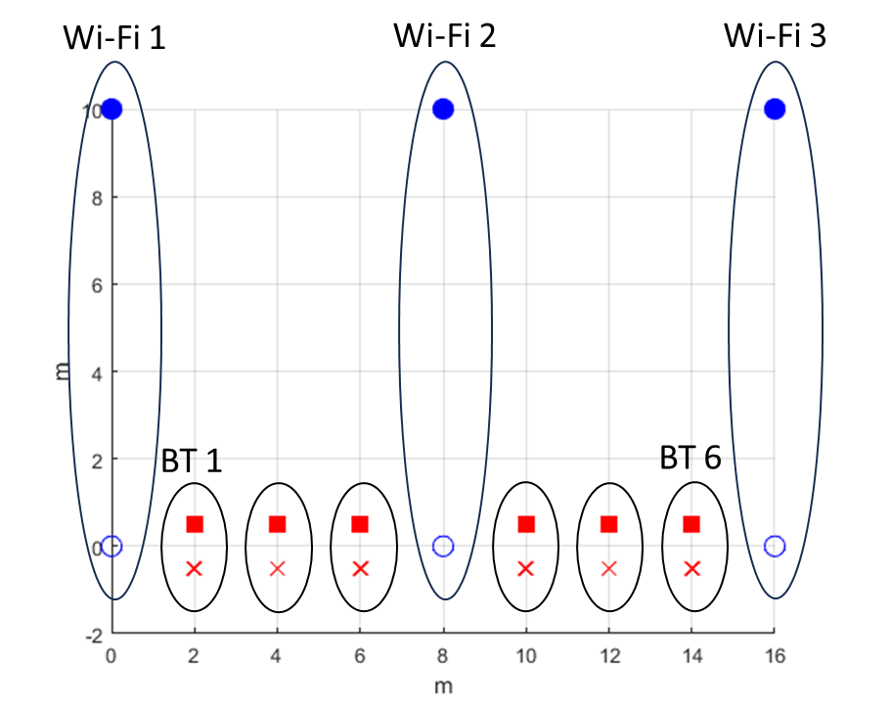
Simulation parameters
Bluetooth:
LE 2M PHY
Gaming audio: 2 earbuds
  1 earbud contains mic
  1 earbud has inertial measurement unit (IMU) sensor
Tx power: 14 dBm
ISO interval = 7.5ms
Max latency = 15ms (2×ISO)
Number of subevents, NSE = 2
1 main TX + 3 retry opportunities
  Total 4 attempts
  If packet is not transmitted in 4 attempts, packet is flushed, and it results in a glitch
Number of channels = 62
  Total hopping BW = 124MHz
Bi-directional traffic
Wi-Fi:
Tx power: 20 dBm at AP/STA
Single stream
One directional traffic
Traffic load: 60%
TXOP duration ≈ 5ms
Bandwidth = 80MHz
RTS →CTS →A-MPDU →BA
Transmission starts at time=3s
*Wi-Fi traffic load = 60% all further slides
20 MHz
80 MHz
Wi-Fi3
Wi-Fi2
Wi-Fi1
Channel model:
AWGN channel with a breakpoint at 5 m
pathloss = 40.05 + 20log10(f/2.4) + 20log10(min(d, b)) + (d > b) * (35log10(d/b))
where d = distance, b = breakpoint = 5 m
5735
5815
5835
5726
5850
Bluetooth BW = 124 MHz

Slide 6
Channelization
Uses both UNII-2c and UNII-3
Uses both UNII-3 and UNII-4
Wi-Fi 2
Wi-Fi 1 and Wi-Fi 3
CH 144
CH 155, 80MHz
CH 165, 20MHz
CH 169
1 2 3 4 5 6 7 8 9 10
45 46 47 48 49 50 51 52 53 54 55 56 57 58 59 60 61 62
UNII-3, 5725-5850 MHz
2MHz

Slide 7
Bluetooth LE transmission with LBT
CCA
360µs
360µs
360µs
360µs
Central
P-1
172µs
172µs
P-2
360µs
360µs
f1
f2
Retrying transmission
f3
f4
Idle period
3.946ms
Connection interval = 7.5ms
NSE = 2, Number of subevents in a connection interval
FT = 2, Flush timeout: Number of connection interval after which packet is discarded
Total 4 attempts to send the packet

Slide 8
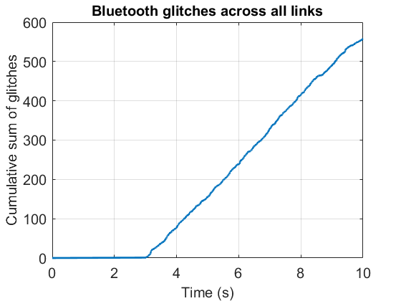
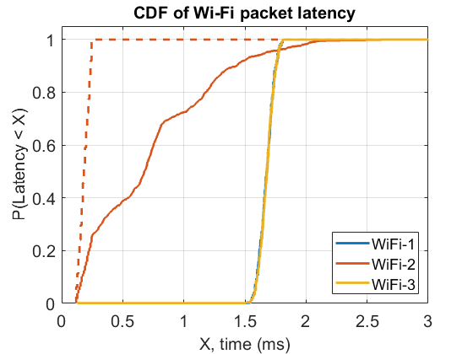
LBT with uniform frequency hopping
Baseline performance for Wi-Fi 2 without any interference
Wi-Fi transmissions start at 3s mark
Significant number of glitches observed in Bluetooth audio due to transmission deferral to Wi-Fi.
Impact of Bluetooth interference
Latency for Wi-Fi 2 increases.
No significant impact on Wi-Fi 1 and Wi-Fi 3. The latency seen in the figure is due to mutual deferral.

Slide 9
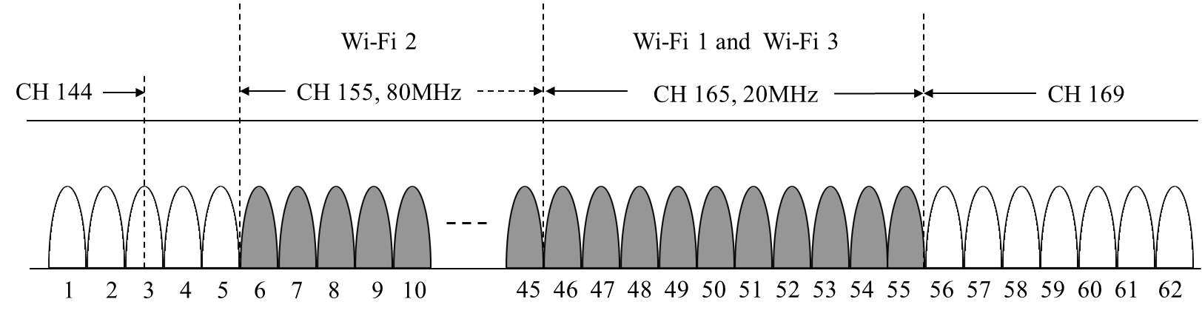
Prioritization of non-overlapping channel
In the final attempt to send the packet, the device hops to one of the non-overlapping channels (i.e., channels 1-5 and 56-62).
Why not prioritize these channels from the first attempt? –
  These channels become congested very quickly by the BT devices. Not scalable.
  Keeps the opportunity open for the overlapped channels to be used.

Slide 10
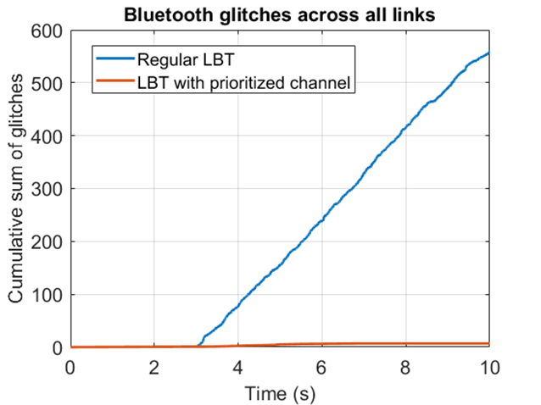
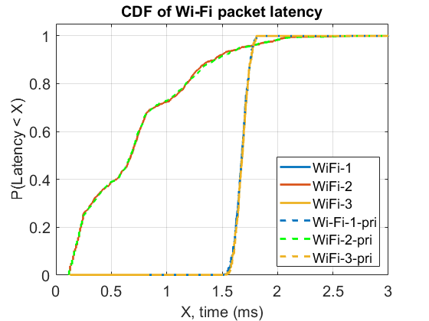
LBT with channel prioritization
Wi-Fi latency results remain almost same with and without channel prioritization.
Suffix “-pri” indicates use of prioritized channel by Bluetooth.
Bluetooth glitches can be significantly reduced with minimal impact on Wi-Fi latency compared to regular LBT.

Slide 11
UNII-5 in FCC
In the FCC regulatory domain, the 5925 MHz to 5945 MHz spectrum, which is not utilized by Wi-Fi in the UNII-5, could potentially be available for Bluetooth use.
By applying the insights gained from our simulations, it could be beneficial to implement a similar channel prioritization strategy in the UNII-5 band as well.

Slide 12
Summary
By giving priority to any non-overlapping channels that may be available in the UNII-3 band (or UNII-5 in FCC) during the final attempts of a Bluetooth packet transmission, the number of glitches can be significantly minimized without causing any significant impact on Wi-Fi latency compared to regular LBT.

Slide 13
References
https://www.bluetooth.com/specifications/specifications-in-development/
11-24-0007-00-coex-proposal-for-bluetooth-and-wi-fi-coexistence-in-5-and-6ghz
11-24-0122-00-coex-bluetooth-isochronous-audio-with-lbt

Slide 14
Backup

Slide 15
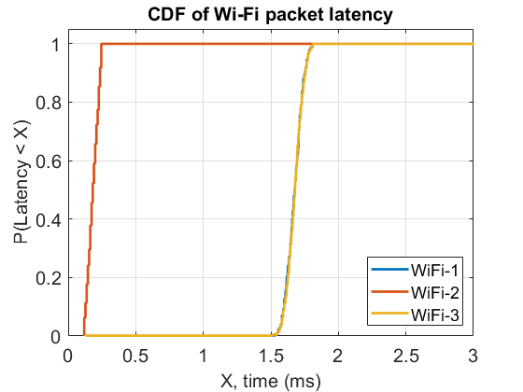
Baseline Wi-Fi performance

