Slide 1
Discussion on DRU
Date: 2024-03-10
Authors:

Slide 2
Abstract
In this contribution, we discuss several topics addressing some practical aspects of defining DRU [1]-[13], this includes:
  Notation of DRU
  Small DRUs and large DRUs
  Combining smaller DRUs to form larger DRUs

Slide 3
Notation of DRU
To facilitate the discussions on different combinations of DRUs (DRU sizes and distribution bandwidths), it is imperative to suggest a notation for DRUs
Examples:
  52DRU20
  26DRU40
  996DRU320
26DRU20
DRU Size
Distribution Bandwidth

Slide 4
Small DRUs and Large DRUs
Following the current classification of RRUs into small RRUs and large RRUs, a similar approach may be recommended for DRUs to limit the possibilities to a manageable set
Small DRUs include
  DRU sizes 26-tone, 52-tone, and 106-tone
  Distribution bandwidths 20 MHz, 40 MHz, 80 MHz
  Examples: 26DRU20, 52DRU80, 106DRU40, and 26DRU40
Large DRUs include
  DRU sizes 242-tone, 484-tone, and 996-tone
  Distribution bandwidths 80 MHz, 160 MHz, 320 MHz
  Examples: 242DRU80, 484DRU160, 996DRU320, 242DRU160

Slide 5
Maximum Power Boosting Factor for Small/Large DRUs
Small DRUs
Large DRUs
DRU | Maximum Power Boost Factor
26DRU20 | 8.13 dB
26DRU40 | 11.14 dB
26DRU80 | 11.14 dB
52DRU20 | 6.37 dB
52DRU40 | 8.13 dB
52DRU80 | 11.14 dB
106DRU20 | 3.36 dB
106DRU40 | 6.37 dB
106DRU80 | 8.13 dB
DRU | Maximum Power Boost Factor
242DRU80 | 5.12 dB
242DRU160 | 8.13 dB
242DRU320 | 11.14 dB
484DRU80 | 2.69 dB
484DRU160 | 5.12 dB
484DRU320 | 8.13 dB
996DRU160 | 2.69 dB
996DRU320 | 5.12 dB

Slide 6
Combining smaller DRUs to form larger DRUs
There are many ways in which smaller DRUs may be combined to form larger DRUs:
  Method 1: Combine smaller DRUs to form larger DRUs in the same distribution bandwidth
    The smaller DRUs are in the same subchannel
    Example 1: Combine Four 26DRU20 to form One 106DRU20
    Example 2: Combine Two 242DRU160 to form One 484DRU160
  Method 2: Combine smaller DRUs of the same distribution bandwidth to form larger DRUs in a larger distribution bandwidth
    The smaller DRUs are in different subchannels
    Example 1: Combine Four 26DRU20 to form One 106DRU80
    Example 2: Combine Two 242DRU80 to form One 484DRU160
NOTE- Method 2 suggests another way to combine DRUs with the pilots evenly distributed across the distribution bandwidth

Slide 7
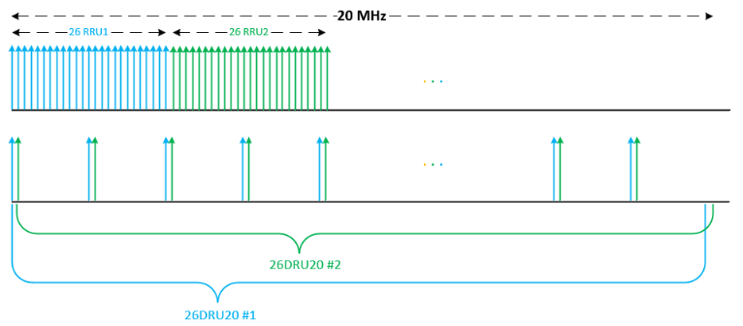
Combining DRUs – Method 1
Combining two 26DRU20 in the same subchannel

Slide 8
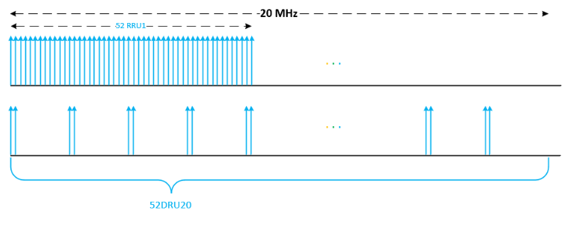
Combining DRUs – Method 1
The combined DRU is 52DRU20 in the same subchannel

Slide 9
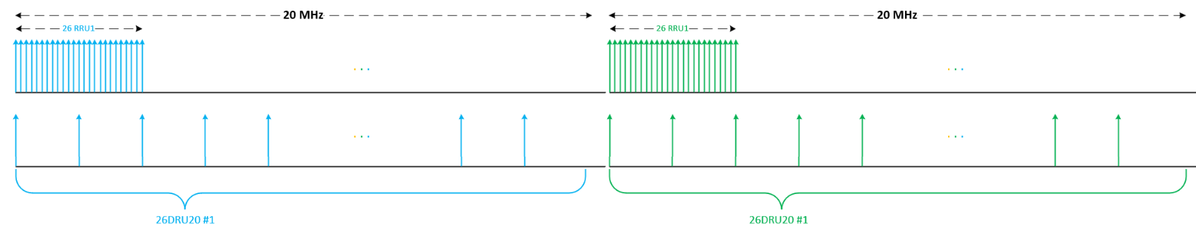
Combining DRUs – Method 2
Combining two 26DRU20 each is in a different subchannels (consecutive subchannels)

Slide 10
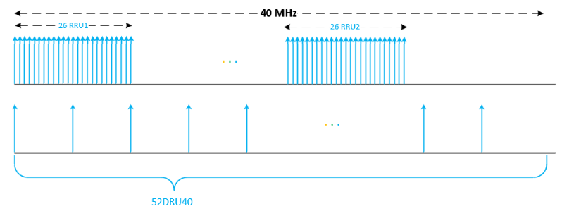
Combining DRUs – Method 2
The combined DRU is 52DRU40

Slide 11
Conclusion
A useful notation is proposed to make it easy to refer to different combinations of DRUs
Also, a categorization of DRUs to small DRUs and large DRUs and different methods to combine smaller DRUs to form larger DRUs are proposed.

Slide 12
SP 1
Do you agree to use the notation sDRUb to refer to a DRU of size s and a distribution bandwidth b
Yes
No
Abs

Slide 13
SP 2
Do you agree to classify DRUs as small DRUs and large DRUs
  Sizes and distribution bandwidths of small DRUs are TBD
  Sizes and distribution bandwidths of large DRUs are TBD
Yes
No
Abs

Slide 14
SP 3
Do you agree to use Method 2 in slide 6 as another way of combining smaller DRUs to form larger DRUs.
Yes
No
Abs

Slide 15
References
[1] 11-23/0037r0, UHR Feature to Overcome PSD Limitations Distributed-Tone Resource Units
[2] 11-23/1115r0, CFO Impact and Pilot Design for dRU
[3] 11-23/1117r0, dRU Signaling for UHR
[4] 11-23/1447r0, CFO Impact and Pilot Design for dRU Follow up
[5] 11-23/1448r0, Further Considerations on dRU
[6] 11-23/1511r1, Pilot Tone Allocation and Other Considerations of Tone-Distributed RUs for UHR
[7] 11-23/1516r0, Use case for distributed RUs in Downlink
[8] 11-23/1919r1, dRU Proposal
[9] 11-23/1988r2, Considerations on DRU Design and Application
[10]11-23/2021r1, Principle and Methodology for dRU Tone Plan Design
[11] 11-23/2031r2, Data Tones Grouping in Tone-Distributed RU
[12] 11-24/0014r0, Further Thoughts on dRU
[13] 11-24/0078r1, A dRU Design Approach for 20 MHz

