Slide 1
Ping Pong Warning for Reliable Connections
Mar 2024
Authors:
Name | Affiliation | Phone | email
Jerome Henry | Cisco Systems |  | jerhenry@cisco.com
Javier Contreras | Cisco Systems
Brian Hart | Cisco Systems
Binita Gupta | Cisco Systems

Slide 2


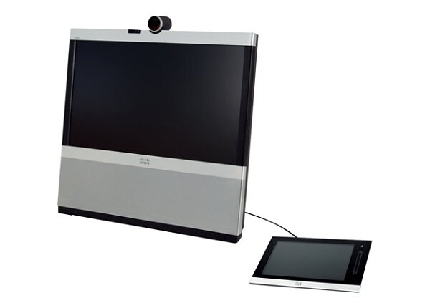

Ping Pong Roaming Still plagues 802.11
The most common scenario is a static STA bouncing between 2 or 3 APs
  For some reason, one AP’s signal falls slightly below the STA scanning/roaming threshold, STA roams to another AP (of weak signal), then main AP (re)becomes better, etc.

Slide 3
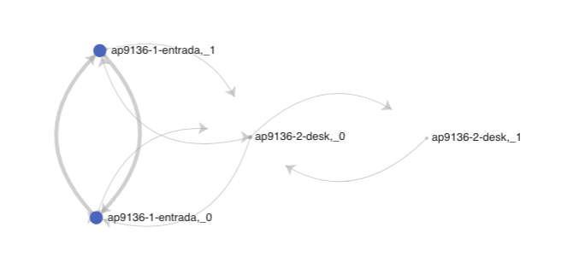
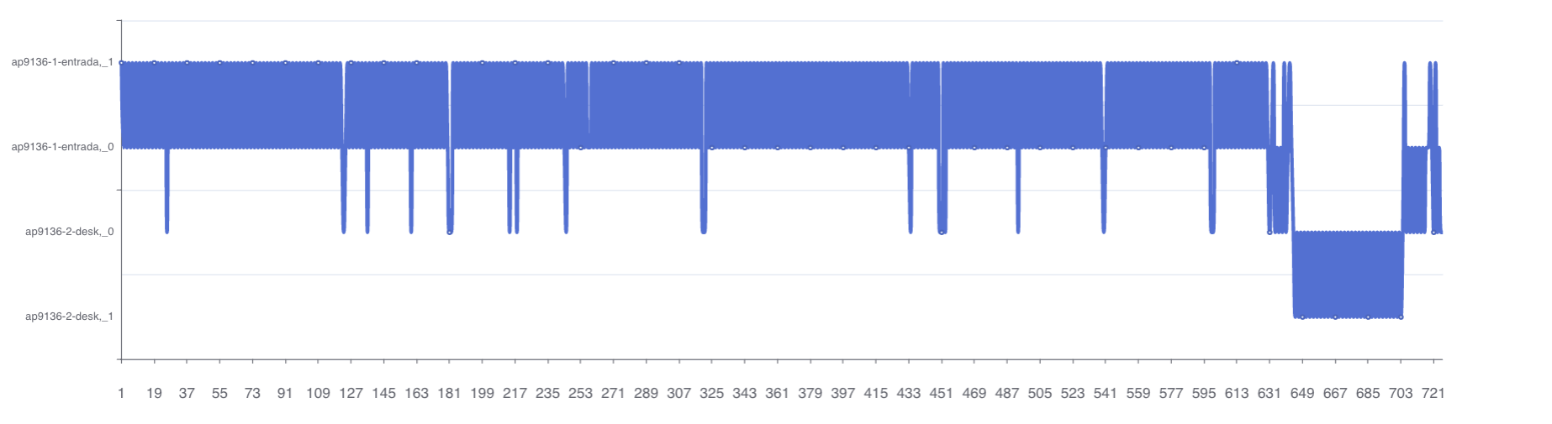
Ping Pong Causes Unreliable 802.11 Experience
The STA needs to scan, find another AP (possibly not great, but better than current), reassociate, resume traffic
  When this happens in a loop, data flow keeps being interrupted, airtime and energy (battery) wasted
  Each time, the decision may be best-at-the-time-the-decision-is-made, but disruptive in the long run

Slide 4
Where an Ultra High reliable Network Can Help
802.11bn APs can observe the Ping Pong roams and warn the STA
  Mere historical record or more advanced techniques (AIML)
802.11bn AP can then send a BTM Stats frame
  Stats: 20 Successful Roaming events in the last 1800 seconds
  Recommend to dampen roaming trigger for the next 20 minutes, or RSSI change of 20 dBm or more
AP1
AP2
assoc
reassoc
reassoc
reassoc
“BTM Stats”
Success Count | Fail Count | Measurement Interval | Recommendation | Optional Candidate List
BTM Stats
e.g. delay next transition, or look for signal change of 10 dB

Slide 5
Summary
802.11bn should define a new BSS Transition Management Stats frame, either sent by the AP as unsolicited or as response to Query
The STA, recoding the ping ping, could also send an augmented BTM frame to the AP (requesting ping pong avoidance recommendations)
AP to propose next transition delay, or to apply RSSI hysteresis value
No rejection or disassociation enforcement
AP can propose to the STA a list of optional nearby AP candidates that the STA can evaluate for roaming

Slide 6
Strawpoll
Do you agree to add the following text to the 11bn SFD:
  11bn shall define a mechanism to limit ping pong roaming:
  Y / N / A

Slide 7
Strawpoll
Do you agree to add the following text to the 11bn SFD:
  11bn shall define a mechanism to exchange reliability metrics between the AP and the STA
  Y / N / A

