Slide 1
Ping Pong Warning for Reliable Connections
Mar 2024
Authors:
Name | Affiliation | Phone | email
Jerome Henry | Cisco Systems |  | jerhenry@cisco.com
Javier Contreras | Cisco Systems
Brian Hart | Cisco Systems
Binita Gupta | Cisco Systems

Slide 2
Ping Pong Roaming Still plagues 802.11
The most common scenario is a static STA bouncing between 2 or 3 APs
For some reason, one AP’s signal falls slightly below the STA scanning/roaming threshold, STA roams to another AP (of weak signal), then main AP (re)becomes better, etc.

Slide 3
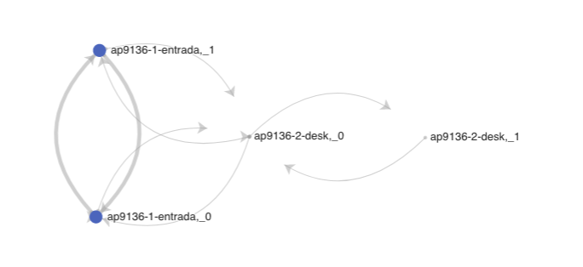
Ping Pong Causes Unreliable 802.11 Experience
The STA needs to scan, find another AP (possibly not great, but better than current), reassociate, resume traffic
When this happens in a loop, data flow keeps being interrupted, airtime and energy (battery) wasted
Each time, the decision may be best-at-the-time-the-decision-is-made, but disruptive in the long run

Slide 4
Strawpoll
Do you agree to add the following text to the 11bn SFD:
11bn shall define a mechanism to limit ping pong roaming:
Y / N / A

