Slide 1
Troubleshooting Metric
Follow Up
March 2024
Authors:
Name | Affiliation | Phone | email
Jerome Henry | Cisco Systems |  | jerhenry@cisco.com
Javier Contreras | Cisco Systems
Brian Hart | Cisco Systems
Binita Gupta | Cisco Systems

Slide 2
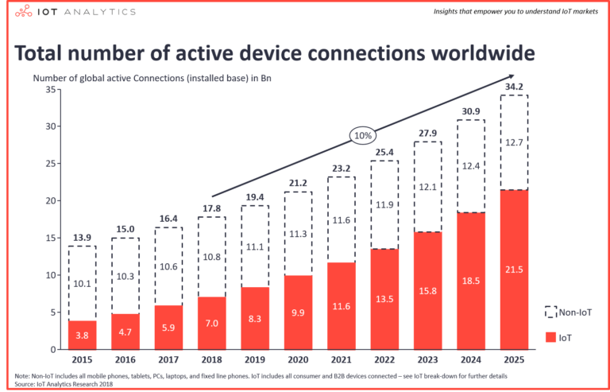
M2M Communications Have Exceeded H2H Communications
The number of IoT connected objects will continue to grow, at a higher rate than non-IoT
  UHR should consider ultra high reliability components for IoT objects

Slide 3
Lack of Visibility is still a major issue
Can’t Connect is still the most common troubleshooting issue
  STA attempts but ends up failing
“Disappearing STAs” is the second most common troubleshooting issue
  STA is connected, then not connected anymore with no reported reason
Performance (QoS) is the next most common troubleshooting issue
  STA’s performance needs are not met (but the AP does not know what they are, and that they are not met)

Slide 4
802.11 is Missing Key KPIs to make UHR IoT-reliable
Basic knowledge about the connecting object
  Alike objects have alike needs (service, security etc.)
Ongoing KPIs about the STA’s performance
  AP cannot guess if STA is receiving the service it needs
Visibility into STA dropping out decisions
  AP (or admin) cannot make network conditions more reliable without knowing when conditions are not reliable
Examples:
  A hand scanner keeps disconnecting and reconnecting
    Turns out to be normal behavior, scanner connects, sends its (barcode) frame then disconnects until the user presses the scan button again
  A large set of MAC addresses associate, but fail during the 4-way handshake
    Without knowing that all clients are fire alarms that fail to connect on the new SSID config, there is no way to improve the connection experience

Slide 5
There Have Been Attempts in the Past
802.11v-2011 Diagnostic request and report (802.11-2020 11.21.3)
  AP sends diagnostic request (action frame, 9.6.13.4) with a Diagnostic Request Element field (9.4.2.68)
    The Diagnostic Request Elements field includes a Diagnostic Request Type field, that can be Manufacturer Information STA Report (type 1)
Category
WNM Action
Dialog Token
Diagnostic Request Elements
Destination URI Element (optional)
Element ID
Length
Diagnostic Token
Diagnostic
Request Type
Diagnostic Timeout
Diagnostic Subelements (optional)
Name | Diagnostic Type Value
Cancel Diagnostic Report | 0
Manufacturer Information STA Report | 1
Configuration Profile | 2
Association Diagnostic | 3
IEEE 802.1X Authentication Diagnostic | 4
Reserved | 5-220
Vendor Specific | 221
Reserved | 222-255

Slide 6
802.11 Diagnostic Report
STA Can Return Manufacturer Information
  When Diagnostic Request Type field is Manufacturer Information STA Report (type 1), STA returns the matching Manufacturer Information (in Diagnostic subelement of the Diagnostic Report)
Category
WNM Action
Dialog Token
Diagnostic Request Elements
Destination URI Element (optional)
Element ID
Length
Diagnostic Token
Diagnostic
Request Type
Diagnostic Status
Diagnostic Subelements
ID | Subelement name
… | …
6 | Device Type
8 | Firmware Version
11 | Manufacturer model string
… | …
Device type: table 9-206
Firmware version: Fig.9-423
Model: Fig. 9-426

Slide 7
802.11 Diagnostic Report Potential and Limitations
The ability to exchange information (not guess) is key to performance
  Every 802.11bn STA should support this exchange
The 11v diagnostic was designed close to 15 years ago
  Some categories are missing (e.g., IoT, AR/VR device types)
  Some categories need additional data (e.g. Device type cat. 5 [Digital Still Camera] -> “Oibo Cam5”)
    Manufacturer model is restricted to wireless network adapter, not sufficient
  Some categories provide insufficient details (e.g., firmware version provides one string, while an Android-based fire alarm would have Android version, vendor add-on version, firmware version, possibly ‘connected to power/on battery, etc.)
802.11bn has an opportunity to modernize these exchanges

Slide 8
802.11bn Possible Remedy
802.11bn can improve on the Diagnostic Report
  An environment (PMF-protected) action frame that the STA can (optionally) send after association
    With details on the HW, SW platform
    (roaming scenarios) with information on why the STA roamed to this AP
  The frame could have a generic format to include additional future environmental information useful to either side
  Accompanied with a “rich management enable/disable” MLME interface for the STA owner to decide when sharing is useful

Slide 9
Sharing Events Has Also Been Defined
802.11v-2011 WNM log (in Event Reporting, 802.11-2020 9.4.2.65.1, 9.4.2.66.1, 9.4.2.66.5, 9.6.13.2, 9.6.13.3)
  AP sends (log) event request, STA replies with (log) event report
  Log is syslog format string, for example (11.21.2.5):
    <0>Oct 03 17:47:00 00:01:02:03:04:05 Adapter DLL Service initialized
    <1>Oct 03 17:48:40 00:01:02:03:04:05 Authentication started
    <1>Oct 03 17:48:46 00:01:02:03:04:05 IEEE 802.1X Authentication Failed, credential failure
    <1>Oct 03 17:49:00 00:01:02:03:04:05 Authentication success
  Because of the disappearing STA problem, these logs could include the tail of previous association
Every 802.11bn STA should support this exchange
  802.11bn should define log subtypes of interest

Slide 10
802.11k Also Tried To Exchange on Performance
STA Statistics Report (802.11-2020 11.10.9.5)
  AP/STA can send a STA Statistics measurement request (802.11-2020 table 9-98) indicating what group of stats is requested
  Other side responds with STA Statistics Report
802.11bn has an opportunity to modernize these exchanges

Slide 11
802.11k Also Tried To Exchange on Performance
STA Statistics Report (802.11-2020 11.10.9.5)
  AP/STA can send a STA Statistics measurement request (802.11-2020 table 9-98) indicating what group of stats is requested
  STA reports all elements in the requested group
  (802.11-2020 table 9-132)
    E.g. group 2:
    dot11QosCounters Group for UP0 for the Interface on which the STA
    Statistics request was received:
    dot11QosTransmittedFragmentCount (Counter32),
    dot11QosFailedCount (Counter32),
    dot11QosRetryCount (Counter32),
    dot11QosMultipleRetryCount (Counter32),
    dot11QosFrameDuplicateCount (Counter32),
    dot11QosRTSSuccessCount (Counter32),
    dot11QosRTSFailureCount (Counter32),
    dot11QosAckFailureCount (Counter32),
    dot11QosReceivedFragmentCount (Counter32),
    dot11QosTransmittedFrameCount (Counter32),
    dot11QosDiscardedFrameCount (Counter32),
    dot11QosMPDUsReceivedCount (Counter32),
    dot11QosRetriesReceivedCount (Counter32)
Peer MAC Address
Randomization Interval
Measurement Duration
Group Identity
Optional subelements
Statistics Group Name | Group Identity
STA Counters from dot11CountersTable | 0
STA Counters from dot11MacStatistics group | 1
QoS STA Counters for UP0 from dot11QosCountersTable | 2
QoS STA Counters for UP1 from dot11QosCountersTable | 3
QoS STA Counters for UP2 from dot11QosCountersTable | 4
QoS STA Counters for UP3 from dot11QosCountersTable | 5
QoS STA Counters for UP4 from dot11QosCountersTable | 6
QoS STA Counters for UP5 from dot11QosCountersTable | 7
QoS STA Counters for UP6 from dot11QosCountersTable | 8
QoS STA Counters for UP7 from dot11QosCountersTable | 9
BSS Average Access Delays as described in 9.4.2.38 and 9.4.2.43 | 10
STA Counters from dot11CountersGroup3 (A-MSDU) | 11
STA Counters from dot11CountersGroup3 (A-MPDU) | 12
STA Counters from dot11CountersGroup3 (BlockAckReq, Channel Width, PSMP) | 13
STA Counters from dot11CountersGroup3 (RD, dual CTS) | 14
STA STA Counters from dot11CountersGroup3 (beamforming and STBC) | 15
RSNA Counters | 16
Reserved | 17-255

Slide 12
802.11 STA Statistics Report Potential and Limitations
The ability to exchange information (not guess) is key to performance
  Every 802.11bn STA should support this exchange
The 11k Statistics report was designed more than 15 years ago
  The structure is rigid: one group, possibly >10 metrics, exchange may be needed for several groups
    For example, retry count may cause to query 8 groups (UP0 to UP7), and throw away all returned metrics except one (retry count)
802.11bn has an opportunity to modernize these exchanges
  Groups, subgroups, add metrics of interest , optimize the exchange to make it efficient

Slide 13
Disappearing Clients
Often, STAs disappear for non-802.11 reasons
  These reasons are known, but cannot be expressed in a frame
802.11bn has the opportunity to fix this limitation
802.11 is interested in L1/L2, but has never be shy to call out other layers when useful
  E.g. ANQP Venue Info, ARP Proxy (IPv4/IPv6), TCLAS (UDP/TCP) and many others

Slide 14
Summary
Building an ultra-highly reliable 802.11 supposes close communication between the STA and the AP
  Each STA type may need different type of support -> the STA should be able to inform the AP about the platform
  Statistics exchanges are also useful, but need to be simplified
  The STA should also be able to inform the AP when it leaves the network, for reasons beyond the classical 802.11 reason codes.
Past attempts in this direction are useful, but need a refresh.

Slide 15
Strawpoll
Do you agree to add the following text to the 11bn SFD:
  11bn shall define a mechanism to exchange information about the STA (e.g., platform, HW, SW, logs)
  Y / N / A

Slide 16
Strawpoll
Do you agree to add the following text to the 11bn SFD:
  11bn shall define a mechanism to exchange reliability metrics between the AP and the STA
  Y / N / A

