Slide 1
Troubleshooting Metric
Follow Up
March 2024
Authors:
Name | Affiliation | Phone | email
Jerome Henry | Cisco Systems |  | jerhenry@cisco.com
Javier Contreras | Cisco Systems
Brian Hart | Cisco Systems
Binita Gupta | Cisco Systems

Slide 2
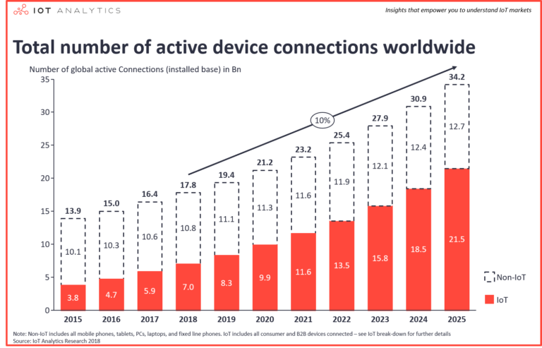
M2M Communications Have Exceeded H2H Communications
The number of IoT connected objects will continue to grow, at a higher rate than non-IoT
  UHR should consider ultra high reliability components for IoT objects

Slide 3
Lack of Visibility is still a major issue
Can’t Connect is still the most common troubleshooting issue
  STA attempts but ends up failing
“Disappearing STAs” is the second most common troubleshooting issue
  STA is connected, then not connected anymore with no reported reason
Performance (QoS) is the next most common troubleshooting issue
  STA’s performance needs are not met (but the AP does not know what they are, and that they are not met)

Slide 4
802.11 is Missing Key KPIs to make UHR IoT-reliable
Basic knowledge about the connecting object
  Alike objects have alike needs (service, security etc.)
Ongoing KPIs about the STA’s performance
  AP cannot guess if STA is receiving the service it needs
Visibility into STA dropping out decisions
  AP (or admin) cannot make network conditions more reliable without knowing when conditions are not reliable
Examples:
  A hand scanner keeps disconnecting and reconnecting
    Turns out to be normal behavior, scanner connects, sends its (barcode) frame then disconnects until the user presses the scan button again
  A large set of MAC addresses associate, but fail during the 4-way handshake
    Without knowing that all clients are fire alarms that fail to connect on the new SSID config, there is no way to improve the connection experience

Slide 5
Strawpoll
Do you agree to add the following text to the 11bn SFD:
  11bn shall define a mechanism to exchange reliability metrics between the AP and the STA
  Y / N / A

