Slide 1
Enhancements for the SBP Procedure
Date: 2024-03-07
Authors:

Slide 2
Introduction
In this contribution, we discuss a proposal to resolve CID 4296.
The issue addressed in this CID is that the current specs for the SBP procedure have limitations:
  There is no way to indicate whether the preferred responders (including the SBP responder i.e., the AP) are required to send the sensing measurement reports to the SBP initiator or not without splitting the preferred responders to at least two groups and perform two SBP sessions.
  Furthermore, there are scenarios (one possible scenario is raised by the CID) where some roles cannot be assigned to the preferred responders (namely, the role of sensing transmitter and receiver). In other words, the allowed roles are either sensing transmitter or sensing receiver.

Slide 3
CID 4296
CID | Clause | PP.LL | Comment | Resolution
4296 | 11.55.2.3 | 169.35 | Using only one bit (Sensing Measurement Report Requested field) to indicate whether the SBP responder (i.e., AP) and other sensing responders shall send the Sensing Measurement Report frames or not is insufficient and does not cover all cases. In the case where Preferred Responder Role Bitmap in the SBP Parameters element is set to 11 (i.e., Transmitter and Receiver), this responder may participate in NDPA sounding phase and TF sounding phase. This may result in a scenario where the responder can consume the sensing measurement report locally (no need to send the report), however, the AP measured the NDP transmitted by this responder and need to send the report back to the SBP initiator. If the Sensing Measurement Report Requested field is set to 0, this indicates that the AP shall not send the report and this measurement will be wasted. | Use a bitmap to indicate to each of the responders with the role receiver or transmitter and receiver in the Sensing Responder Role Bitmap whether the report is requested or not. I will bring a contribution to address this issue.

Slide 4
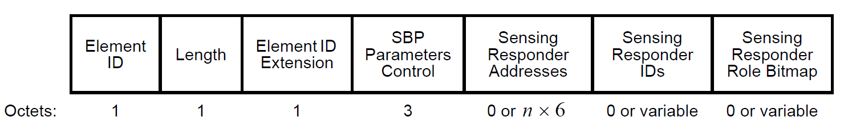
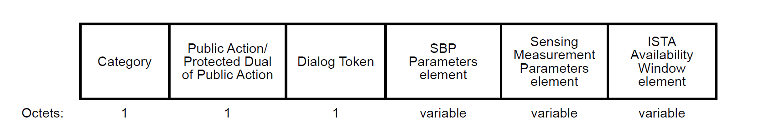
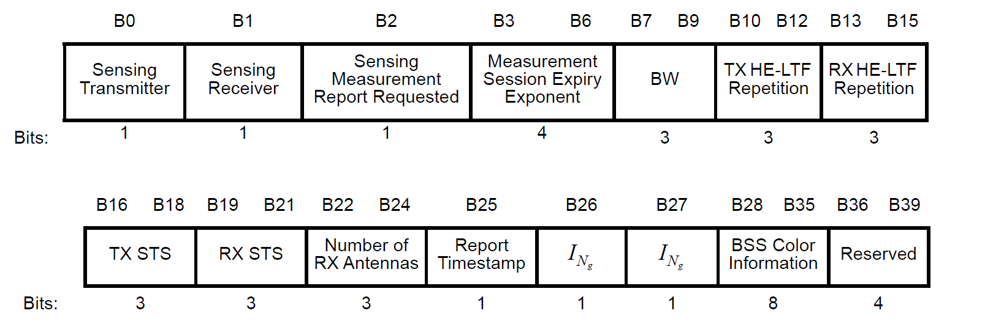
Recap: SBP Procedure

Slide 5
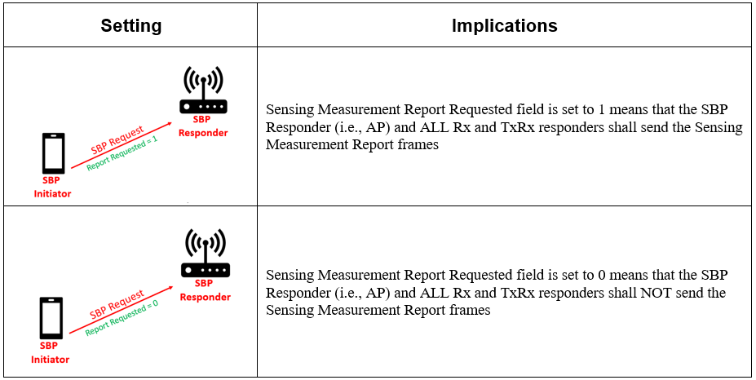
Current Behavior

Slide 6
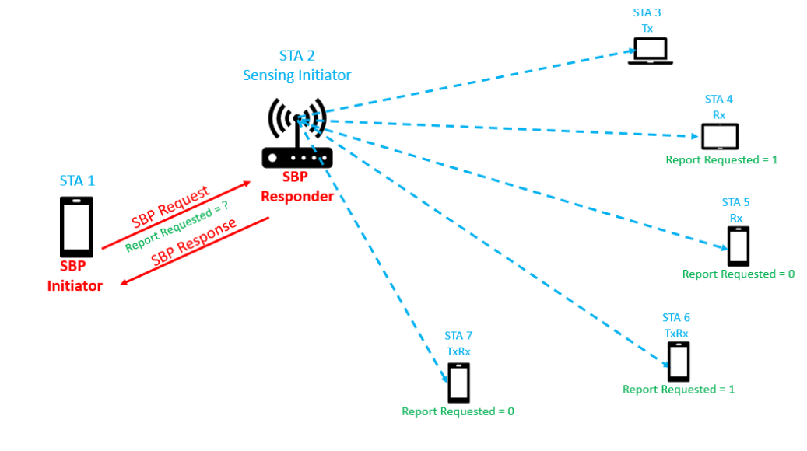
General Scenario
In this scenario:
  STA 3 is a transmitter
  STA 4 and STA 5 are receivers
  STA 6 and STA 7 are transmitters and receivers
STA 4 and STA 6 are required to send the sensing measurement report
STA 5 and STA 7 are NOT required to send the sensing measurement report
Sensing Measurement Request

Slide 7
Current Behavior for the General Scenario
SBP Initiator in the previous scenario shall do the following :
  Split the 5 responders into two groups
    Group 1: includes all transmitters & all receivers that are required to send the sensing measurement report (STA 3, STA 4, STA 6)
    Group 2: includes all receivers that are NOT required to send the sensing measurement report (STA 5)
  Assign STA 7 the role of a transmitter and include it to Group 1
  Start an SBP Procedure 1 with Group 1
  Assign STA 7 the role of a receiver and include it to Group 2
  Start an SBP Procedure 2 with Group 2

Slide 8




Special Scenario
STA 1:
SBP Initiator, vendor sensing software compatible with STA 2/3
Configured as Sensing Receiver
Does not require measurement report from STA 2/3
Requires measurement report from AP for STA 4/5
STA 2/3:
Vendor sensing software compatible with STA 1
Locally consume and process CSI
Configured as Sensing Receivers
STA 4/5:
No vendor sensing software
Necessary for STA 1 to obtain Measurement Report
Configured as Sensing Transmitters, AP generates report for STA 1
(STA 2)
SI2SR NDP
(AP)
SBP Responder
(STA 3)
Local CSI Consumption
(Vendor Sensing SW)
SI2SR NDP
Report from
STA 4/5
(STA 1)
SBP Initiator
Sensing SR2SI NDP
(STA 4)
(STA 5)
Local CSI Consumption + OTA Reports
(Vendor Sensing SW)
Measurement Report to STA 1
(No vendor Sensing SW)

Slide 9
Current Solution Overview
Sensing Measurement Session ID=X
Existing SPB signaling
  Only provides a single bit in the Sensing Measurement Parameters element (Sensing Measurement Report Requested) which currently applies to all sensing receivers.
To realize the above scenarios using existing SBP signaling
  SBP initiator would need to create two separate sessions, which will result in two separate exchanges
SBP Request
Sensing Measurement Request
Sensing Measurement Response
SBP Response
Within SBP Request frame, SBP Initiator:
  Includes only sensing receivers which deploy the vendor sensing software
  Set Sensing Measurement Report Requested = 0 (in Sensing Measurement Parameters)
Sensing Measurement Session ID=Y
SBP Request
Sensing Measurement Request
Sensing Measurement Response
SBP Response
Within SBP Request frame, SBP Initiator:
  Includes only sensing transmitters
  Set Sensing Measurement Report Requested = 1 (in Sensing Measurement Parameters)
Sensing Measurement Session ID=X
Sensing Measurement Session ID=Y
Polling Phase
NDPA Phase
Polling Phase
TF Phase
SBP Reporting
. . .
No Report:
(STA1, STA2, STA3)
Report to SBP Initiator: (STA4, STA5)

Slide 10
Limitations of the Current Behavior for Both Scenarios
Incurs complexity
  All complexity is in the non-AP STA side (i.e., the SBP initiator)!
Negotiating twice will hold the media for longer time (more airtime)
  Less efficient in terms of channel usage
No flexibility
  SBP Initiator has the ability to define Sensing RX / TX roles, however there is no way to signal measurement report is required.
Current limitations require different SBP scenarios to be conducted using two separate Measurement Sessions.

Slide 11
Enhanced Solutions Overview
Enhanced solutions
  Provide SBP initiator flexibility to specify in the SBP Request frame which sensing receivers need to provide report to SBP initiator, and which ones will locally consume measurement.
  Result in handling this scenario using a single SBP session, and all measurements occurring in a single exchange.
SBP Request
Sensing Measurement Request
Sensing Measurement Response
SBP Response
Sensing Measurement Session ID=X
Polling Phase
NDPA Phase
TF
Phase
SBP Reporting
No Report:
(STA1, STA2, STA3)
Report to SBP Initiator: (STA4, STA5)

Slide 12
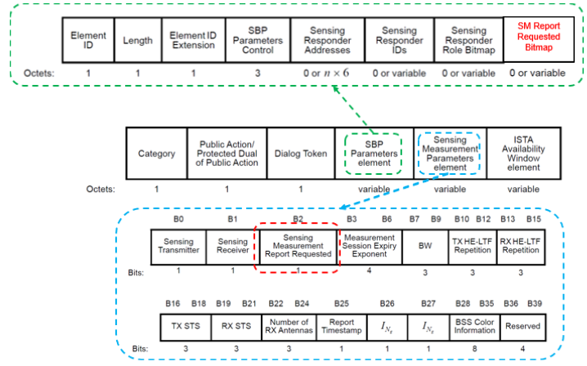
Changes to the Current Spec Draft
Option 1
  Include a bitmap (e.g., SM Report Requested Bitmap in the SBP Parameters element) where each bit in this bitmap indicates to the SBP responder (i.e., the AP) and each one of the responders in the Sensing Responder Role Bitmap with a receiving role whether the sensing measurement report is requested or not.

Slide 13
Changes to the Current Spec Draft
Option 2
  Include a bitmap (e.g., SM Report Requested Bitmap in the SBP Parameters element) where each bit in the bitmap indicates to each one of the responders in the Sensing Responder Role Bitmap with a receiving role whether the sensing measurement report is requested or not and use the Sensing Measurement Report Requested field in the Sensing Measurement Parameters element to indicate to the SBP Responder whether the sensing measurement report is requested or not.

Slide 14
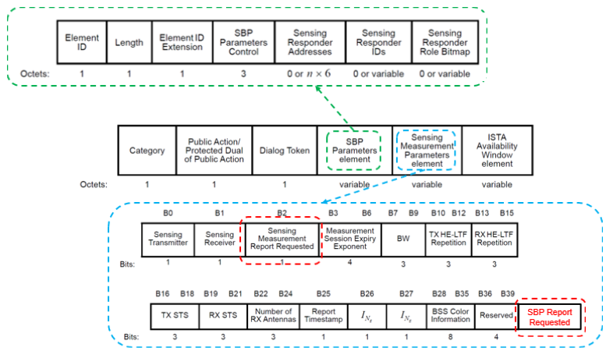
Changes to the Current Spec Draft
Option 3
  Interpret Sensing Measurement Report Requested bit as being applied ONLY to sensing responder / sensing receivers.
  Add additional bit which applies to sensing initiator / sensing receiver (e.g., AP) to signal if AP should produce report for SBP initiator

Slide 15
Pros and Cons of the Enhancement Options
 | Option 1 | Option 2 | Option 3
Changes to the specs | Add a bitmap to the SBP Parameters element | Add a bitmap to the SBP Parameters element | Add a bit to the Sensing Measurement Parameters element
Applicability | General Scenarios | General Scenarios | Special Scenarios
Limitations | No limitations | No Limitations | Does not allow responders with TxRx role
Enhancements to the SBP Procedure | Flexibility, Simplicity, and Efficiency | Flexibility, Simplicity, and Efficiency | Flexibility, Simplicity, and Efficiency

Slide 16
Conclusions
Simple changes to the current SBP negotiation procedure may enable a more flexible, simple and efficient SBP procedure.
  Flexibility allows the SBP initiator to selectively choose whether a sensing responder is required to send or not to send the sensing measurement reports (including the SBP responder, i.e., AP)
  Simplicity allows the SBP initiator to include all sensing responders in one SBP procedure
  Efficiency allows the SBP initiator to negotiate once for all sensing responders instead of negotiating twice, once for the responders that are required to send the report and once for the responders that are not required to send the report.
    This will save airtime

Slide 17
SP
Which option do you prefer to enhance the SBP procedure?
  Option 1
  Option 2
  Option 3
  None of them
  Abs

