Slide 1
Multi-link Operation for IMMW
Date: 2024-03-11
Authors:
Name | Affiliation | Address | Phone | Email
Insun Jang | LG Electronics | 19, Yangjae-daero 11gil, Seocho-gu, Seoul 137-130, Korea |  | insun.jang@lge.com
Jinsoo Choi
 |  |  |  | js.choi@lge.com
Dongju Cha |  |  |  | dongju.cha@lge.com
Eunsung Park |  |  |  | esung.park@lge.com
Insik Jung |  |  |  | insik0618.jung@lge.com
HanGyu Cho |  |  |  | hg.cho@lge.com
Sanggook Kim |  | 10680 Treena St, San Diego CA 92131 , USA |  | sanggook.kim@lge.com

Slide 2
Introduction
Generally, IMMW SG focuses on an MLD with which at least one STA operating on a mmWave bands is affiliated
Several contributions [1]-[4] have provided similar views in terms of a multi-link operation to reduce control/management overhead on mmWave bands
In this contribution, we share our views on multi-link operation for IMMW
For convenience, we call STAs (or APs) operating on mmWave bands mSTA (or mAPs) and also call STAs (or APs) operating on sub-7GHz bands sSTA (or sAPs)

Slide 3
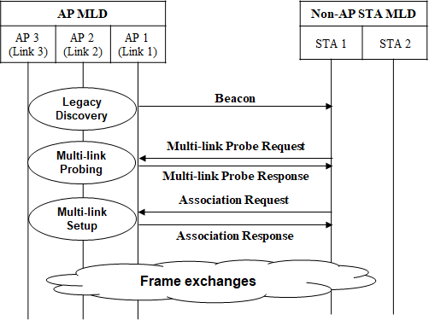
Recap: Multi-link Operation in 11be
Basically, Multi-link Operation provides significantly efficient operations in terms of discovery, association, authentication….
Note: Some procedures are omitted (e.g., authentication)

Slide 4
Potential Directions
No Beacon-like MGMT frame on mAP(s) is assumed
Basically, DMG Beacon already had many information
To reduce management overhead and power consumption in mmWave bands (e.g., like DMG Beacon), transferring most of information (e.g., capabilities, operating parameters) available/supportable on sub-7GHz bands would be better
That assumption does not prevent necessary (periodic) information to transmit on mmWave bands, which can be discussed
Existing multi-link operations are utilized, e.g., instead of mSTA affiliated with the same MLD as sSTA(s)
sSTA requests or provides the information of mSTA
sSTA performs multi-link setup including mSTA
sSTA setups and schedules any other mechanisms (e.g., TWT, beamforming training) involving mSTA

Slide 5
Basic Discovery
Beacon (and Probe Response frame) provide basic mAP/MLD information through RNR IE and Basic ML IE
Non-AP MLD can utilize the information (e.g., Channel, TBTT offset, MLD parameters) to identify mAP and its MLD
In RNR IE,
Some of the existing info can be organized properly for mAP except unnecessary information for mmWave bands (e.g., BSS parameters)
E.g., MLD parameters for non-primary link in mobile AP MLD are only provided
Some info related to timing (e.g., TBTT offset) can be reconfigured (assuming no Beacon)
Additional info may be discussed (e.g., reachability), but bloating should be considered in terms of reduced NR
In Basic ML IE,
Generally, mandatory Common Info would be included (e.g., MLD MAC address)
Optional Link Info could be considered, e.g., without IMMW Beacon, broadcast TWT schedule may be announced per mAP

Slide 6
Multi-link Discovery/Setup
ML Probe Response frames and Association frames provide “Complete Profile” as mSTA Profile through Basic ML IE
Complete Profile format can be constructed if no MGMT frames are transmitted on mSTA
In terms of ML Probing,
Existing STA Info can be reused with presence bit, the timing info such as Beacon Interval, TSF offset can be reconfigured (assuming no IMMW Beacon)
Additional STA Info can be considered, e.g., regarding DL/UL reachability for mSTA
If we make a lot of changes of current per-STA profile, we may go with a different/dedicated per-STA profile for mSTA
ML Probing could be considered as mandatory to obtain full info of mSTA before multi-link setup

Slide 7
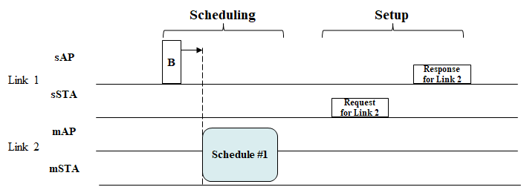
Other MLO-based Mechanisms
A lot of management mechanisms based on MLO were well-defined in 11be
Multi-link-assisted TWT, TIM, Critical Update, TID-to-link mapping, Reconfiguration, ….
Thanks to the efforts, necessary mechanisms (e.g., beamforming training) in mmWave bands can designed based on MLO

Slide 8
Conclusion
In this contribution, we shared our views on multi-link operation for IMMW
Multi-link Operation is very good tool to involve and control/manage mSTAs in an MLD smoothly while no Beacon-like MGMT frame on mAP(s) is assumed
In addition, Multi-link Probing could be considered as mandatory to obtain full info of mSTA before multi-link setup
IMMW-dedicated mechanisms based on MLO needs to be discussed later

Slide 9
References
[1] 11-23/2004, Technical scope proposal
[2] 11-23/1905, High Level Thoughts on IMMW
[3] 11-23/1819, Integrated mmWave Design Considerations
[4] 11-23/1968, Discussion on general direction of integrated mmWave

