Slide 1
Hierarchical Modulation for 802.11 – initial results
Date: 2024-03-XX
Authors:

Slide 2
Analytical Results, New findings and Discussions
[3] gives expressions for BER for SISO, uncoded , Hierarchical Modulation systems.
Next few slides provide BER plots for 16QAM and 64 QAM based on formulation in [3]
  These are not results from simulation, but from the analytical expressions given in the reference
A few parameters are introduced in the next slide to understand/interpret those results.

Slide 3
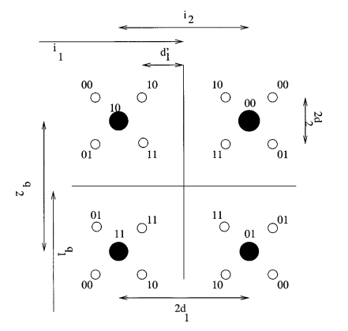
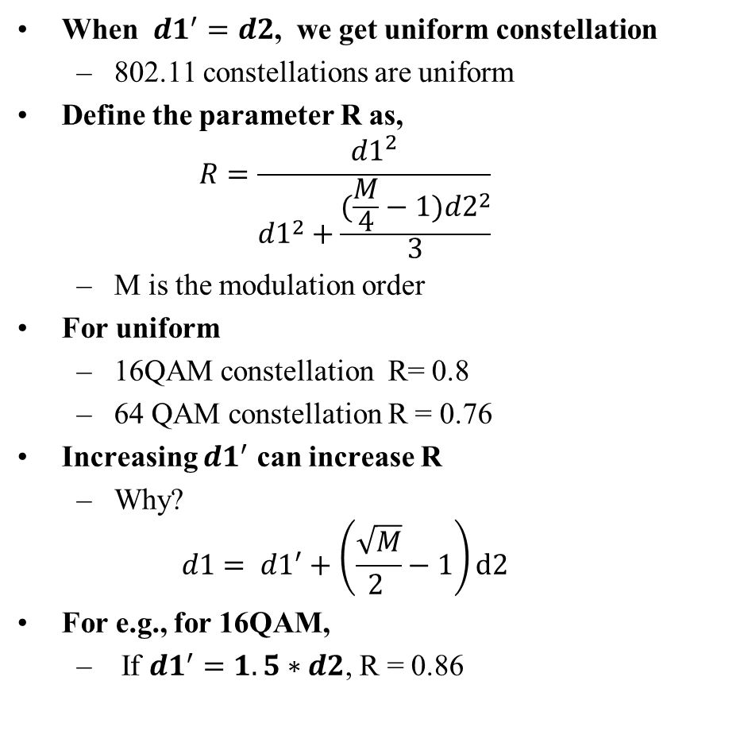
definitions (illustrations with 16 QAM constellation)
When ${d1}^{′}=d2$, we get uniform constellation
  802.11 constellations are uniform
Define the parameter R as,
  $$R=\frac{{d1}^{2}}{{d1}^{2}+\frac{(\frac{M}{4}−1){d2}^{2}}{3}}$$
  M is the modulation order
For uniform
  16QAM constellation R= 0.8
  64 QAM constellation R = 0.76
Increasing ${d1}^{′}$ can increase R
  Why?
  $$d1= {d1}^{′}+\left(\frac{\sqrt{M}}{2 }−1\right)d2$$
For e.g., for 16QAM,
  If ${d1}^{′}=1.5∗d2$, R = 0.86

Slide 4
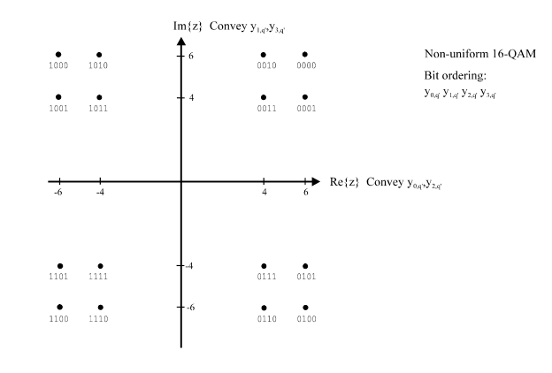



Non-uniform 16QAM (higher R)
$$higher {d1}^{′ }⟹higher R$$
$${d1}^{′}$$
$${d1}^{′}$$

Slide 5
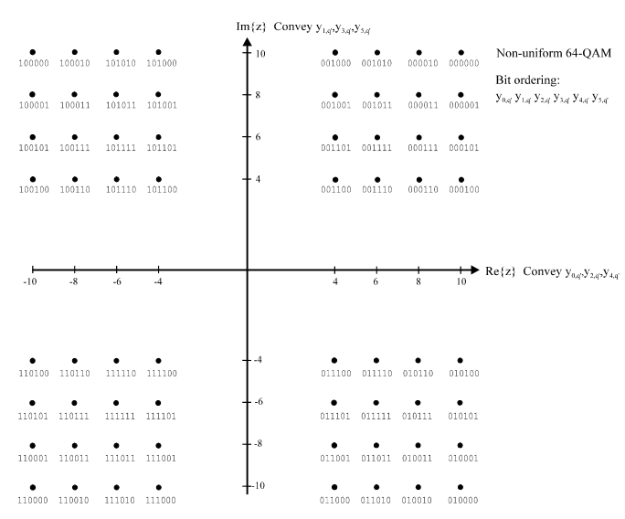


Non-uniform 64QAM (higher R)
$$higher {d1}^{′ }⟹higher R$$
$${d1}^{′}$$
$${d1}^{′}$$

Slide 6
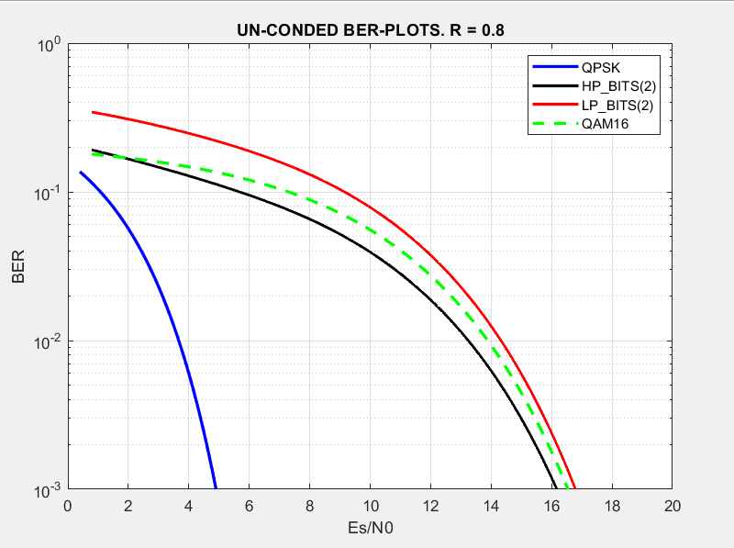
Uncoded BER vs SNR for uniform 16 QAM (channel AWGN )
HP & LP streams have different levels of robustness

Slide 7
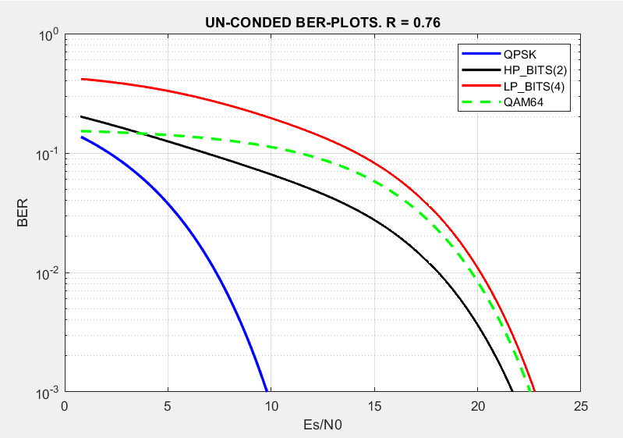
Uncoded BER vs SNR for uniform 64 QAM (channel AWGN )
HP & LP streams have different levels of robustness

Slide 8
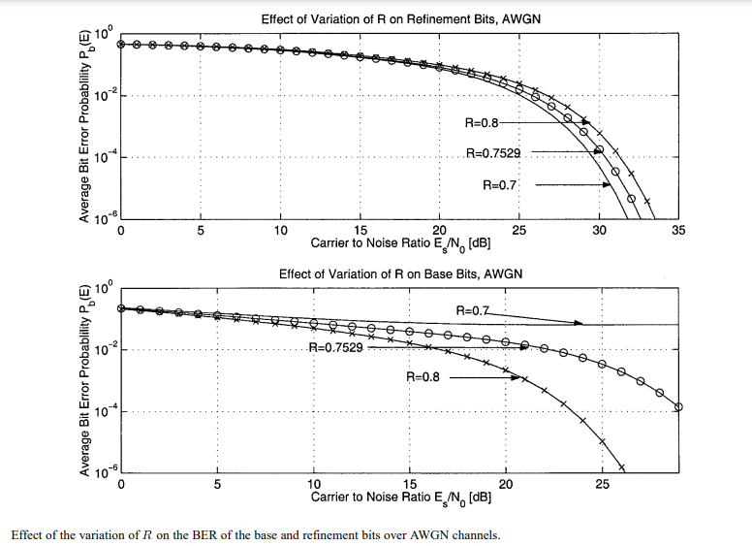
Results from [3] – 256QAM
Definitions
  LP bits are a.k.a Refinement bits
  HP Bits are a.k.a Base Bits
Discussion
  As R increases HP robustness increases considerably whereas LP robustness degrades slightly.
Uniform Constellation

Slide 9
Current Observations
Based on the current findings we propose
  HM with non-uniform constellations (increase R)
  Independently select the coding for HP and LP streams.
The study is ongoing

Slide 10
Reference
[1] Hierarchical Modulation for 802.11 – IEEE 802.11-24/0409r1

