Slide 1
Discussion on bounded delay in Industrial Scenarios
Date: 2024-03-XX
Authors:
Name | Affiliations | Address | Phone | Email
Yue Xu | Huawei | Huawei Nanjing R&D Institute, Nanjing, Jiangsu, China, 210012 |  | xuyue57@Huawei.com
Chenhe Ji
Shuaishuai Zhang
Chun Pan
Xiaofei Bai

Slide 2
Introduction
Latency and Reliability are two of the most important guiding criteria in UHR (Ultra High Reliability) SG[1].
Achieving bounded delay and high single-pass success rates is a common requirement for many services in industrial scenarios [2]. However, current Wi-Fi mechanisms lack support for these packets that require deterministic latency.
To address this challenge and enhance performance requirements for low latency and high reliability in industrial scenarios, we propose three potential solutions from high level.

Slide 3
Recap: UHR in Industrial scenarios
Type | Brief info
AGV (Automated Ground Vehicle) / AMR (Autonomous Mobile Robot) | Involving communication, including guidance control, process data exchange, video/image, and emergency stop, between robots and a control system,
Assembly line | Combination of AGV/AMR, sensors, robot/drone motion control, and video transfer.
Robot/drone motion control | Remote operation with haptics communication, programmed robot operation with emergency stop.
Sensors | Periodical report of information to the control system. High-density deployment environment.
Bounded delay and high-reliability services find extensive application in industrial scenarios.
In many scenarios or services, traffic flows can be categorized as bounded delay traffic.
Consequently, the effective utilization of 11bn (or Wi-Fi 8) in industrial settings to fulfill the prescribed service requirements, notably high reliability and low latency, assumes paramount importance.

Slide 4
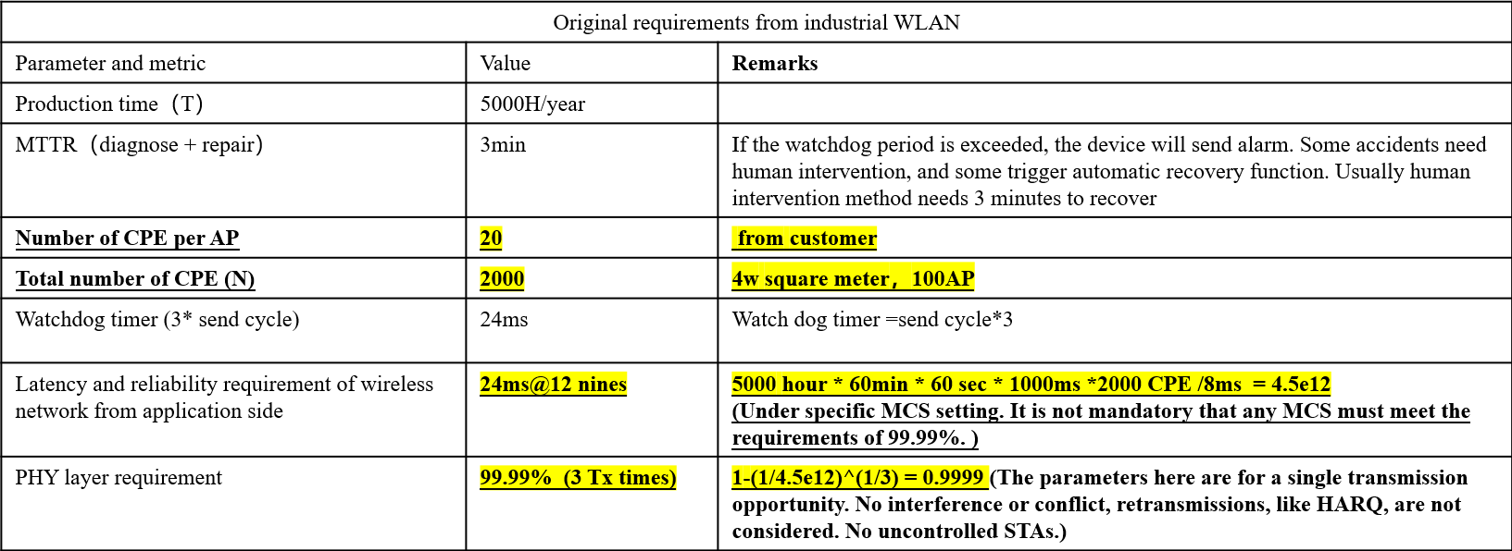
Goal and Issue
In an industrial environment, bounded delay and a relatively high single transmission success rate need to be ensured (shown in the table).
Based on the profinet protocol, if the delay exceeds 24 ms, users may go offline.
However:
Within Wi-Fi networks, aperiodic management packets, such as those for measurement, negotiation, and capability announcements, are prevalent. Presently, the Wi-Fi mechanism lacks support for bounded delay scheduling of these packets, and triggers fail to indicate the scheduling of packets in a queue.
In a bounded delay scenario, an interruption of a service with a high deterministic latency requirement may cause a service device to go offline, thereby disrupting normal operation of an industrial production line.

Slide 5
Potential Options
We believe that there are three potential ways to better ensure deterministic latency and high single transmission success rate in industrial scenarios.
Option 1: STA TxMode Negotiation based solutions
- The AP negotiates with the STA to mark and identify the traffic of specific STAs or services.
- The interaction process between the AP and the STA needs to be added.
Option 2: Trigger based solutions
- Receive and transmit feature data by (re-)using an existing trigger frame or designing a new trigger frame
Option 3: TWT (or rTWT) based solutionsil
- Reuse or add TWT (or rTWT) functions, split TWT sessions, and send&receive specific data flows based on feature rules.

Slide 6
Summary
In this contribution, we illustrate the problems in the industrial scenario: the current Wi-Fi mechanism lacks support bounded delay scheduling of these packets.
We have provided 3 potential solutions (directions) and requires more details and thorough deliberation.

Slide 7
References
[1] UHR proposed PAR, IEEE 802.11-23/480
[2] 11-23-1570-00-uhr-Latency Consideration of Industrial Scenarios

Slide 8
SP
Do you think the issue of bounded delay needs to be further discussed in industrial scenarios?
- Yes
- No
- Abstain

