Slide 1
DPWiFi for IEEE802.11bn WMANs
Date: 2024-04-18
Authors:

Slide 2
Abstract
TWI’s proposed “DPWiFi” IEEE802.11bn PHY/MAC, particularly relevant to Wireless Metropolitan Area Networks (“WMANs”), represents Breakthrough wireless technology enabling Disruptive radio products creating Revolutionary broadband networks delivering Transformative Internet Access, in the not too distant future and the whole world over

Slide 3
Proposed DPWiFi IEEE802.11bn PHY/ MAC Specification
32 IEEE802.11be concurrent, cochannel TGbe EHT RF streams
32x32 MIMO Dynamic Polarization Multiplexing
32x32 MIMO Tx/Rx DLOS/ nLOS/ NLOS Beam Forming/ Steering
Propagation Channel Impairment Mitigation
AP Tx Multi-beaming
AP/ Client Rx Interference Cancellation
Client Rx Multipath Recombination
90D/ 10U TDMA MAC
5-7 GHz UNII Operation

Slide 4
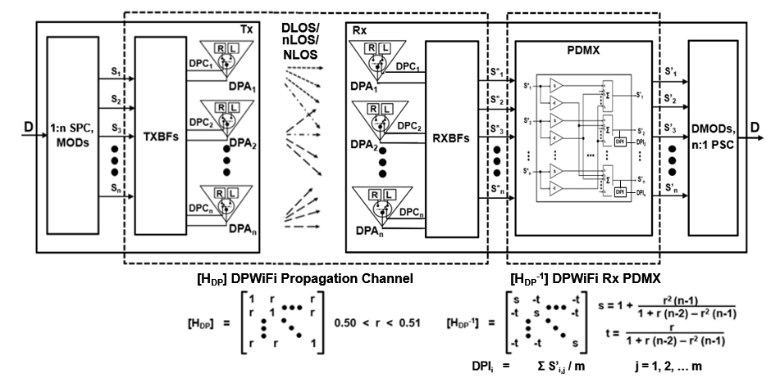
Breakthrough DPWiFi Technology
The WMAN DP propagation channel [H_{DP}] is an n-dimensional “Polarization Space” The upper bound for n, if it exists, greatly exceeds 32
The [H_{DP}] transfer function is non-singular, deterministic, scalar and uniform
I.e., h_{ij} = 1, i = j; h_{ij} = 0 ≤ r < 1 , i ≠ j
The “Propagation Channel Dynamic Polarization Index (ChDPI) r” varies with [H_{DP}] impairments
DPWiFi DLOS, nLOS and NLOS links are subject to [H_{DP}] “depolarization”
(i.e., induced Rx signal angular polarization rotation wrt Tx-established orthogonal baseline)
DLOS links experience atmospheric fog, rain, etc. of up to 5º [H_{DP}] depolarization
nLOS links obstructed/ diffracted by foliage or structures face up to 15º depolarization
NLOS links reflected by structures or vehicles depolarize by up to 45º

Slide 5
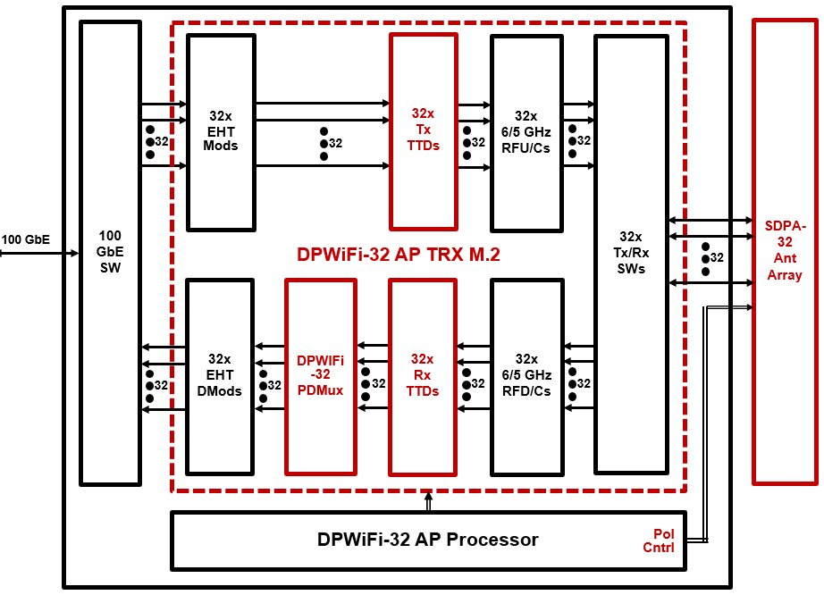
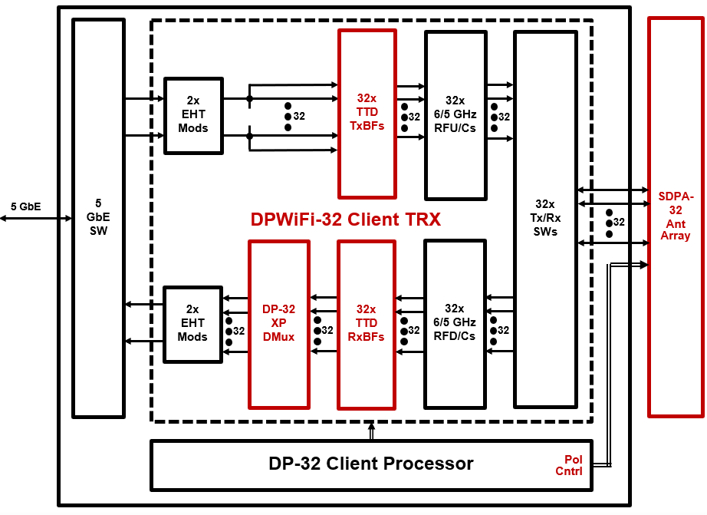
Breakthrough DPWiFi Chipsets

Slide 6
Disruptive DPWiFi APs and Clients
The 2 DPWiFi SoCs enable 3 core DPWiFi Radios:
DPWiFi Backhaul (“DPBH”): High Directivity 184 Gbps AP/ Meshnode
DPWiFi Base Station (“DPBS”): Wide Coverage 184 Gbps AP
DPWiFi CPE (“DPC”): High Directivity 5.8 Gbps Client

Slide 7
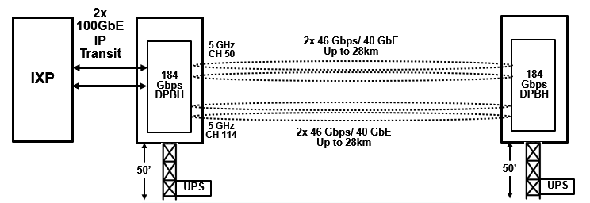
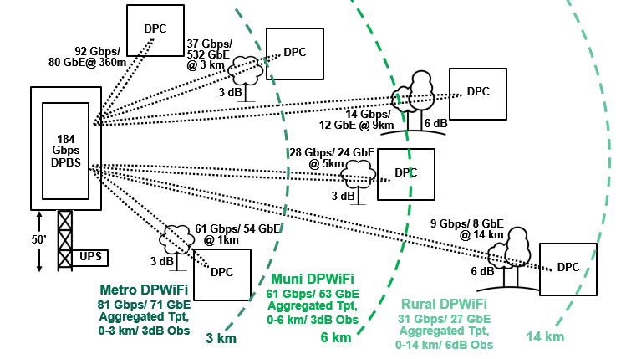
Revolutionary DPWiFi Networks
Fixed WiFi Access Backhaul
One FWiFiA Backhaul link
transports 184 Gbps up to 28 km
“Metropolitan DPWiFi” for densest population cities
“Municipal DPWiFi” for sparser population cities
“Rural DPWiFi” for lightly populated regions
Fixed WiFi Access Distribution
One FWiFiA Distribution NW
supplies dedicated 4kHD to
60k subscribers within 3 km, or
40k subscribers within 6 km, or
20k subscribers within 14 km

Slide 8
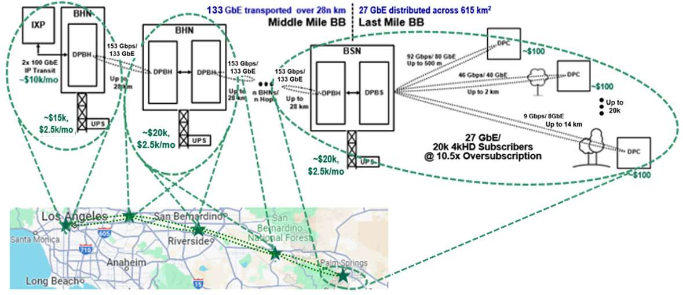
Transformative DPWiFi Rural WMANs
Rural FWiFiA: 184 Gbps Base Station/ Up to 20k Subscribers up to 14 km away
90% Rural DPWiFi Gross Margin BLOWS UP today’s Exurban FWA Business Model

Slide 9
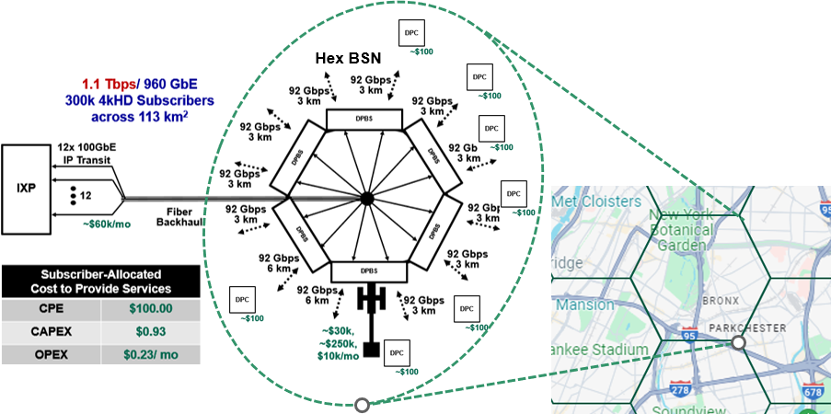
Transformative DPWiFi Urban WMANs
Metro FWiFiA: 1.1 Tbps Base Station/ Up to 300k Subscribers per 3km radius big city cell
97% Metro DPWiFi Gross Margin BLOWS UP today’s Urban FWA Business Model

Slide 10
What’s to Become of DPWiFi WMANs?
There are ~1.4B Fixed Broadband (“FBB”) connections worldwide today
~ 72.8% Fiber (FTTx)
~ 16.0% Cable (Mostly USA-CN DOCSIS)
~ 8.7% Copper (DSL, ADSL, VDSL)
About that North American Fixed Wireless Access
~3k WISPs are vying to BB-connect ~12k communities (500-50k residents) with $50-100/mo HD And achieve a 1 – 5% penetration of ~60% of the USA-Canada population (~80M households)
$10/mo Dedicated 60/60/24/7 Rural FWiFiA would capture practically ALL those households
This means ~80M DPWiFi CPEs deployed, or ~40M DPCs sold annually For a $800M/yr CPE SoC and $4B/yr DPC Terminal business in 5 years
Fixed WiFi Access will completely upend that Global Broadband Order
Global FBB incumbent NWOs will overbuild their own urban networks with Metro/ Muni FWiFiA
Those same incumbents then expand into the neighboring countryside with Rural FWiFiA
All those FWiFiA networks combine to offer $10/mo 60/60/24/7 4kHD to up to 2B global subs by 2029 And don’t forget many subs will also drive connected cars by then, accounting for ~ 500M more connections
This means ~2.5B DPWiFi CPEs deployed, or ~1.25B DPCs sold yearly Or a $25B/yr CPE SoC and $125B/yr DPC Terminal business in 5 years
DPWiFi WMANs will EAT Legacy Fixed Broadband!

Slide 11
References
1. 23/1606r1-UHRSG Dynamic Polarization Multiplexing and Beamforming WLANs Carlos A Rios (Terabit Wireless Internet), 13-Sep-2023
23/1756r3-TGbn MIMO Dynamic Polarization and Beamforming: Proposed IEEE802.11bn PHY Carlos A Rios (Terabit Wireless Internet), 16-Nov-2023
24/0041r12-TGbn DPWiFi MATLAB Validation Carlos A Rios (Terabit Wireless Internet), 02-Feb-2024

