Slide 1
UEQM evaluation and simulation results
Date: 4-Mar-24
Authors:

Slide 2
Abstract
[1] gives an overview over previous submissions and shows UEQM benefits on an artificial channel
Questions addressed in this submission:
  When considering additional MCS, which combinations of (modulation order, code rate) are useful in practice
  For UEQM, provide more details on specific MCS that show improvements at various SNR
  Analysis of UEQM for NSS > 2
  Analysis of UEQM with spatial stream optimization
    Not forcing 2 (or 4) spatial streams

Slide 3
Analysis of Modulation/code rate combinations
MCS defined in 802.11 are a subset of all possible combinations of modulation and code rates
  Full set would be b:{BPSK, QPSK, …, 4K QAM} ×K/N:{1/2, 2/3, ¾, 5/6}
Why allow all combinations?
  Link adaptation is simplified (less constraints in the search)
  Performance is improved (see next slides)

Slide 4
High-level description of Evaluation Method
  Combine SNR per spatial stream/carrier from sounding to averaged SNR per spatial stream l SNR_{l}
  Compare sounding SNR with required SNR table: SNR_{req}(K/N,b) (example on slide 31) and select set of candidate constellation sizes
  Find the best MCS in the set of candidate constellation sizes and transmit packet
    Appendix slide 20, 21 gives an overview of the algorithm for all possible code rate/constellation size settings
    Appendix slide 22 shows the algorithm for reduced code rate/constellation size settings (e.g., only existing combinations)
    Slides 23-25 give numerical examples for different choices of poissible modulation/code rate

Slide 5
Extension of constellation size/code rate options
3 cases tested
All possible modulation×code rate combinations
Existing MCS + Additional Rate 2/3 MCS (green+yellow)
Existing MCS: green
Slides 30-32 give a numerical example for different choices of possible modulation/code rate for these 3 options.
LDPC K/N | Constellation size b/bit
½ | 1 | 2 | 4 | 6 | 8 | 10 | 12
2/3 | 1 | 2 | 4 | 6 | 8 | 10 | 12
¾ | 1 | 2 | 4 | 6 | 8 | 10 | 12
5/6 | 1 | 2 | 4 | 6 | 8 | 10 | 12

Slide 6
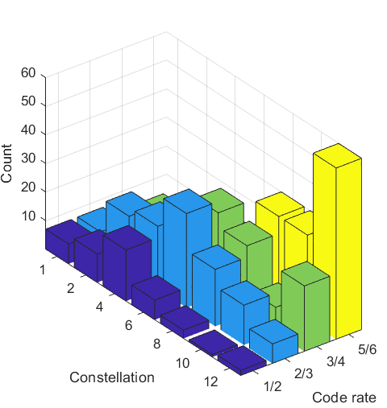
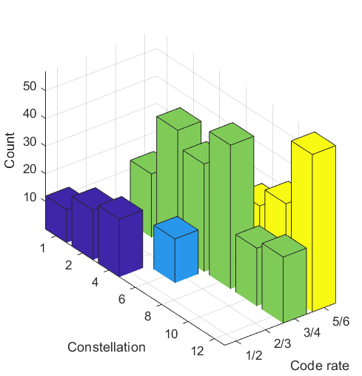
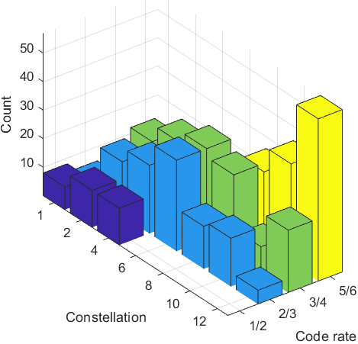
Rate-vs.-Range different Settings
Additional settings help in the medium SNR region (15-25dB)
Selected MCS shown below
MCS5 2 spatial streams
D NLOS 2x2
All settings possible
Existing +
Rate 2/3
Existing only

Slide 7
Modulation/code rate combinations: Conclusions
The following combinations are rarely used:
  Code Rate ½ at higher constellations
  Code rates ¾ and 5/6 for lower modulations
Focus should be on Code Rate 2/3
  Limited constellation sizes for rate 2/3 cause a step in the rate-vs.-range curve around 1200Mbit/s (64-QAM, Rate 2/3, 2 spatial streams)
  Adding 1-, 2- and 4-bit constellations with Rate 2/3 code is not enough.

Slide 8
UEQM detailed evaluation
Analyze UEQM on three different levels:
  RvR curves
  High-level statistics of successful UEQM
    Specifically, modulation difference between streams
  Detailed analysis of successful MCS
Results presented for: 2 Tx antennas, 2 Rx antennas and 4 Tx antennas, 2 Rx antennas, B LOS and D NLOS channels

Slide 9
2 TX antennas, 2 RX antennas –
RvR results
Rate vs. Range (B LOS) (D NLOS)
All modulation/code rate options allowed for UEQM

Slide 10
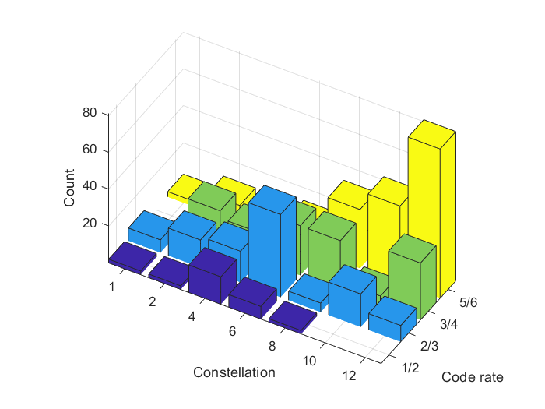
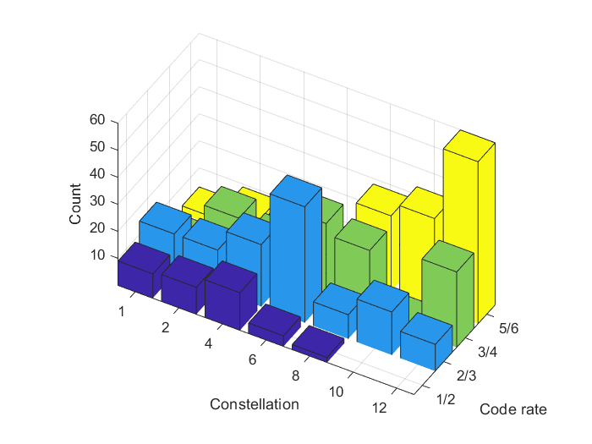
2 TX antennas, 2 RX antennas
Used Code rate/constellation combinations
B LOS D NLOS

Slide 11
D NLOS, 2 TX antennas, 2 RX antennas
Optimal modulation difference
B LOS D NLOS
Diff 0 = EQM, Diff 1 = one QAM order difference, ...
Diff = 2 Dominant for 2Tx/2Rx/2NSS

Slide 12
Selected MCS for Channel B LOS 2x2 (%)
Equal MCS not used at low/medium SNR when unequal modulation is available
Frequently recurring MCS (>2%) highlighted

Slide 13
4 TX antennas, 2 RX antennas
Rate vs. Range (B LOS) (D NLOS)
All modulation/code rate options allowed for UEQM

Slide 14
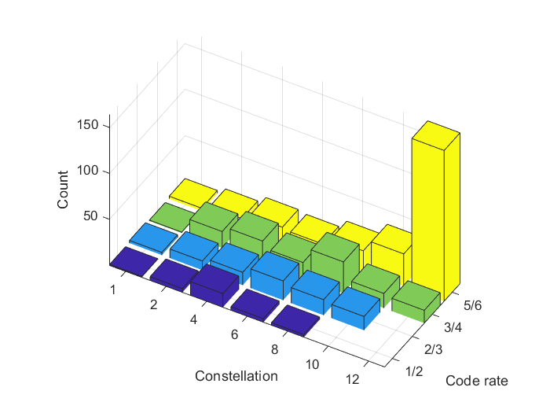
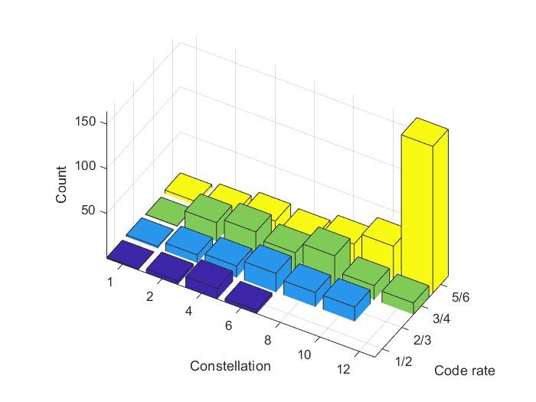
4 TX antennas, 2 RX antennas
Used Code rate/constellation combinations
B LOS D NLOS

Slide 15
D NLOS, 4 TX antennas, 2 RX antennas
Optimal modulation difference
Histogram (B LOS) (D NLOS)
Diff 0 = EQM, Diff 1 = one QAM order difference, ...
Diff = 1 dominant for 4Tx/2Rx/2NSS

Slide 16
Selected MCS for Channel B LOS 4x2 (%)
Modulation difference between spatial streams is less for 4x2 MIMO, but equal modulation is still not used, except 10/10 and12/12 bit
Frequently recurring MCS (>2%) highlighted

Slide 17
4 TX antennas, 4 RX antennas
Rate vs. Range (B LOS) (D NLOS)
All modulation/code rate options allowed for UEQM

Slide 18
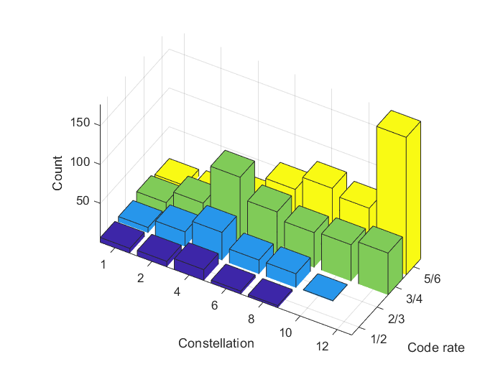

4 TX antennas, 4 RX antennas
Used Code rate/constellation combinations
B LOS D NLOS

Slide 19
D NLOS, 4 TX antennas, 4 RX antennas
Optimal modulation difference
Histogram (B LOS) (D NLOS)
Diff 0 = no difference between spatial stream 1 and spatial stream l (l=2,3,4), Diff 1 = one QAM order difference, ...
Diff 0 doesn‘t necessarily mean equal modulation

Slide 20
Selected MCS for Channel B LOS 4x4 (%)
With UEQM, the use of 4 spatial streams in 4x4 MIMO is much more likely
Only showing frequently recurring MCS

Slide 21
Conclusions
When available, unequal modulation is used in the majority of cases
2x2 beamforming:
  Preferred modulation order difference is 2, max. difference is 3
4x2 beamforming
  Preferred difference is 1, max. is 2
4x4 beamforming
  Preferred difference is 1 and 2, max. is 4 (sometimes 5)
2x2 has the highest UEQM gain, 4x2 the lowest gain
For 4x4 MIMO, UEQM improves max. rates

Slide 22
References
[1] UEQM Benefit Analysis, 24/0438
[2] UHR MIMO RvR enhancement with unequal modulation, 24/0016
[3] Unequal Modulation in MIMO TxBF in 11bn, 24/0113
[4] Improved Tx Beamforming with UEQM, 24/0117
[5] Unequal Modulation over Spatial Streams, 24/0176

Slide 23
Backup Slides

Slide 24
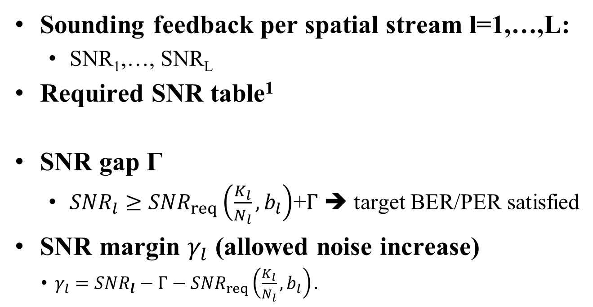
Evaluation Method Prerequisites
Sounding feedback per spatial stream l=1,…,L:
  SNR₁,…, SNR_{L}
Required SNR table¹
SNR gap Γ
  ${SNR}_{l}≥{SNR}_{req}\left(\frac{K_{l}}{N_{l}},b_{l}\right)$+$Γ$ ➔ target BER/PER satisfied
SNR margin $γ_{l}$ (allowed noise increase)
  $γ_{l}={SNR}_{l}−Γ−{SNR}_{req}\left(\frac{K_{l}}{N_{l}},b_{l}\right).$
SNR_{req}/dB | K/N=1/2 | K/N=2/3 | K/N=3/4 | K/N=5/6
B=1 | -0.94 | 0.87 | 1.83 | 3.06
B=2 | 2.06 | 3.87 | 4.84 | 6.06
B=4 | 7.60 | 9.89 | 11.05 | 12.45
B=6 | 12.20 | 15.09 | 16.48 | 18.10
B=8 | 16.47 | 20.05 | 21.73 | 23.59
B=10 | 20.60 | 24.92 | 26.92 | 29.06
B=12 | 24.64 | 29.73 | 32.08 | 34.54
¹The required SNR is derived for the AWGN channel with euqal SNR on each carrier. On the real channel, the SNR is different per carrier and a proper mapping to a single SNR per spatial stream is required.

Slide 25
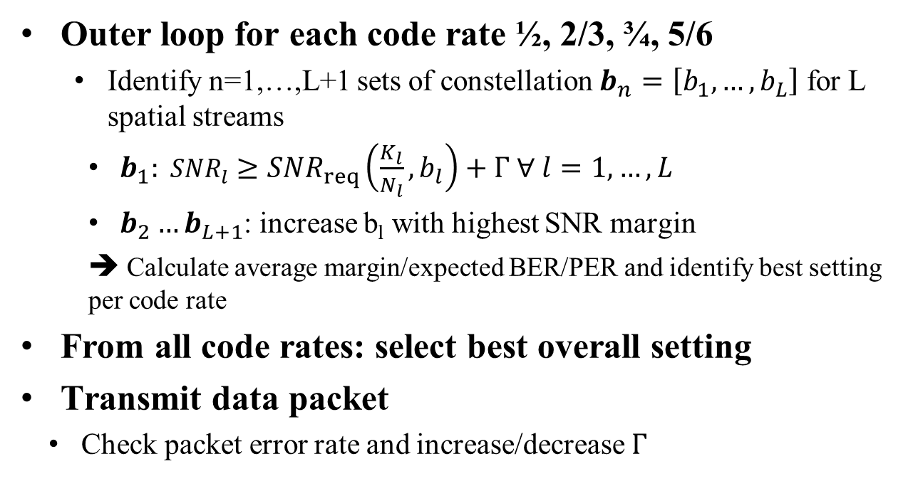
Evaluation Method
Outer loop for each code rate ½, 2/3, ¾, 5/6
  Identify n=1,…,L+1 sets of constellation $b_{n}=\left[b_{1},…,b_{L}\right]$ for L spatial streams
    $b_{1}: {SNR}_{l}≥{SNR}_{req}\left(\frac{K_{l}}{N_{l}},b_{l}\right)+Γ ∀ l=1,…,L$
    $b_{2}…b_{L+1}$: increase b_{l} with highest SNR margin
    ➔ Calculate average margin/expected BER/PER and identify best setting per code rate
From all code rates: select best overall setting
Transmit data packet
  Check packet error rate and increase/decrease $Γ$

Slide 26
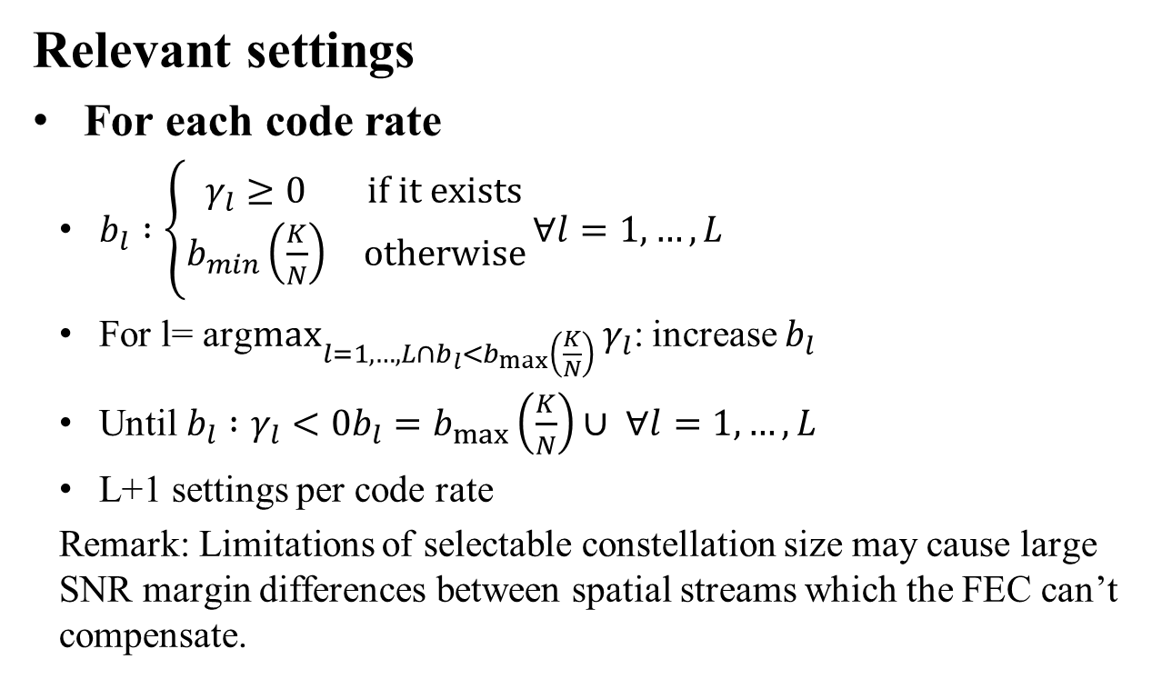
Evaluation Method (Reduced set)
SNR_{req}/dB | K/N=1/2 | K/N=2/3 | K/N=3/4 | K/N=5/6
B=1 | -0.94
B=2 | 2.06 |  | 4.84 | 6.06
B=4 | 7.60 |  | 11.05 | 12.45
B=6 |  | 15.09 | 16.48 | 18.10
B=8 |  |  | 21.73 | 23.59
B=10 |  |  | 26.92 | 29.06
B=12 |  |  | 32.08 | 34.54
Relevant settings
For each code rate
  $b_{l} :\left\{\begin{matrix}γ_{l}≥0 & if it exists \\ b_{min}\left(\frac{K}{N}\right) & otherwise\end{matrix}\right.∀l=1,…,L$
  For l= arg$\max_{l=1,…,L∩b_{l}<b_{max}\left(\frac{K}{N}\right)}{γ_{l}}$: increase $b_{l}$
  Until $b_{l} :γ_{l}<0b_{l}=b_{max}\left(\frac{K}{N}\right)∪ ∀l=1,…,L$
  L+1 settings per code rate
  Remark: Limitations of selectable constellation size may cause large SNR margin differences between spatial streams which the FEC can’t compensate.

Slide 27
Evaluation Method Example
No Limitations
Channel SNR: 20dB
Spatial streams: 1 or 2
1 stream: 2 streams
SNR_{req}/dB | K/N=1/2 | K/N=2/3 | K/N=3/4 | K/N=5/6
B | 10 | 8 | 8 | 6
γ | 3.2 | 3.7 | 2.0 | 5.6
BER | <1e-7 | <1e-7 | <1e-7 | <1e-7
Goodput | 4.99 | 5.33 | 5.99 | 4.99
B | 12 | 10 | 10 | 8
γ | -0.9 | -1.1 | -3.1 | 0.2
BER | 1.2e-1 | 2e-1 | 2e-1 | 2e-1
Goodput | 0 | 0 | 0 | 0
SNR_{req}/dB | K/N=1/2 | K/N=2/3 | K/N=3/4 | K/N=5/6
B | 10/4 | 8/2 | 6/2 | 6/2
γ | 0.2/1 | 0.7/4.7 | 4.1/3.7 | 2.7/2.5
BER | <1e-7 | <1e-7 | <1e-7 | 1e-6
Goodput | 6.99 | 6.66 | 5.99 | 6.62
B | 10/6 | 8/4 | 8/2 | 8/2
γ | 0.2/-3.6 | 0.7/-1.3 | -1/3.7 | -2.8/2.5
BER | 2e-1 | 2e-1 | 2e-1 | 2e-1
Goodput | 0 | 0 | 0 | 0
B | 12/6 | 10/4 | 8/4 | 8/4
γ | -3.9/-3.6 | -4.1/-1.3 | -1/-2.5 | -2.8/-3.9
BER | 2e-1 | 2e-1 | 2e-1 | 2e-1
Goodput | 0 | 0 | 0 | 0

Slide 28
Evaluation Method Example
Existing mcs+rate 2/3 with all const. sizes
Channel SNR: 20dB
Spatial streams: 1 or 2
1 stream: 2 streams
SNR_{req}/dB | K/N=1/2 | K/N=2/3 | K/N=3/4 | K/N=5/6
B | 4 | 6 | 8 | 6
γ | 16 | 8.7 | 2.0 | 5.6
BER | <1e-7 | <1e-7 | <1e-7 | <1e-7
Goodput | 1.99 | 3.99 | 5.99 | 4.99
B |  |  | 10 | 8
γ |  |  | -3.1 | 0.2
BER |  |  | 2e-1 | 2e-1
Goodput |  |  | 0 | 0
SNR_{req}/dB | K/N=1/2 | K/N=2/3 | K/N=3/4 | K/N=5/6
B | 4/4 | 8/2 | 6/2 | 6/6
γ | 13.1/1 | 0.7/4.7 | 15.9/3.7 | 4.3/3.7
BER | <1e-7 | <1e-7 | <1e-7 | 8e-2
Goodput | 3.99 | 6.66 | 5.99 | 0
B |  | 8/4 | 8/2 | 8/6
γ |  | 0.7/-1.3 | 9.7/3.7 | -1/3.7
BER |  | 2e-1 | 2e-1 | 2e-1
Goodput |  | 0 | 0 | 0
B |  | 10/4 | 8/4 | 10/6
γ |  | -4.1/-1.3 | 4.7/3.7 | -1/-2.5
BER |  | 2e-1 | 2e-1 | 2e-1
Goodput |  | 0 | 0 | 0

Slide 29
Evaluation Method Example
Existing Settings
Channel SNR: 20dB
Spatial streams: 1 or 2
1 stream: 2 streams
SNR_{req}/dB | K/N=1/2 | K/N=2/3 | K/N=3/4 | K/N=5/6
B | 4 | 6 | 8 | 6
γ | 16 | 8.7 | 2.0 | 5.6
BER | <1e-7 | <1e-7 | <1e-7 | <1e-7
Goodput | 1.99 | 3.99 | 5.99 | 4.99
B |  |  | 10 | 8
γ |  |  | -3.1 | 0.2
BER |  |  | 2e-1 | 2e-1
Goodput |  |  | 0 | 0
SNR_{req}/dB | K/N=1/2 | K/N=2/3 | K/N=3/4 | K/N=5/6
B | 4/4 | 6/6 | 6/2 | 6/6
γ | 13.1/1 | 5.6/-6.5 | 15.9/3.7 | 4.3/3.7
BER | <1e-7 | 9e-3 | <1e-7 | 8e-2
Goodput | 3.99 | 0 | 5.99 | 0
B |  |  | 8/2 | 8/6
γ |  |  | 9.7/3.7 | -1/3.7
BER |  |  | 2e-1 | 2e-1
Goodput |  |  | 0 | 0
B |  |  | 8/4 | 10/6
γ |  |  | 4.7/3.7 | -1/-2.5
BER |  |  | 2e-1 | 2e-1
Goodput |  |  | 0 | 0

Slide 30
Simulation Parameters
Parameter | Value
TX/RX Antennas | 2/2, 4/2 or 4/4
Spatial streams | 1 to 4 (optimized)
Bandwidth | 160 MHz
AP TX Power | 21 dBm
Channel model | B LOS or D NLOS [8]
Code rates | ½, 2/3, ¾, 5/6
Cconstellation size | 1,2,4,6,8,10 12 bit
Frequency | 5.25GHz
GI | 1.6µs
TX/RX SNR | 40dB/42dB
Channel aging/Doppler | 1.2km/h, 6Hz
BF quantization | ideal
Feedback carrier grouping | 16
Overhead | Sounding and MAC overhead not considered

