Slide 1
Analysis on UEQM and UEQ MCS
Date: 2024-03-04
Authors:
Name | Affiliation | Address | Phone | Email
Ross Jian Yu | Huawei |  |  | ross.yujian@huawei.com
Shiyue He
Anqi Wei
Wei Ruan
Mengyao Ma
Ying Li
Dan Wang
Ming Gan

Slide 2
Recap
In [1-3], a detailed description on cloud VR use case has been presented, which needs high requirement on Tput and latency. Moreover, two aspects regarding latency reduction have been presented:
QoS enhancement
Unequal error protection (multi-layer/coding transmission/unequal MCS, separate encoders)
Through simulations and analysis, we show that unequal MCS has the following benefits:
Take advantage of the channel selective gains (spatial domain and frequency domain).
Provide different protections for frames of different importance (spatial domain and frequency domain).
Good for interference environment, errors happened in one RU layer doesn’t affect the other RU (frequency domain UEQ MCS).
In [4-7], simulation results show the benefits of unequal modulation (UEQM, single encoder) over EQM in spatial domain.
Take advantage of the channel selective gains

Slide 3
UEQM vs UEQ MCS – Channel Selective Gains
We first show our results between UEQM and UEQ MCS. The simulation setup is the same as shown in [3].
We compare the following four cases:
MC-MIMO (UEQ MCS)
UEQM
SU-MIMO 4SS (with equal power)
SU-MIMO 3SS (with equal power)
SU MIMO 4SS with unequal power
SU MIMO 3SS with unequal power
Other parameters are the same as before: 4 Tx and 4 Rx, 20MHz channel
The simulations are based on real measured channels.

Slide 4
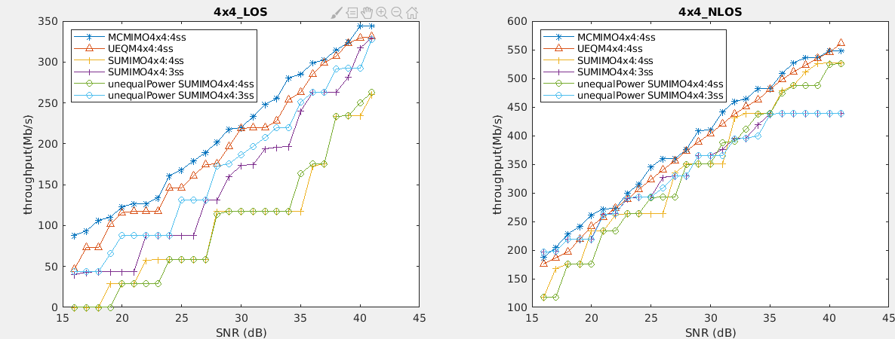
UEQM vs UEQ MCS – Channel Selective Gains
The results are shown below:
CN=40
CN=18
MC-MIMO (UEQ MCS) shows gain over UEQM through the SNR range of interest for the LOS case and most of the SNR range for the NLOS case.

Slide 5
UEQM vs UEQ MCS – Interference
Reliability, especially reliability when interference exists is an important factor to consider in 11bn.
Besides the channel selective gains, for UEQ MCS in frequency domain, as the encoders are independent in different RUs, the narrow band interference in one RU doesn’t affect the data in another RU.
The gains are shown in [3] and also pasted in the appendix of this slides for convenience.

Slide 6
UEQM vs UEQ MCS – Complexity
For UEQM, a single encoder and decoder is applied. For UEQ MCS, multiple encoders and decoders are applied.
From the AP side, UEQ MCS in frequency domain is like OFDMA, and UEQ MCS in spatial domain is like MU-MIMO.
From the non-AP STA side, UEQ MCS requires new capabilities like the AP to handle multiple PSDUs are needed.
Worth to have considering the further gains of UEQ MCS
If some vendor does have concern, can make this feature at the non-AP STA side optional.

Slide 7
Summary
In this presentations, we show more results and analysis of UEQ MCS, and show its further advantage over UEQM and EQM.

Slide 8
Straw Poll 1
Do you agree to include the following into the 11bn SFD?
11bn defines unequal MCS in spatial domain.
Different modulation orders and rate combinations in different spatial streams
Y
N
A

Slide 9
Straw Poll 2
Do you agree to include the following into the 11bn SFD?
11bn defines unequal MCS in frequency domain.
Separate modulation orders and rate combinations in different resource units
Y
N
A

Slide 10
Reference
[1] 11-22-0952-00-0wng-cloud-vr-use-case-and-requirements
[2] 11-22-1930-00-0uhr-layered-qos-and-multi-layer-transmission
[3] 11-23-0060-02-0uhr-layered-qos-and-multi-layer-transmission-follow-up
[4] 11-24-0016-01-00bn-uhr-mimo-rvr-enhancement-with-unequal-modulation
[5] 11-24-0113-01-00bn-unequal-modulation-in-mimo-txbf-in-11bn
[6] 11-24-0117-01-00bn-improved-tx-beamforming-with-ueqm
[7] 11-24-0176-01-00bn-unequal-modulation-over-spatial-streams

Slide 11
Appendix

Slide 12
Simulation setup – MC-MIMO vs SU-MIMO – 4T4R
In previous simulations, we show the comparison of 4Tx, 4Rx, 4SS transmission between MC (Multiple Coding)-MIMO vs SU-MIMO where MC code can apply different MCS on different streams. Different PSDU are transmitted in different streams. The MC-MIMO shows at least 10%~15% gain over SU-MIMO.
We receive the following comments regarding the simulations:
For baseline SU-MIMO, 3SS sometimes can achieve higher Tput than 4SS for a 4Tx, 4Rx transmission.
With unequal power allocation (waterfilling), the baseline SU MIMO can achieve better performance.
Hence in this simulation, we compare the following four cases:
MC-MIMO
SU-MIMO 4SS (with equal power)
SU-MIMO 3SS (with equal power)
SU MIMO 4SS with unequal power*
SU MIMO 3SS with unequal power*
Other parameters are the same as before: 4 Tx and 4 Rx, 20MHz channel
The simulations are based on real measured channels.
*With unequal power allocation, the transmit power imbalance of each antenna increases. The power of some RF channels may exceeds a preset value, and the power of some channels is not fully used.

Slide 13
Simulation results – MC-MIMO vs SU-MIMO – 4T4R
X-axis: channel SNR, Y-axis: Tput
MC-MIMO still shows obvious gain over baseline SU-MIMO through the SNR range of interest for the LOS case and most of the SNR range for the NLOS case.

Slide 14
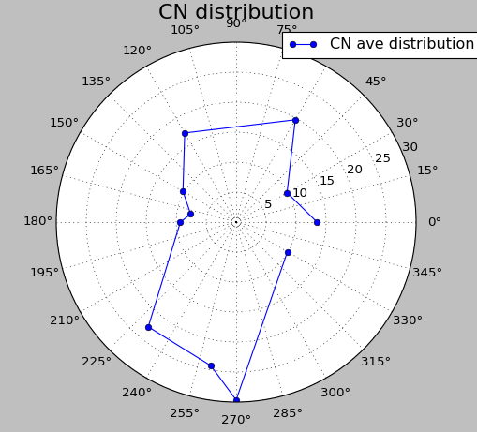
Simulation setup – MC-MIMO vs SU-MIMO – 2T2R
We received further comments to show the performance for 2SS case.
We further compare the following three cases:
MC-MIMO 2SS
SU-MIMO 2SS (with equal power)
SU-MIMO 1SS (with equal power)
Other parameters are the same as before: 2 Tx and 2 Rx, 20MHz channel
The simulations are based on a real channel. Three directions with different condition number (CN) number are chosen:

Slide 15
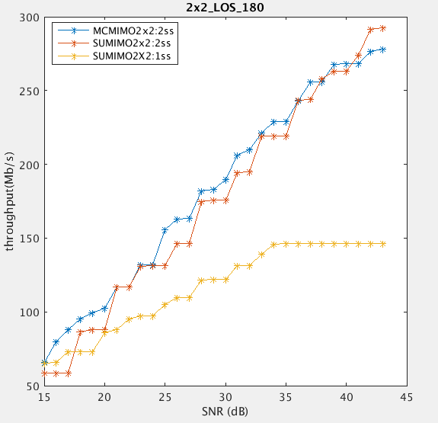
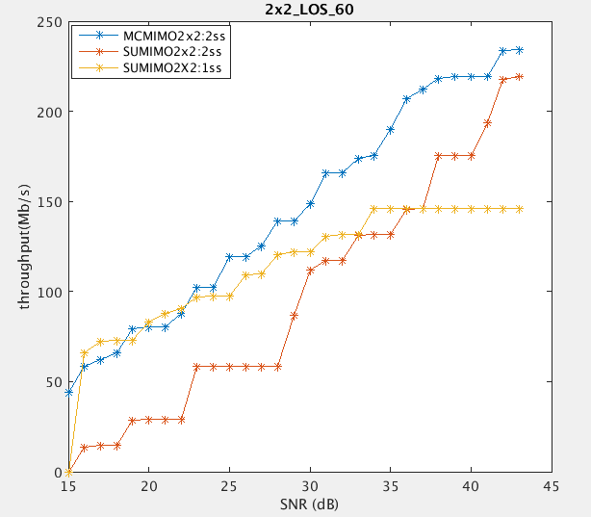
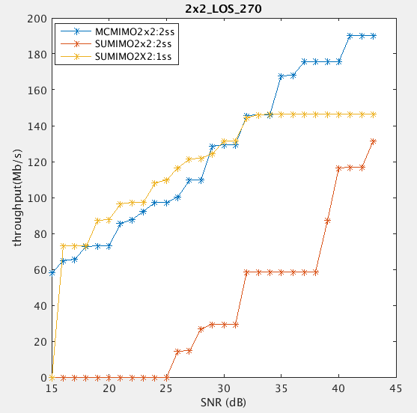
Simulation results – MC-MIMO vs SU-MIMO – 2T2R
CN: 4.8
CN: 20
CN: 30
X-axis: channel SNR, Y-axis: Tput
MC-MIMO still shows obvious gain over baseline SU-MIMO.

Slide 16
Simulation setup – MC-MIMO vs SU-MIMO – 4T2R
We received further comments to show the performance for 2SS case.
We further compare the following three cases:
MC-MIMO 2SS
SU-MIMO 2SS (with equal power)
SU-MIMO 1SS (with equal power)
Other parameters are the same as before: 4 Tx and 2 Rx, 20MHz channel
The simulations are based on a real channel. Three directions with different CN number are chosen: 5, 10, 15.

Slide 17
Simulation results – MC-MIMO vs SU-MIMO – 4T2R
CN=5
CN=10
CN=15
X-axis: channel SNR, Y-axis: Tput
MC-MIMO shows gain over baseline SU-MIMO when CN is 10 or 15, whilst usually CN<10. In general, no obvious gain.

Slide 18
Simulation setup – Independent coding MRU vs joint coding RU/MRU
Simulation results for interference environment are also provided.
The total bandwidth is 80 MHz, AWGN channel. The Power RSSI is -50dBm. The interference is added to the upper 40 MHz (defined as RU 1). The interference occupies 50% and 90% of the total time respectively.
Three cases are compared:
SU case: joint coding over the whole bandwidth, following the current procedure
SU Punc case: joint coding over the non-interfered potion of the total bandwidth (lower 40 MHz, defined as RU 0). More accurately, this is a smaller bandwidth transmission.
MRU case: independent coding MRU case, the data is encoded separately in RU 0 and RU1.
1T1R. Throughput is optimized regarding all supported MCSs.
Interference
Upper 40 MHz, RU 1
Lower 40 MHz, RU 0

Slide 19
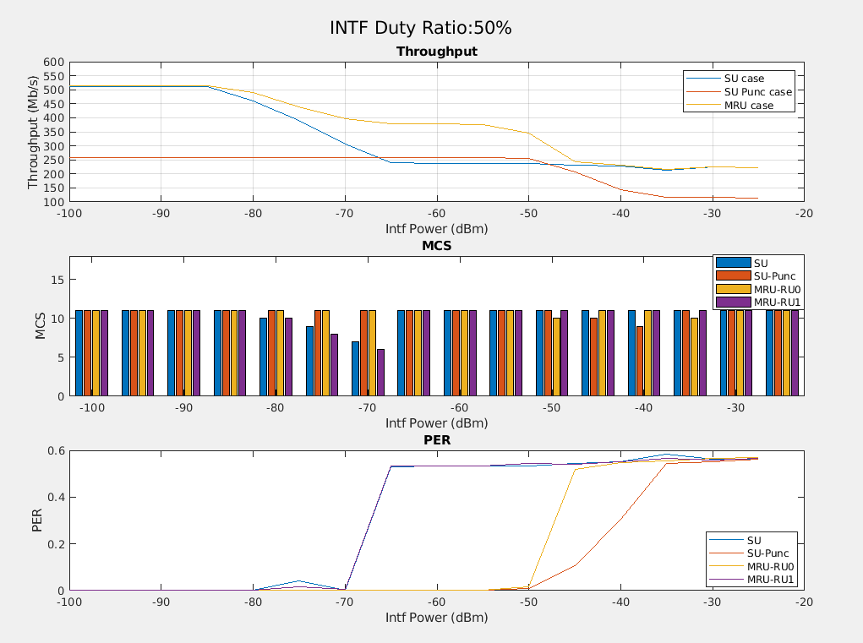
Simulation results – Independent coding MRU vs joint coding RU/MRU
Independent coding MRU case shows obvious throughput gain compared with SU case and SU punc case.

Slide 20
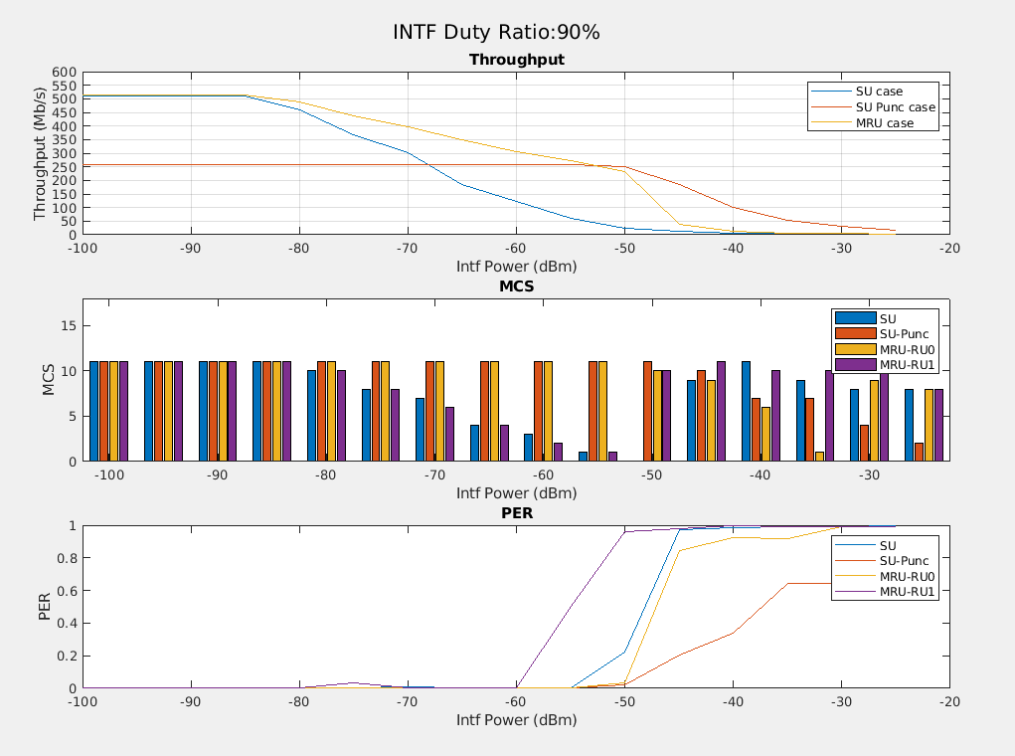
Simulation results – Independent coding MRU vs joint coding RU/MRU
Independent coding MRU case shows obvious throughput gain compared with SU case and SU punc case.

