Slide 1
Enabling Non-Primary Channel Access
Date: 2024-03-05
Authors:
Name | Affiliation | Address | Phone | Email
Dongju Cha | LG Electronics | 19, Yangjae-daero 11gil, Seocho-gu, Seoul 137-130, Korea |  | dongju.cha@lge.com
Insun Jang
 |  |  |  | insun.jang@lge.com
Jinsoo Choi
 |  |  |  | js.choi@lge.com
Hongwon Lee |  |  |  | hongwon.lge@lge.com
Sunhee Baek |  |  |  | sunhee.baek@lge.com
Geonhwan Kim |  |  |  | geonhwan.kim@lge.com
Yelin Yoon |  |  |  | yl.yoon@lge.com
Eunsung Park |  |  |  | esung.park@lge.com
Dongguk Lim |  |  |  | dongguk.lim@lge.com
Jinyoung Chun |  |  |  | jiny.chun@lge.com
Insik Jung |  |  |  | insik0618.jung@lge.com
HanGyu Cho |  |  |  | hg.cho@lge.com
Sanggook Kim |  | 10225 Willow Creek Rd, San Diego, CA, USA |  | sanggook.kim@lge.com

Slide 2
Introduction
In the previous contributions, Non-Primary Channel Access (NPCA) mechanism has been discussed widely for efficient wide bandwidth utilization in 11bn [1]~[9]
Basically, many contributions consider STA(s) switches to the Non-Primary Channel (NPCH) when the PCH is BUSY due to OBSS traffic
However, STA(s) having capability for Non-Primary Channel Access (NPCA) shall switch to non-primary channel (NPCH) when primary channel is BUSY due to OBSS PPDU may not be proper in some cases (next slide)

Slide 3
Improper Case for Switching to the NPCH
Even though the PCH is BUSY due to the OBSS traffic, it is not proper to switch to the NPCH in the following cases,
All of the STA(s) associated with AP having capability for NPCA are not capable for NPCA
Occupied channel of the OBSS TXOP is overlapped with the NPCH that STA(s) contends
Basic NAV may be too short for the STA(s) to obtain the TXOP on the NPCH
Besides this, STA(s) may not willing to switch to the NPCH intentionally for the purpose of power saving, QoS requirement, and etc.
For these intentional operation, we propose STA(s) having capability for NPCA to enable or disable the operation of NPCA

Slide 4
NPCA Mode Indication
NPCA Mode: A mode of operation that allows STA(s) having capability for NPCA to switch to the NPCH when the PCH is BUSY due to the OBSS PPDU
STA(s) having capability for NPCA can enable or disable its NPCA Mode and it needs to be announced by an AP and indicated by a non-AP STA
With this,
STA(s) can guarantee that the recipient STA is performing NPCA when Basic NAV is set on the primary channel due to OBSS PPDU
STA(s) can set enable/disable its NPCA Mode depending on its intention (e.g., For the purpose of power saving, QoS requirement, or etc.)

Slide 5
NPCA Mode Indication (Cont’d)
With indicated NPCA Mode,
On AP side,
AP switches to the NPCH and initiates TXOP to the non-AP STA that indicates its NPCA Mode to be enabled
If all the non-AP STAs set the NPCA Mode to be disabled, AP does not switch to the NPCH regardless of its NPCA Mode
Or, AP may set its NPCA Mode to be disabled
On non-AP STA side,
When AP announces its NPCA Mode to be enabled, non-AP STA that enables its NPCA Mode can switch to the NPCH and initiates TXOP to the AP
If AP announces its NPCA Mode to be disabled, non-AP STAs does not switch to the NPCH regardless of its NPCA Mode
Or, non-AP STAs may set its NPCA Mode to be disabled

Slide 6
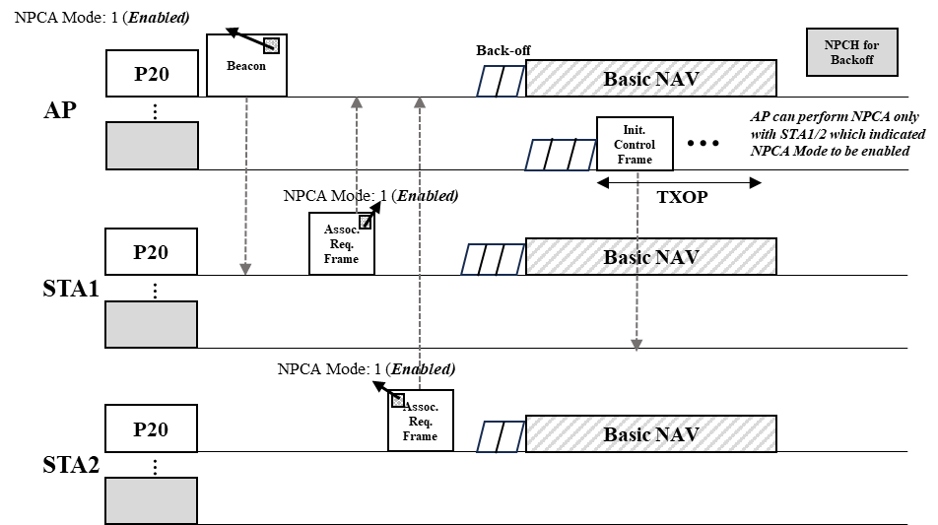
Example of Announcing/Indicating NPCA Mode
AP and STA(s) that are capable for NPCA shall indicates whether it would perform NPCA when Basic NAV is set on the primary channel through NPCA Mode (e.g., set to 1 to indicate enabled, otherwise set to 0)
NPCA Mode can be carried in existing management frame (E.g., AP announces its NPCA Mode through Beacon frame)
STA(s) receiving NPCA Mode of AP indicates its NPCA Mode to notify AP that each STA(s) would switch to the NPCH or not
When NPCA Mode of AP is enabled, AP switches to the NPCH and initiate TXOP to STA(s) indicating NPCA Mode to be enabled
When NPCA Mode of AP is disabled, STAs do not switch to the NPCH regardless of its NPCA Mode

Slide 7
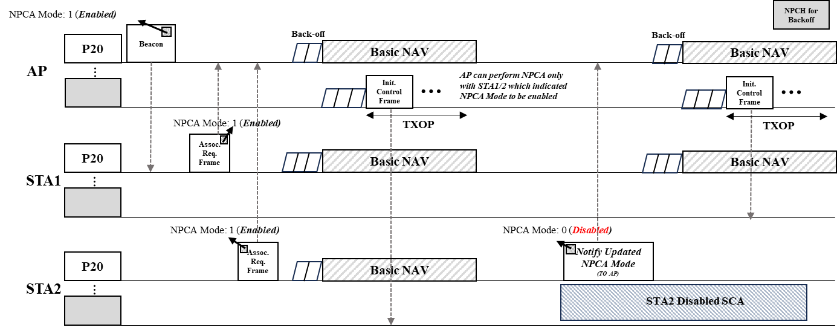
Example of Updating NPCA Mode
STA(s) can update its NPCA Mode based on its intention (e.g., QoS requirement or power saving)
In the beginning all STAs (e.g., STA1/STA2) enabled its NPCA Mode, so it switches to the NPCH when the PCH is BUSY due to the OBSS PPDU
After a while, STA2 notifies AP that it would update its NPCA Mode to be disabled
Updated NPCA Mode can be carried in QoS Data, BA frame or newly defined action frame (e.g., NPCA Mode Notification frame)
AP receiving updated NPCA Mode of the STA2 can notify that STA2 would not switch to the NPCH
AP performs NPCA only w/ STA1 which enabled its NPCA Mode

Slide 8
Conclusion
In this contribution, we’ve proposed NPCA Mode Indication and examples of indicating and updating NPCA Mode to notify whether STA(s) would switch to the NPCH when the PCH is BUSY due to the OBSS PPDU

Slide 9
Reference
[1] 23/1112r0, Thoughts on Secondary Channel Access
[2] 23/1911r0, Secondary Channel Access and Frame Transmission
[3] 23/034r1, Non-primary Channel Utilization
[4] 23/1444r1, Non-primary channel access evaluations_followup
[5] 23/1419r0, Nonprimary channel access discussions
[6] 23/1365r0, Discussions on Non-primary Channel Access
[7] 23/797r0, Non-primary channel access
[8] 23/1288r0, Non-primary Channel Utilization Follw-up
[9] 23/1414r0, secondary channel usage follow up

Slide 10
SP1
Do you agree to include the following into the 11bn SFD?
STA(s) shall not switch to the non-primary channel when the non-primary channel that STA(s) performs channel access is overlapped with occupied channel of the OBSS PPDU?

Slide 11
SP2
Do you agree to include the following into the 11bn SFD?
non-AP STA that is capable of NPCA shall indicate whether it enables or disables the operation of NPCA
Detailed signaling is TBD

Slide 12
SP3
Do you agree to include the following into the 11bn SFD?
AP that is capable of NPCA shall announce whether it enables or disables the opeartion of NPCA
Detailed signaling is TBD

Slide 13
SP4
Do you agree to include the following into the 11bn SFD?
non-AP STA that is capable of NPCA shall not switch to the non-primary channel when it recognizes that AP announces its operation of NPCA to be disabled

Slide 14
SP5
Do you agree to include the following into the 11bn SFD?
AP that is capable of NPCA shall not switch to the non-primary channel when it recognizes that all of the associated non-AP STAs that are capable of NPCA indicate its operation of NPCA to be disabled

