Slide 1
Target STA Prioritization in EDCA-based Preemption Mechanisms during a DL TXOP
Date: 2024-04-22
Authors:

Slide 2
Background (1/2)
Preemption
Preemption is one of solutions to support low latency (LL) applications [1]
Some techniques for preemption have been contributed [2-3]
Among the techniques, an EDCA-based preemption mechanism to handle aperiodic LL traffic was discussed [3]
This document proposes to prioritize the LL data transmission of target STA (i.e., TXOP responder) in DL TXOP based on the EDCA-based preemption mechanism

Slide 3
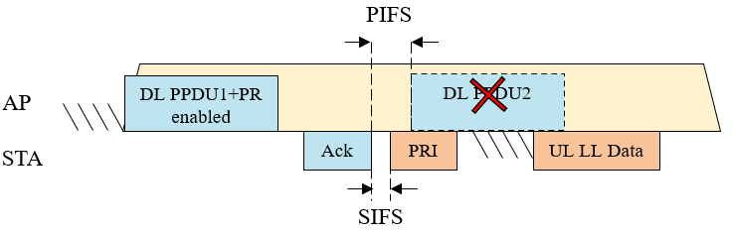
Background (2/2)
EDCA-based Preemption Mechanisms in [3]
Solution for UL LL Traffic arriving during a DL TXOP
  AP sends a preemption enabled (PR) indication to LL STAs and will perform the next DL PPDU transmission PIFS after the BA in case no associated STA sends a preemption indication (PRI)
  LL STAs can send a PRI within PIFS (e.g. SIFS after the BA) and then start contending by ignoring the NAV set by the AP in previous frames
Target STA (i.e., TXOP responder) of DL TXOP joins as one of LL STAs if UL LL Data transmission is required
  Target STA sends ACK as response to DL PPDU1
  Target STA can send a PRI within PIFS and then start contending with other LL STAs for preemption

Slide 4
Motivation
UL LL Data Transmission of Target STA without Contention
Target STA is a potential UL LL STA in EDCA-based mechanisms
Target STA transmission could be failed because of collision or other transmissions
- Because target STA contends with other UL LL STAs after PRI
- If the transmission of target STA is collided with other transmissions, target STA fails to send its data
- If one of other UL LL STA sends its LL data earlier than target STA, target STA fails to send its data
If target STA can be prioritized,
- Target STA can send its data without contention
- DL TXOP can be used more efficiently because target STA does not need to contend with others
. Target STA : LL data transmission without contention
. Other LL STAs : Contention without target STA if TXOP is not exhausted

Slide 5
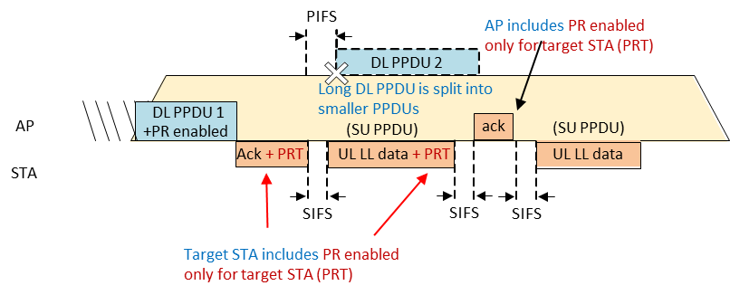
Proposal
Target STA Prioritization in EDCA-based Preemption during DL TXOP
EDCA-based mechanism [3] is the baseline operation
- e.g., if target STA has no LL data, the operation is same as in [3]
If target STA has LL data, response (ACK) to < DL PPDU 1 + PR enabled > includes PRT (PRI only for Target STA) and UL LL data can be sent after SIFS
- Other LL STAs shall not send PRI if PRT is included in the response (i.e., ACK frame of target STA)
If target STA needs to send an additional LL data, UL LL data includes PRT
If TXOP is not exhausted, AP may includes PRT if UL LL data with PRT is received
- Otherwise, AP may includes PR enabled as in [3]

Slide 6
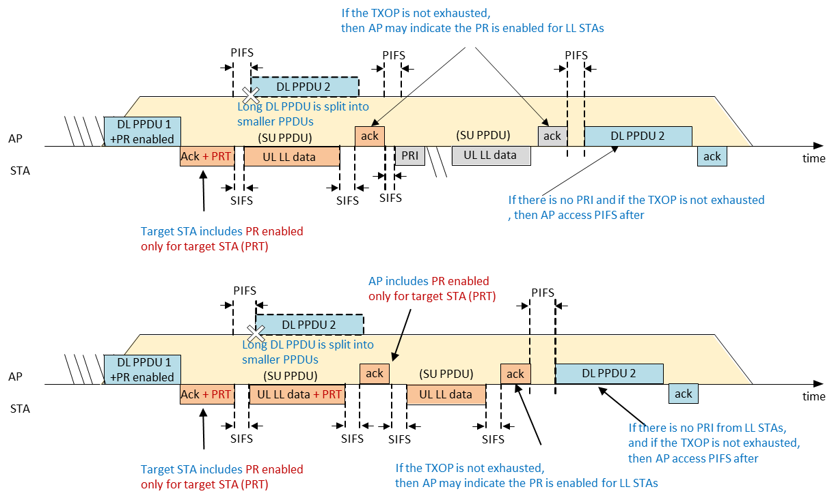
Examples for Target STA Prioritization in EDCA-based Preemption Mechanisms during a DL TXOP

Slide 7
Summary
Target STA prioritization in EDCA-based preemption is proposed
Proposal enhances the overall efficiency of DL TXOP preemption
  Target STA can send UL LL data without contention
  Contention can be slightly weakened by omitting target STA from the total # of LL STAs
If preemption mechanism in a DL TXOP in 11bn is considered, target STA prioritization with EDCA-based preemption can be discussed further

Slide 8
References
[1] 11-23/0092, Preemption
[2] 11-23/798, Preemption-for-low-latency-application-follow-up
[3] 11-23/1886, Preemption-techniques-to-meet-low-latency-ll-targets

