Slide 1
Seamless Roaming Procedure Follow-Up
Date: 2024-05-14
Authors:
Name | Affiliation | Address | Phone | Email
Yelin Yoon | LG Electronics | 19, Yangjae-daero 11gil, Seocho-gu, Seoul 137-130, Korea |  | yl.yoon@lge.com
Insun Jang
 |  |  |  | insun.jang@lge.com
Hongwon Lee
 |  |  |  | hongwon.lee@lge.com
Jinsoo Choi
 |  |  |  | js.choi@lge.com
Sunhee Baek |  |  |  | sunhee.baek@lge.com
Geonhwan Kim |  |  |  | geonhwan.kim@lge.com
Dongju Cha |  |  |  | dongju.cha@lge.com
HanGyu Cho |  |  |  | hg.cho@lge.com
Sanggook Kim |  | 10225 Willow Creek Rd, San Diego, CA, USA |  | sanggook.kim@lge.com

Slide 2
Re-cap
In the previous meeting, we introduced an MLD based architecture for seamless roaming and the procedure based on the introduced architecture. [3]
We have defined a new AP MLD where its UMAC manages the functionalities that are required for roaming and to be shared among the AP MLDs.

Slide 3
Introduction
In Seamless Roaming, we have two different types of architecture
  An architecture that has a common UMAC among the AP MLDs for roaming [1] [2] [3] [7]
    The controls are centralized to the UMAC of the roaming MLD
    There is a single medium access control (MAC) and a single MAC service access point (MAC SAP) to the logical link control (LLC) sublayer
  Roaming Enhancement using the existing architecture [4] [5] [6] (especially, [5] the existing FT)
    This method may require a context transfer between the serving AP MLD to the target AP MLD
    Each AP MLD has its own MAC SAP
In this contribution, we want to compare two architectures and discuss how the roaming procedure varies depending on the architecture

Slide 4
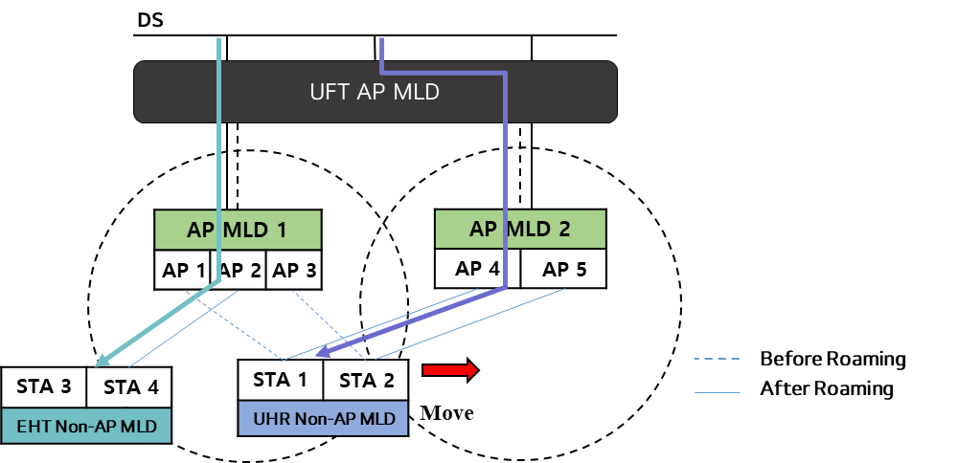
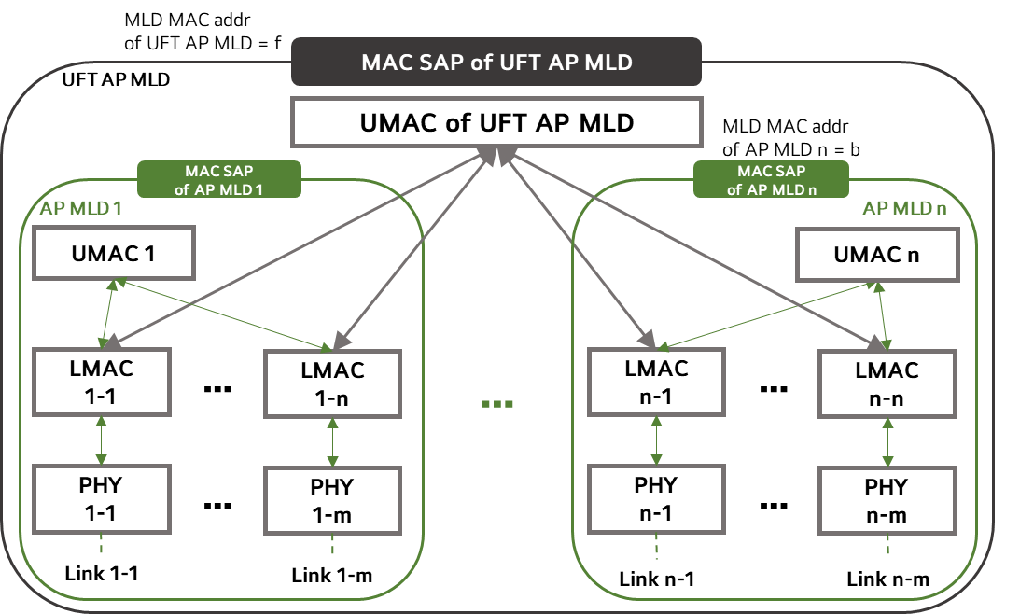
Roaming Architecture
(Without Context Transfer)
MLD based architecture
  An MLD based architecture has a common AP MLD upper MAC interfaced with all the AP MLDs that can perform a seamless roaming.
    UMAC of the UFT AP MLD controls all the UMAC functions required for seamless roaming
    Non-AP STA associates with the UFT AP MLD
    The UFT AP MLD has its own MAC SAP
    The UFT AP MLD has its unique MLD MAC address and it shall be announced in management frames
    ( e.g. beacon as in 11be)

Slide 5
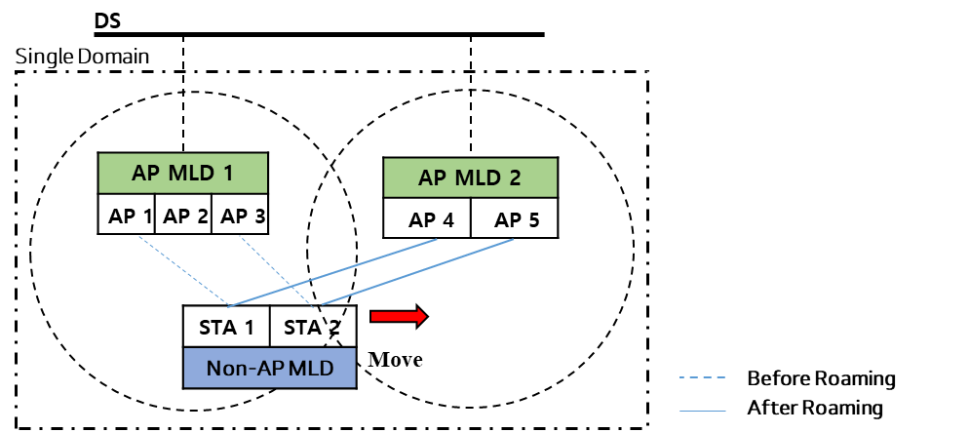
Roaming Architecture
(With Context Transfer)
To enable seamless roaming without changing the architecture, we may need to transfer some contexts between the Serving AP MLD and the Target AP MLD
  All AP MLDs in a Single Domain (called Single Mobility Domain) should be logically connected to maintain the Multi-Link Setup while roaming
  All AP MLDs are mapped to DS individually and the non-AP MLD associates with the AP MLD
  When a non-AP MLD roams from the serving AP MLD to the target AP MLD, it shall roam without re-authentication and re-association as stated in the Motion passed [8]
  We may need a logical entity connected with AP MLDs in a Single Domain to share the information among AP MLDs
  The security key should be shared among the AP MLDs in a same Single Domain
    A single MAC Address for a SMD

Slide 6
Roaming Signalling
Some signalling is required to trigger roaming which involves frame exchanges between the serving AP MLD/target AP MLD and the non-AP MLD
  A Roaming Request frame to trigger roaming
    Roaming can be triggered by both AP MLD and non-AP MLD
    It may include the request to add the link(s)
      Once the link is established, an Add Link Response is sent via an Add Link Response frame
  A Roaming Response Frame to notify the non-AP MLD that it is ready to roam
    In case the context transfer is performed, the Roaming Response frame is transferred after the context is transferred and the DS Mapping is switched to the target AP MLD
      It can also be used to confirm that the context transfer has been terminated
    In case the context transfer is not performed, the Roaming Response frame is transmitted once the UFT AP MLD accepts the Roaming Request

Slide 7
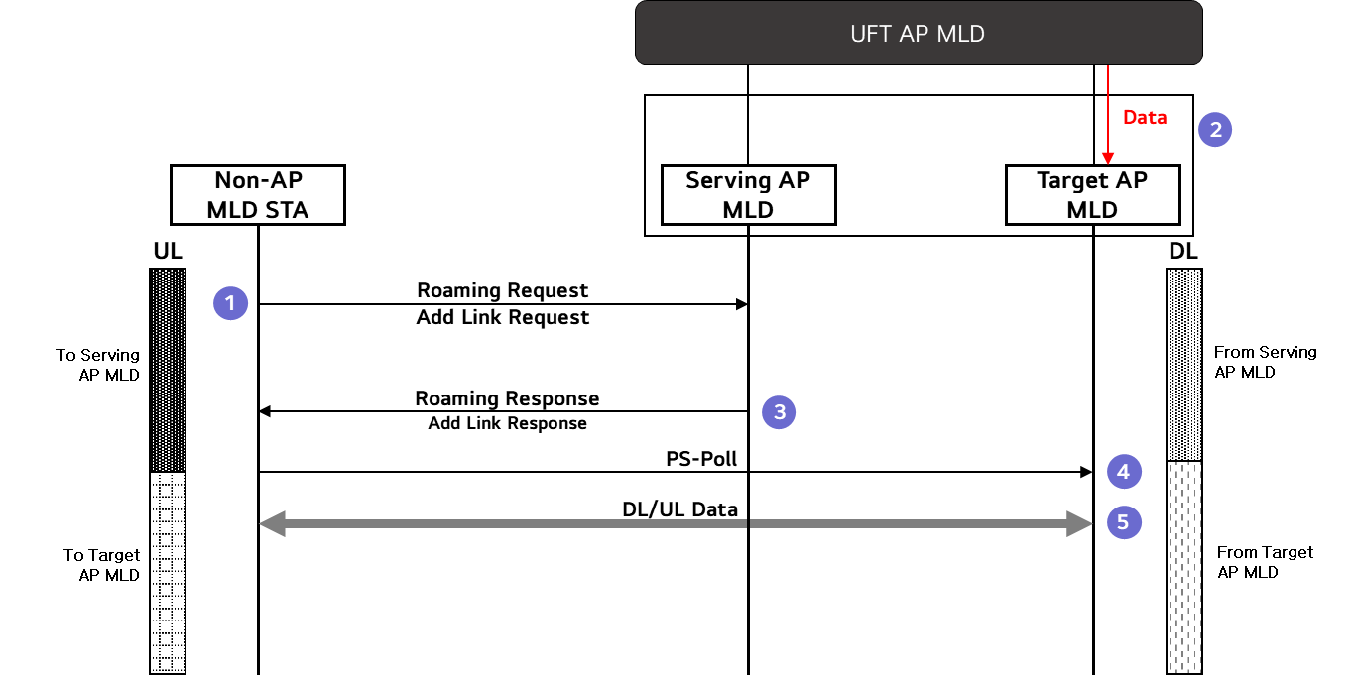
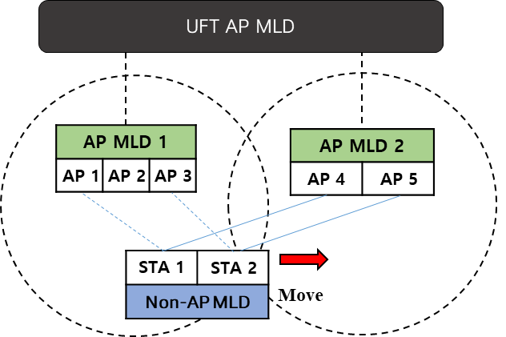
Roaming Procedure
(without Context Transfer)
Roaming controlled by the UFT AP MLD
  Once the non-AP MLD STA receives the Roaming Response indicating that the link with the Target AP MLD has been established, it sends a PS-Poll to wake up the Target AP MLD
  When the Target AP MLD is awake, the non-AP MLD can start the transmission of DL/UL data with the Target AP MLD
  As everything is being controlled by the UFT AP MLD, the non-AP MLD STA experiences almost no delay during roaming

Slide 8
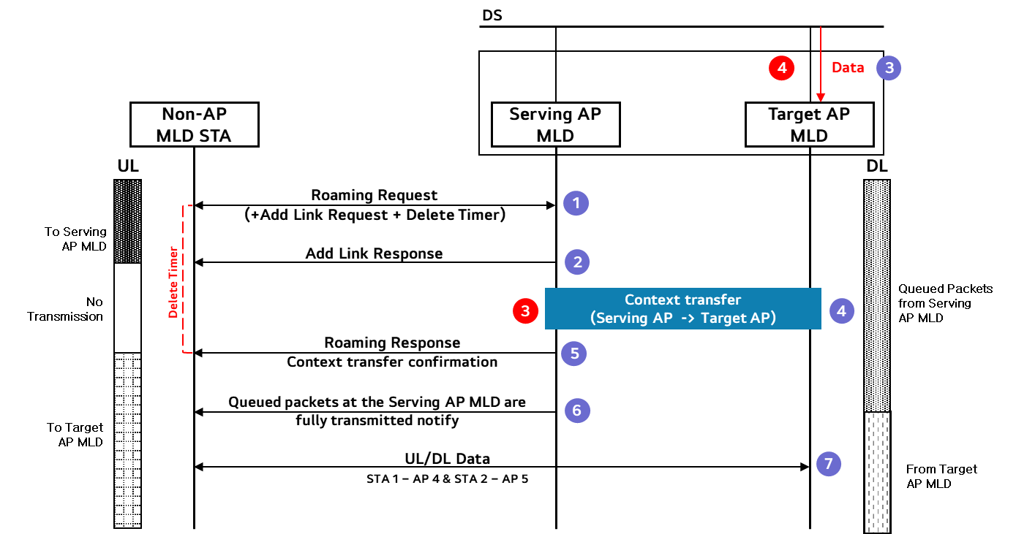
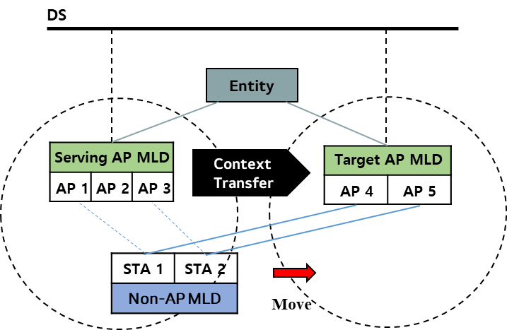
Roaming Procedure
(with Context Transfer)
Roaming Procedure with context transfer may vary depending on whether the links connected to the Serving AP MLD and the Target AP MLD are using the same channel or different channels
Same Channel Case
  If the links are on the same channel, DL/UL transmission with the Serving AP MLD can be performed simultaneously with the DL/UL transmission with the Target AP MLD
  There exists a moment where the UL transmission needs to be postponed until the Roaming Response is transmitted
* context transfer can be performed before the DS Mapping change or vice versa

Slide 9
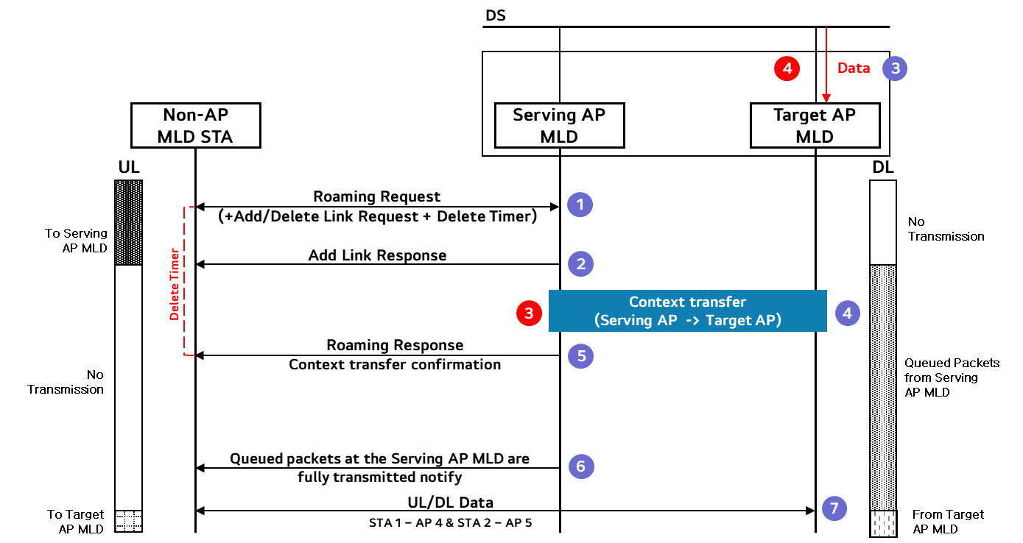
Roaming Procedure
(with Context Transfer)
Different Channel Case
  If the links are on different channels, UL/DL transmissions with the Serving AP MLD and the Target AP MLD cannot be done simultaneously
  The non-AP MLD STA experiences a greater delay in the UL transmission while receiving the queued packets from the Serving AP MLD

Slide 10
Roaming Procedure Discussion
 | MLD based architecture | Roaming with Context Transfer
Delay | Almost no delay | Some delay exists It may aggravate in a different channel case
Implementation complexity | Requires an architectural change The implementation may be more complex | Maintains the current architecture The implementation may be simpler
Security | Security key can be created in the Roaming MLD and shared to the affiliated AP MLDs | Security key shared via secure channel
MLD based architecture is the most preferred scenario as it has almost no delay which fulfills the purpose of the seamless roaming
  However, due to the architectural change, it may be difficult to implement it
  For the ease of implementation, we can use the context transfer based architecture but it may be beneficial to keep the door open to the MLD based architecture

Slide 11
Context Transfer Contents
The Context Transfer may cause much overhead depending on the load of the context. Hence, we want to give a degree of freedom for an non-AP MLD to choose what kind of contexts to be transferred.
The non-AP MLD and the AP MLD can negotiate what contexts will be transferred before the roaming gets triggered
  If nothing is selected, no context transfer is performed.
If the contents of the Context Transfer is not negotiated in advance, the AP MLD can inform what was transferred via the Context transfer and what needs to be negotiated/established after roaming in the Roaming Response frame
If there is no context transfer, it may be better to use the MLD based architecture

Slide 12
Conclusion
In this contribution, we have introduced
  Comparison of two architectures and the according procedures depending on the use of the same channel and the different channels
  The signalling for initiating roaming and to add and to delete the links
  The suggestion of varying the Context Transfer contents to minimize the delays caused by transferring too much context

Slide 13
Straw Poll #1
Do you agree to add the following text to the TGbn SFD?
  The definition of an Single Mobility Domain (SMD):
    A logical entity that consists of one or more AP MLD(s) that are non-collocated, within the same extended service set (ESS), that support a seamless roaming between themselves
    NOTE – The exact name can be changed

Slide 14
References
[1] 11-23/279 Considerations on Seamless Roaming
[2] 11-23/1090 Seamless Roaming Follow-up
[3] 11-23/1908 Seamless Roaming Procedure
[4] 11-24/0396 Seamless Roaming within a Mobility Domain –Follow Up
[5] 11-24/0349 Enhanced Fast BSS Transition
[6] 11-23/1937 Smooth Roaming Follow Up: Procedure and Signalling
[7] 24/0052 Seamless Roaming Details
[8] 24/1209 Specification Framework for TGbn

