Slide 1
QoS based Spatial Reuse
Authors:

Slide 2
Abstract
Simulations using pathloss and SNR measurements from real enterprise deployments demonstrate that Spatial Reuse degrades throughput for many of the APs and non-AP STAs in the deployments
However, modifying SR to allow for access category specific OBSS PD thresholds dramatically improves channel access for QoS sensitive flows, enabling use of wider channel bandwidth

Slide 3
Simulating Capacity based on REAL Enterprise Deployments – step 1
We collect AP-to-AP pathloss measurements between all these APs and also collect client SNR measurements in this deployment.
  Pathloss between APs is used to calculate interference OBSS links in the simulation. Client SNR data is used for intra-BSS links in the simulation.
  No 802.11 pathloss modeling is used, as we have found in the past that 802.11 pathloss models to not accurately model many enterprise deployments.
A professional tool is used to generate a channel number and EIRP for all the APs in a real Enterprise deployment based on desired bandwidth.

Slide 4
Simulating Capacity based on REAL Enterprise Deployments – step 2
PHY Layer link simulation was developed to estimate system capacity assuming a certain traffic load/utilization
  CCA is modelled for channel access. If OBSS signal is above the CCA PD level when a STA is attempting to transmit, channel access is blocked for the STA
  Data rate is computed based on SINR. If the SINR is below that required for MCS 0, the link fails.
  Traffic load is modeled by a random probability that a STA attempts to transmit.
  Physical Layer throughput is computed at each AP in terms of a distribution across all clients in the BSS.
  PHY Layer throughput is multiplied by 0.5 to approximate 50% IP and Medium Access Control layer efficiency (i.e. TCP/IP and 802.11 MAC). This is called “Goodput”
  We then look at the median goodput and worst 5%-ile goodput for each AP, for a particular offered traffic load
    This models the average client performance in a BSS and a bad/edge client performance in a BSS
  We collect statistics on blocked links and failed links, which provide an abstraction for latency/jitter
The simulation has been verified against real deployments, and has proven to accurately model throughput.

Slide 5
Simulating Capacity based on REAL Enterprise Deployments – step 3
To investigate Spatial Reuse, we run the simulation with different OBSS PD levels.
  Default CCA PD Threshold is -92 dBm (estimate of typical signal detection level).
  We compare goodput for each AP when changing OBSS PD level from -92 dBm to other levels

Slide 6
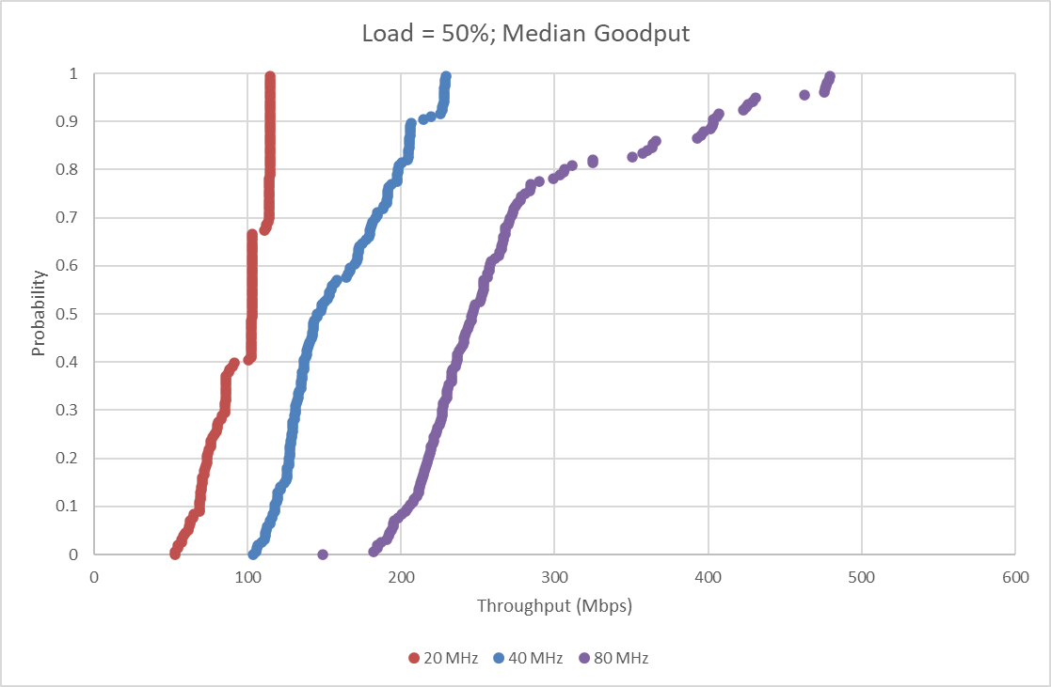
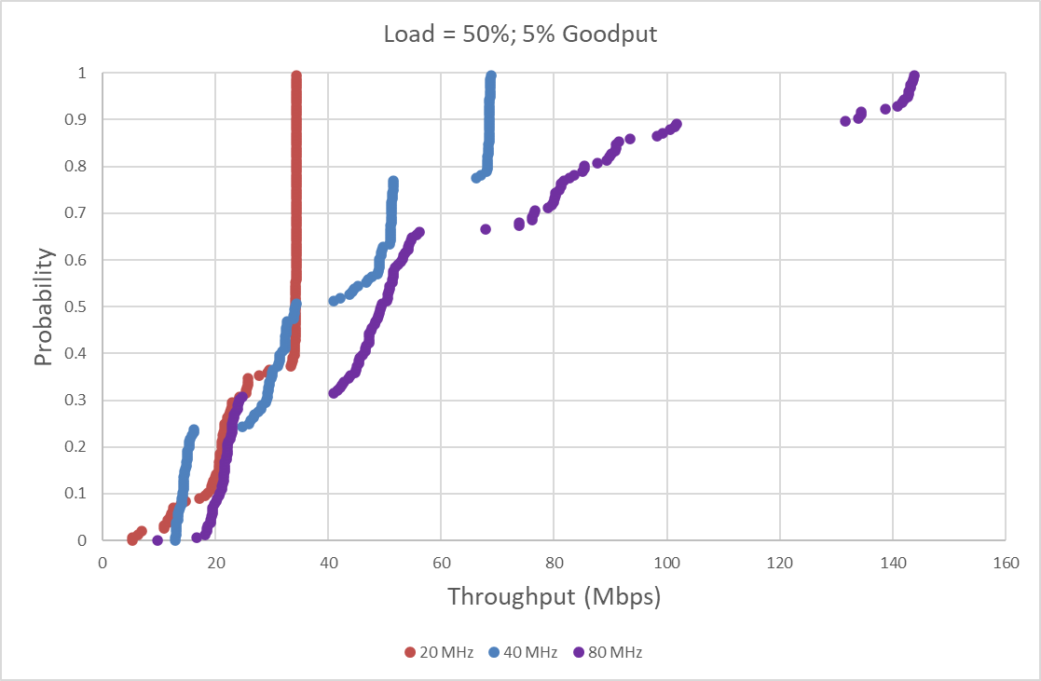
Corporate Office Building
The first data set was collected from a corporate office building. The deployment consists of four floors with over 150 APs
We run the simulation for 20, 40, and 80 MHz channel bandwidths. We model a busier period with traffic load of 50%
Each “dot” in the graph represents the throughput of a BSS
Simulations indicate that 80 MHz channel bandwidth results in highest median and 5% BSS throughput
  That said, corporate IT chose 40 MHz.

Slide 7
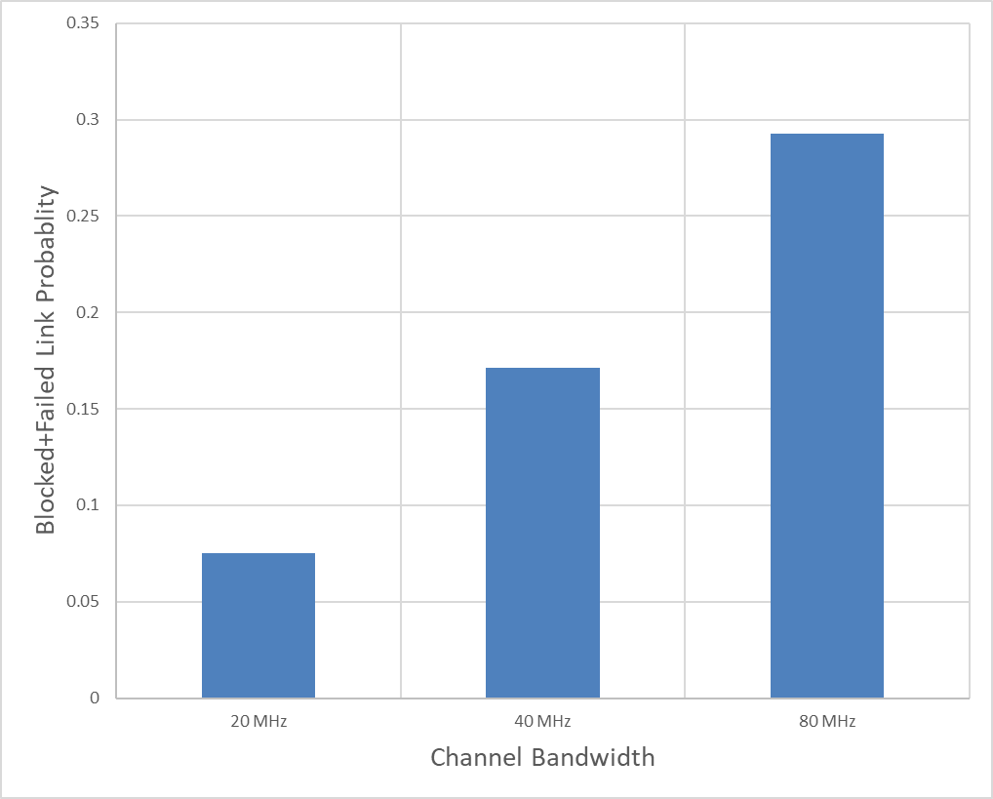
Quality of Service
In addition to throughput, we collect blocked link and failed link statistics to model latency/jitter
As expected, with increased channel bandwidth and increased frequency reuse, the probability of links being blocked or failing due to interference increases
Corporate IT chose 40 MHz as a balance between throughput and quality of service

Slide 8
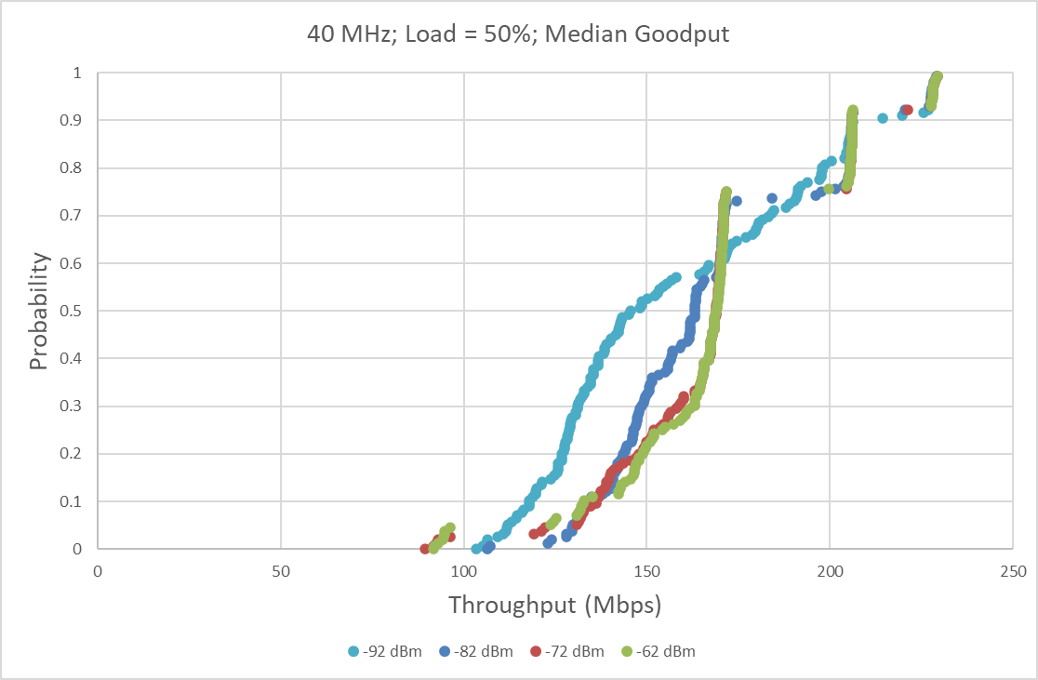
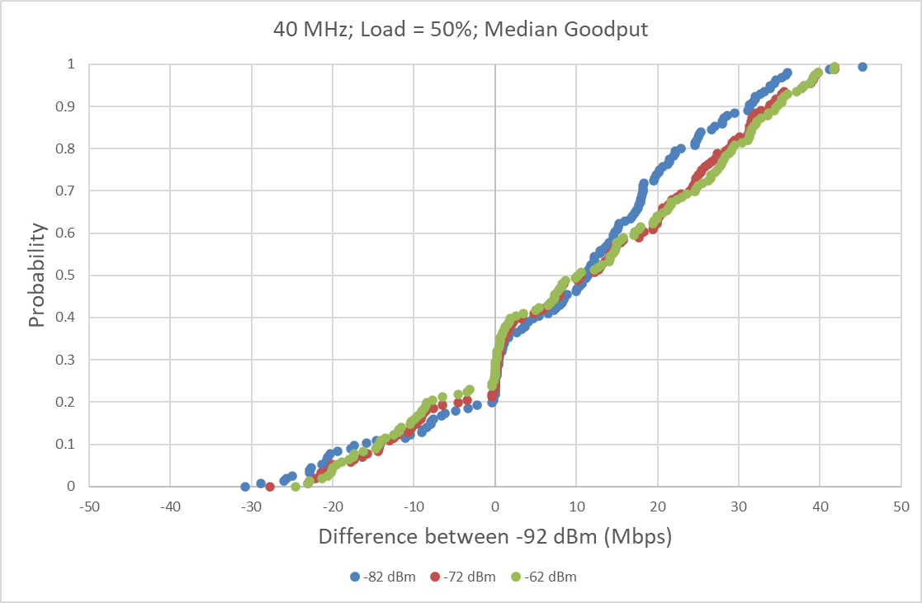
Spatial Reuse
Can we increase throughput/system capacity with SR?
We rerun the simulation with OBSS PD level increased to -82, -72, -62 dBm. All STAs are transmitting at EIRP levels below threshold for PD level of -62 dBm
From the bottom left plot, the CDF lines cross each other and it is difficult to tell if there is improvement with SR. Alternatively, for each BSS we calculate the difference in throughput between the SR OBSS PD level and the baseline of -92 dBm. This is the bottom right plot.
Not much difference between -82, -72, and -62 dBm. In addition, with median BSS throughput, SR resulted in worse throughput for 20% of the BSS’s

Slide 9
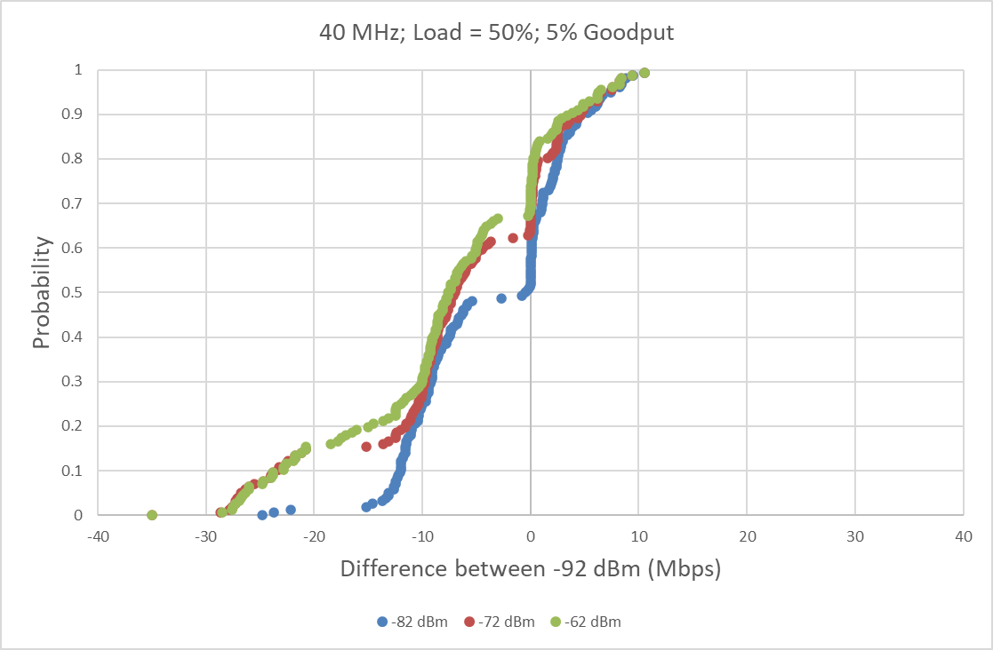
Performance of “Clients at Edge of BSS”
We also collect 5th percentile BSS throughput statistics as a model for performance of clients at the edge of a BSS
With OBSS PD level of -82 dBm, 50% of the BSS are worse off. With -72 and -62 dBm this increases up to 70%
This indicates that SR will substantially impact the worse off clients

Slide 10
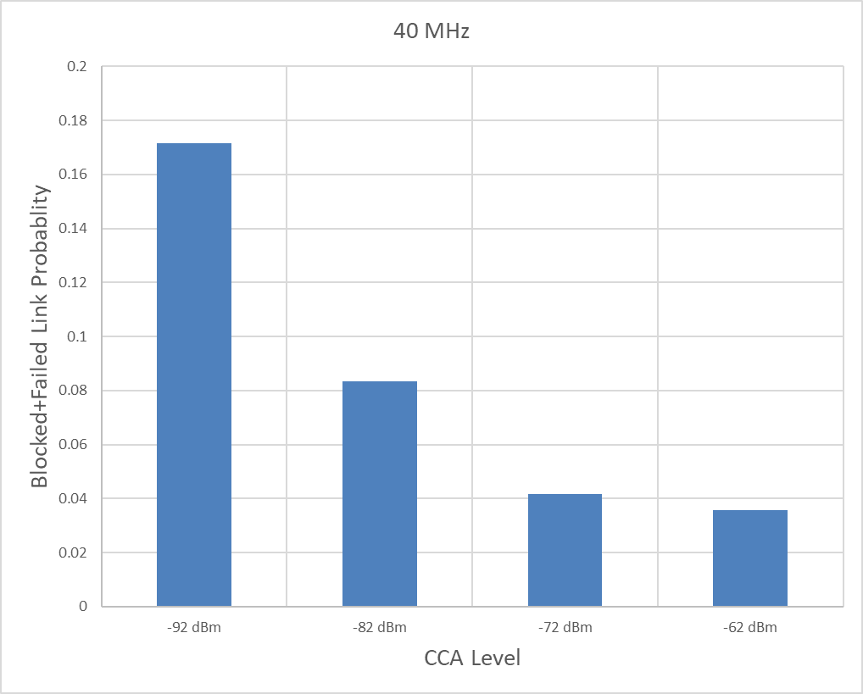
Quality of Service with SR
On the other hand, we see that the probability of links being blocked or failing decreases with increasing OBSS PD level

Slide 11
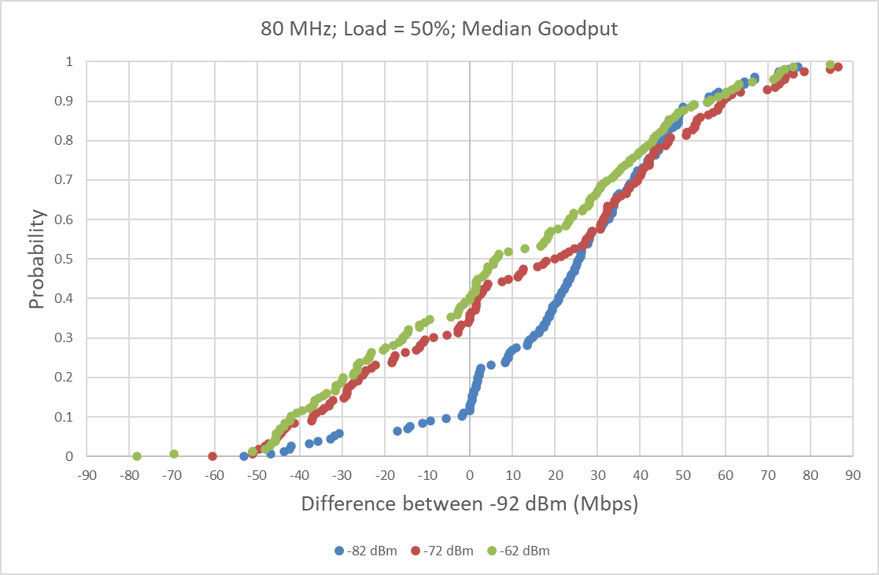
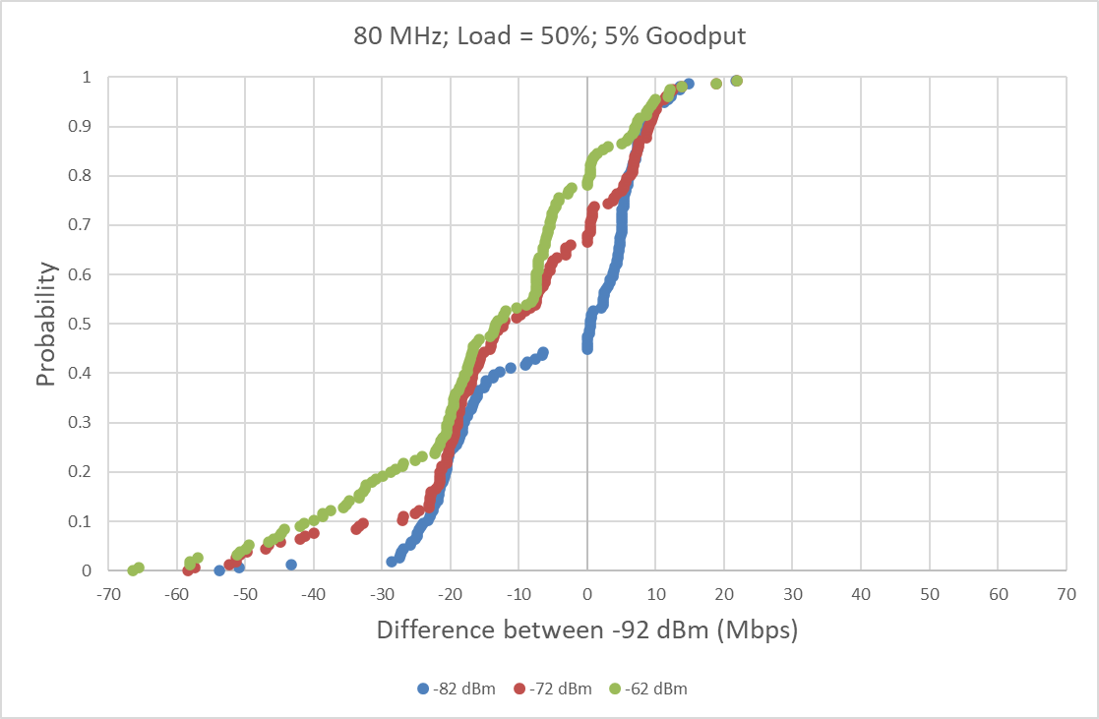
Revisiting 80 MHz Channel Bandwidth
Given the lessons learned from 40 MHz, could SR be used to increase channel bandwidth?
With the plots below, SR behaves similarly with 80 MHz as with 40 MHz
However with 80 MHz, the gain from switching from 40 MHz to 80 MHz more than offsets the loss in throughput from SR

Slide 12
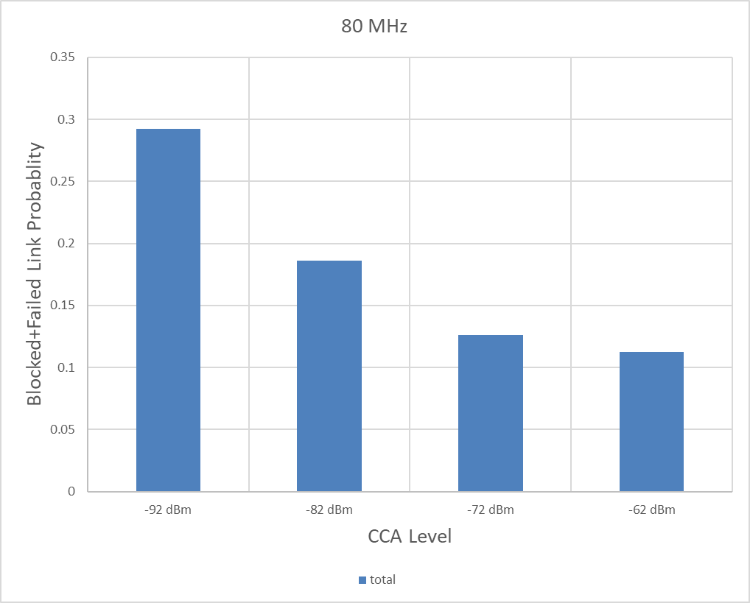
QoS Improvement from SR for 80 MHz
Like what we saw with 40 MHz, OBSS PD level decreases the blocked link and failed link statistics for 80 MHz
  But the probability is still above 10%
Currently, all access categories use the same SR OBSS PD level
Could SR be used to improve QoS even more by using it to give preferential channel access (like EDCA)?
Could QoS be improved specifically for an AC like Voice with different OBSS PD levels for different ACs?

Slide 13
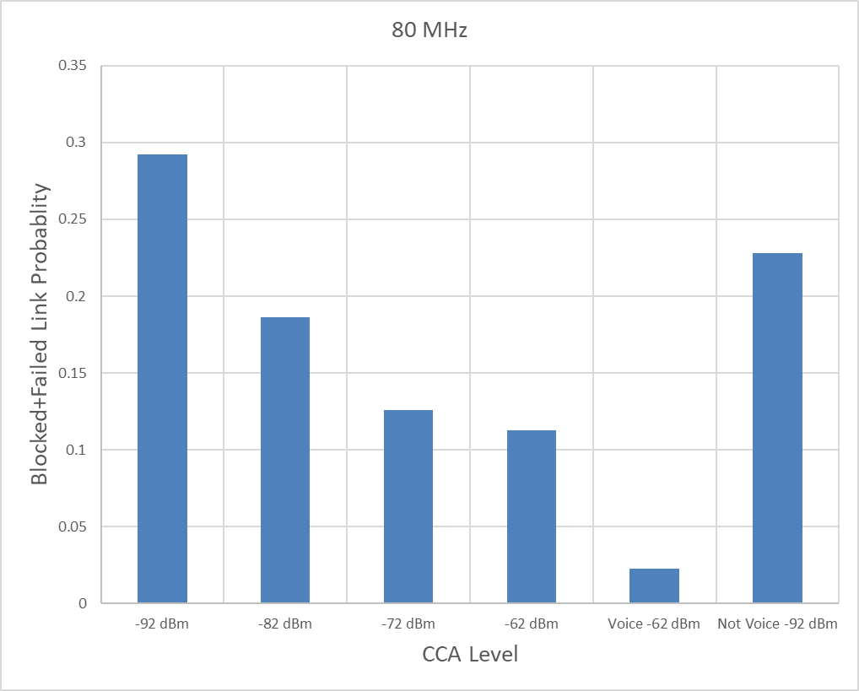
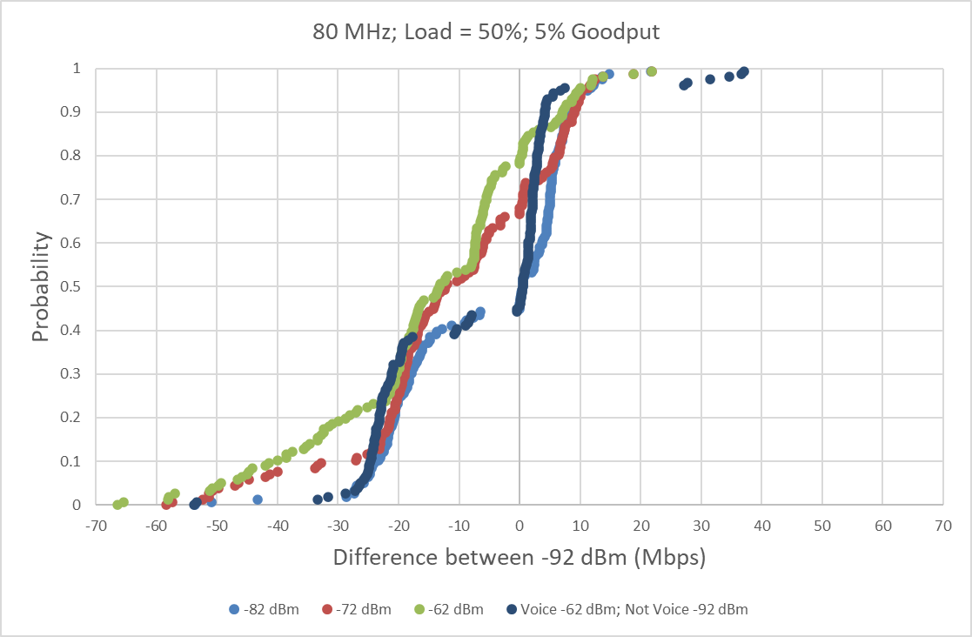
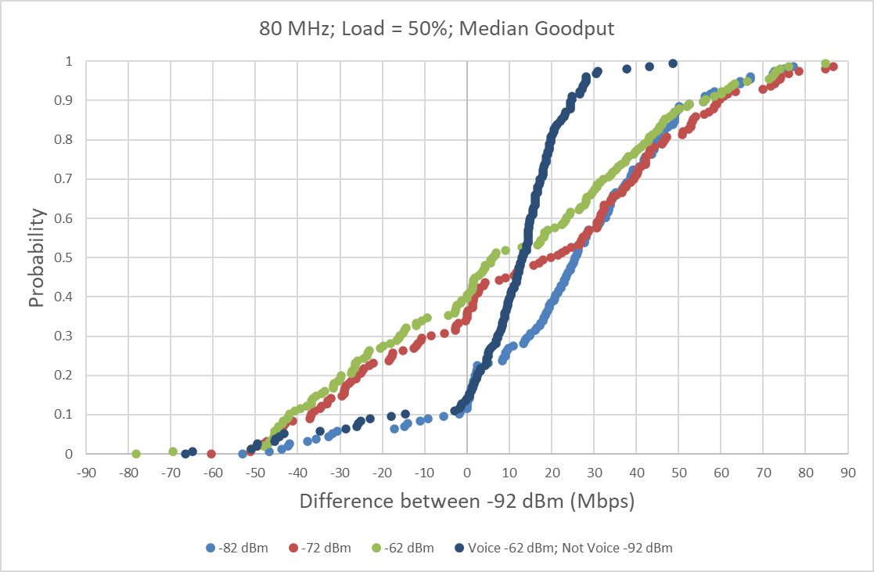
SR for Voice
We experiment with only allowing SR on Voice flows, with PD level of -62 dBm. All other AC’s remain using -92 dBm.
The simulation models 25% of the flows are Voice, 75% are the other AC’s
Though there is less gain in throughput, there is also less loss
More importantly, the blocked link and failed link probability for Voice drops to 2%!
While the other AC’s still have a probability of 22%, this is lower than originally for 80 MHz

Slide 14
Conclusion
The same exercise was run on a REAL stadium, with over 1500 APs. We see similar improvement to the voice flows.
Modification of SR to allow AC specific thresholds dramatically improves channel access for QoS sensitive flows.

