Slide 1
Enhancements on TWT SP Management
Date: 2024-05-13
Authors:

Slide 2
Problem Statement
802.11bn is aiming for more power efficient operation for devices
TWT is a key power saving operation that enables periodic wake up times for STAs to exchange frames
TWT SP early termination is an important mechanism for TWT operation, where an SP can be terminated before scheduled end time if needed (e.g., all traffic delivered)
This document explores enhancements for TWT SP termination mechanism for 802.11bn

Slide 3
Background: 11ax TWT SP Termination
In 11ax spec, when a TWT SP termination is detected by a STA within the TWT SP, the STA may transition to the doze state
As per baseline, a STA can classify any of following events as a TWT SP termination (26.8.5)
The transmission by the STA of an acknowledgment in response to an individually addressed QoS Data or QoS Null frame sent by the AP that had the EOSP subfield equal to 1
The transmission by the STA of an acknowledgment in response to an individually addressed frame that is neither a QoS Data frame nor a QoS Null frame, sent by AP with the More Data field equal to 0.
…
The reception of a Trigger frame sent by the TWT responding STA or TWT scheduling AP that has the More TF field equal to 0 and is not addressed to the TWT requesting STA or TWT scheduled STA provided that the TWT requesting STA or TWT scheduled STA is either awake for an announced trigger-enabled TWT SP but didn’t transmit an indication that it is in the awake state to the TWT responding STA or TWT scheduling AP, or is awake for an unannounced trigger-enabled TWT SP.
…

Slide 4
Need for SP early termination
TWT SP duration should be chosen as a balance between provisioning enough time for intended traffic delivery (with some margin for possibility of medium contention, retransmissions) and power saving (STA should not be in awake state unnecessarily)
If traffic is delivered earlier within an SP, early termination of the SP can help the STA save more power without having to wait until SP end
SP early termination is applicable to all TWT schedules, including individual, broadcast and R-TWT

Slide 5
Problem: Missing STA indication for SP termination
In termination scenarios described in 26.8.5, AP decides if/when to terminate and signals termination.
AP is not required to check STA’s readiness to terminate before terminating SP
This results in two possibilities:
AP may terminate too early: STA is not done with intended usage of SP
AP is not required to check STA’s buffer status before terminating SP
Even if AP is required to check buffer status, it is possible that due to jitter in traffic arrival, STA’s current buffer is 0 but it still has traffic to deliver within the SP (e.g., if buffer is checked right at SP start, and traffic arrives a bit later into the SP.
In most cases, STA has most up-to-date information about its traffic and intended usage of the SP, and currently there is no mechanism for STA to convey this “SP termination readiness” information
AP may not terminate at all
In field, we see several implementations not terminating at all due to lack of this “feedback loop” about termination readiness

Slide 6
Proposal: Add a termination readiness indication from STA side
Add new explicit signaling for STA to indicate its readiness to terminate the SP
An explicit indication for this purpose removes any ambiguity about STA’s intentions or termination readiness state. E.g., it is not tied to the instantaneous buffer state or specific/all TIDs
AP may wait until it receives the readiness indication from the STA to terminate the SP
The readiness indication may also serve as a “nudge” to terminate the SP if/when AP is also done delivering traffic in DL
The proposal is not to change the termination mechanism itself
STA is not terminating the SP, but instead just signaling its readiness to terminate
AP may terminate the SP, as per current spec, with methods covered in 26.8.5

Slide 7
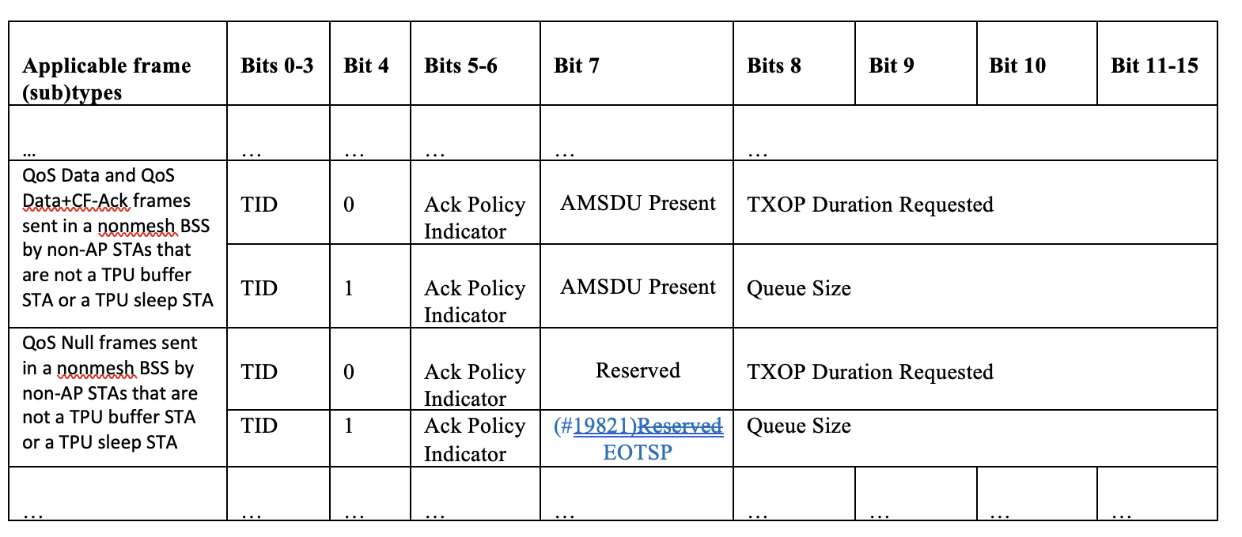
Possible signaling methods for explicit termination readiness indication
Example 1: A reserved bit in QoS Control included in QoS NULL frames may be used for 1-bit termination indication (EOTSP: End of traffic for SP)
Table 9-10 (QoS Control field)

Slide 8
Possible signaling methods for explicit termination readiness indication
Example 1: A reserved bit in QoS Control included in QoS NULL frames may be used for 1-bit termination indication (EOTSP: End of traffic for SP)
Example 2: A new A-Control field may be added for SP management

Slide 9
Summary
We discuss SP early termination mechanism in context of TWT power save, and identify additional signaling mechanisms to further optimize and improve the utility of this feature
An explicit indication of a STA’s readiness to terminate the SP can greatly benefit power saving in scenarios when STA is done using the SP earlier than scheduled end time

Slide 10
SP1
Do you agree to define a new mechanism in 802.11bn that enables a STA to indicate its readiness to terminate an ongoing TWT SP
NOTE 1 – The exact signaling mechanism is TBD, and existing frames and fields may be used with suitable modifications
NOTE 2 – The SP does not propose changing the termination mechanism/signaling itself. As per current spec, a TWT SP may be terminated as specified in 26.8.5

