Slide 1
AMP Energizer Devices and BSS Coloring
Date: 2024-03-08
Authors:

Slide 2
Abstract
Proposal of an operational scheme to allow using AMP STAs in the 2.4 GHz spectrum despite range limitation and trying to limit impact on the legacy devices.

Slide 3
Background
During PAR writing many concerns were raised on 2.4 GHz channel utilization by AMP STAs (data and charging frames)
Previous contributions showed short operational ranges in the 2.4 GHz spectrum
  https://mentor.ieee.org/802.11/dcn/24/11-24-0075-00-0amp-follow-up-on-amp-link-budgets.pptx
  https://mentor.ieee.org/802.11/dcn/24/11-24-0163-00-0amp-update-on-dual-band-operation.pptx
https://mentor.ieee.org/802.11/dcn/23/11-23-1195-00-0amp-thoughts-on-amp-iot-and-par.pptx
introduced the AMP Energizer Device concept

Slide 4
Motivation
Limiting operations to S1G or other low frequencies is likely to limit adoption
2.4 GHz is highly available

Slide 5


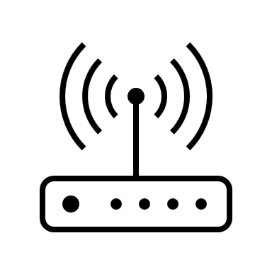
Proposal – AMP Energizer Devices in 2.4 GHz
AMP Energizer Device in 2.4 GHz = Regular Wi-Fi STA that can help the AP to power up AMP STAs at their range
AMP Device
AMP Energizer Device
AP

Slide 6
Proposal – BSS Coloring (1/2)
AP instructs AMP Energizer Devices to use BSS coloring to reduce impact on the channel for charging devices
AMP Device
Legacy STA
AMP Energizer Device
AP

Slide 7
Proposal – BSS Coloring (2/2)
AMP Energizer Devices could be:
  Stationary Wi-Fi devices connected to the AP in a given location
  Mobile Wi-Fi devices that need the data from AMP STAs
AP instructs AMP Energizer Devices:
  How often and for how long to send charging frames
  Maximum power to be used
  BSS color to be used

Slide 8
Advantages
AMP STAs can be powered up by ad-hoc or passing by AMP Energizer Devices even if they are not at powering up range by the AP
BSS Coloring limits the impact on the regular traffic that can be transmitted at the same time

Slide 9
TBDs
Mechanism for the AMP Energizer Device to negotiate with AP the charging instructions
AMP STAs could be communicating directly with the AP (data) or the buddy STAs could relay the data to the AP

Slide 10
Discussion and Feedback

Slide 11
References
https://mentor.ieee.org/802.11/dcn/23/11-23-1195-00-0amp-thoughts-on-amp-iot-and-par.pptx
https://mentor.ieee.org/802.11/dcn/24/11-24-0075-00-0amp-follow-up-on-amp-link-budgets.pptx
https://mentor.ieee.org/802.11/dcn/24/11-24-0163-00-0amp-update-on-dual-band-operation.pptx

