Slide 1
Multiple DRU Follow Up
Date: 2024-03-10
Authors:
Name | Affiliation | Address | Phone | Email
Eunsung Park | LG Electronics | 19, Yangjae-daero 11gil, Seocho-gu, Seoul 137-130, Korea |  | esung.park@lge.com
Dongguk Lim |  |  |  | dongguk.lim@lge.com
Jinyoung Chun |  |  |  | jiny.chun@lge.com
Insik Jung |  |  |  | insik0618.jung@lge.com
Jinsoo Choi |  |  |  | js.choi@lge.com
HanGyu Cho |  |  |  | hg.cho@lge.com

Slide 2
Introduction
In [1], we proposed multiple DRU (MDRU)
  MDRU can be constructed by combining DRUs which are distributed in different channels for a PPDU transmission
  In particular, in 80 MHz which has a punctured 20 MHz channel, two DRUs in non-punctured 20 MHz and 40 MHz are combined
In this contribution, we address some MDRU issues raised in the last meeting
We also propose restriction rules for MDRU to reduce signaling overhead and give an example of an MDRU application

Slide 3
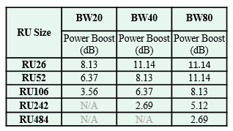
Recap
In [1], we proposed to combine two DRUs which are distributed in non-punctured 20 MHz and 40 MHz, respectively, for a 80 MHz channel where one 20 MHz channel is punctured
  To maintain the power boost gain and increase the data rate, two DRUs which have the same gain can be combined
    52 DRU (40 MHz) + 26 DRU (20 MHz)
    106 DRU (40 MHz) + 52 DRU (20 MHz)
  In addition, to increase the maximum data rate and improve resource utilization, we can also consider the following MDRU
    242 DRU (40 MHz) + 106 DRU (20 MHz)

Slide 4
Issues for MDRU - Implementation
Sizes for some MDRUs are not consistent with the conventional MRUs, and thus, we may need a new implementation
  For 52+26 MDRU, we can simply reuse the existing LDPC tone mapper and BCC interleaver defined in 52+26 MRU
  For 106+52 and 242+106 MDRUs, we can either consider designing new LDPC tone mapper and BCC interleaver or reusing the existing implementation by applying the LDPC tone mapper and BCC interleaver to each component DRU
    For the latter case, we may need a segment parser within a 80 MHz channel to use these two MDRUs
    It would be better to make the PHY processing consistent in all MDRUs and DRUs, and thus, the former approach seems better

Slide 5
Issues for MDRU - Power Imbalance
In all component DRUs comprising an MDRU, per-tone power should be the same
  There is no power imbalance issue in 52+26 and 106+52 MDRUs
    Component DRUs in each of these MDRUs have the same power boosting gain meaning they use the same number of tones per MHz
    PSD limitation is defined per MHz, and thus, per-tone power is the same in each component DRU
  As to 242+106 MDRU, per-tone power for 106 DRU is higher, and thus, transmit power for 106 DRU can be reduced to match its per-tone power to that of 242 DRU
    There is no power boosting gain loss for 242 DRU
  Although 242+106 MDRU has loss in a power boosting gain (only for 106 DRU), it is possible to achieve much higher data rate than using either 106 DRU or 242 DRU
    Note that, without an MDRU support, the maximum data rate comes from 242 DRU

Slide 6
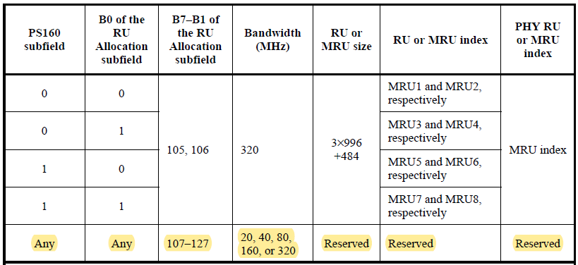
Issues for MDRU - Signaling (1/2)
For MDRU allocation, it may be hard to reuse the current RU / MRU allocation method
  There is no conventional RU / MRU corresponding to the proposed MDRUs
Possible approach 1 for signaling
  We can use the reserved values in the RU Allocation subfield

Slide 7
Issues for MDRU - Signaling (2/2)
Possible approach 2 for signaling
  Another approach is to use two User Info fields with the same value of the AID12 subfield
    Both AID 12 subfields are set to the STA’s AID which is assigned to MDRU
    In each User Info field, each component DRU can be allocated and an MDRU indication can be added
  These two User Info fields can be located next to each other for STAs’ power saving
In both approaches, it would be better to restrict possible MDRUs
  In approach 1, the reserved values are limited and these can be also used to indicate other new RUs / MRUs
  In approach 2, using two User Info fields increases the overhead and STAs’ power consumption
    By restricting MDRUs, we can come up with a method which allocates MDRU with only one User Info field

Slide 8
Restriction Rules for MDRU
We propose the following restriction rules for MDRUs
  We consider one-to-one mapping between component DRUs
    I.e., different MDRUs do not use the same DRU
  To this end, we can consider that DRUs which have the same index in 40 MHz and 20 MHz, respectively, are combined, e.g.,
    242 DRU_1 + 106 DRU_1, 242 DRU_2 + 106 DRU_2
    106 DRU_1 + 52 DRU_1, 106 DRU_2 + 52 DRU_2, 106 DRU_3 + 52 DRU_3, 106 DRU_4 + 52 DRU_4
    Note that there are two 242 DRUs and four 106 DRUs in 40 MHz and two 106 DRUs and four 52 DRUs in 20 MHz channel
  When it comes to 52+26 MDRU, since there are eight 52 DRUs and nine 26 DRUs in 40 MHz and 20 MHz, respectively, we can consider the following approach
    We can combine two DRUs in the order of index excluding 26 DRU corresponding to middle 26 RRU
  By applying this restriction rule in conjunction with an MDRU indication, only one User Info field is enough for MDRU allocation
    In the User Info field, one of the component DRUs is indicated with an MDRU indication

Slide 9
Example for MDRU Application
We consider supporting 20 MHz and 80 MHz operating STAs in a 80 MHz channel where one 20 MHz channel is punctured
  In a non-punctured 20 MHz channel where 20 MHz distribution bandwidth is applied, 20 MHz operating STAs can be supported
    There can be some DRUs which are not allocated to 20 MHz operating STAs
  In a non-punctured 40 MHz channel where 40 MHz distribution bandwidth is applied, 80 MHz operating STAs can be supported
    One of the remaining DRUs in 20 MHz can be additionally allocated to a certain 80 MHz operating STA for better throughput, i.e., an MDRU is allocated to the STA

Slide 10
Conclusion
We have addressed the following issues for MDRU
  Implementation
  Power imbalance
  Signaling
We have also proposed restriction rules for MDRU to reduce the signaling overhead
In addition, we have given a simple example of an MDRU application

Slide 11
Straw Poll #1
Do you agree to add the following text to the TGbn SFD?
  Multiple DRU (MDRU) is defined by combining two DRUs which are distributed in non-punctured 20 MHz and 40 MHz, respectively, in a 80 MHz channel where one 20 MHz channel is punctured
    Detailed combinations are TBD
Y/N/A: //

Slide 12
Straw Poll #2
Do you agree to add the following text to the TGbn SFD?
  The following MDRUs are supported in a 80 MHz channel where one 20 MHz channel is punctured
    52 DRU (from non-punctured 40 MHz) + 26 DRU (from non-punctured 20 MHz)
      DRUs are combined in the order of index excluding 26 DRU corresponding to middle 26 RRU
    106 DRU (from non-punctured 40 MHz) + 52 DRU (from non-punctured 20 MHz)
      DRUs with the same index are combined
      106 DRU_i + 52 DRU_i where i = 1, 2, 3 and 4
    242 DRU (from non-punctured 40 MHz) + 106 DRU (from non-punctured 20 MHz)
      DRUs with the same index are combined
      242 DRU_i + 106 DRU_ i where i = 1 and 2
Y/N/A: //

Slide 13
References
[1] 11-24-0014-00-00bn-further-thoughts-on-DRU

