Slide 1
Thoughts on L4S Support in Wi-Fi
Date: 2024-03-01
Authors:

Slide 2
Introduction
UHR PAR scope includes improving low latency support
L4S technology is defined by IETF RFCs [5-7] to provide improved end-to-end latency support with low packet losses due to congestion
Earlier presentations have covered L4S support in Wi-Fi [1-4]
  [1] Highlights that WLAN access can be a bottleneck & L4S congestion signaling in WLAN can improve e2e latency
  [2] Describes mapping of L4S Dual Queue AQM (Active Queue Management) to Wi-Fi ACs for AC_BE & AC_VI
  [4] Proposes to extend ECN signal of L4S to MAC layer for the downlink
In this presentation we propose enhancements for supporting L4S in 802.11, specifically:
  A) L4S Dual Queue AQM mapping to 802.11
  B) L4S related signaling between upper layer and MAC
  C) Faster L4S congestion signaling at L2 for DL
  D) Enhanced TCLAS to enable classifying L4S flows in SCS
  E) L4S considerations in SCS based scheduling
  F) L4S capability signaling

Slide 3
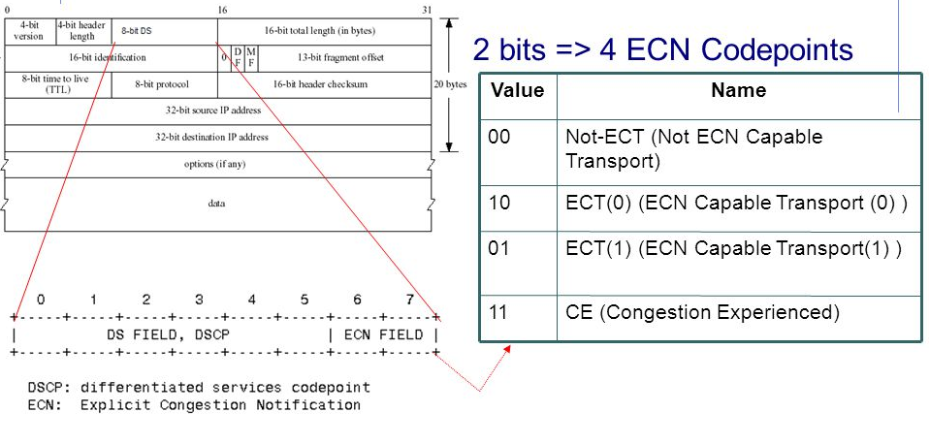
Recap of L4S Signaling
L4S enables early notification of network congestion to the receiver and then to the sender to allow the sender adjusting its sending rate, without dropping packets.
  ECN field in IP header signals L4S capable transport and congestion notification
  L4S sender uses ECT1 (ECN=01) for L4S enabled flow
  Bottleneck node upon experiencing congestion marks CE (ECN=11)
  CE markings are received at the L4S receiver
  L4S receiver sends congestion feedback to the sender at Layer 4 (e.g. TCP or QUIC)
  Sender reduces its data rate which reduces congestion in the L4S queues
L4S support is needed at the sender, receiver and the bottleneck nodes (the Wi-Fi AP would be a bottleneck node)
Figure Source [1]
CE-marking feedback in Layer 4 or above
L4S Sender
Application
Sets IP.ECT1
L4S Receiver
Application
Echoes CE in L4++
ECT1
Network node
ECT1
Bottleneck node
CE|ECT1
Network node
CE|ECT1

Slide 4
Recap of L4S Dual Queue AQM
L4S aims to reduce latency added due to queuing delay to achieve improved e2e latency
Achieves this by maintaining dual queue AQM:
  A shallow L4S queue for L4S flows (as L4S does not build deep queues), and
  A Classic queue for other non-L4S flows
CE markings are signaled when congestion is experienced in the L4S queue
[7] defines coupling between dual queues such that each queue gets similar throughput for fairness
For L4S support, WLAN APs (and STAs) would need to implement L4S Dual Queue AQM
Figure Source [2]

Slide 5
A) Mapping L4S Dual Queue AQM to 802.11
[2] Suggested mapping of L4S Dual Queue AQM to 802.11 to create shallow L4S queues for BE & VI. That makes sense given these categories can have a mix of L4S and classic flows.
  All applications requiring low e2e delay may not be mapped to AC_VI, hence need L4S queue for BE as well
For AC_VO, voice traffic packets are small (160 bytes), queue is already shallow. Hence, no separate L4S queue and ECN marking needed for AC_VO.
In 802.11 baseline, when Alternate EDCA is activated (from .11aa), 6 transmit queues are defined
  A_VO and A_VI queues were added to differentiate between different types of VO and VI traffic (e.g. video conf. vs streaming video).
  With 11be SCS+QoS Characteristics, flows within a TID/AC can be differentiated per SCS scheduling. Hence, alternate queues not needed.
We propose that UHR APs set Alternate EDCA=0 and repurpose alternate queues to for L4S queues (for AC_BE and AC_VI).

Slide 6
Where should L4S Dual Queue AQM be implemented?
Option 1: Above the MAC layer
Option 2: At the MAC layer
Option 1 makes 802.11 blind to L4S, does not enable tight control for L4S flows scheduling close to 802.11 Tx queue. Hence, can be hard to realize low queuing delay while achieving optimal throughput.
Option 2 provides tight control for L4S flows scheduling in 802.11 close to Tx queue, to achieve low queuing delay and optimal throughput​
In this contribution we focus on enhancements needed to enable this option.

Slide 7
B) Enabling L4S Dual Queue AQM at the MAC
Dual Queue AQM at the MAC
ECN markings are in the IP header at L3. MAC layer/L2 does not look into the IP header of each packet.
Need to signal L4S packets to the MAC layer for queuing of these packets in the right queue.
Enhance MA-UNITDATA.request primitive to signal L4S packets, by adding an L4S parameter. MAC layer queues L4S packets in the L4S queue that corresponds to the priority value (mapped to AC_BE or AC_VI).
Approach 1 for CE marking: When congestion is experienced at the MAC, it is signaled to the upper layer/L3 to CE mark (set ECN=11) subsequent packets. Add a new L4S-CE.indication northbound MAC-SAP (or MLME) primitive for this.
MA-UNITDATA.request(
  source address,
  destination address,
  routing information,
  data,
  priority,
  …
  MSDU format,
  SCSID,
  L4S
  )
L4S-CE.indication(
source address,
destination address,
priority,
SCSID,
L4S marking probability,
Classic queue drop probability,
…
)

Slide 8
B) Enabling L4S Dual Queue AQM at the MAC
Dual Queue AQM at the MAC
Approach 2 for CE marking: when an MSDU experiences congestion at the MAC, the MSDU is sent to the upper layer for CE marking, and after marking the MSDU is inserted back in the MAC queue at the same place (to avoid out-of-order delivery). Define new L4S-CE-MARKING.request/response primitive to achieve this.
L4S-CE-MARKING.request(
  source address,
  destination address,
  routing information,
  data,
  priority,
  …
  MSDU format,
  SCSID,
  queue dialog token
  )
L4S-CE-MARKING.response(
  source address,
  destination address,
  routing information,
  data,
  priority,
  …
  MSDU format,
  SCSID,
  queue dialog token
  )

Slide 9
C) L2 Signaling for Downlink L4S Congestion
  Approach 1 or Approach 2 involves asking the upper layer for CE marking – can add delay to congestion notification.
  Approach 3 for CE marking: Faster CE signaling at L2 - either MPDUs experiencing congestion or other MPDUs in same L4S queue closer to Tx can be marked at L2 to signal congestion earlier.
    Signal using a new Control ID in A-Control
    Can be used instead of Approach 1 or Approach 2
  When STA receives a data frame with L4S CE in A-Control, it will request upper layer to add L3 CE marking.
  Enhance MA-UNITDATA.indication to add a request for packets to be CE marked by L3.
MA-UNITDATA.indication(
  source address,
  destination address,
  routing information,
  data,
  priority,
  …
  MSDU format,
  SCSID,
  L4S CE marking request
  )

Slide 10
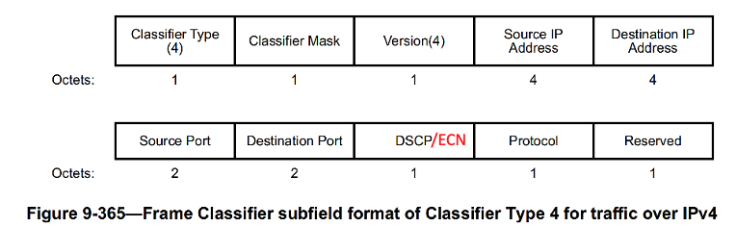
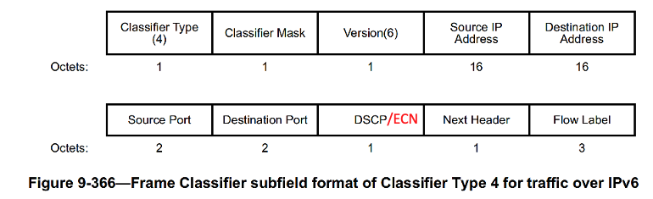
D) L4S traffic classification using TCLAS
  TCLAS in SCS can be used to classify L4S traffic based on ECN bits (01, 11) and indicate specific QoS for L4S flows. For example, using SCS+TCLAS, STA can request:
    a) specific Delay Bound to be provided for L4S flows, b) map L4S flows to a higher-QoS TID
    c) for a VPN tunnel, where multiple flows map to same IP-tuple, STA can request a delay bound and/or min data rate for just the L4S flows over that tunnel.
  To enable classification of L4S flows, extend TCLAS to classify based on ECN. For Classifier Type 4, DSCP field can be redefined to be interpreted as indicating DSCP, ECN or both - the 2 MSBs indicate ECN.
    E.g. TCLAS can be used to indicate an L4S flow, by including two TCLAS elements (indicating ECN=01 and ECN=11), and a TCLAS Processing element indicating ‘either match’
    ECN based classification is used when supported by both sides (AP and STA)

Slide 11
E) L4S considerations in SCS based scheduling
  Coexistence of L4S flows with SCS flows:
  An SCS flow can be an L4S flow (or not), and vice versa
  If an SCS flow is also an L4S flow, STA should signal that to the AP (using TCLAS as on slide 10). AP uses this info in applying any L4S based policy, at the time of SCS exchange.
    For UL if TCLAS is not included, STA can indicate a flow is L4S flow in the QoS Characteristics element (e.g using a Reserved bit in Control info)
  L4S flows are always mapped to L4S queues, independent of whether SCS stream established.
  AP’s SCS scheduling should attempt to meet the QoS characteristics of SCS flows (either classic or L4S), while trying to keep shallow queues for L4S flows.

Slide 12
F) L4S Capability Signaling
  Both peer STAs need to signal support for L4S related capability to use L4S enhancements. Depending upon the features supported for L4S, the following capability can be signaled:
    L4S Dual Queue AQM
    L4S CE L2 signaling for downlink
      Using A-Control
    TCLAS ECN classification for L4S
    L4S signaling in QoS Characteristics
  L4S related capabilities can be signaled in the Extended Capabilities element and/or in the UHR Capabilities element

Slide 13
Summary
  We propose mapping L4S Dual Queue AQM to 802.11 at the MAC layer
  We propose MAC SAP primitive enhancement for indicating L4S MSDUs
  For L4S congestion signaling in DL, we propose:
    A new L4S-CE.indication to signal L2 congestion for CE marking of future packets at L3 (Approach 1)
    MAC SAP primitives to send MDSU to upper layer, CE mark and send back to MAC (Approach 2)
    Faster L4S CE signaling at L2 using A-Control (Approach 3)
    Approach 3 can be used instead of Approach 1 or Approach 2
  We propose to enhance TCLAS to enable classifying L4S flows using ECN bits
  We shared how L4S flows are considered in SCS based scheduling
  We propose L4S capability signaling to communicate support for L4S related features

Slide 14
References
[1] 11-23/2065, WNG, “End-to-End Congestion Control, L4S and Implications for Wi-Fi”
[2] 11-23-0679-00-0uhr-low-latency-qos-based-on-l4s
[3] 11-24-0080-01-0arc-l4s-over-wi-fi-links
[4] 11-24-0384-01-00bn-low-latency-based-on-l4s
[5] IETF RFC 9330 “Low Latency, Low Loss, and Scalable Throughput (L4S) Internet Service: Architecture”
[6] IETF RFC 9331 “The Explicit Congestion Notification (ECN) Protocol for Low Latency, Low Loss, and Scalable Throughput (L4S)”
[7] IETF RFC 9332 “Dual-Queue Coupled Active Queue Management (AQM) for Low Latency, Low Loss, and Scalable Throughput (L4S)”

