Slide 1
MU CSI Feedback Type for Non-TB Sounding:
Improving the SU-MIMO performance Part 2
Date: 2024-03-01
Authors:
Name | Affiliation | Address | Phone | Email
Junghoon Suh | Huawei |  |  | junghoon.suh@huawei.com
Yan Xin |  |  |  | Yan.Xin@huawei.com
Osama AboulMagd |  |  |  | Osama.AboulMagd@huawei.com
Edward Au |  |  |  | edward.ks.au@huawei.com

Slide 2
Background
The SU transmission is a common use case in WLAN
Several proposals have been proposed to improve the link throughput and the quality between a single AP and a single STA [1-5]
Most proposals above require an accurate singular value feedback
  Average SNR feedback per stream is not being practically used among the currently deployed APs regardless of its support in the 802.11 Specification
MU type of CSI Feedback may be required to further improve the SU-MIMO performance
We can allow more options in choosing the number of LTFs

Slide 3
Background
A water-filling algorithm which assigns more TX power to the stream with higher singular value feedback is well-known to achieve an optimum performance
  Few 11bn contributions have shown the performance results based on a water-filling algorithm
  [3] shows the little performance gain for an Eigen-Beamforming (SVD Beamforming: Eigen vectors being used for a precoder) with a power scaling (reverse water-filling: higher TX power being allocated to the stream with the lower singular value) against the pure Eigen-Beamforming (EGBF) with an equal modulation across the streams
  It is an unsuitable combination between an EGBF and a reverse water-filling, because an EGBF inherently assigns more TX power to the stronger stream but the reverse water-filling actually reverse it

Slide 4
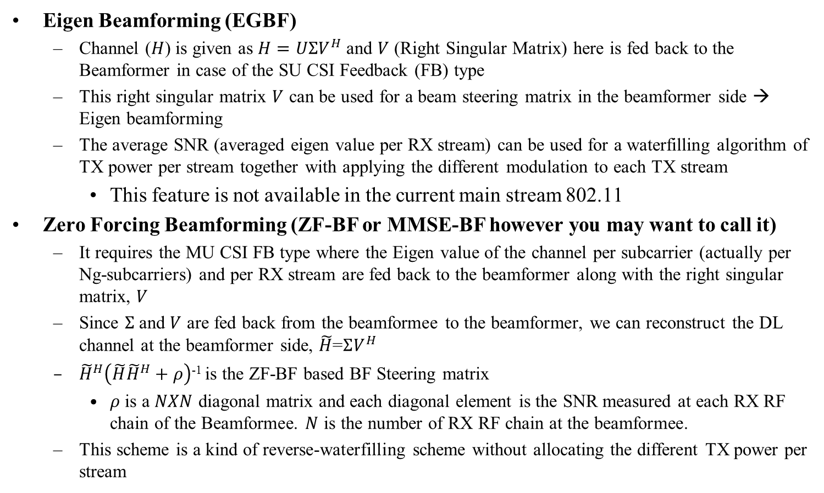
ZFBF: a natural reverse water-filling
Eigen Beamforming (EGBF)
  Channel ($H$) is given as $H=UΣV^{H}$ and $V$ (Right Singular Matrix) here is fed back to the Beamformer in case of the SU CSI Feedback (FB) type
  This right singular matrix $V$ can be used for a beam steering matrix in the beamformer side → Eigen beamforming
  The average SNR (averaged eigen value per RX stream) can be used for a waterfilling algorithm of TX power per stream together with applying the different modulation to each TX stream
    This feature is not available in the current main stream 802.11
Zero Forcing Beamforming (ZF-BF or MMSE-BF however you may want to call it)
  It requires the MU CSI FB type where the Eigen value of the channel per subcarrier (actually per Ng-subcarriers) and per RX stream are fed back to the beamformer along with the right singular matrix, $V$
  Since $Σ$ and $V$ are fed back from the beamformee to the beamformer, we can reconstruct the DL channel at the beamformer side, $\tilde{H}$=$ΣV^{H}$
  ${\tilde{H}}^{H}\left(\tilde{H}{\tilde{H}}^{H}+ρ\right)$⁻¹ is the ZF-BF based BF Steering matrix
    $ρ$ is a $NXN$ diagonal matrix and each diagonal element is the SNR measured at each RX RF chain of the Beamformee. $N$ is the number of RX RF chain at the beamformee.
  This scheme is a kind of reverse-waterfilling scheme without allocating the different TX power per stream

Slide 5
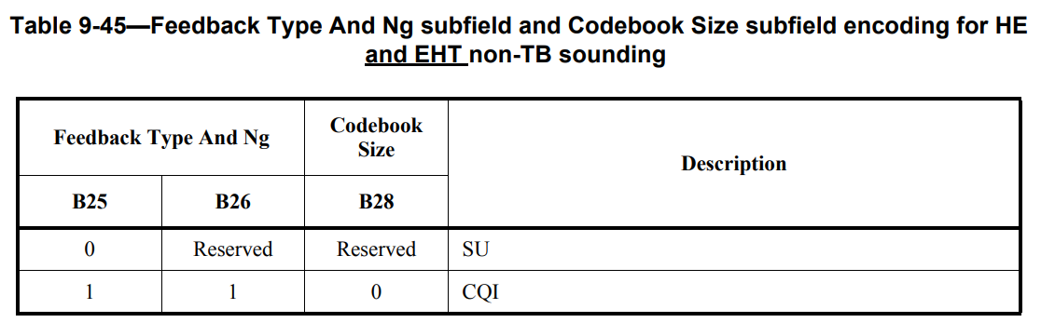
CSI FB type for Non-TB Sounding in HE and EHT
For Non-TB Sounding of HE and EHT, there are only two CSI feedback types available, which are SU and CQI
  CQI feedback is computed by averaging the Eigen values of channel over an indicated frequency range for the OFDMA scheduling purpose
  The SU type is basically the feedback of the right singular matrix of the channel along with the average SNR values of the channel per stream

Slide 6
CSI FB Type in the UHR Non-TB Sounding
MU CSI FB is necessary regardless of TB or Non-TB Sounding
We need to include the MU CSI FB type in an NDPA of any Non-TB Sounding period
In the Table 9-45 of the EHT Specification, 802.11be D2.3, we can set the B26 to 1 to indicate the MU CSI FB Type with the B25 set to 0

Slide 7
More options in the LTF Extension
In the current EHT Common field of EHT-SIG field, there are 3 bits assigned to indicate the Number of EHT-LTFs
  It is only allowed to use twice as many LTFs as the number of TX Spatial Streams (SS), that is, for 1, 2, and 4 SS, it is only allowed to use 2, 4, and 8 LTFs for LTF extension
We propose to allow as many LTFs as the integer multiples of TX SS with 8 LTFs as being the maximum
  E.g. for 2 TX SS, we can allow 2, 4, 6 and 8 LTFs
The enhanced LTF Extension can be effective in the Range Extension

Slide 8
Simulation setting
ZFBF vs. EGBF SU-MIMO
Chan_D, 2x2 MIMO (2 N_SS, 2 N_TX, 2 N_RX)
  2, 4, or 8 N_LTF for data PPDU
Chan_D, 2x4 MIMO (2 N_SS, 4 N_TX, 2 N_RX)
  2, 4, or 8 N_LTF for data PPDU
4 N_LTF for a sounding PPDU
20 MHz, 4x-LTF
Detection: MMSE
Equal modulation across the streams
RX-SNR where the effective channel gains are reflected in the calculation of SNR

Slide 9
PER Performance of EGBF-SU 2X2

Slide 10
PER Performance of ZF-BF SU 2X2

Slide 11
PER Performance of ZF-BF SU 2X4 (Rank 2)

Slide 12
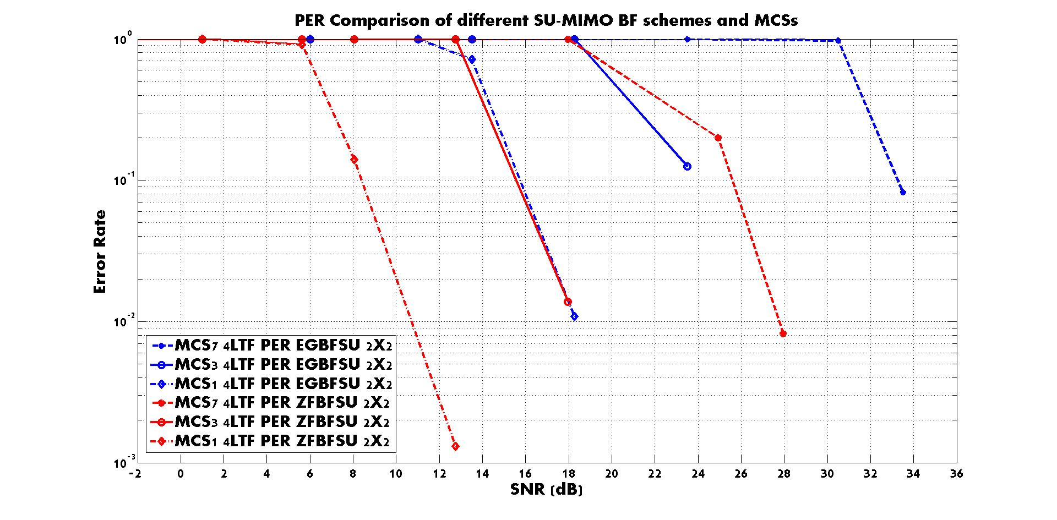

Slide 13
Summary
ZFBF based SU-MIMO shows about 7 dB gain over the EGBF (SVD-BF) based SU-MIMO with Equal Modulation across the streams
MU CSI FB is necessary regardless of TB or Non-TB Sounding
  MU CSI FB type is useful for both ZFBF SU-MIMO and UEQM
    For UEQM, the MU CSI FB Type can be used for the determination of MCS or Modulation per stream
We need to allow more options in choosing the number of LTFs

Slide 14
References
[1] 11-23/1927r1, Update of the Spatial Modulation, Junghoon Suh et.al., Huawei
[2] 11-22/1930r0, Layered QoS and multi-layer transmission follow-up, Ross Jian Yu et.al., Huawei
[3] 11-24/0016r0, UHR MIMO RvR enhancement with unequal modulation, Rui Cao et.al., NXP
[4] 11-24/0113r0, Unequal Modulation in MIMO TxBF in 11bn, Alice Chen et.al., Qualcomm
[5] 11-24/0117r0, Improved Tx Beamforming with UEQM, Ron Porat et.al., Broadcom

Slide 15
SP 1
Do you agree to support the MU CSI FB Type in a Non-TB Sounding?
  Yes
  No
  Abs

Slide 16
SP 2
Do you support to have more options in choosing the number of LTFs in proportion to the number of spatial streams?
  Yes
  No
  Abs

