Slide 1
CCA Modes in 802.15.4
Date: 2024-03-12
Authors:

Slide 2
Abstract
This submission provides a background on 802.15.4ab NB modes, reviews the CCA Modes in 802.15.4me Draft 3, and provides a way forward to improve coexistence between 802.11 and 802.15.4ab NB.
Carlos Aldana, Meta

Slide 3
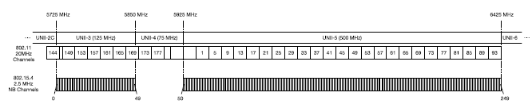
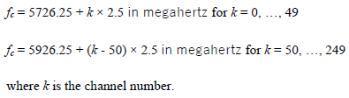
Background on NB Frequencies
802.15.4ab defines 250 total NB channels in UNII-3 (50) and UNII-5 (200)

Slide 4
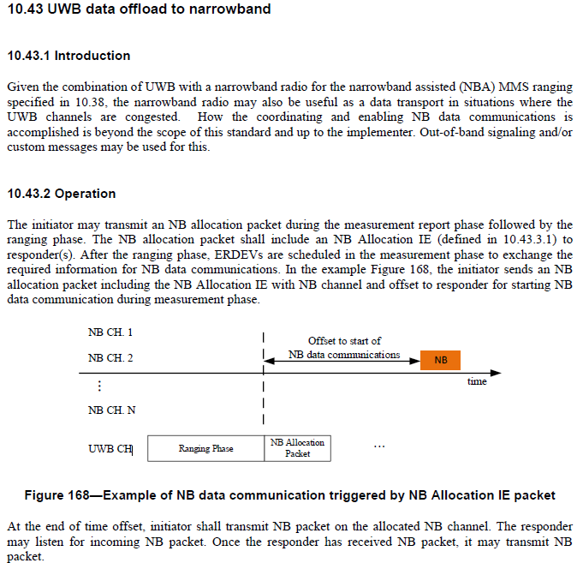
Background: No-LBT Data Transmission using NB (10.43)

Slide 5

Background: NBA-MMS (10.38) with optional LBT
1ms
NB
Poll
UWB
UWB
UWB
UWB
UWB
UWB
UWB
NB
Report 2
Initiator
NB
Resp
UWB
UWB
UWB
UWB
UWB
UWB
UWB
NB
Report 1
Responder
Optional
Section 10.38.8.3

Slide 6
Background on Coex SC Strawpoll
“802.11 Coex SC recommends that 802.15.4ab considers adopting a mandatory coexistence mechanism to enable shared use of the spectrum and adequate performance between 802.11 and 802.15.4ab. This mandatory coex mechanism should consist of one or more of LBT or other techniques”
44 Y, 13N, 0 Abstain

Slide 7
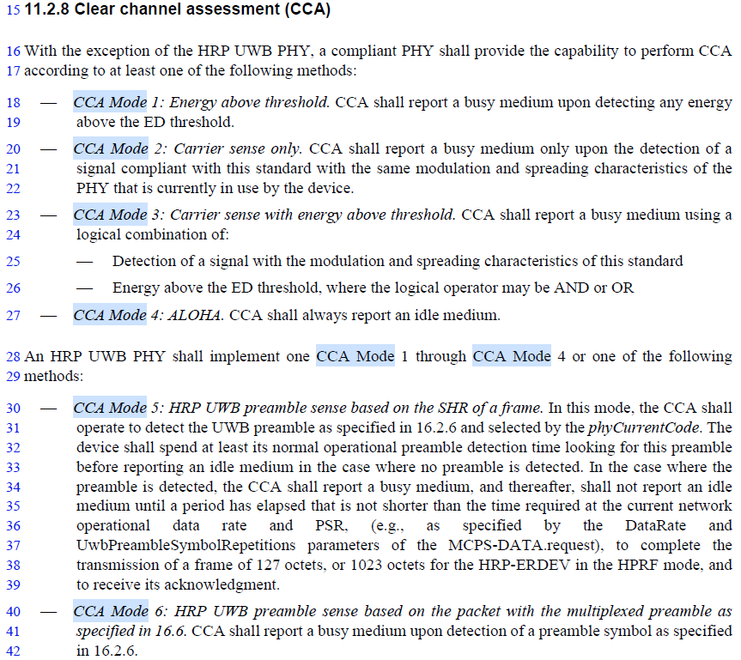
6 CCA Modes in 802.15.4me-D03

Slide 8
Additional Text in Section 11.2.8 in 802.15.4me D03
CCA mode 4 would typically be used in low duty cycle applications.
The PHY PIB attribute phyCcaMode, as described in 12.3.2, shall indicate the appropriate operation mode. The CCA parameters are subject to the following criteria:
  Unless otherwise specified in this standard for the PHY being used, the ED threshold shall be phyCcaEdThreshold.
  The CCA detection time shall be equal to phyCcaDuration, as defined in Table 12-2.
Carlos Aldana, Meta

Slide 9

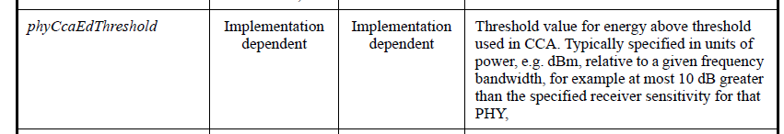
CCA Mode, CCA Duration and ED Threshold in Table 12-2

Slide 10
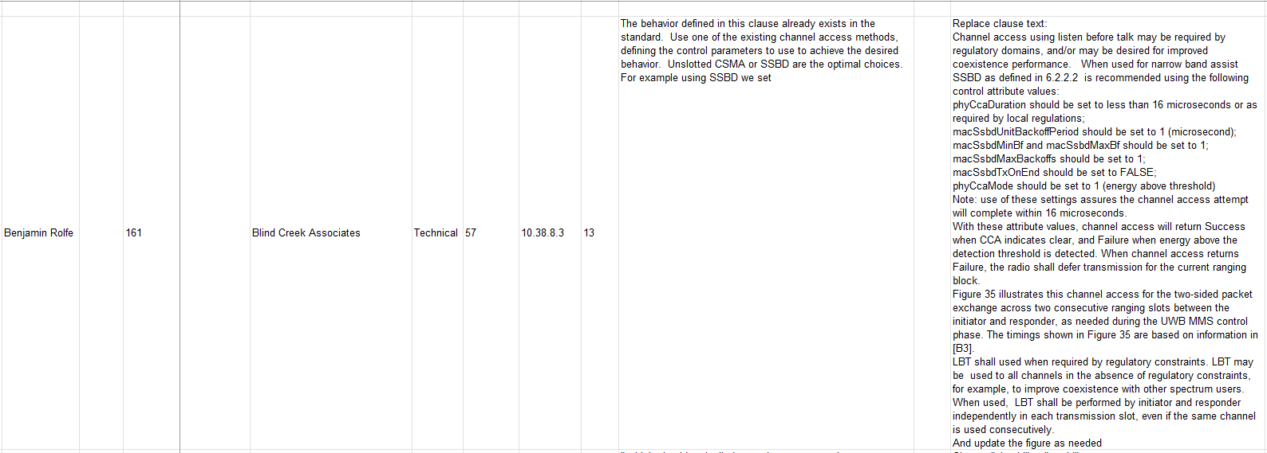
Proposal by Ben in 802.15.4ab (Comment to Draft C)

Slide 11
Proposed Way Forward
For both NB-Data and NBA-MMS described 802.15.4ab Sections 10.43 and 10.38, CCA mode 1, is the mandatory channel access mechanism with the following parameters:
  ED threshold value of TBD dBm/MHz
  TBD phyCCADuration value between 14-25 us
  probability of detection > = 90%
Alternatively, if SSBD is the preferred mandatory channel access mechanism, in addition to the 3 parameters listed above, these additional SSBD parameters shall be used:
  macSsbdMaxBackoffs = 0
  macSsbdPersistence = 0
  macSsbdTxOnEnd = False
  macSsbdUnitBackoffPeriod = 1 (microsecond)
  macSsbdMinBf and macSsbdMaxBf = 1

Slide 12
References
P802-15-04me-D03.pdf
P802.15.4ab-pre-ballot-C.pdf
IEEE 802.15-23/243r2 (NB Assisted Data Communications)
IEEE 802.15-22/381r5 (NBA-UWB MMS Ranging Text Proposal for 15.4ab)
IEEE 802.11-23/1259r1 (Effect of no-LBT NB on 802.11 devices)
IEEE 802.11-24/130r0 (Effect of no-LBT NB on 802.11 devices: Part 2)
IEEE 802.11-24/148r0 (NB Simulation Results Comparison)
IEEE 802.11-23/1279r0 (NB with LBT)
IEEE 802.15-23/243r2 (NB Assisted Data Communications)
IEEE 802.15-22/381r5 (NBA-UWB ranging text proposal for 15.4ab TFD)
IEEE 802.15-21/593r2 (More on NBA-MMS)
IEEE 802.15-21/292r0 (Opportunities for improved UWB/NB coordination)

