Slide 1
Considerations on LL Preemption
Date: 2024-01-15
Authors:

Slide 2
Abstract
Preemption methods are discussed in UHR SG [1, 2]
This contribution proposes an NFRP-based LL preemption methods focusing on:
  Reducing sequence overhead
  Enhancing scheduling efficiency

Slide 3
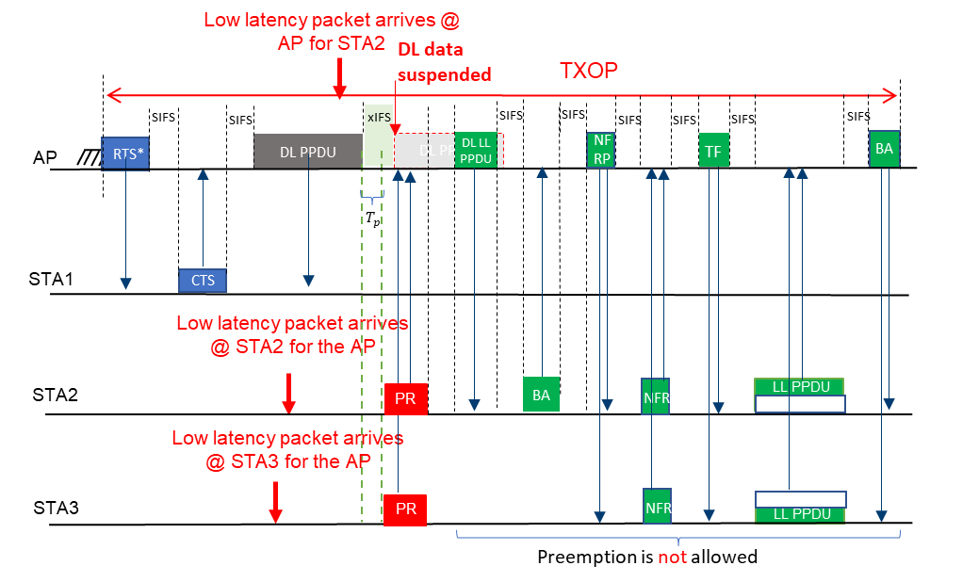
Background
It is important to check STAs attempting to preemption sequence
  NFRP-based LL preemption method has been proposed in [2]
Too much sequence overhead will decrease the overall preemption efficiency

Slide 4
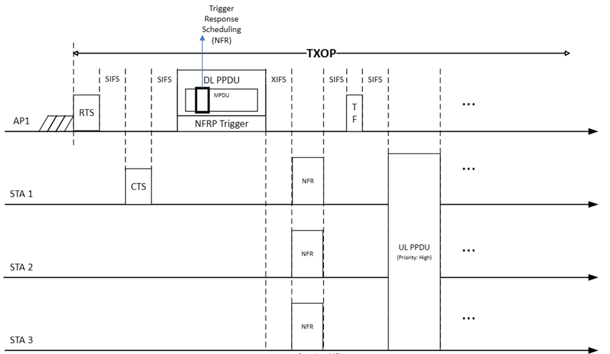
Proposal
Assigning an RU for broadcast NFRP Trigger to decrease the overhead
  For the DL recipient STA, unicast NFRP Trigger frame or a control header information can be included

Slide 5
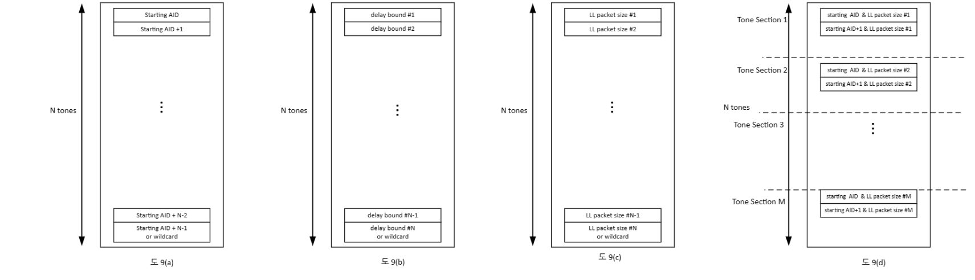
Consideration on NFR tone mapping
Conventional NFR only informs an on/off information
AP needs more information for proper scheduling
  Which STA
  Priority
  Resource allocation
By diversely configuring NFR tone mapping, more information can be provided
  Necessary for preemption scheduling
    AID, Delay bound, Packet transmission duration, Combinations

Slide 6
Summary
In this submission, considerations on NFRP-based LL preemption method have been discussed
Reducing sequence overhead
  NFRP contained in a RU of MU PPDU
Enhancing the scheduling
  diversely configuring NFR tone mapping

Slide 7
References
[1] 11-23/1229r1: Preemption for low latency application (Follow up), https://mentor.ieee.org/802.11/dcn/23/11-23-1229-01-0uhr-preemption-for-low-latency-application-follow-up.pptx
[2] 11-23/1174r0: TXOP preemption follow up, https://mentor.ieee.org/802.11/dcn/23/11-23-1174-00-0uhr-txop-preemption-follow-up.pptx

