Slide 1
Protocol Design for UL Implicit Beamforming
Date: 2024-02-05
Authors:

Slide 2
Introduction
Several performance results were shown in [1] that beamformed TB PPDU is very effective in improving Rate-vs-Range (RvR) performance.
  The protocol design for UL beamforming is shown in [2], where the design is based on an explicit way.
  However, it requires longer sounding process due to multiple triggering packet transmission.
In order to reduce the air-time required for sounding process, we are considering UL “implicit” beamforming for TB PPDU.
  The implicit beamforming was an implementation-specific solution for 11ac/ax/be.
  However, in order to help the channel smoothing operation in the AP, it is desirable to define the operation in the Spec.
In this contribution, we present two types of protocol designs for UL implicit beamforming in TB PPDU.

Slide 3
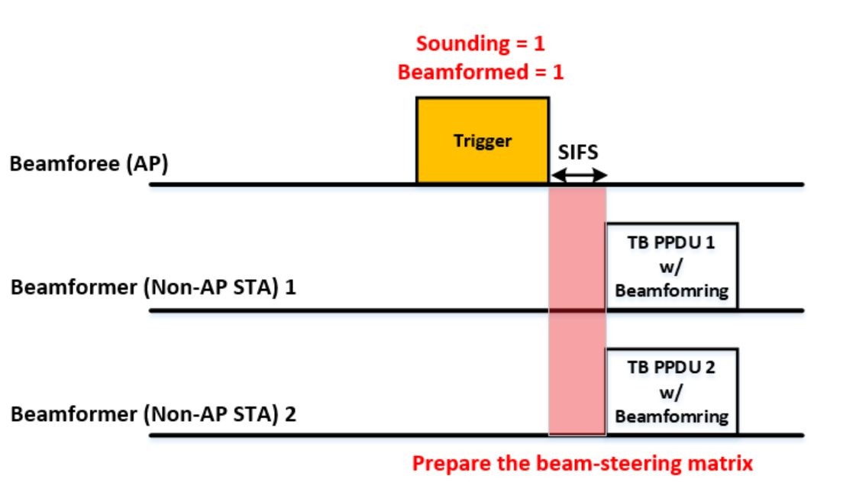
Option 1: Trigger Frame based Implicit UL BF
Procedure
  AP transmits Trigger frame and Non-AP STAs prepare for the beam-steering matrix by using the Trigger frame.
    “Sounding” field is set to 1 in the PHY header (e.g. UHR-SIG) of the Trigger frame.
    “Beamformed” field is set to 1 in the User Info field of the Trigger frame.
  Corresponding non-AP STAs transmit beamformed TB PPDU.
  If both “Sounding” and “Beamformed” fields are set to 0, TB PPDU is transmitted without beamforming.

Slide 4
Sounding and Beamformed Fields
Sounding
  A new “Sounding” field is introduced to indicate Non-AP STAs to prepare for beam-steering matrix.
  “Sounding” field is in the PHY header (e.g. UHR-SIG) in the Trigger frame.
    This is to give Non-AP STAs enough time to prepare beamformed TB PPDU, which is transmitted SIFS after Trigger frame.
Beamformed
  AP solicits beamformed TB PPDU using Trigger frame to non-AP STAs, where new “Beamformed” field is set to 1.
    Ex) Use B25 in the User Info field, which is reserved in 11be.
 | B0 B11 | B12 B19 | B20 | B21 B24 | B25 | B26 B31 | B21 B38 | B39
 | AID2 | RU Allocation | UL FEC Coding Type | UL UHR-MCS | Beamformed | SS Allocation/RA-RU Information | UL Target Receive Power | PS160 | Trigger Dependent User Info
Bits: | 12 | 8 | 1 | 4 | 1 | 6 | 7 | 1 | variable
[Exemplary design based on 11be]

Slide 5
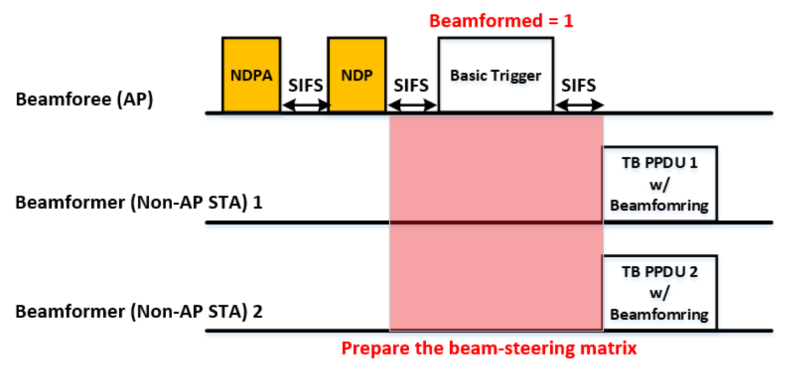
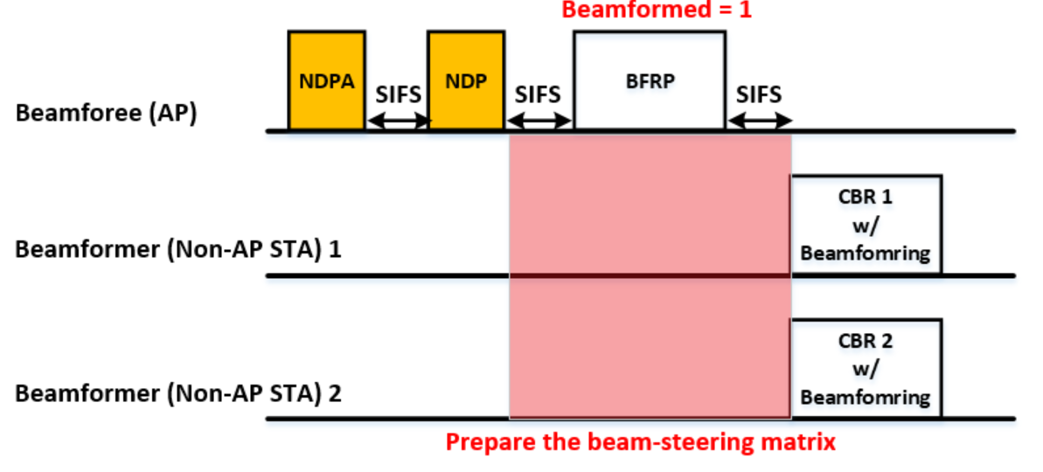
Option 2: Sounding Frame based Implicit UL BF
Procedure
  AP transmits the NDPA and NDP, and Non-AP STAs prepare for the CBR (Compressed Beamforming Report) frame.
    This process is the same as the conventional sounding process.
  (Case 1) AP transmits Basic Trigger frame.
    Non-AP STAs transmits beamformed TB PPDU using a beamforming-steering matrix derived from the CBR.
  (Case 2) AP transmits BFRP Trigger frame.
    Non-AP STAs transmits beamformed CBR using a beamforming-steering matrix derived from the CBR.

Slide 6
Summary
We propose new protocols to support UL implicit beamforming in UHR
  Option 1: Trigger frame based implicit UL BF
    Pros:
      No sounding process is required.
    Cons:
      There is a risk of lack of time to prepare for the beam-steering matrix.
  Option 2: Sounding frame based implicit UL BF
    Pros:
      Existing DL sounding processes can be reused.
      There is enough time to preparing for the beam-steering matrix.
      Beamformed CBR feedback is possible.
    Cons:
      There is larger overhead compared with option 1.

Slide 7
Reference
[1] 802.11-20/1672r0, UL Beamforming for TB PPDUs in 11be.
[2] 802.11-24/xxxxr0 Protocol Design for UL Beamforming.

