Slide 1
Discussion on A-PPDU follow-up
Date: 2024-05-08
Authors:
Name | Affiliations | Address | Phone | email
Ross Jian Yu | Huawei |  |  | ross.yujian@huawei.com
Ming Gan
David Xun Yang
Yan Xin
Stephen McCann

Slide 2
Recap
In [1], three preferred modes are proposed:
Other modes, for example, EHT+UHR, need further study, depending on the benefits of UHR features, when compared with a standalone EHT PPDU.
Opt (1) and (d) are proposed because large bandwidth OFDMA is optional for a non-EHT HE non-AP STA, and seldom applied.
80 MHz
HE PPDU
80 MHz
HE PPDU (by UHR STA)
(1)
HE PPDU
80 MHz
HE PPDU
160 MHz
80 MHz
HE PPDU (by UHR STA)
UHR PPDU
UHR PPDU
160 MHz
160 MHz
(a)
(d)

Slide 3
A-PPDU Q&A clarifications
Q1: HE MU PPDU has to be used for PPDU alignment in DL. The use case is limited.
Below are the replies:
For HE 80 + HE 80, an HE SU PPDU can be used. If Only two users are scheduled, this can be frequently used.
For HE + UHR, HE MU PPDU is needed.
Case 1: HE MU PPDU is transmitted to two or more users.
Case 2: HE MU PPDU is transmitted to one user (optional feature).
Case 3: HE MU PPDU is transmitted to one user and one dummy user.
Some spectrum is wasted, but can earn more spectrum back.
This can also be frequently used.
Q2: HE STAs are two generations away.
Below are the replies:
Legacy devices are used quite often, especially in home scenario.
There is report forecasting $7.96 billion of Wi-Fi 6E devices market size by 2030 [2].
Wi-Fi 6 and Wi-Fi 6E devices keep increasing until 2025 (no data beyond that) [3].

Slide 4
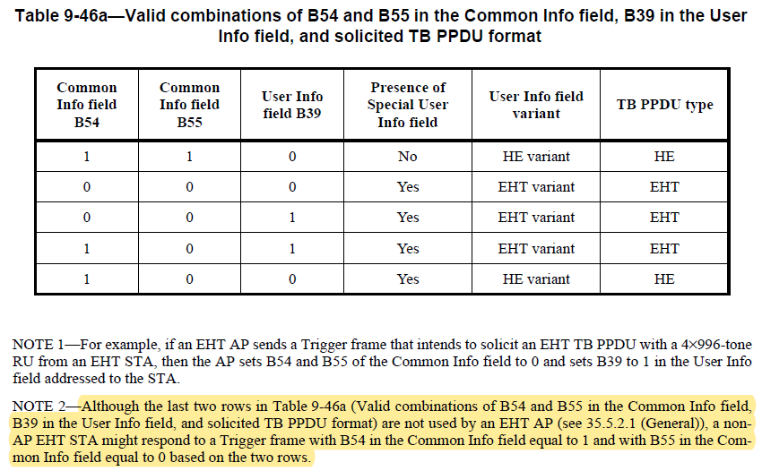
TB A-PPDU in 11be
In 802.11be, the trigger frame can enable an A-PPDU of HE TB PPDU and EHT TB PPDU whilst the spec disallows the AP to do that.
B54 is set to 1 to indicate HE TB PPDU in P160, B55 is set to 0 to indicate presence of Special User Info field, which indicates EHT TB PPDU exists. Then in User Info field, B39 is set to 0 to indicate P160, which means HE variant User Info field, B39 is set to 1 to indicate S160, which means EHT variant User Info field.
Trigger frame
HE TB PPDU
160 MHz
…
EHT TB PPDU
(BW=320MHz-1/2)
160 MHz
Non-HT Duplicate

Slide 5
TB A-PPDU in 11bn
If we allow a UHR AP can use the last two rows, then TB A-PPDU of HE TB PPDU and EHT TB PPDU is doable with no further efforts. HE non-AP STA and EHT non-AP STA can transmit HE TB PPDU, UHR non-AP STA can transmit EHT TB PPDU. EHT non-AP STA may also participate in EHT TB PPDU if there is no interoperability issue.
Furthermore, if PHY Version Identifier is set to UHR, then TB A-PPDU of HE TB PPDU and UHR TB PPDU is straightly doable.
Other modes need some further works.

Slide 6
DL(non-TB) A-PPDU in 11bn
DL A-PPDU is not discussed in detail in 11be.
Within A-PPDU, each PPDU indicates its own bandwidth, with DSO or SST [1].
Moreover, the aggregated bandwidth, or exact bandwidth combinations may also be signaled (needs further study).

Slide 7
Summary
In this contribution, some questions from previous presentations are further clarified.
Regarding the benefits, the cases of HE 80 + HE 80 and HE 160 + UHR 160 can double the Tput. The case of HE 80 + HE 80 + UHR 160 can result in a four times Tput gain. They can also reduce the latency.
A-PPDU can be used together with dynamic subband operation (DSO) or subband selective transmission (SST).

Slide 8
Straw Poll #1
Do you agree to include the following into the 11bn SFD?
11bn defines frequency domain aggregation of aggregated PPDUs. A frequency domain aggregated PPDU consists of multiple PPDUs.
The PPDU format combinations include HE PPDU, other PPDUs are TBD.
The number of PPDUs is TBD.
Y
N
A

Slide 9
Straw Poll #1
Do you agree to include the following into the 11bn SFD?
11bn defines frequency domain aggregation of PPDUs. A frequency domain aggregated PPDU consists of multiple PPDUs.
The PPDU format combinations are TBD.
The number of PPDUs is TBD.
Y
N
A

Slide 10
Straw Poll #2
Do you agree to include the following into the 11bn SFD?
11bn defines frequency domain aggregation of an 80 MHz HE PPDU and 80 MHz HE PPDU.
Y
N
A

Slide 11
Straw Poll #3
Do you agree to include the following into the 11bn SFD?
11bn defines frequency domain aggregation of a 160 MHz HE PPDU and 160 MHz UHR PPDU.
Y
N
A

Slide 12
Straw Poll #4
Do you agree to include the following into the 11bn SFD?
11bn defines frequency domain aggregation of an 80 MHz HE PPDU, 80 MHz HE PPDU and 160 MHz UHR PPDU.
Y
N
A

Slide 13
References
https://mentor.ieee.org/802.11/dcn/23/11-23-1865-01-00bn-discussion-on-sst-and-a-ppdu.pptx
https://www.industryarc.com/Research/wifi-6E-devices-market-research-800237#:~:text=Wi%2DFi%206E%20Devices%20Market%20size%20is%20estimated%20to%20reach,devices%20that%20require%20wireless%20connectivity
https://www.wi-fi.org/beacon/the-beacon/wi-fi-by-the-numbers-technology-momentum-in-2023

