Slide 1
802.15 Liaison Report – March 2024
Date: 2024-03-12
Authors:

Slide 2
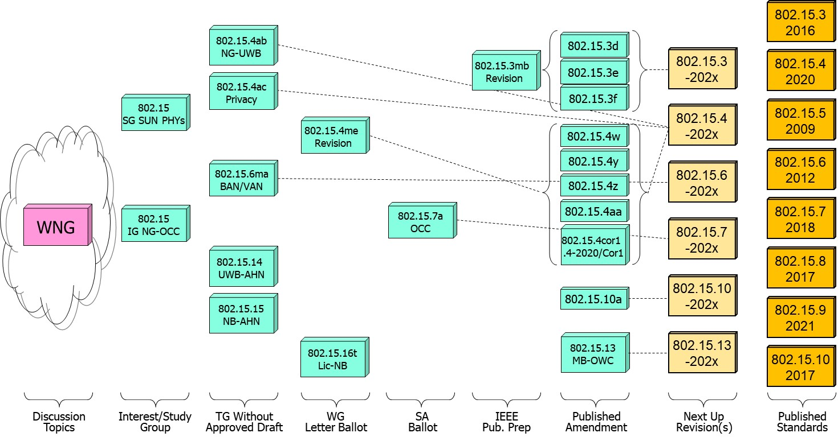
802.15 WG Standards Pipeline (Jan. update)

Slide 3
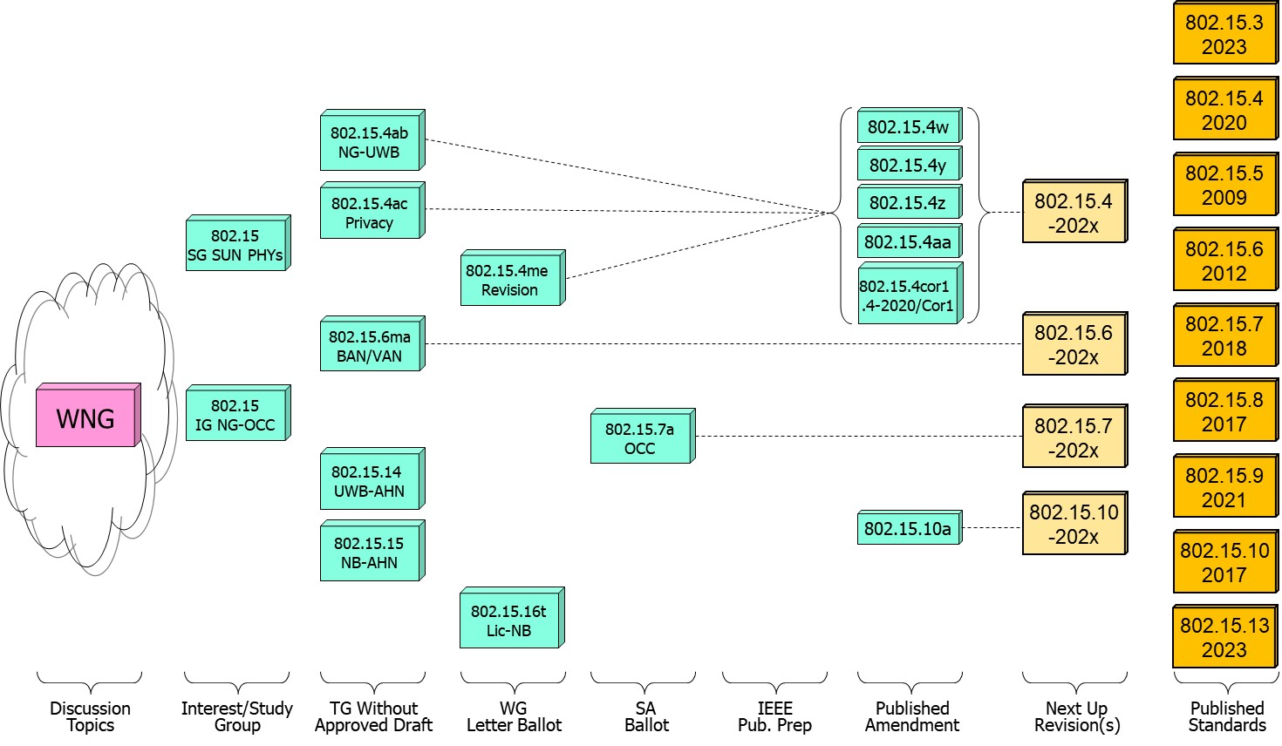
802.15 WG Standards Pipeline (updated)

Slide 4
SG Next Generation SUN PHYs
What is it?
  Next Gen (2nd ) SUN/Smart Utility Network OFDM (802.15.4 amendment)
  Higher data rates and longer range PHY enhancements through improved link budget.
  Enablement of city wide simple star networks, dense networks with >10K nodes, Power efficient for battery operated end node.
  Target PHY is the existing SUN-OFDM PHY .
Status:
  Early stages of development;
  Review properties of target spectrum (channel masks, channel scheme, modulation)
  Continue use case development

Slide 5
802.15.4ab Next Generation UWB
What is it:
  Builds on 802.15.4z increasing footprint and usefulness to additional usages beyond range measurement and improve IR signal limitations.
  Main areas of enhancements:
    Ranging resiliency and improved
    Waveforms optimization and support for sensing usages
    Improved data rates
    Support for additional spectrum
    Interference mitigation and co-existence with other wireless (802.11, BLE).
Status:
  Continue comment resolution for pre-WG approved draft.

Slide 6
802.15.4ab Next Generation UWB
Major areas of discussion:
  Continue CR for pre-approved draft.
  Continued discussion of co-existence and LBT of NB operation.

Slide 7
802.15.4ac Privacy
What is it:
  Modifications to the IEEE Std 802.15.4 medium access control (MAC address in frames, group address/PAN ID)
  Improved user privacy to protect from user tracking and profiling attack.
  Amongst the mechanisms MAC address randomization and rolling MAC address.
Status:
  In draft development; targeting initial draft out of May meeting.
  First draft of primitives' requirements.
  Progress on the identified issues of current standard: static MAC address , MAC address set across multiple radios in a single physical device, MAC address refresh, security context refresh for group and unicast, network discover and more.

Slide 8
802.15.16t Narrow Band Licensed Operation (NB-Lic)
What is it:
  Licensed Narrow Band (NB) Operation in channels bandwidth between 5 – 100KHz in the VHF/UHF bands such as 160MHz, 450MHz, 700MHz and 900MHz, taking advantage of the superior channel propagation properties. Targeted usages mission critical operation.
Status and main discussion topics:
  In advanced stage of WG letter ballot (D1.1).

Slide 9
802.15.6ma - Enhanced Dependability Body Area Network (ED-BAN)
What is it:
  Enhancements to the BAN (Body Area NW) Ultra Wideband (UWB) physical layer (PHY) and media access control (MAC) to support enhanced dependability to a human BAN (HBAN) and support for vehicle body area networks (VBAN).
  This revision focuses on international operation.
Status:
  In development of initial draft, most focus on PHY protocol aspect (coex 15.4ab)
  Evaluation of ranging functionality performance
  Preliminary MAC frame formats in support of PHY development

Slide 10
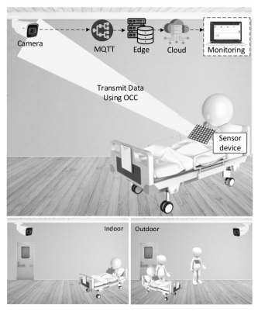
Next Generation Optical Camera Communication (OCC)
What is it:
  Interest group to evaluate the value of a new OCC standard with focus on 190-10K nm
  Future applications include indoor/outdoor and submerged applications with data rates of 100Mbps and mobility of up to 350Km/h and 200m range.
Technology and techniques considered:
  Introduction of MIMO OFDM, relaying and heterogenous operation (RF based networks).
Status:
  In initial stages, group reviewed submissions on benefit of GAN based AI and software defined vehicular network.

Slide 11
