Slide 1
802.18 Liaison Report – March 2024
Date: 13 March 2024
Author:

Slide 2
RR-TAG at a glance
Membership as of 12 March 2024
  58 voters (including 8 on LMSC)
  3 nearly voters
  14 aspirants
Officers
  Chair: Edward Au (Huawei Technologies)
  Co-Vice Chair: Stuart Kerry (OK-Brit; Self)
  Co-Vice Chair: Al Petrick (Skyworks Solutions)
  Secretary: VACANT
  IEEE SA Program Manager: Jodi Haasz (IEEE SA)
Ad-hoc chair
  IEEE Statement Update on Spectrum (ISUS): VACANT

Slide 3
Progress since the 2024 January interim
Reviewed the latest ongoing consultations:
  US FCC: 6 GHz Second Further Notice of Proposed Rulemaking
Approved the following IEEE 802 LMSC submission:
  Colombia ANE: 6 GHz band coexistence study
Discussed the latest topics related to spectrum and regulation in Europe, North America, and Asia Pacific.
Update from ETSI BRAN on 18 January 2024.

Slide 4
Objectives this week (1)
Review and consider approval of an IEEE 802 LMSC’s response to the following consultations
  US FCC: 6 GHz Second Further Notice of Proposed Rulemaking
    Draft response: 18-24/0007
  US NSF: Request for Information on the National Spectrum Research and Development Plan (Tentative)
Discuss the latest topics related to spectrum and regulation in Europe, North America, and Asia Pacific
  ETSI BRAN March 2024 update
  Update on UWB Regulation Framework in Europe
  Overview on CEPT ECC Report in PC on OOB limits for VLB RLAN in 6 GHz

Slide 5
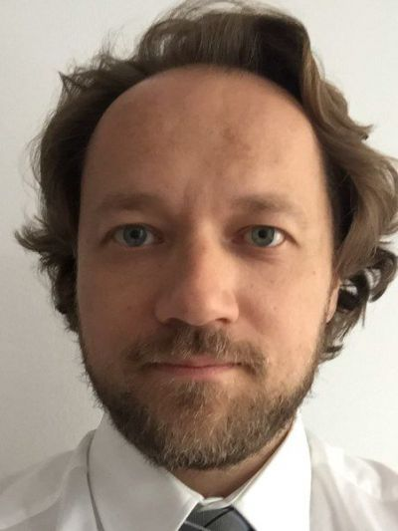
Objectives this week (2)
Invited presentation (bimonthly members enrichment activities)
  Title: The RSPG Work Programme for 2024-2025
  Speaker: Dr. Aleksander Sołtysik
    Chair, European Commission Radio Spectrum Policy Group
    Permanent Representation of Poland to the European Union
  Document: 18-24/0025
Source: Aleksander Soltysik

Slide 6
Objectives this week (3)
Conduct officer election by using DirectVote Line
Chair candidate:
  Edward Au (Huawei Technologies)
Vice Chair candidates (in alphabetical order of their family names):
  Stuart Kerry (OK-Brit; Self)
  Gaurav Patwardhan (Hewlett Packard Enterprise)
  Al Petrick (Skywork Solution)
  Ben Rolfe (Blind Creek Associates)

Slide 7
THANK YOU VERY MUCH for your support
Thank you very much for all of your support these 2 years:
34 submissions to consultations issued by 19 administrations all over the world, with increasing number of comments accepted/recognized
11 submissions to ITU-R WP5A through collaboration with IEEE 802.11 ITU AHG
3 IEEE SA Government Engagement Program on Standards webinars
6 invited presentations as part of the member enrichment activities (one per mixed-mode plenary/interim since May 2023)

Slide 8
Goals for the next two-year term
Focus Area | Option | Concept
Identify opportunities | Public consultations | Continue to advocate for policies that can support the growth of the 802 wireless-related ecosystems by contributing to relevant regulatory consultations worldwide.
Increase the awareness | 802 participants centric | Drive excitement for spectrum and regulation topics through the bimonthly members enrichment activities.
 | Policy makers centric | Partner with IEEE SA to organize webinars with policy makers through the IEEE SA Government Engagement Program on Standards (GEPS).

