Slide 1
Update on Dual Band Operation
Date: 2024-01-17
Authors:

Slide 2
Abstract
This document analyses the suitability of different frequency bands for AMP devices.
Additionally, it shows the benefits of dual-band operation.

Slide 3
Motivation
Backscatter communication for AMP was proposed for different frequency bands
Recent analyses shows only very short communication distances with 2.4 GHz [5]
This presentation shows further analyses on the discussed frequency bands

Slide 4
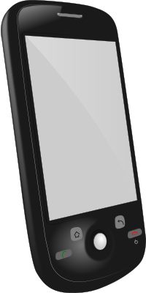
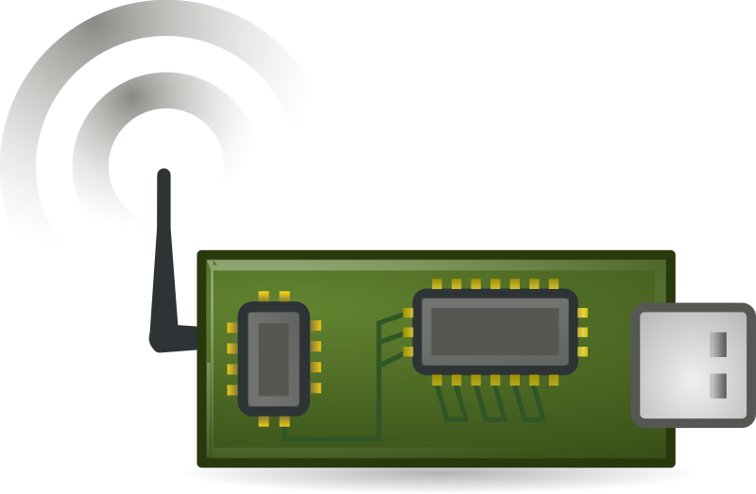
Backscatter Full Duplex Issue
e.g. f_{c}=915MHz, P_{TX}=36dBm
P_{RX}=P_{TX}
e.g. f_{c}=915MHz±Δf, P_{RX}=-80dBm
Interrogator
AMP STA
Backscatter modulation is full duplex with typically a small frequency offset Δf < 1MHz [1]
Full duplex with high deltas between P_{TX} and P_{RX} in the very same device is very challenging [2]
Proven technology for UHF RFID [1]
Challenging in tiny and cost-sensitive smartphones

Slide 5
Effect of the Signal Frequency on Backscatter Communications
For Line-of-Sight the well known Friis equation describes the free space path loss [3, 5]
The pathloss depends on the frequency f
The real reason is the smaller antenna aperture for the assumed antenna gain of 0dBi
Higher frequencies allow for high gain antennas with small dimensions, but they will get directive

Slide 6
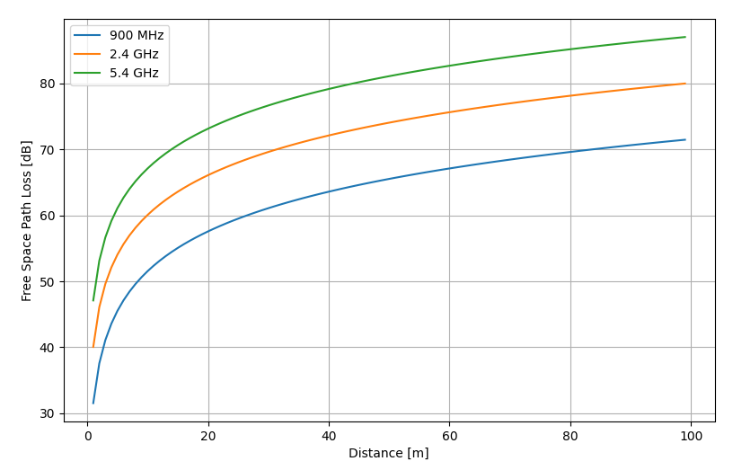
Free Space Path Loss
Example for 10m:
900MHz → 51dB
2.4GHz → 60dB
5.4 GHz → 67dB

Slide 7
Radar Equation
Interrogator
Backscatter AMP Device
A backscatter AMP STA is only able to reflect the signal from the interrogator
The propagation loss due to the Free Space Path Loss has to be considered twice!
Radar Equation

Slide 8
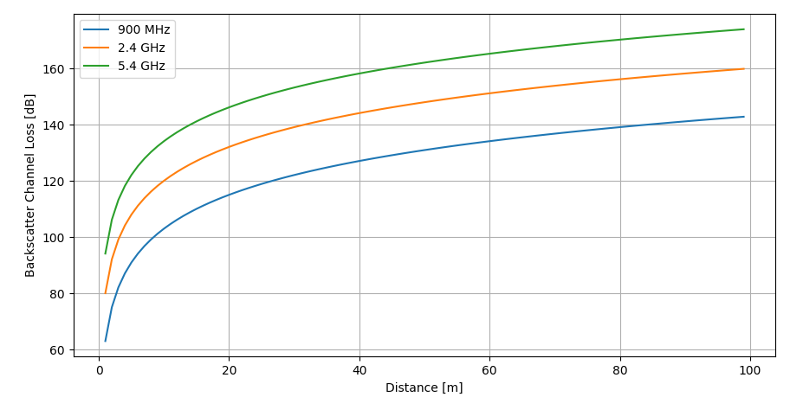
Backscatter Channel Loss (Radar Equation)
Example for 10m:
900MHz → 103dB
2.4GHz → 120dB
5.4 GHz → 134dB

Slide 9
Some Observations
Free Space Path Loss shows the effect on the wireless energy transfer
  For a distance of 10m 900MHz has a gain of 9dB compared to 2.4GHz
  Higher antenna gains will not help (e.i.r.p. limit, directivity)
Backscatter Channel Loss shows the effect on the backscatter communication for a co-located reader
  For a distance of 10m 900MHz has a gain of 17dB compared to 2.4GHz
  Higher antenna gain will only help on the interrogator side for RX

Slide 10
Effect of Frequency Regulation in Europe
In Europe the frequency regulation allows [3,7]
  868 MHz: 500mW e.r.p. (equivalent to approx. 1W e.i.r.p)
  2.4 GHz: 100mW e.i.r.p. for broadband signals (PSD limit!!)
  2.4 GHz: 10mW e.i.r.p. for narrowband signals
The higher transmit powers for backscatter modulation and wireless energy transfer are only available in the 868MHz band
Higher transmit powers in 2.4GHz require wideband signals [7] ➔ Very high channel utilization due to low downlink bit-rates and potentially long charging times

Slide 11
Overall Impact of the Frequency
2.4GHz has a significantly higher path loss
2.4GHz does not allow for high transmit powers
Offers only very short communication ranges [5]
Do we really want to waste the 2.4GHz spectrum for low rate communications with very high powers?

Slide 12
Dual-Band Operation [6]
f_{c}=868 or 915MHz
f_{c}=2.4GHz
Interrogator
Passive AMP STA
Use sub-GHz for the downlink and the energy transfer
Use 2.4GHz for the uplink
Continuous power transfer during communication, but without full-duplex issue!

Slide 13
Benefits Dual-Band Operation
Presentation [6] shows the feasibility using a link-budget analyses
The low-rate downlink and energy transfer is done in the sub-GHz band
  Higher powers and lower losses for wireless energy transfer
  No long-time utilization of the valuable 2.4GHz spectrum
  Feasibility of multi-frequency sub-GHz devices (e.g. 868MHz, 915MHz) as used in UHF-RFID [1]
The uplink signals in 2.4GHz are very short and consume negligible spectrum resources
Easy integration in small devices as full duplex is not required, and smartphones already support the bands

Slide 14
Summary
Full duplex may be problematic if smartphones are used as “interrogators”
2.4GHz shows many disadvantages for backscatter communications
2.4GHz is too valuable for long wideband signals
Dual-band operation combines the advantages of sub-GHz and 2.4GHz
Possibility of simple interrogators, e.g. smartphones(that already support all frequencies …)

Slide 15
Literature
[1] K. Finkenzeller: “RFID handbook: fundamentals and applications in contactless smart cards, radio frequency identification and near-field communication”, John Wiley & Sons; 2010
[2] Full-Duplex TIG Report, 11-18/498r8
[3] https://en.wikipedia.org/wiki/Free-space_path_loss
[4] IEEE 802.11-23/1562r8, Draft Technical Report on support of AMP IoT devices in WLAN
[5] IEEE 802.11-24/0075r0, Follow Up on AMP Link Budgets
[6] IEEE 802.11-23/0876r0, X-Band Operation
[7] IEEE 802.11-24/0056r0, How 802.11ba Handled SNR

