Slide 1
R-TWT Coordination Negotiation in Multi-BSS
Date: 2024-03-10
Authors:
Name | Affiliation | Address | Phone | Email
SunHee Baek | LG Electronics | 19, Yangjae-daero 11gil, Seocho-gu, Seoul 137-130, Korea |  | sunhee.baek@lge.com
Jinsoo Choi |  |  |  | js.choi@lge.com
Insun Jang |  |  |  | insun.jang@lge.com
Yelin Yoon |  |  |  | yl.yoon@lge.com
Geonhwan Kim |  |  |  | geonhwan.kim@lge.com
DongJu Cha |  |  |  | dongju.cha@lge.com
Eunsung Park |  |  |  | esung.park@lge.com
Dongguk Lim |  |  |  | dongguk.lim@lge.com
Jinyoung Chun |  |  |  | jiny.chun@lge.com
Insik Jung |  |  |  | insik0618.jung@lge.com
HanGyu Cho |  |  |  | hg.cho@lge.com
Sanggook Kim |  | 10225 Willow Creek Rd, San Diego, CA, USA |  | sanggook.kim@lge.com

Slide 2
Introduction
The R-TWT coordination in Multi-BSS is related to expanding the operation and protection of the R-TWT schedule in the existing single BSS, which is discussed in TGbn, [1] ~ [13].
Since the R-TWT coordination is an operation on Multi-BSS, AP and OBSS AP can agree/negotiate their R-TWT schedule(s) to minimize the interference from the other schedule(s) of the other BSSs.
  For example, when an AP and OBSS AP aren’t located in the same ESS, they can operate a negotiation for the R-TWT coordination.
In this contribution, we suggest how to negotiate R-TWT schedule(s) between APs.

Slide 3
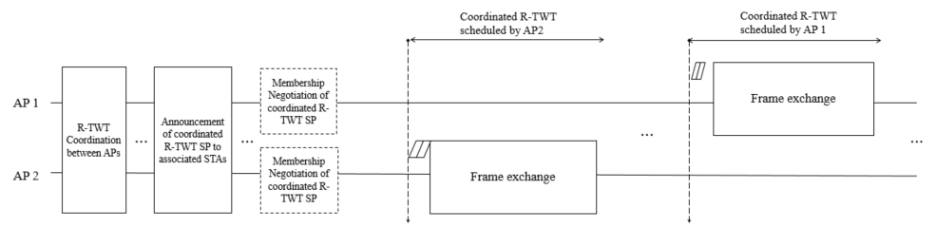
Overview
In Multi-BSS, if a coordinated R-TWT schedule(s) is set through negotiation between APs, the influence between the R-TWT schedules of each AP can be minimized.
  During the R-TWT coordination, APs exchange schedule information for R-TWT to coordinate it.
    The coordination for R-TWT schedule between APs is carried out through the frames containing the TWT Parameter set(s) for the coordination request and/or the coordination response.
    The frame containing the TWT Parameter set(s) for coordination request can be initialized from an AP to the other AP located within the range of transmitting/receiving the Beacon frame.
  As the result of the R-TWT coordination, APs obtain the coordinated R-TWT schedule(s).
Main Point

Slide 4
Signaling Method for R-TWT Coordination
In the current spec, a TWT schedule negotiation between AP and STA is performed through TWT setup frame. Therefore, there are two options depending on whether the TWT setup frame is used or not, as follows;
  Option 1) Use TWT element in TWT setup frame.
    The fields related to the schedule information within the TWT element shall be used in R-TWT coordination.
      E.g., TWT interval, duration of TWT schedule, TWT(Target Wake Time)
    The schedule information of R-TWT can be set based on the neighboring AP’s TSF.
      The neighboring AP’s TSF can be obtained from the overhearing Beacon frame.
    If the additional information not in the TWT element for R-TWT coordination is needed, the new element for the additional information can be added to the TWT setup frame in R-TWT coordination. (e.g., AP coordination scheme, EDCA Parameter Set of AP(/STA))
  Option 2) Define new element or frame based on TWT element in TWT setup frame.
    If too much information needs to be changed when the TWT element in TWT setup fame is used to coordinate the R-TWT schedule between APs, a new element/frame may needs to be defined.
      The new element/frame includes the needed information only to coordinate the R-TWT schedule between APs.
      For example, the TWT setup command can be set to one of values among Request, Accept, or Reject.

Slide 5
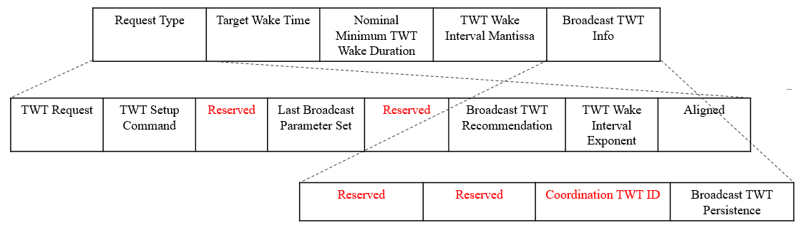
TWT element for R-TWT Coordination
    If the option 1 is used, the information within the TWT element for R-TWT coordination is used as it is, and the other information not used in the R-TWT coordination may be replaced with the reserved or the new one(s).
  The (sub)fields related to the schedule information of R-TWT remain to be used.
    Target Wake Time, Nominal Minimum TWT Wake Duration, TWT Wake Interval Mantissa, TWT Wake Interval Exponent, Broadcast TWT Persistence
  Also, the (sub)fields related to indicate a purpose of transmitted info. in the TWT setup frame remain to be used.
    TWT Request, TWT Setup Command, Broadcast TWT Recommendation
  The other subfields not to be used between APs are replaced to the Reserved or the new subfield(s).
    Ex1) The Trigger, Flow Type, Restricted TWT Traffic Info Present, and Restricted TWT Schedule Info subfields can be changed to the Reserved subfields.
    Ex2) The Aligned subfield can be interpreted to the Overlapped TWT subfield to indicate whether the R-TWT schedule is coordinated to overlapped with an OBSS R-TWT schedule.
    Ex3) The Broadcast TWT ID subfield can be replaced with the Coordinated TWT ID subfield to indicate the schedule information of R-TWT to coordinate between APs as an ID.
*Black txt indicates same (sub)field from the original TWT element.
*Red txt indicates different (sub)field from the original TWT element.

Slide 6
R-TWT Coordination Request/Response
If the option 1 is used, the TWT setup frame for the R-TWT coordination can be consisted of the TWT Parameter set field(s) by including the following purposes.
  The TWT Parameter set field for Coordination Request is a TWT Parameter set field that includes the schedule information of R-TWT to request the R-TWT coordination.
    The TWT Request subfield is set to 1.
    TWT Setup Command subfield is set to 0(Request TWT), 1(Suggest TWT), or 2(Demand TWT).
  The TWT Parameter set field for Coordination Response is a TWT Parameter set field that includes the response to the received the TWT Parameter set field for Coordination Request.
    The TWT Request subfield set 0.
    The TWT Setup Command subfield set 4(Accept TWT) 5(Alternate TWT), 6(Dictate TWT), or 7(Reject TWT).
  An AP can aggregate the TWT Parameter set field(s) for Coordination Response and the TWT Parameter set field(s) for Coordination Request within a TWT element.
    The TWT Parameter set field(s) for Coordination Response is based on the received the TWT Parameter set field for Coordination Request.
    And then, the TWT Parameter set field(s) for Coordination Request can be added after the TWT Parameter set field(s) for Coordination Response.

Slide 7
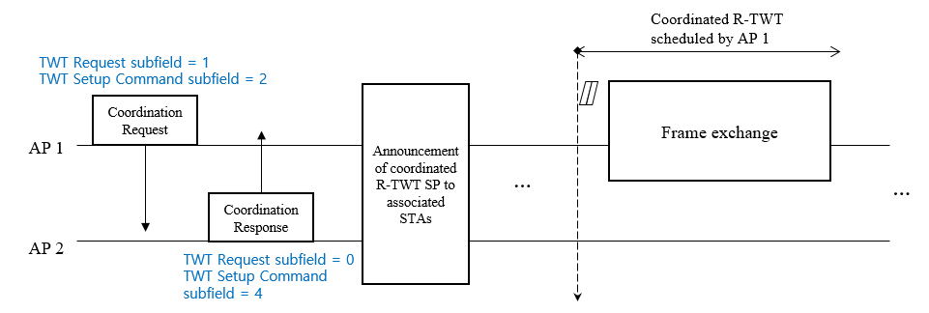
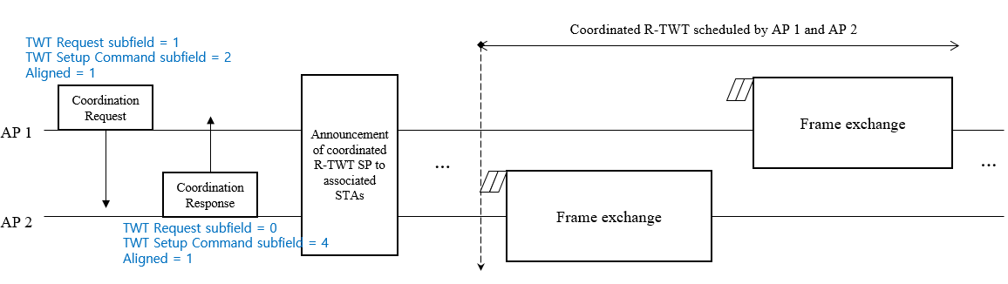
R-TWT Coordination: Example 1
The frame for R-TWT coordination can be exchanged by including the TWT Parameter set(s) for Coordination Request or Coordination Response.
  AP 1 → AP 2: Coordination Request for the schedule information of R-TWT of AP 1
  AP 2 → AP 1: Coordination Response to accept the received Coordination Request
  AP 1 → AP 2: Coordination Request for the schedule information of R-TWT of AP 1 and AP 2
  AP 2 → AP 1: Coordination Response to accept the received Coordination Request
[Case 1]
[Case 2]

Slide 8
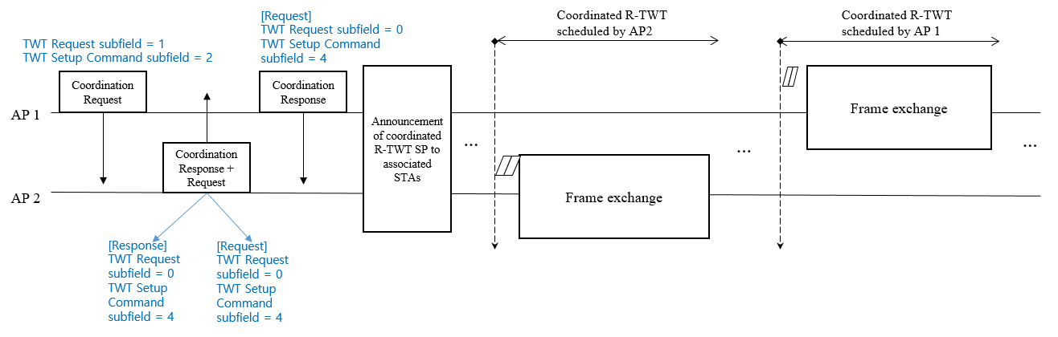
R-TWT Coordination: Example 2
The frame for R-TWT coordination can be exchanged by including the TWT Parameter set(s) for Coordination Request and/or Coordination Response.
  AP 1 → AP 2: Coordination Request for the schedule information of R-TWT of AP 1
  AP 2 → AP 1: Coordination Response to accept the received Coordination Request & Coordination Request for the schedule information of R-TWT of AP 2
  AP 1 → AP 2: Coordination Response to accept the received Coordination Request

Slide 9
Conclusion
In this contribution, we propose a negotiation singling methods and procedures for R-TWT schedule(s) coordination between an AP and neighboring AP.
  Signaling Method for R-TWT coordination between APs
    Option 1) Use the TWT element in TWT setup frame
    Option 2) Define new element/frame
  Procedure of R-TWT coordination between APs
    Ex1) The exchanged frame includes the TWT Parameter set(s) corresponding to the Coordination Request(s) or the Coordination Response(s)
    Ex2) The exchanged frame includes the TWT Parameter set(s) corresponding to the Coordination Request(s) and/or the Coordination Response(s)
      It should need to be limited to more than 3 steps.

Slide 10
Straw Poll 1
Do you agree to add the following text to the TGbn SFD?
  The TWT setup frame is used to coordinate/negotiate the schedule information of R-TWT between AP and OBSS AP.
    The detail signaling is TBD.

Slide 11
Straw Poll 2
Do you agree to add the following text to the TGbn SFD?
  The TWT element is used to coordinate/negotiate the schedule information of R-TWT between AP and OBSS AP.
    The detail signaling is TBD.

Slide 12
Straw Poll 3
Do you agree to add the following text to the TGbn SFD?
  The (sub)fields not to use in TWT element within TWT setup frame for R-TWT coordination are replaced the reserved (sub)fields or the other (sub)fields.
    TBD is which (sub)fields are replaced.

Slide 13
Straw Poll 4
Do you agree to add the following text to the TGbn SFD?
  The new TWT element is defined to use to coordinate/negotiate the schedule information of R-TWT between AP and OBSS AP.
    The new TWT element is defined the necessary (sub)fields based on the current TWT element for R-TWT schedule information between APs.
    The detail signaling is TBD.

Slide 14
Straw Poll 5
Do you agree to add the following text to the TGbn SFD?
  The TWT setup frame exchanged between APs allows to include the new TWT Parameter set for coordination request(s) after the TWT Parameter set for coordination response(s).
    The TWT Parameter set for coordination request is corresponding to a TWT Parameter set field setting TWT Request subfield to 1.
    The TWT Parameter set for coordination response is corresponding to a TWT Parameter set field setting TWT Request subfield to 0.
    The names of coordination request and coordination response are TBD.

Slide 15
References
[1] 23/771 Coordinated of R-TWT Protection in Multi-BSS
  [2] 23/226 Coordination of R-TWT for Multi-AP Deployment
  [3] 23/250 AP coordination with R-TWT
[4] 23/291 R-TWT Multi-AP Coordination
[5] 23/293 Follow-up on TWT-based Multi-AP Coordination
[6] 23/297 rTWT for Multi-AP
[7] 23/355 Enhanced R-TWT and M-AP operation
[8] 23/771 Coordinated R-TWT Protection in Multi-BSS
[9] 23/860 Further thoughts on coordinated TWT
[10] 23/1087 Announcement for R-TWT Coordination
[11] 23/1424 Follow-up on peer-to-peer(P2P) communication for UHR
[12] 23/1929 Further considerations on coordinated TWT
[13] 23/2022 R-TWT for multi-AP follow up

Slide 16
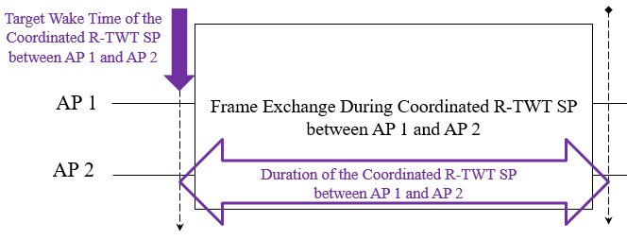
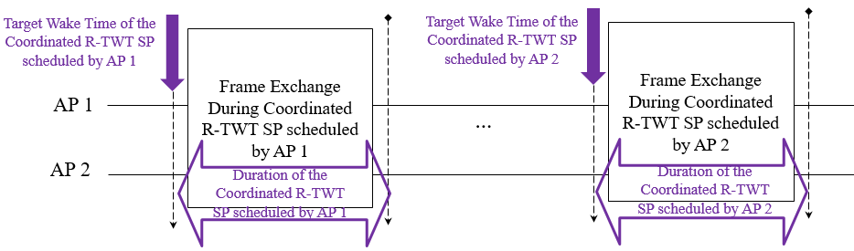
Appendix. R-TWT Coordination Types
Overlapped coordinated R-TWT schedule
  If the R-TWT schedules in R-TWT coordination request/response have the same values of TWT interval, TWT SP duration, and target wake time(TWT) based on the different TSFs of APs, APs coordinate them regarding as overlapped coordinated R-TWT schedule.
Non-overlapped coordinated R-TWT schedule
  If the R-TWT schedules in R-TWT coordination request/response have different values of TWT interval and target wake time(TWT) based on the different TSFs of APs, APs coordinate them as non-overlapped coordinated R-TWT schedule.
*The overlapped coordinated R-TWT schedule means fully overlapped schedule, so partially overlapped schedule doesn’t considered in this contribution.

