Slide 1
DirectVote Live (DVL)
Ieee standards association
September 2023

Slide 2
Roles and responsibilities
    Group Administrator (Staff Role)
    Person responsible for the group who creates the meetings
    The Group Administrator has the same privileges as the Meeting administrator
    Meeting Administrator (Staff or Volunteer Role)
    Person responsible for administering the meeting
      Responsible for uploading the current voters
      Sending meeting invitation
      Entering motions
      Opening/adjourning the meeting
      Opening/closing the motions
        Showing the results
  Voter
    Responsible for voting on the motions
        Third bullet level, click “increase indent” four times
  To return to the main body text style, click “decrease indent” until the right style appears

Slide 3
DirectVote Live (DVL)
Voting step-by-step
Ieee standards association
September 2023

Slide 4
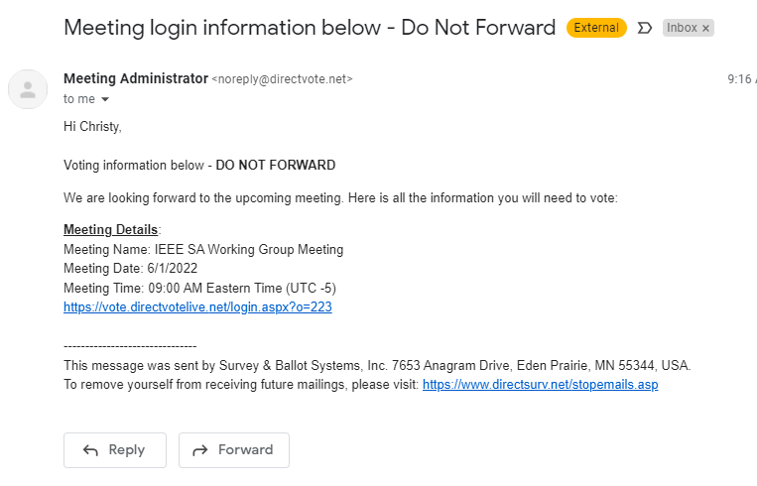
DVL E-mail Meeting Invitation
Click on the Meeting URL to enter the meeting (the meeting URL for the group does not change).

Slide 5
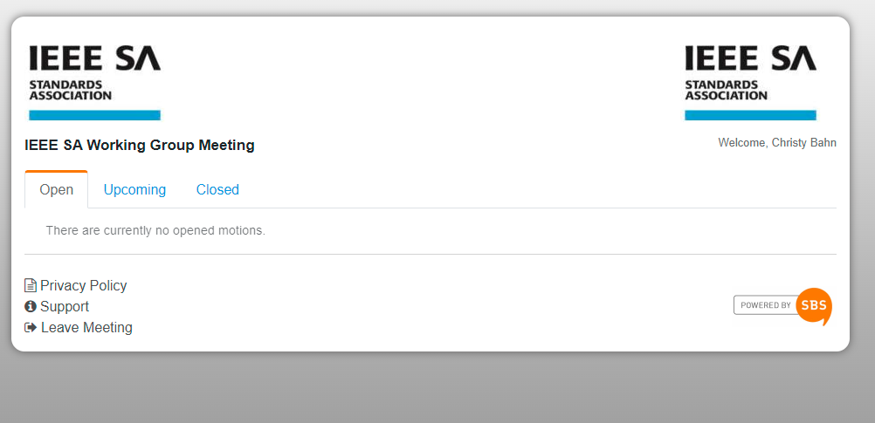
Voting interface
The meeting title
will appear here.
Notes:
Update SS

Slide 6
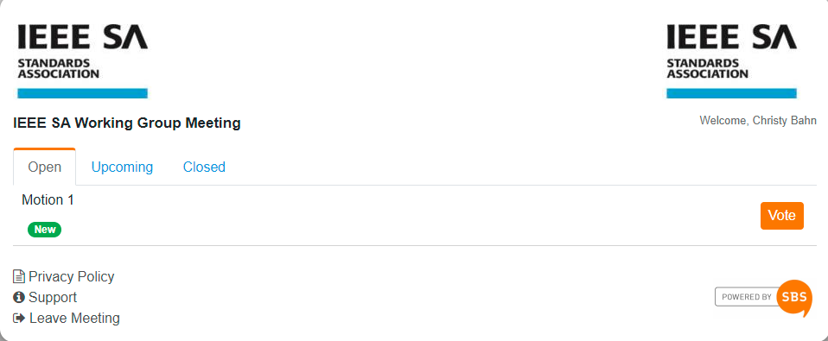
Motion
Locate the first motion being voted on and click the “Vote” button
The motion will not appear until it is opened for voting by the Meeting Administrator
Notes:
Put 10 and 11 together

Slide 7
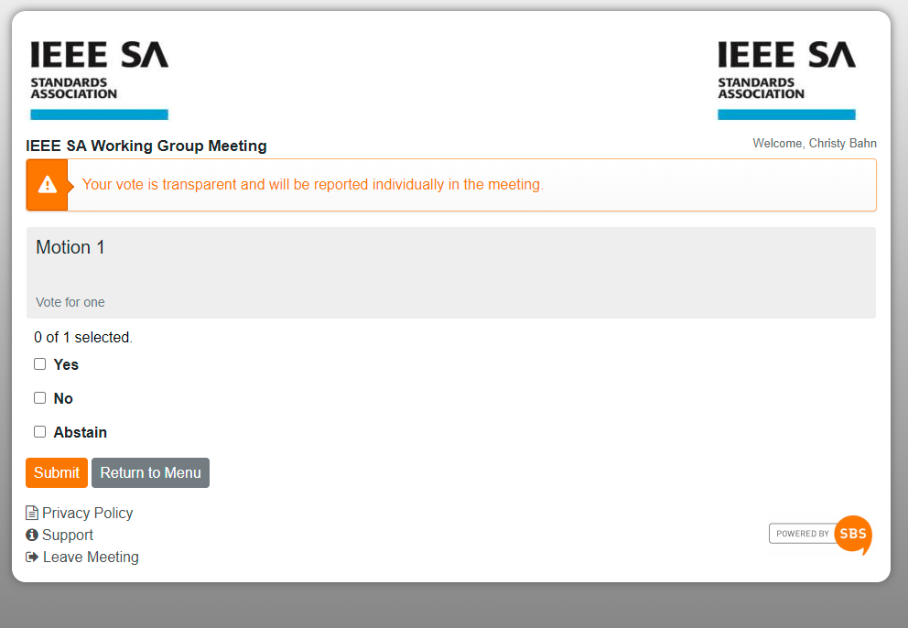
Casting your vote
Step 1 - Make your selection
{
Step 2 - Click “Submit” to record your vote
Notes:
Put 10 and 11 together

Slide 8
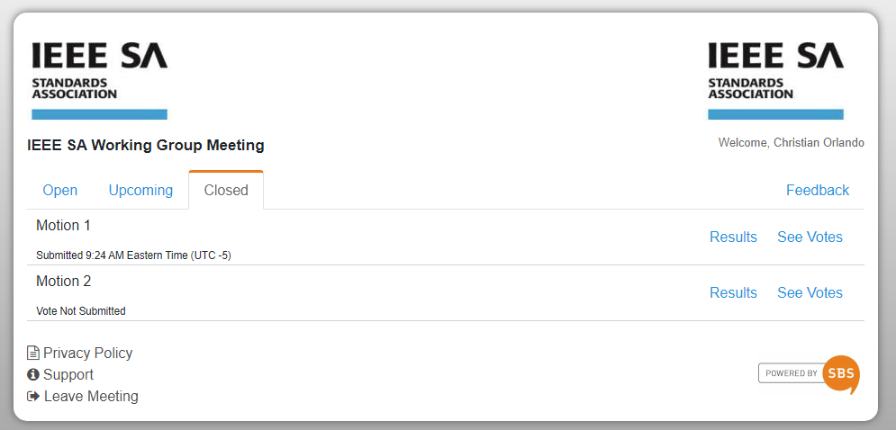
Has my vote been submitted and recorded?
YES: A “Submitted” status below a motion shows a time stamp indicating your vote has been recorded.
NO: A “Vote Not Submitted” status below a motion indicates that your vote has not been recorded.
Notes:
Put 10 and 11 together

Slide 9
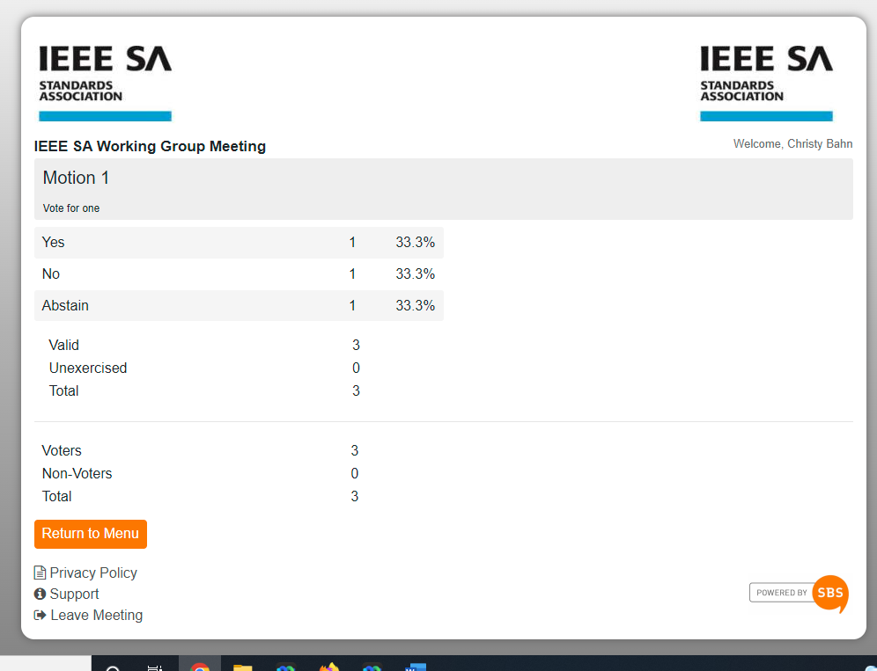
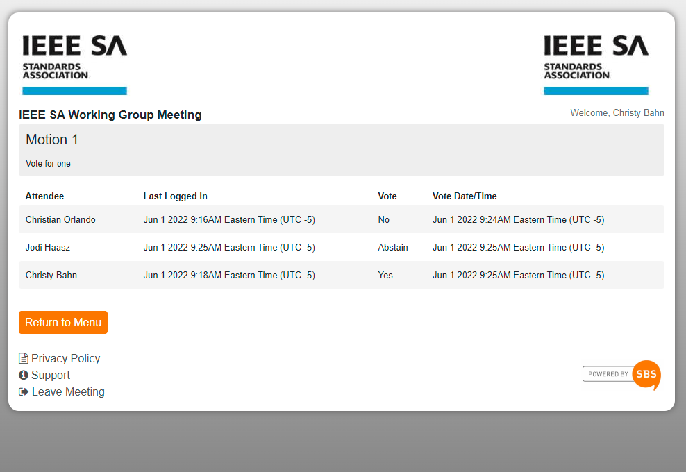
View votes/results
To view votes, select “See Votes”
To view results, select “Results”
Notes:
Replace 35/6

Slide 10
voting Results – terms
    Valid – The voter clicked “Vote,” selected an option, and clicked “Submit” for the motion.
    Unexercised – The voter clicked “Vote,” and then clicked “Submit” without choosing an option for the motion.
    Total – The total number of votes cast for the motion.
    Voters – The total number of voters for the motion that submitted a vote.
    Non-Voters – The total number of voters for the motion who did not submit a vote.
    Eligible Voters – The total number of voters signed into the voting tool to vote for the motion.
Notes:
Add SA LINK

Slide 11
FAQs

Slide 12
Frequently asked questions
    I can’t login to DVL. What do I do?
    You must be a voting member to access DVL.
    Verify your e-mail address used for your IEEE account. If you have recently changed your email address, please contact the DVL meeting administrator or your Program Manager.
    If you are still unable to login to DVL please contact your Program Manager or IEEE Contact & Support.
    The motion is open but I do not see the “Vote” button for the motion. What do I do?
    If a vote has started but you do not see the “Vote” button, refresh your screen by reloading the web page. If that does not work, please contact the DVL meeting administrator or your Program Manager.
    The DVL window or tab has closed, or I’ve received a message that my session has timed out or expired. What do I do?
    If at any time during the meeting you need to get back into DVL, log back in via the provided link.
    Why do the voting timestamps in DVL not match my local time?
    Unless otherwise indicated, voting timestamps within DVL are being represented in UTC -5.
    Can I be both a Meeting Administrator and the Group Administrator?
    Yes, however there can be only one Group Administrator.
Notes:
Carry 1st ? to meeting admin pp as well

Slide 13
Voting at a glance

Slide 14


Voting at a glance
    Access DirectVote Live (DVL) via the IEEE SA link for voters
    - https://vote.directvotelive.net/login.aspx?o=223
    When asked to login, use your IEEE Account (myProject) username and password
    You will automatically be directed to the meeting
    In DVL look for the button for motions currently requiring your vote (this will appear to the right-hand side of the motion)
    Make your vote selection and click to record your vote
    Look for new or amended motions to appear at the bottom of the motions tab
Notes:
Add SA LINK

Slide 15
For More information
Please contact Christy A. Bahn
c.bahn@ieee.org

