Slide 1
HE-UHR Aggregated Sounding Design
Date: 2024-01-16
Authors:

Slide 2
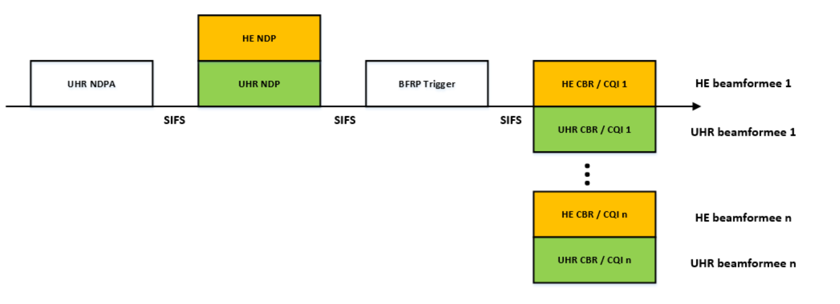
Introduction
In this contribution, we focus on the high level designs of
UHR NDPA
UHR NDP
which enable the HE-UHR aggregated sounding.
Advantage
Compared to two separate HE-UHR soundings, one aggregated sounding can reduce the air-time consumption by about 2 times, leading to improved beamforming throughput.

Slide 3
UHR NDPA (1/3)
Recap: HE NDPA

Slide 4
UHR NDPA (2/3)
Sounding Dialog Token
Until now, VHT/HE/EHT NDPA are distinguished by using 2 bits in the Sounding Dialogue Token (NDP Announcement Variant subfield).
However, these are no reserved bits for UHR.
Propose to set 2 bits in Sounding Dialog Token as below.
The NDP Announcement Variant subfield and a NDPA version identifier (will be shown in next slide) are jointly used to identify the UHR NDPA.
HE and UHR can be multiplexed in a single NDPA.
This design enables HE-UHR aggregated sounding.
NDP Announcement Variant subfield | Description
0 | VHT NDPA
1 | Ranging NDPA
2 | HE NDPA, UHR NDPA
3 | EHT NDPA

Slide 5
UHR NDPA (3/3)
STA Info subfield
Special STA Info subfield [1]
The Special STA Info subfield is a STA Info subfield that does not carry STA specific information but carries extended common information not provided in the Common Info field.
E.g.) Bandwidth, Primary/Secondary160 etc.
The Special STA Info subfield is identified by an AID11 value of TBD.
The location of the Special STA Info subfield is TBD.
E.g.) Located immediately after the Common Info field.
E.g.) Located immediately before the first UHR STA Info field.
The NDPA Version Identifier subfield indicates the NDPA version [1].
AID 11 | NDPA Version Identifier | Information for BW, PS160 etc.
Bits: 2 | 3 | TBD
Frame Control | Duration | RA | TA | Sounding Dialog Token | Special STA Info | HE STA Info 1 | …. | HE STA Info n | UHR STA Info 1 | …. | UHR STA Info m | FCS
Octets: 2 | 2 | 6 | 6 | 1 | 4 | 4 |  | 4 | 4 |  | 4 | 4

Slide 6
UHR NDP (1/2)
UHR NDP design
Propose a UHR NDP with no UHR-SIG symbol to align with the HE NDP.
Also propose a UHR NDP with one UHR-SIG symbol to align with EHT NDP.
In the case of the UHR NDP, the information on whether the number of UHR-SIG symbols is 0 or 1 is carried by the U-SIG.
HE NDP
L-STF | L-LTF | L-SIG | RL-SIG | HE-SIGA | HE-STF | HE-LTF | PE
8$μs$ | 8$μs$ | 4$μs$ | 4$μs$ | 8$μs$ | 4$μs$ | Variable duration | 4$μs$
EHT NDP
L-STF | L-LTF | L-SIG | RL-SIG | U-SIG | EHT-SIG | EHT-STF | EHT-LTF | PE
8$μs$ | 8$μs$ | 4$μs$ | 4$μs$ | 8$μs$ | 4$μs$ | 4$μs$ | Variable duration | 4$μs$
Proposed UHR NDP
L-STF | L-LTF | L-SIG | RL-SIG | U-SIG | UHR-SIG | UHR-STF | UHR-LTF | PE
8$μs$ | 8$μs$ | 4$μs$ | 4$μs$ | 8$μs$ | 0 or 4$μs$ | 4$μs$ | Variable duration | 4$μs$

Slide 7
UHR NDP (2/2)
Exemplary design of U-SIG
There will be enough room in U-SIG to carry information required for UHR NDP decoding, even though there is no UHR-SIG symbol.
For example,
Field | Category | Subfield | Bit size | Description
U-SIG | Version Independent (26 bits) | PHY Version identifier | 3
 |  | Bandwidth | 3
 |  | UL/DL | 1
 |  | BSS Color | 6
 |  | TXOP | 7
 |  | Disregard | 5
 |  | Validate | 1
 | Version Dependent (20 bits) | Spatial Reuse | 4
 |  | GI+LTF Size | 2
 |  | Number of UHR-LTF Symbols | 4
 |  | Beamformed | 1
 |  | Number Of UHR-SIG Symbols | 1 | Indicates this value to be equal to the number of UHR-SIG symbols, i.e., 0 or 1.
 |  | Reserved | 8
 | CRC & Tail (6 bits) | CRC in U-SIG | 4
 |  | Tail in U-SIG | 6

Slide 8
NDPA-NDP Identification Method
Exemplary method
UHR NDPA identification
The presence of the Special STA Info Field and the value of the NDPA version identifier are jointly used to identify the UHR NDPA.
NDP Announcement Variant subfield (‘2’) of the NDPA indicates that HE-UHR aggregated NDP transmission will follow, which also implicitly indicates that there will be no UHR-SIG symbol in the following UHR NDP.
UHR NDP identification
Upon recipient of an UHR NDP, the LENGTH field of the L-SIG indicates UHR NDP if it indicates there is no data symbols.
Number Of UHR-SIG Symbols field of the U-SIG confirms that the number of UHR-SIG symbols is zero.

Slide 9
Summary
We proposed the high design of UHR NDPA which can multiplex HE and UHR into one NDPA.
We also proposed the design of UHR NDP which includes both options
with no UHR-SIG symbol to be aligned with the HE NDP.
with one UHR-SIG symbol to be aligned with the EHT NDP.
Subsequent contribution will show more detailed designs with specific subfields.

Slide 10
SP #1
Do you agree that UHR NDP has the following two options?
Having no UHR-SIG symbol to be aligned with the HE NDP.
Having one UHR-SIG symbol to be aligned with the EHT NDP.
Y / N / Abstain

Slide 11
Reference
[1] 802.11-24/0138r0, EHT-UHR Aggregated Sounding Design.

