Slide 1
Channel raster considerations for 60GHz band in IMMW
Date: 2024-01-16
Authors:
Name | Affiliations | Address | Phone | email
Micky Mehta | Pharrowtech BV |  |  | micky.mehta@pharrowtech.com

Slide 2
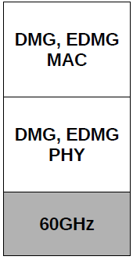
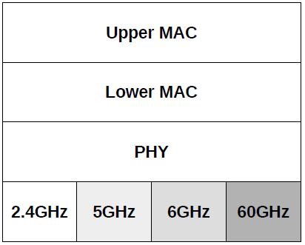
Introduction
802.11ac MAC & PHY, and possibly beyond to include 802.11ax, 802.11be …
802.11ad,
802.11ay
Use of 60GHz band in WLAN and WPAN technologies is not new
802.15.3c, 802.11ad (DMG) and 802.11ay (EDMG) are well known
But unlike before, we’re now considering integrating a 60GHz front-end to existing MAC & PHY specifications operating largely in sub-7GHz [1]
… and so how much and what aspects of the existing specs should we modify, if at all?

Slide 3
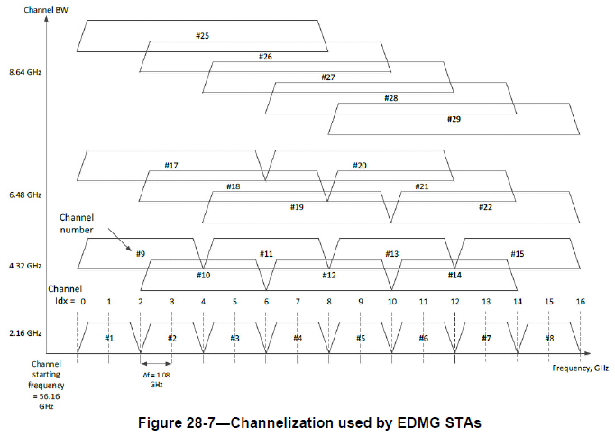
Existing 60GHz band channelization in 802.11
EDMG channel BWs are multiples of 2.16GHz
Spacing Δf in multiples of 1.08GHz is specified
[2.16+2.16] GHz
4.32GHz, [4.32+4.32] GHz, 6.48GHz … etc
We propose reducing Δf in multiples of 2^{n}
Where n = [0,-1,-2,-3]
1080MHz, 540MHz, 270MHz etc
CBWs and spacing closer to sub-7GHz channel raster
E.g., better fit for 160MHz and 320MHz CBWs, resp.
Maintain backwards compatibility with (E)DMG
Benefit CCA detection
Ref: IEEE Std 802.11ay-2021; "Amendment 2: Enhanced Throughput for Operation in License-exempt Bands above 45 GHz"

Slide 4
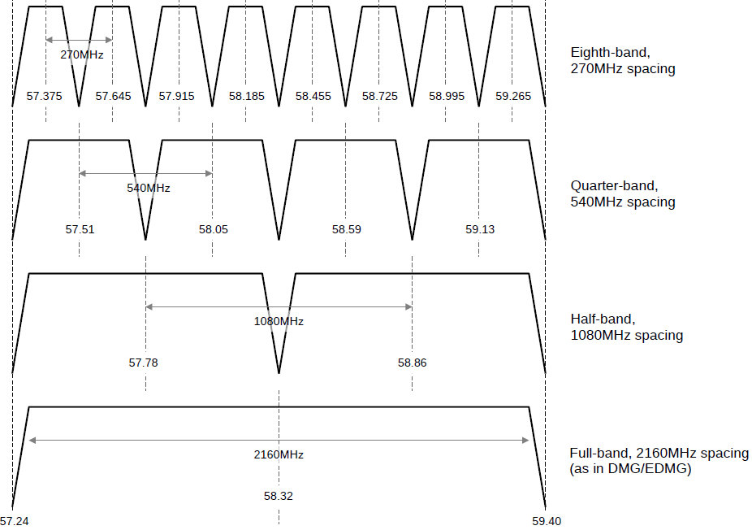
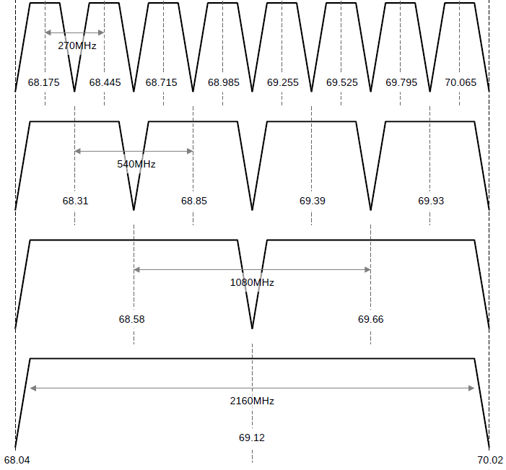
Sub-channelization to narrower bandwidths
48 channels, each of 270MHz CBW
24 channels, each of 540MHz CBW
12 channels, each of 1080MHz CBW
Channel#1
6 channels, each of 2160MHz CBW
Channel#6

Slide 5
Summary
A plausible channelization scheme for 60GHz band has been proposed
Maintain primary (legacy) channel spacing of 2.16GHz
Support whole fractions of the primary, such that Δf =2^{n}, where n=[0,-1,-2,-3]
It retains backwards compatibility with incumbent 60GHz amendments in 802.11
Offers a relatively easier path for candidate implementation [2], [3]
Reduced complexity and development time-scales
In keeping with the desire to have the IMMW PAR focused and towards rapid adoption
Offers a rapid path to realistic implementation with an upclocked 802.11ac modem
RF impairments are pronounced in mmWave band; and consensus on how to mitigate and/or circumvent will take due consideration in IMMW SG [4]
Agreeing on likely channel raster particulars now will help IMMW SG better focus on RF impairments and related discussions

Slide 6
References
[1] 11-23/1819r1 “Integrated mmWave Design Considerations”
[2] 11-23-2004r0, “IMMW technical scope proposal”
[3] 11-23/1905r0 “High Level Thoughts on IMMW”
[4] 11-23/1878r0 “Design Considerations on IMMW”
[5] 11-23/1968r0 “Discussion on general direction of integrated mmWave”

