Slide 1
Improved Transmit MIMO Beamforming with UEQM
Date: 2024-01-18
Authors:
Name | Affiliations | Address | Phone | email
Ron Porat | Broadcom |  |  | ron.porat@broadcom.com
Qijia Liu | Broadcom

Slide 2
Introduction
Unequal modulation (UEQM), meaning one encoder and different QAM per spatial stream was previously proposed in 11n but not adopted in practice.
In here we review the performance gain of UEQM using the current MCS set (which has widely expanded since 11n)
Simulation assumptions:
  SVD based Tx beamforming
  MIMO Configs: 2x2, 4x2, 4x4
  80MHz
  DNLOS, BLOS
  Including RF impairments
  Gain numbers based on RvR simulation, which uses genie rate selection per channel realization at each SNR point
Why should we expect gains? better QAM matching to the different SNR per stream with SVD based BF especially with higher condition numbers

Slide 3
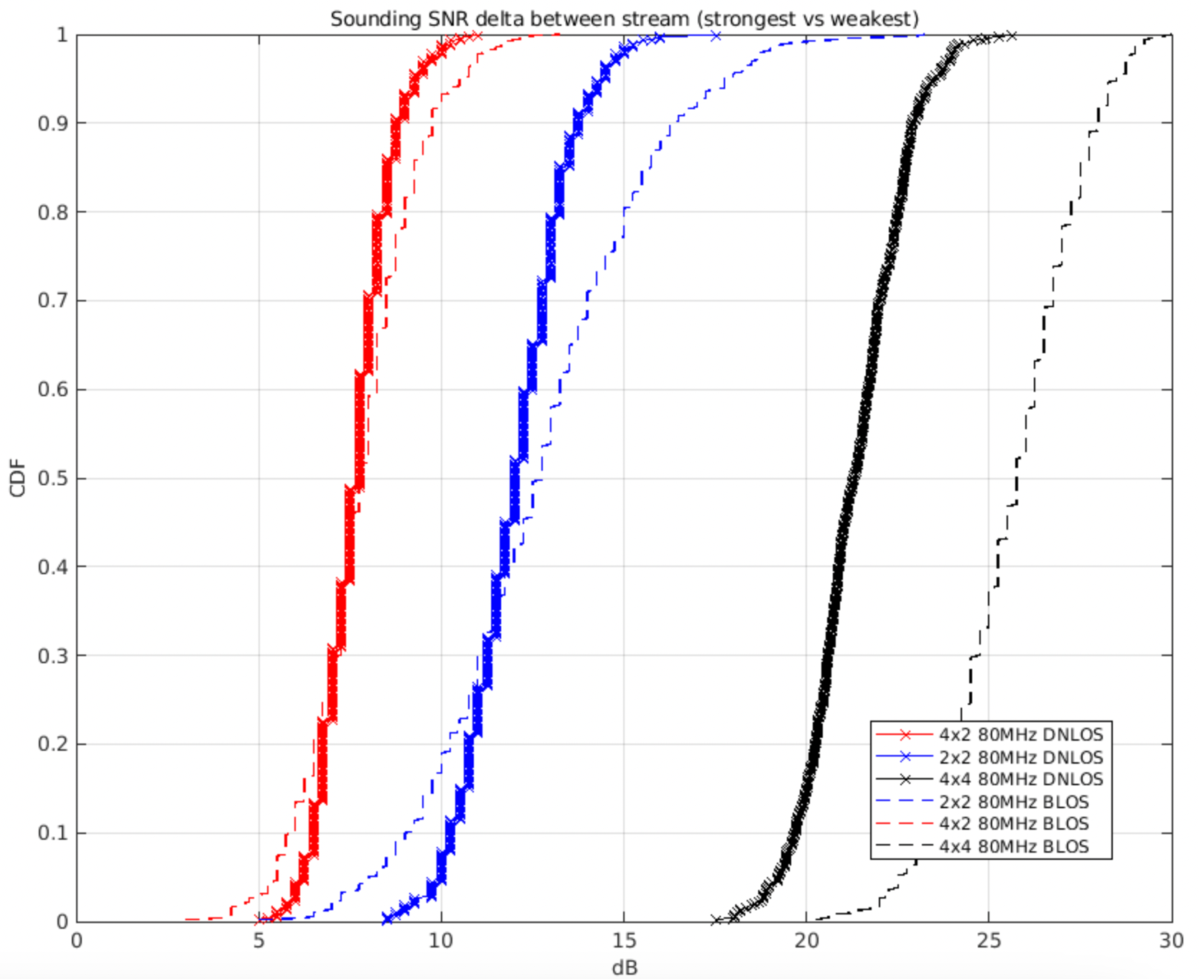
Condition Numbers (1)
As seen in the
Simulation
4x4 –
strongest/weakest

Slide 4
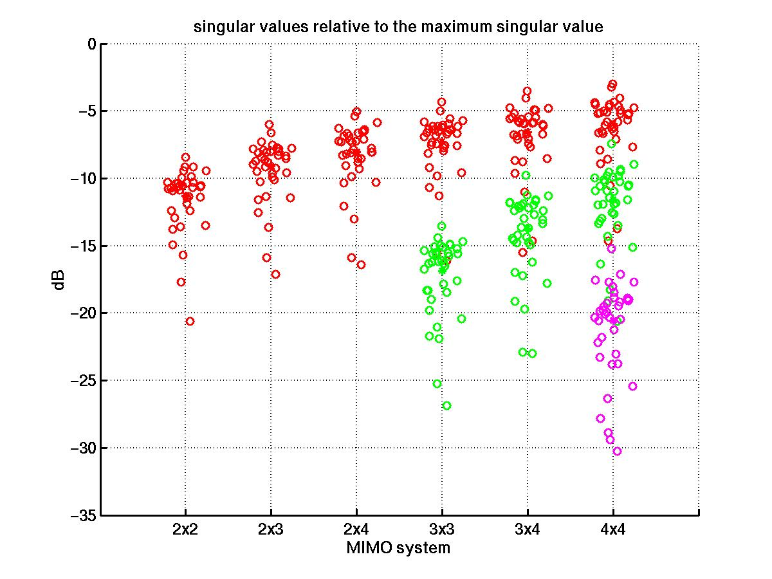
Condition Numbers (2)
As seen in a measurement
campaign in an enterprise
environment with 4x4 ULA half
lambda spacing 36x4 locations

Slide 5
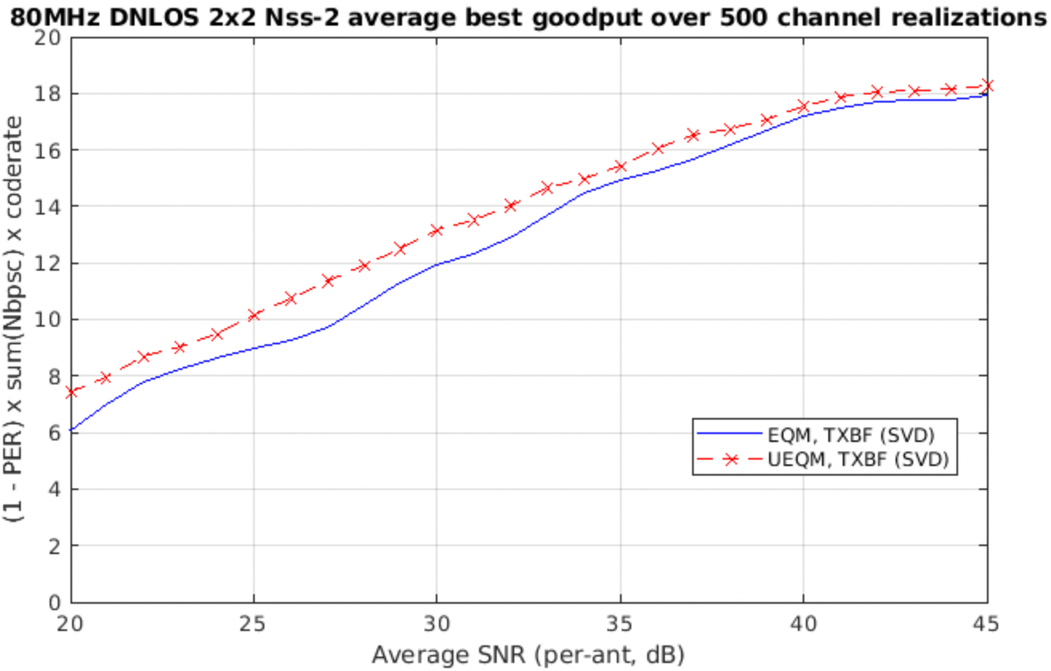
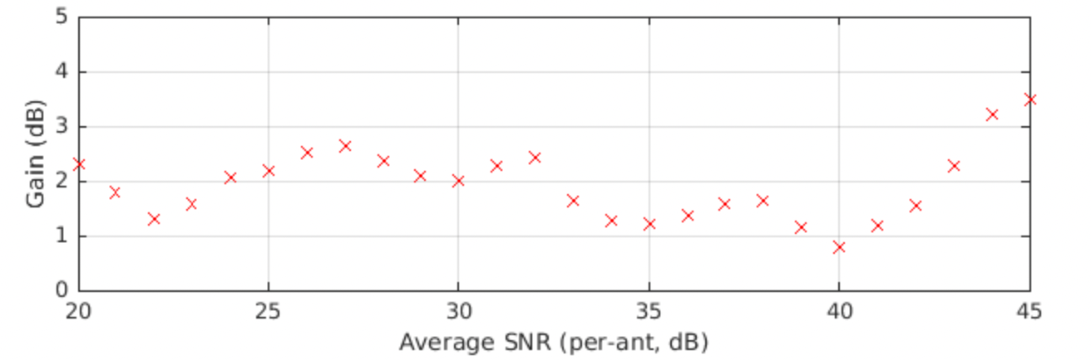

Slide 6
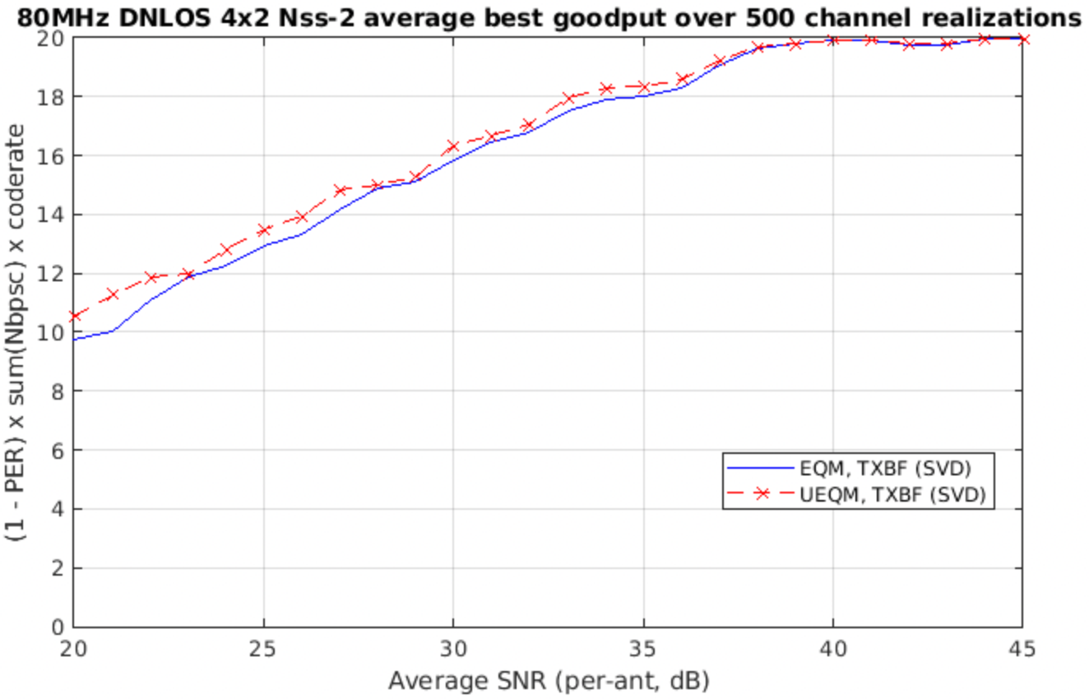
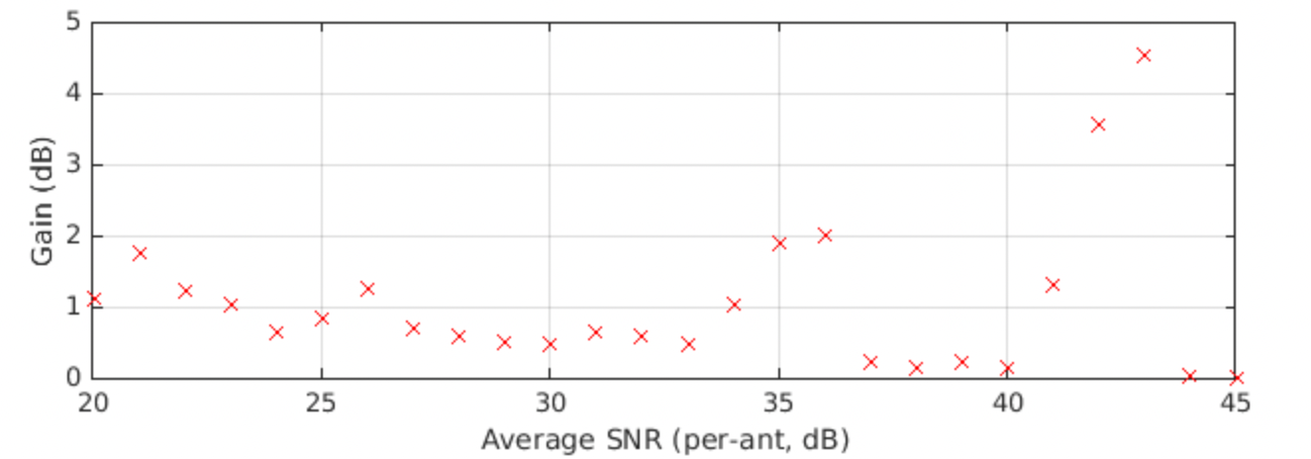

Slide 7
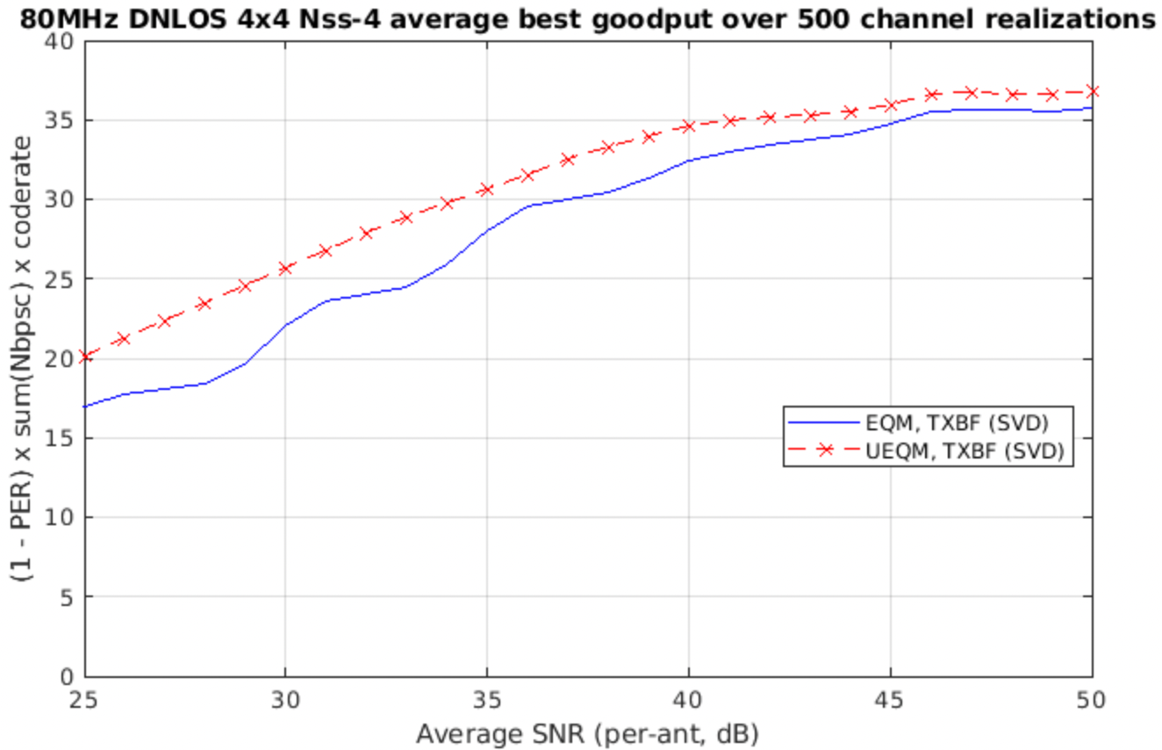
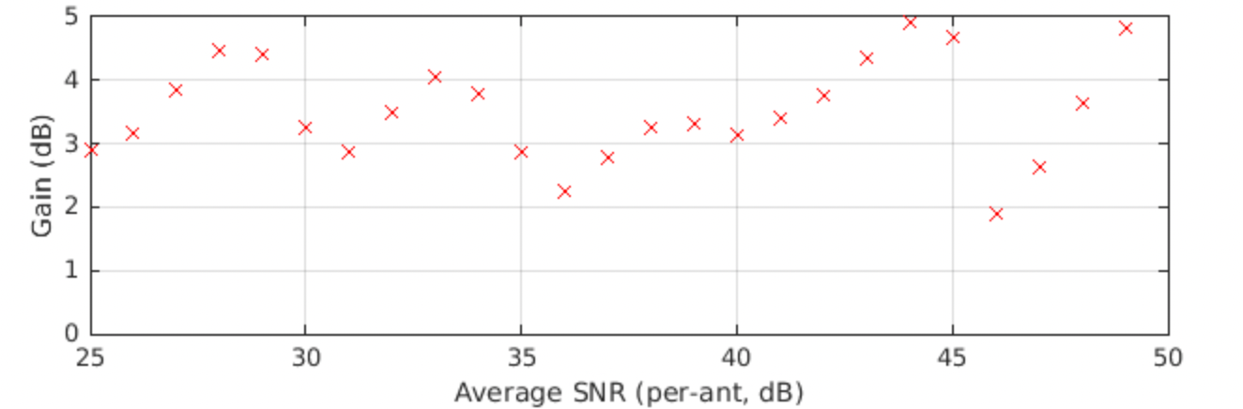

Slide 8
Summary of Gains and Conclusions
() – median gain
All QAM Combinations | 2x2 Nss-2 | 4x2 Nss-2 | 4x4 Nss-4
80MHz DNLOS | 0.8 - 2.6dB (2dB) | 0.2 - 2dB (0.9dB) | 2.2 - 5dB (3.6dB) Peak goodput gain: 3%
80MHz BLOS | 1.8 - 3dB (2.5dB) | 0.3 - 1.8dB (0.7dB) | 4.6 - 7dB (5.6dB) Peak goodput gain: 7%
Highest gain in square configs 2x2 , 4x4 (higher in 4x4)
→ Recommend adopting UEQM in 11bn

Slide 9
SP #1
Do you agree to add to the 11bn SFD : 11bn supports unequal modulations (UEQM) with single encoder for all spatial streams and different modulation per spatial stream for beamforming with at least 2ss
  This is used for single user MIMO beamforming transmission in full bandwidth or OFDMA

