Slide 1
Seamless Roaming Consideration
Date: 2024-05-13
Authors:

Slide 2
Abstract
This presentation intends to share our experiences of seamless handover implementation on MLD.

Slide 3
Our Experiences
We have implemented WLAN seamless handover system from 20 years ago.
We would like to share our experiences.
We have implemented:
Use 2 wireless physical interfaces
Use multiple logical interfaces on a single wireless physical interface (APs have to be operated on the same channel)
Use multiple logical interfaces on multiple wireless physical interfaces
We used
MISP (base idea of .11ai) / .11ai for fast authentication
It is not necessary but better to be used.
Mobile IP for IP layer transparency
Although we used mobile IP, it is not related to seamless roaming in a DS.

Slide 4
Multiple Interfaces Seamless Handover Implementation
A non-AP STA (STA) communicates through AP1.
The STA finds AP2 and associates with it. (keep using AP1 link) Now the STA has two links, AP1 and AP2.
In certain condition, the STA decides to use AP2 link. (implementation dependent)
The STA notify its location to the network.
The STA transmits packets to AP2 while the STA can receive packets from both AP1 and AP2. This means the STA can receive buffered packets from AP1. (No packet losses)
In certain condition, the STA decides to disconnect from AP1. (implementation dependent)
Seamless handover from AP1 to AP2 completes.
AP1
AP2
Interface
Interface
STA
This system was used for V2I communication
of train surveillance in some places.

Slide 5
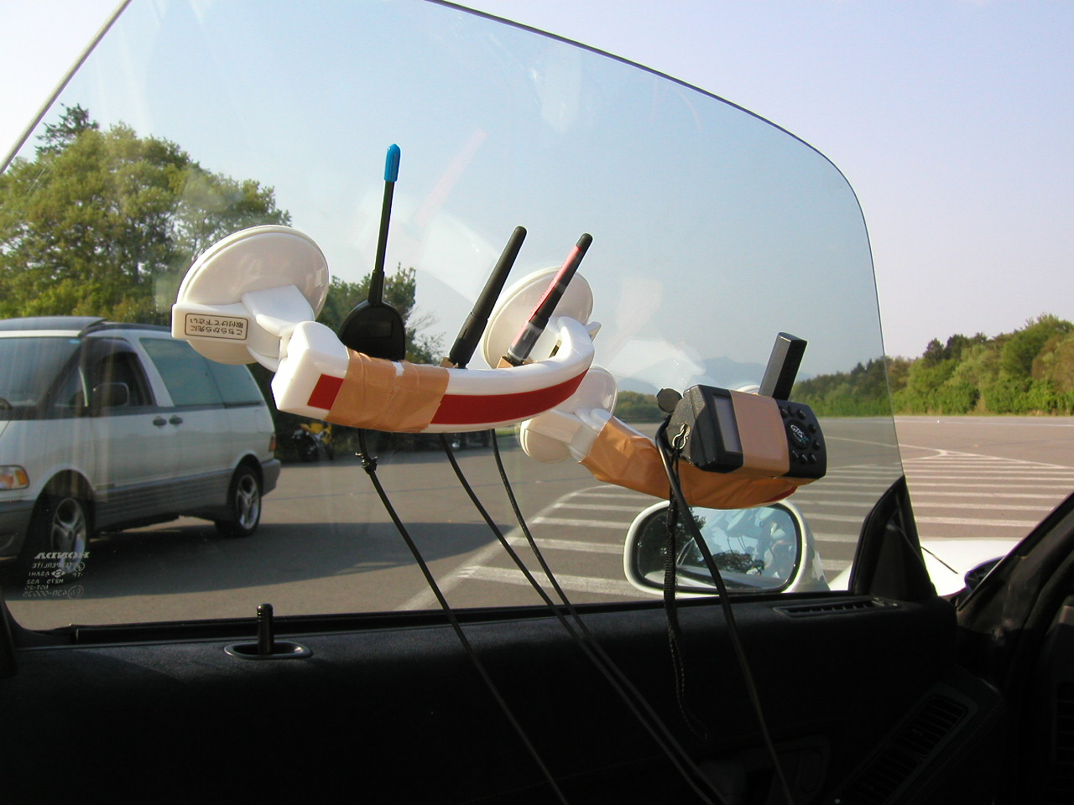
Trial in 2003
Antennas of the
mobile node
We tested seamless handover at a test course in 2003.
We installed 4 APs along the course. The distance of each AP was 300m.
The non-AP STA had 2 interfaces.
Realtime video transfer (DVTS) was tested.
Seamless video transfer was observed up to 260km/h (speed limit of the vehicle).
We have also tested in a laboratory.
We got the results that indicated no packet losses for 1ms interval UDP TX/RX.
AP

Slide 6
MLD Roaming Consideration
TX from non-AP MLD is simple. Just use the preferred link.
RX on non-AP MLD needs to notify its location to DS.
Non-AP MLD can notify its location by transmitting a broadcast frame to DS. (e.g Gratuitous ARP/NDP)
IEEE 802.1Q compliant devices will route the frame correctly.
Seamless roaming can be realized by existing IEEE 802.11.
Just a non-AP MLD implementation issue.

Slide 7
Example MLD Seamless Roaming Flow of Two Interfaces
N
Q(IF1) < Q(IF2)
IF1: TX / RX
IF2: Scan
IF1: TX / RX
IF2: Found new AP
Y
IF1: TX / RX
IF2: Associate / MLD Reconfig
IF1: RX
IF2: Advertise / TX
IF1: RX
IF2: TX / RX
Delay
IF1: Disconnect
IF2: TX / RX
Q(IF1) > Q(IF2)
IF1: Scan
IF2: TX / RX
IF1: Found new AP
IF2: TX / RX
IF1: Associate / MLD Reconfig
IF2: TX / RX
IF1: Advertise / TX
IF2: TX / RX
IF1: TX / RX
IF2: RX
Delay
IF1: TX / RX
IF2: Disconnect
Y
N

Slide 8
What should be standardized?
We should consider standardization issue and implementation issue separately.
Standardization is required for interaction with other STAs.
MLD seamless roaming can be realized by non-AP MLD implementation without any changes on APs.
Is MLD seamless roaming specific standard required?

Slide 9
References
H. Morioka, M. Ohmori, M. Ohta, H. Mano, “Development of a Seamless Handover Method Using Two Wireless LAN Devices on a Mobile Node”, The 10th IPSJ DPS Workshop, 2002 (Japanese)
H. Morioka, H. Mano, M. Ohmori, M. Ohta, M. Hirabaru, M. Hasegawa, M. Inoue, "Seamless Handover with Wireless LAN, Mobile IP, MISP and PDMA", The 9th International Symposium on Wireless Personal Multimedia Communications, 2006
MISP is a base idea of IEEE 802.11ai. Please refer 11-05/0859r0.

