Slide 1
TXOP Level Preemption for Low Latency Application
Date: 2024-01-10
Authors:

Slide 2
Introduction
Preemption was discussed in [1] as a general solution to support low latency application in different scenarios [2].
In this document, we will futher discuss how this technique can be used in the DL TB, UL SU TXOP scenario and how to send LL PPDU after preemption

Slide 3
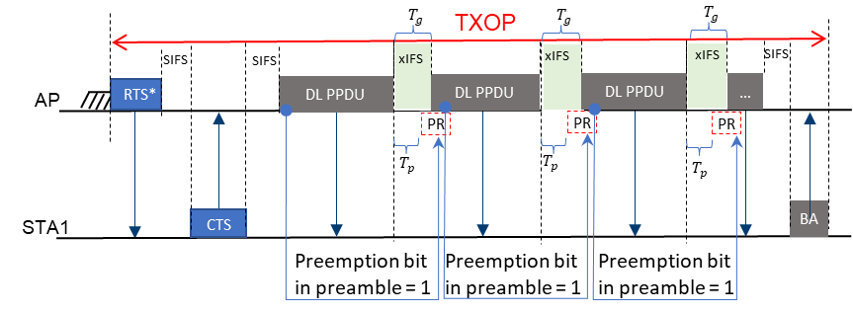
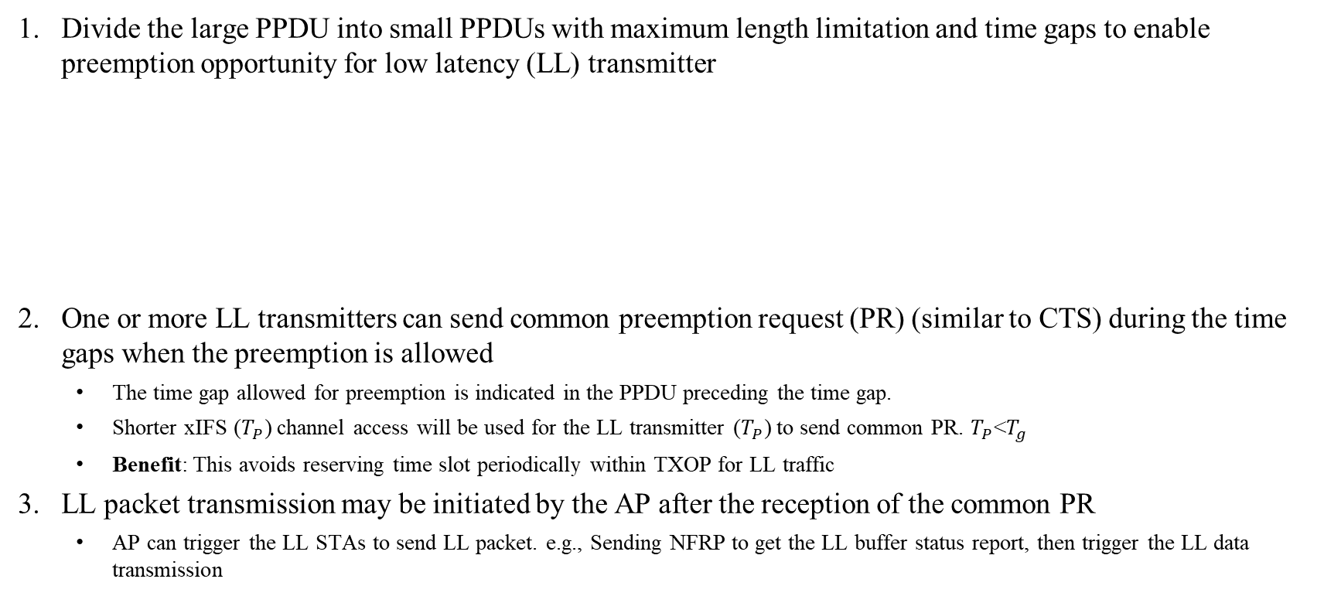
Recap - General solution for case A and case B [1]
(Event-based or periodic LL traffic with jitters)
Preemption in DL TXOP case
January 2024
Divide the large PPDU into small PPDUs with maximum length limitation and time gaps to enable preemption opportunity for low latency (LL) transmitter
One or more LL transmitters can send common preemption request (PR) (similar to CTS) during the time gaps when the preemption is allowed
  The time gap allowed for preemption is indicated in the PPDU preceding the time gap.
  Shorter xIFS ($T_{P}$) channel access will be used for the LL transmitter ($T_{P}$) to send common PR. $T_{P}$<$T_{g}$
  Benefit: This avoids reserving time slot periodically within TXOP for LL traffic
  3. LL packet transmission may be initiated by the AP after the reception of the common PR
  AP can trigger the LL STAs to send LL packet. e.g., Sending NFRP to get the LL buffer status report, then trigger the LL data transmission

Slide 4
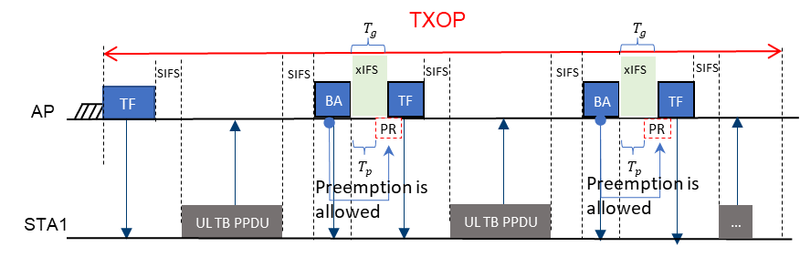
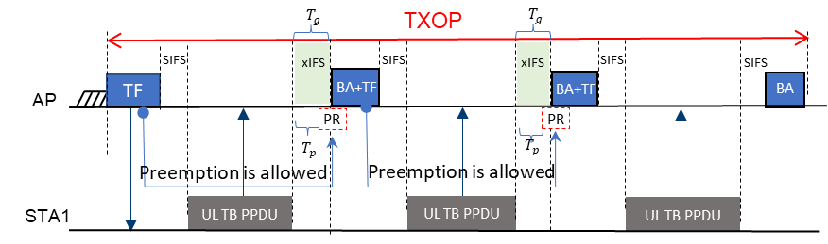
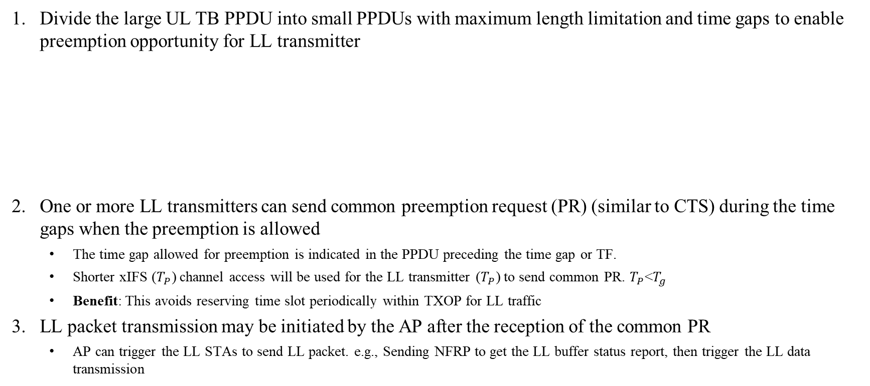
Preemption in UL TB case
January 2024
Divide the large UL TB PPDU into small PPDUs with maximum length limitation and time gaps to enable preemption opportunity for LL transmitter
One or more LL transmitters can send common preemption request (PR) (similar to CTS) during the time gaps when the preemption is allowed
  The time gap allowed for preemption is indicated in the PPDU preceding the time gap or TF.
  Shorter xIFS ($T_{P}$) channel access will be used for the LL transmitter ($T_{P}$) to send common PR. $T_{P}$<$T_{g}$
  Benefit: This avoids reserving time slot periodically within TXOP for LL traffic
  3. LL packet transmission may be initiated by the AP after the reception of the common PR
  AP can trigger the LL STAs to send LL packet. e.g., Sending NFRP to get the LL buffer status report, then trigger the LL data transmission

Slide 5
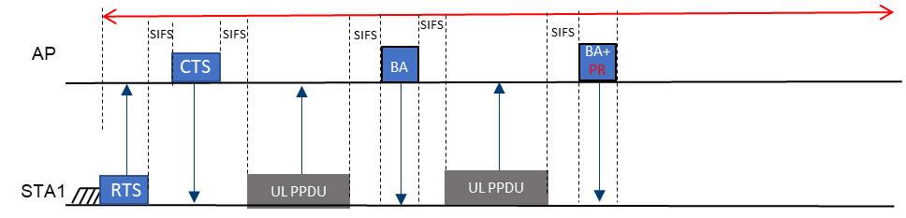
Preemption in UL SU TXOP case
Divide the large UL SU PPDU into small PPDUs with maximum length limitation and time gaps to enable preemption opportunity for the AP
AP can send BA with PR or other ways to indicate the preemption request when the preemption is allowed
  3. LL packet transmission may be initiated by the AP after the transmission of the PR

Slide 6
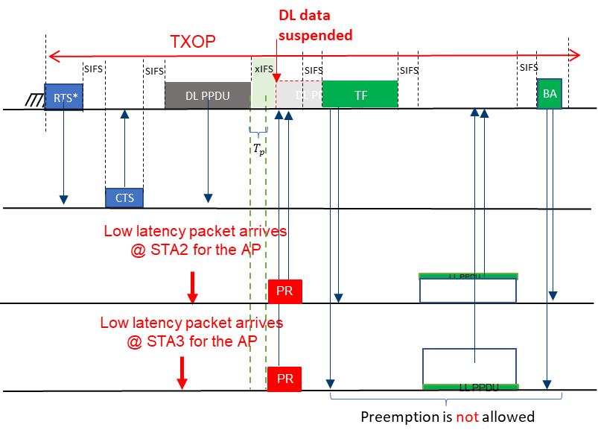
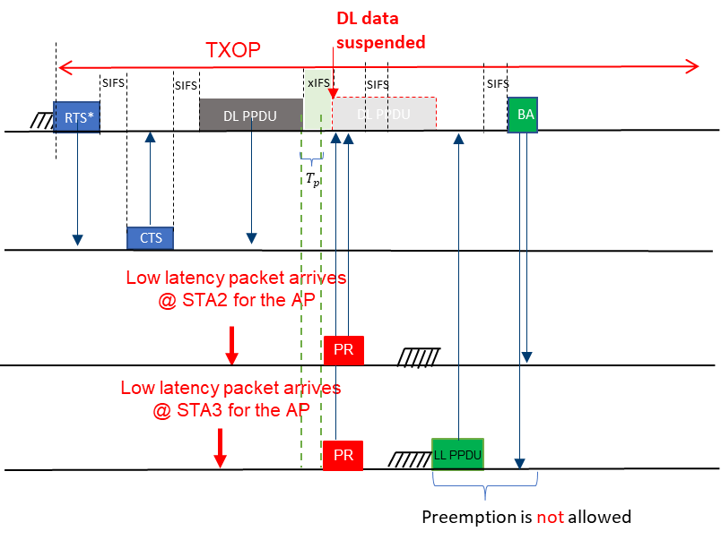
How to enable LL PPDUs after preemption
(Event-based or periodic LL traffic with jitters)
PR + NFRP + NFR + TF + LL PPDU [3]
PR + TF + UORA for LL PPDUs
PR + EDCA for LL PPDUs [4]
PR + basic TF + BSR + TF + LL PPDUs

Slide 7
Summary
Preemption can provide bounded latency while keeping low performance impact to the high throughput traffic.
Further consideration:
  xIFS time
  Preemption Request frame
  Further overhead reduction

Slide 8
References
[1] 11-23-0092r0, “Preemption”
[2] 11-23-0018r1, “Low latency support in UHR”
[3] 11-23-1229r1, “Preemption-for-low-latency-application-follow-up”
[4] 11-23-1886r0, “Preemption-techniques-to-meet-low-latency-ll-targets”

Slide 9
SP
Do you agree to define a mechanism in 11bn for a TXOP holder to allow a STA associated with the TXOP holder to preempt the TXOP holder's frame exchange sequence for low latency traffic delivery
  NOTE: The TXOP holder can be an AP or a non-AP STA and the policy for TXOP holder allowing preemption is TBD

