Slide 1
MLD Roaming scenarios
Date: 2024-01-12
Authors:

Slide 2
Abstract
This contribution discusses MLD roaming scenarios with enabling seamless roaming for non-AP MLD STAs
  Make before break
  Eliminate the packet loss
STA assists in the roaming to reduce packet loss and latency

Slide 3
Scenario 1. “Intra V-MLD” Roaming
DS
ETH switch
Purpose:
Extend the EHT architecture to allow APs/MLDs to be not co-located
Optimize data path to DS to reduce latency
Provide lossless roaming
Each MLD may consist of one or more Affiliated APs
Data path
Virtual MLD
Virtual MLD
Management path
(proprietary)
MLD1
MLD2
Roaming/Virtual MLD:
Non-Link specific management frame endpoint
STA MLD associates with V-MLD MAC address
Reordering buffer is in the MLDs only (no buffer in the V-MLD)
V-MLD does not have access to the DS
STA MLD

Slide 4
Initial phase:
Router
DL Data
DL Ethernet frame
Ethernet Switch
UL Data
UL Ethernet frame
2.4GHz
5GHz
AP MLD1
AP MLD2
5GHz
2.4GHz
DL Data & UL DATA
STA MLD

Slide 5
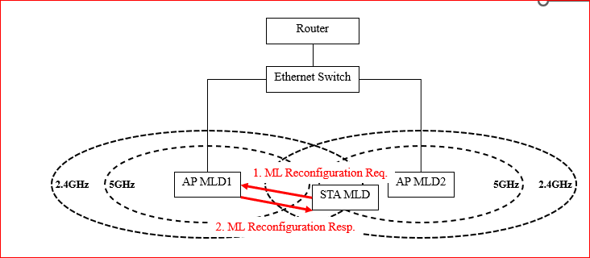
Transition step 1
STA sends ML reconfig to MLD1 to set up link(s) with MLD2. This step can be
  STA initiated
  MLD triggered

Slide 6
Transition Step 2a
Router
Ethernet Switch
1. MLD Roaming Indication
2.4GHz
5GHz
AP MLD1
AP MLD2
5GHz
2.4GHz
STA MLD
STA initiates roaming by sending a Roaming Indication frame to MLD1

Slide 7
Transition Step 2b
Router
Ethernet Switch
UL Data
UL Ethernet frame
2a. Flush UL Data frames received from STA MLD
2b. V-MLD coordination (context tr)
2.4GHz
5GHz
AP MLD1
AP MLD2
5GHz
2.4GHz
STA MLD
MLD1 flushes UL data to DS

Slide 8
Transition Step 3
  STA Requests DS Map Update to MLD2 (DS stops sending DL data through MLD1)
    STA sending UL data (if any) through MLD2 does DS Map update automatically
    STA may request MLD2 to buffer its DL data until ready to receive
Router
Ethernet Switch
DS Mapping update
DS Map update Req
2.4GHz
5GHz
AP MLD1
AP MLD2
5GHz
2.4GHz
DL data for STA MLD
STA MLD

Slide 9
During transition
    Depending on STA capabilities, DL data is retrieved by the STA either sequentially or in parallel from the MLDs
      If sequential, STA requests MLD2 to buffer DL data for STA until STA receives all DL from MLD1
Router
DL Data
Ethernet Switch
DL Ethernet frame
UL Data
UL Ethernet frame
MLD2 to buffer DL Data frames until STA ready to receive DL from MLD2
2.4GHz
5GHz
AP MLD1
AP MLD2
5GHz
2.4GHz
DL Data
STA MLD
UL Data

Slide 10
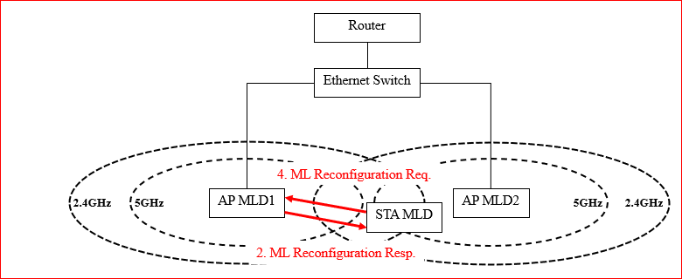
Transition Step 4a
STA releases its links with MLD1
Requests the DL data from MLD2

Slide 11
Transition Step 4b
    STA request for DL Data (if buffering was requested)
Router
Ethernet Switch
2.4GHz
5GHz
AP MLD1
AP MLD2
5GHz
2.4GHz
STA MLD
UL/DL data with MLD2

Slide 12
Roaming complete
Router
DL Data
Ethernet Switch
DL Ethernet frame
UL Data
Pack
UL Ethernet frame
STA MLD
DL Data & UL DATA
2.4GHz
5GHz
AP MLD1
AP MLD2
5GHz
2.4GHz

Slide 13
What is proposed to enable this roaming scenario
Define procedures which allows
  MLDs to indicate they belong to a V-MLD
  STA to indicate roaming intent and MLD buffer flush request
  STA to request DS Map Update
  STA to request DL data buffering for the roaming transition period

Slide 14
Scenario 2. Inter V-MLD roaming
DS
Data path
ETH switch
Virtual MLD1
Virtual MLD2
Management path
(proprietary)
MLD1
MLD2
MLD3
STA MLD

Slide 15
Inter V-MLD roaming
“Inter MLD” roaming from STA pov is when (V-)MLD2 MAC is different than (V-)MLD1 MAC
STA uses ReAssociation Request frame instead of Reconfiguration Request
  This ReAssociation Request to not trigger an automatic DS mapping change
There is no common V-MLD to assist with ‘context transfer’ between MLDs, but retain the Mobility Domain concept
Sequence of events same as in Intra V-MLD case, except ‘context transfer’ to be done by the STA itself
STA to use an updated Fast BSS Transition procedure to transfer BA agreement (and other needed context)

Slide 16
What is proposed to enable this roaming scenario
Define an enhanced Fast BSS Transition procedure which
  Allows the STA to do the ‘context transfer’ itself between the serving and target MLDs
    Does the ‘blue box’ functionality from slide 7
  Integrates with the procedures to be defined for the intra V-MLD roaming scenario

Slide 17
Conclusion
We propose a non-AP MLD centric roaming procedures.
We prefer to minimize information sharing and interaction between AP MLDs.
Spec should define minimal features to allow minimizing/eliminating packet loss during roaming

