Slide 1
Probe-Before-Talk and Unsolicited Unavailability Announcement for Co-ex Management
Date: 2024 – 1 – 11
Authors:
Name | Affiliations | Address | Phone | Email
Qi Wang | Apple Inc. |  |  | qi_wang2@apple.com
Oren Shani
Yong Liu
Neel Nurani Krishnan
Zhou Lan
Jarkko Kneckt
SK Yong
Anuj Batra
Mohamed Abouelseoud
Morteza Mehrnoush

Slide 2
Introduction
A WLAN device often needs to manage in-device co-existence issues such as co-ex between Wi-Fi infrastructure connection and other technologies (e.g., Bluetooth)
In this submission, we propose the following WLAN in-device co-existence management mechanisms:
Probe-Before-Talk (PBT);
Unsolicited Unavailability Announcement (UUA).
PBT and UUA improve performance by:
Preventing data loss;
Preventing undesired transmit rate reduction;
Preventing unnecessary blockage of the medium.

Slide 3
Unmanaged Co-ex Events Cause STA’s Performance Degradation
When an AP’s transmission to a STA occurs during a co-ex event at a STA, the transmission fails;
Subsequently, the AP often reduces the transmit rate of data packets, and do not recover to the previous rate for a long time, although the rate reduction is not the right remedy for this scenario;
As a result, the STA’s throughput degrades.

Slide 4
Existing Common Co-Management Methods and Shortcomings (1)
-- May need to be transmitted too early to ensure channel access, which prevents AP’s DL transmission for a long period, or
-- Insufficient time to transmit before the co-ex event, which triggers AP’s rate drop and hurt throughput.
-- After the co-ex event, there is additional overhead for STA to send a PPDU with PM = 0 so that the AP can resume DL transmission.
TX
PPDU with PM =1
PPDU with PM =0
Or PS Poll
Ack
STA
Co-ex event
RX
Ack
Ack
PPDU
AP refrains from transmission to the STA
Method 1: Entering Power Save Mode

Slide 5
Existing Common Co-ex Management Methods and Shortcomings (2)
-- Excessive medium reservation, although only need to indicate STA’s absence
-- May need to be transmitted too early to ensure channel access, which blocks the medium for a long period, or
-- Insufficient time to transmit before the co-ex event, which may trigger AP’s rate drop and hurt throughput
NAV = Duration (CTS-to-self)
TX
CTS-to-self
Ack
STA
Co-ex event
RX
PPDU
All devices refrain from transmission to the STA and other STAs.
Method 2: CTS-to-self

Slide 6
Proposal: Probe-Before-Talk (PBT)
An TXOP Initiator (e.g., AP) shall first transmit a PBT_RTS in an TXOP that it initiates;
If available, the TXOP Responder (e.g., STA) responds with a PBT_CTS that contains its unavailability:
Whether the STA is available during the entire, or part of the, TXOP duration indicated in the PBT_RTS;
The duration for which the STA will be unavailable;
Upon successful reception of a PBT_CTS, the TXOP Initiator (e.g., AP):
Truncate the TXOP to a duration <= PBT TXOP duration;
The TXOP Initiator (e.g., AP) shall refrain from transmitting to the TXOP Responder (e.g., STA) during the Responder’s Unavailability time;
May transmit a CF-end after the truncated TXOP to reset NAV.

Slide 7
Two Scenarios
A = End time of PBT TXOP Duration
B = Start time of Unavailability
If PBT_TXOP Duration < PBT_RTS Duration, A = B
If PBT_TXOP Duration = PBT_RTS Duration, A <= B

Slide 8
PBT_CTS Design
 | Frame Control | Duration | RA | TA | Unavailability Profile | FCS
Octets: | 2 | 2 | 6 | 6 | ~ 6 | 4
Control | Unavailability Start Time | Minimum Unavailable Duration
The start time intends to represent a near term Unavailability

Slide 9
A TXOP When PBT-CTS Not Received
When the TXOP initiator (e.g., AP) does not receive a PBT_CTS successfully (i.e., the TXOP responder is unavailable), the TXOP initiator (e.g., AP):
Shall not transmit data packets;
Shall not disable the STA;
May retry another PBT_RTS later;
Shall consider co-ex event as one possible reason for PBT_RTS/PBT_CTS failure, and take this into account in the rate selection logic for data packets;
The behavior described above is desirable for the conventional RTS/CTS approach as well.

Slide 10
Proposal: Unsolicited Unavailability Announcement (UUA)
STA transmits unsolicited unavailability information, without AP’s probing

Slide 11
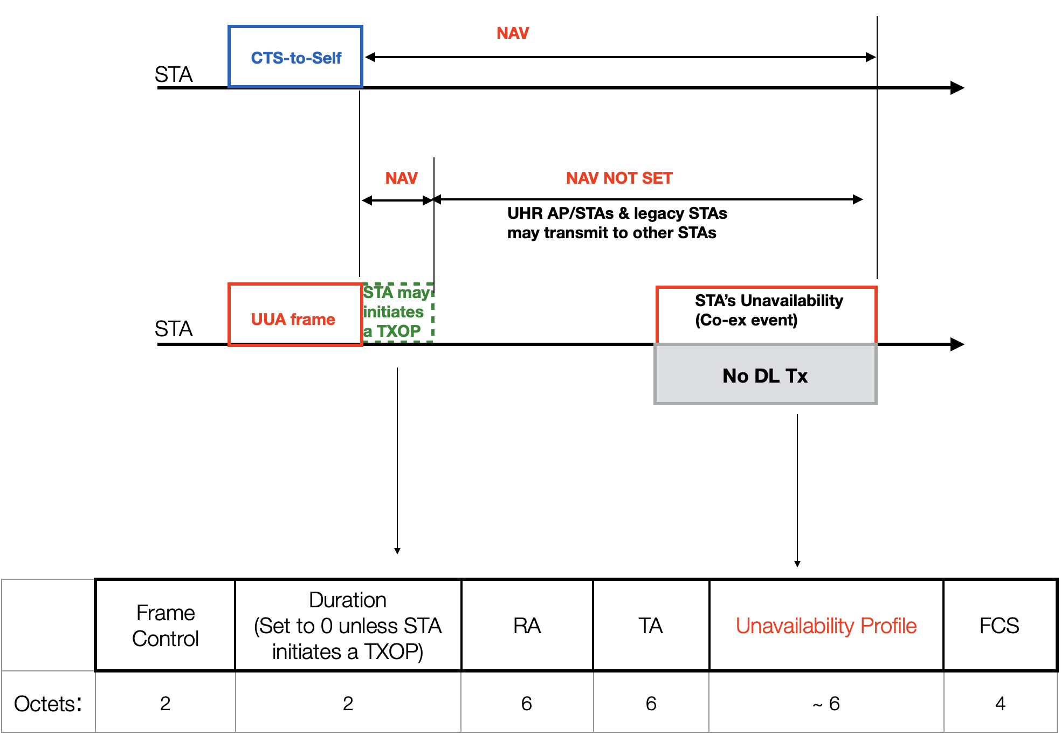
UUA vs. CTS-to-Self

Slide 12
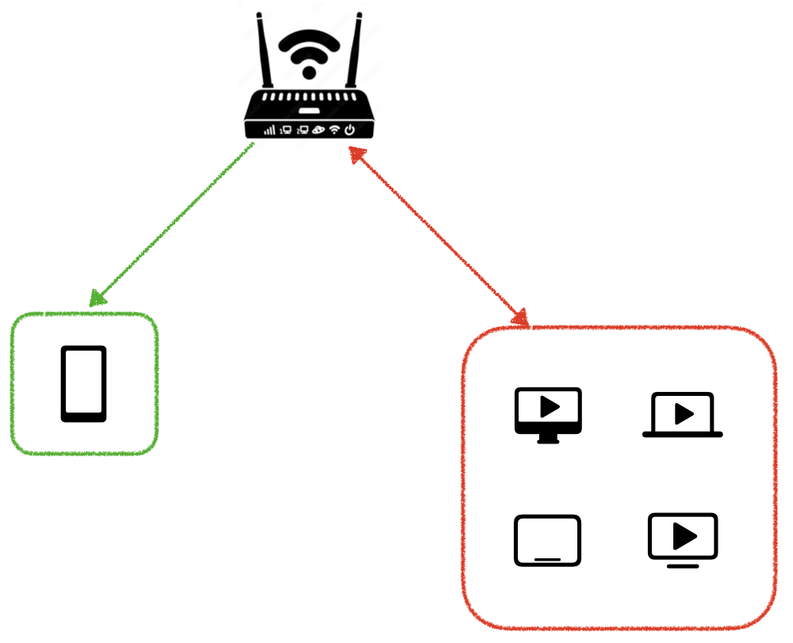
Simulation Assumptions
Wi-Fi channel – 5 GHz, 80 MHz
AP ⇒ DUT STA:
Wi-Fi Traffic – DL UDP, Full buffer
Access category for EDCA = AC_BE
Co-ex Traffic at DUT STA:
Deterministic, periodic – 3.75 ms active every 15 ms
Stochastic, aperiodic – Co-ex activity duration ~ U(2.5 ms, 7.5 ms), Coex activity interval $∈$ [10 ms, 15 ms, 30 ms]
Legacy STA Traffic:
Number of legacy STAs = 4; associated to the same AP as the DUT STA
Wi-Fi Traffic – Bi-Di UDP; traffic data rate based on the channel utilization
Channel access – SU (UL and DL), Access category = AC_BE
Aggregate channel load / utilization – 0%, 10%, 30%, 50%, 70%, 90%
All devices are within ED range of each other; no hidden nodes
Max PPDU limit = 5.4 ms for all devices, BA window size = 256
AP rate adaptation algorithm – Minstrel
Rate adaptation algorithm is triggered by successive failures of Data PPDUs; RTS/CTS failures are ignored
Results averaged across 30 random seeds; each seed corresponds to a simulation run time of 90 seconds
Network Topology
Infra Wi-Fi AP
DL Traffic
Bi-Di Traffic
DUT STA
Legacy STAs

Slide 13
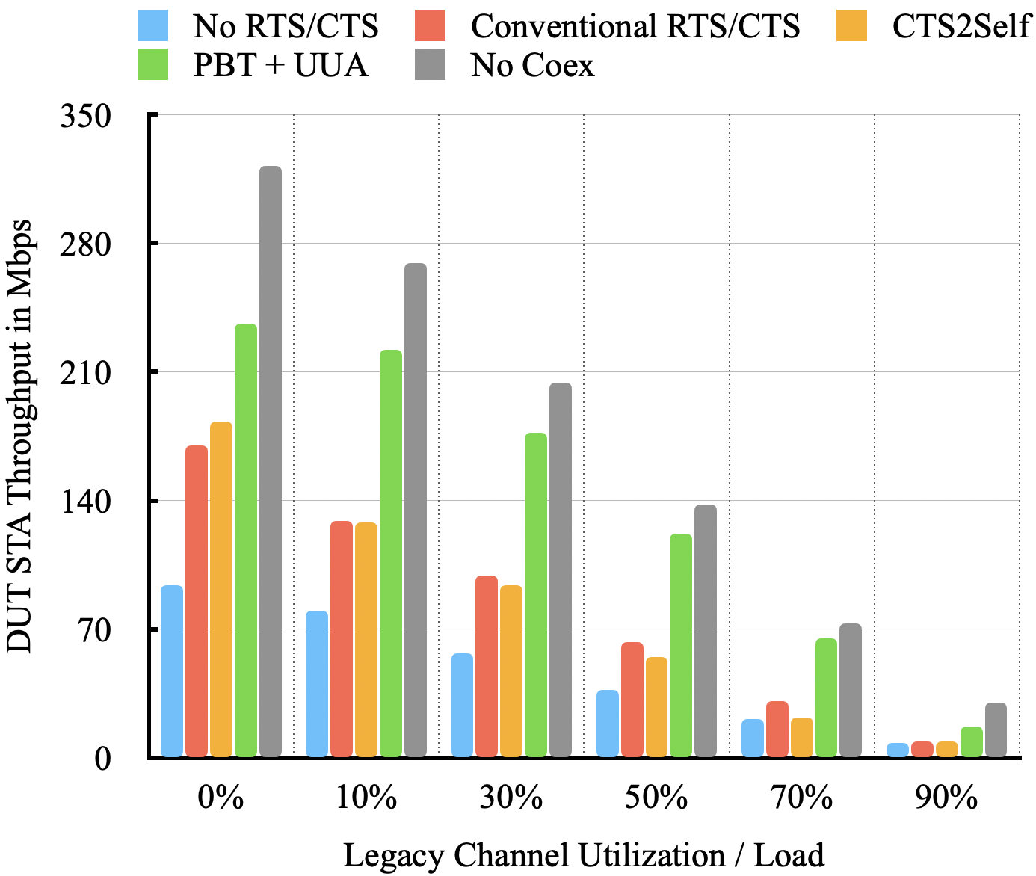
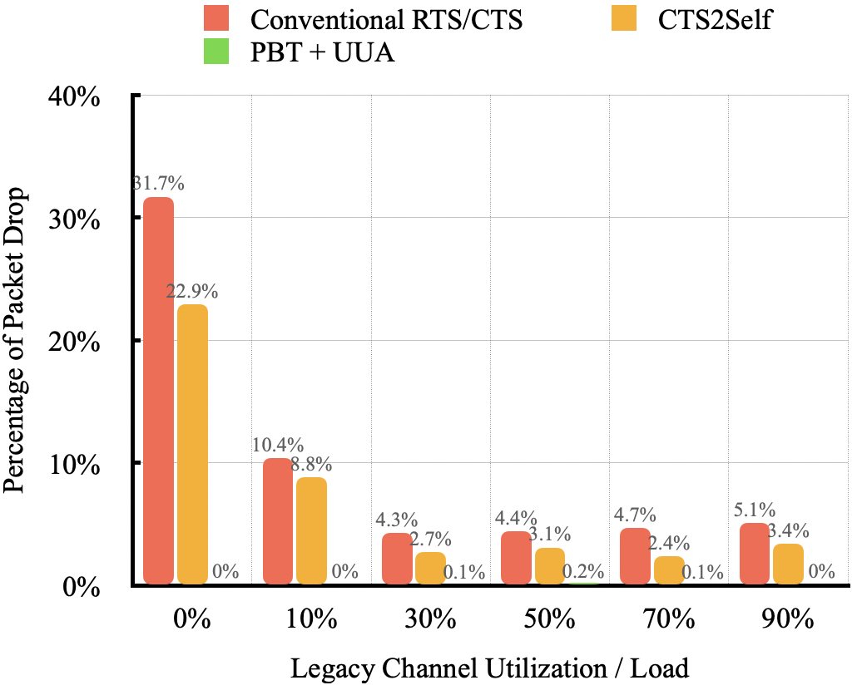
DUT Performance with Periodic Co-ex Traffic
Co-ex Traffic Pattern – Periodic, 3.75 ms active every 15 ms
DUT STA Throughput in Mbps
Percentage of Packet Drops
Number of retries threshold (RTS or data) = 7

Slide 14
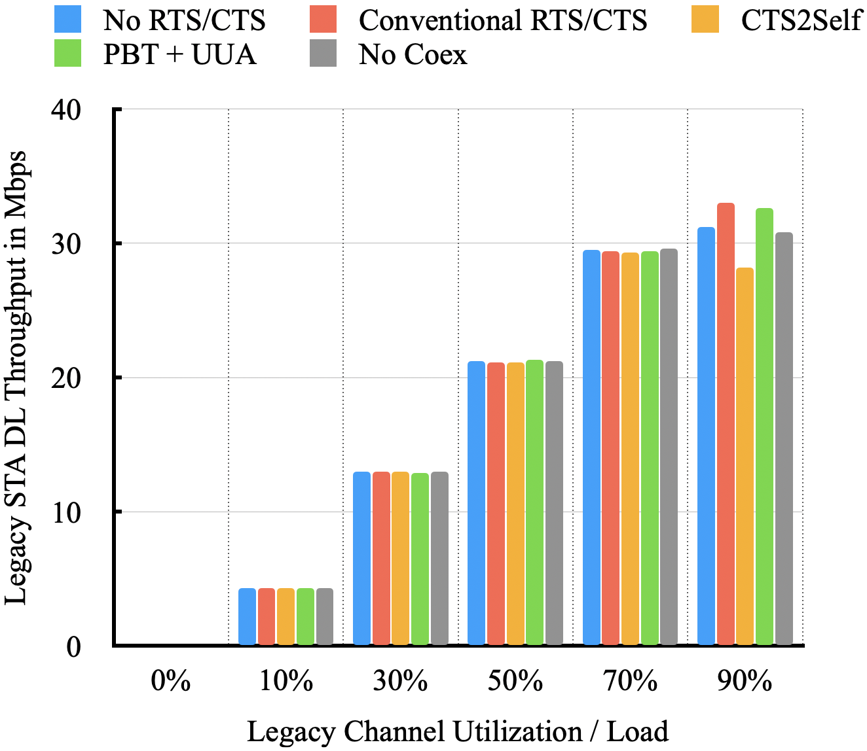
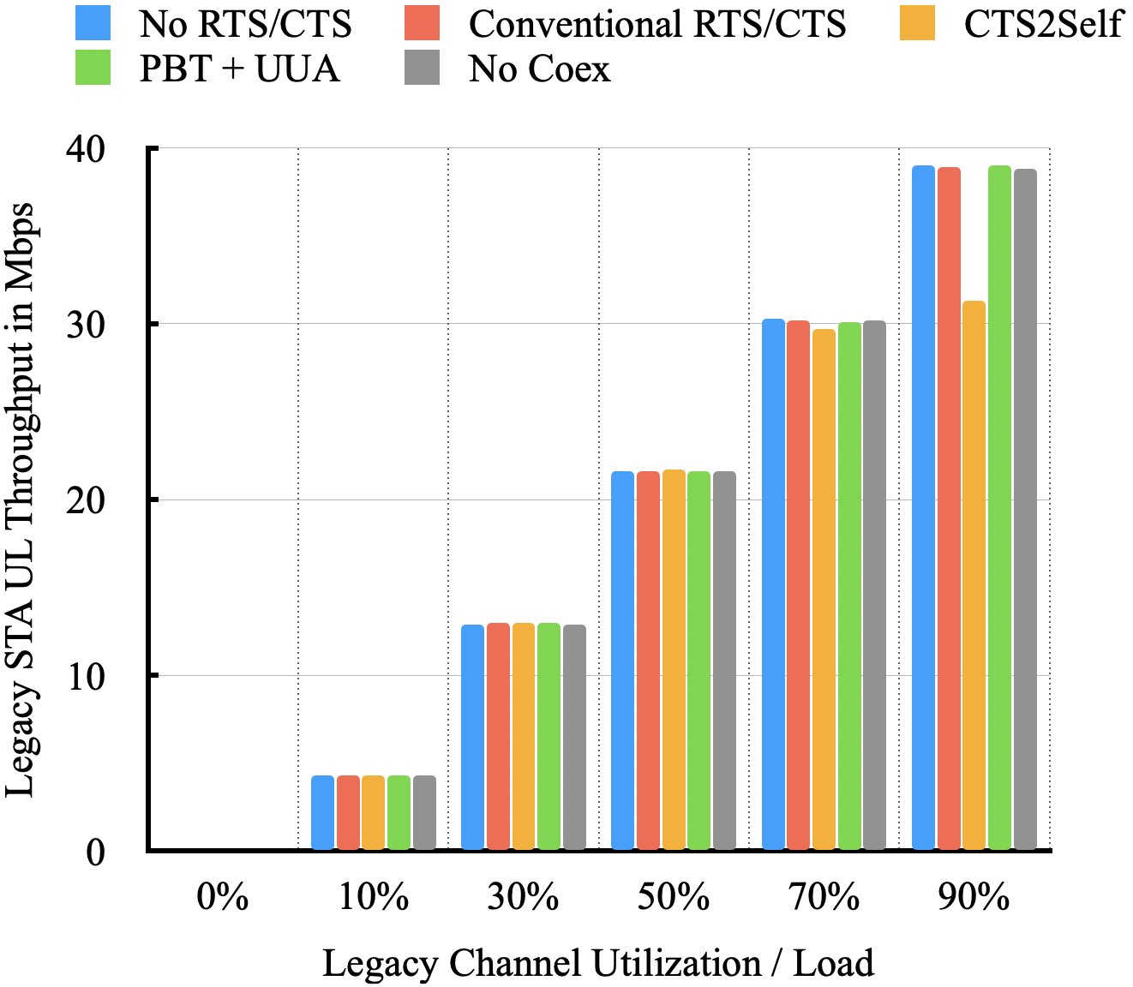
Legacy Performance with Periodic Co-ex Traffic
Co-ex Traffic Pattern – Periodic, 3.75 ms active every 15 ms
Per Legacy STA DL Throughput in Mbps
Per Legacy STA UL Throughput in Mbps
Notice the drop in throughput performance of Legacy STAs when CTS2Self is used by the DUT STA due to medium blockage, particularly in high traffic load

Slide 15
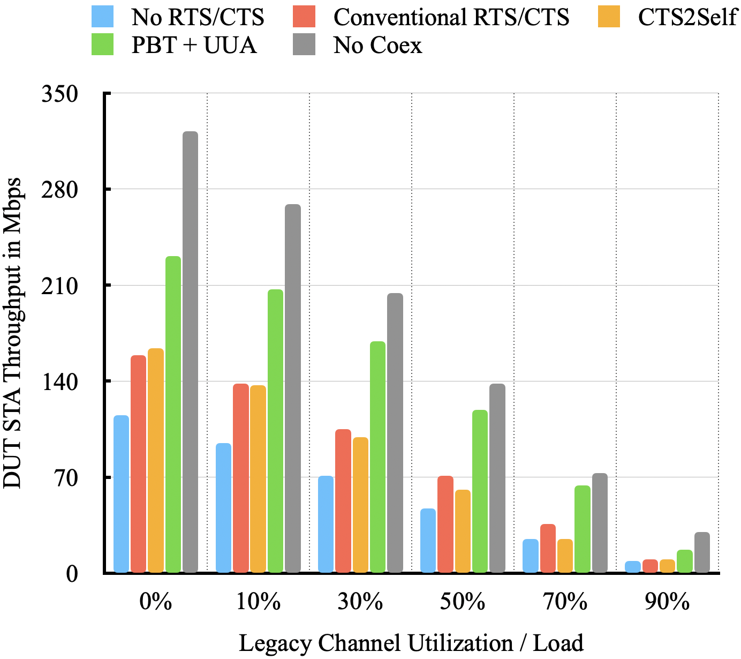
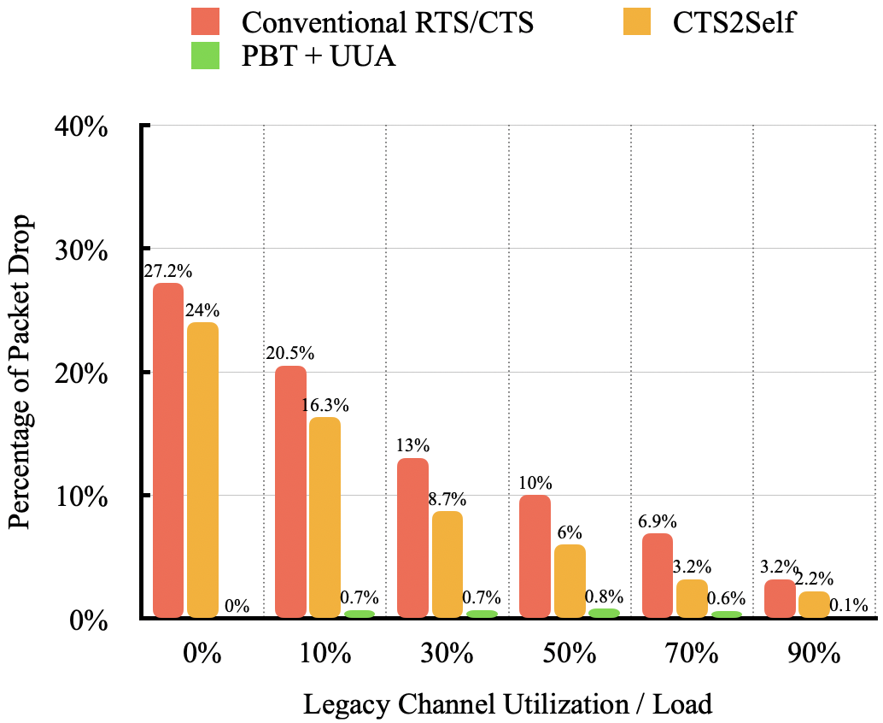
DUT Performance with Aperiodic Co-ex Traffic
Co-ex Traffic Pattern – Aperiodic, Activity duration ~ U(2.5 ms, 7.5 ms), Activity interval $∈$ [10 ms, 15 ms, 30 ms]
DUT STA Throughput in Mbps
Percentage of Packet Drops
Number of retries threshold (RTS or data) = 7

Slide 16
Summary
We have described the methods of Probe-Before-Talk (PBT) and Unsolicited Unavailability Announcement (UUA) to manage WLAN’s in-device co-existence issue.
Our simulation results demonstrate that PBT and UUA improve WLAN system performance by preventing data loss, removing undesired transmit rate reduction, and avoiding unnecessary medium blocking.

