Slide 1
Thoughts on IMMW extensions to optical bands
January 2024
Date: 2024-01-16
Authors:

Slide 2
Abstract
January 2024
In a series of contributions to IMMW SG meetings in November 2023, thoughts and considerations for the integration of mmWave were presented and discussed [1]. A contribution was also dedicated to the extension of IWWM for optical bands [2]. In this contribution, further thoughts on the extension for optical bands will be presented.

Slide 3
Outline
January 2024
“RF free” use case
Hybrid use case
Integrated LC use case
Conclusions
References

Slide 4
“RF free” use case
January 2024
There are use cases where LC is used as a complement where RF has limitations. For these uses cases it can be assumed that it is a hybrid solution, i.e. RF and LC are used at the same time and complement each other. For example, an RF band can be used to control and manage the integrated LC band which can be used for data.
However, there are also use cases where it is not desired or permitted to use RF bands at all, i.e. these are "RF free" use cases. In IMMW group, the concept of a two-band solution is already discussed. For these use cases, two optical bands (channels) should be used.

Slide 5
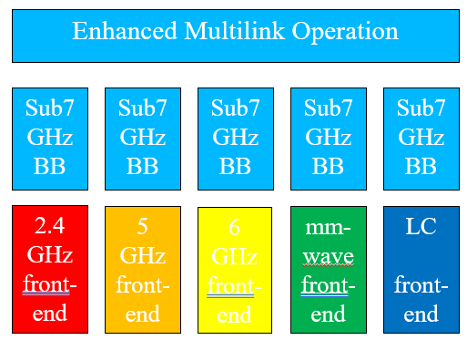
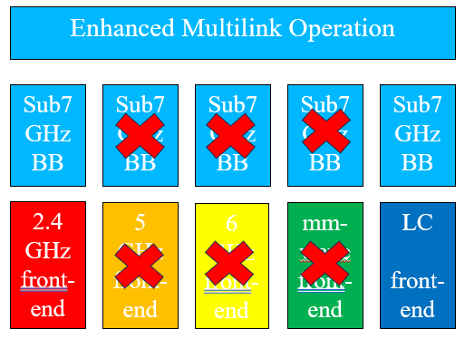
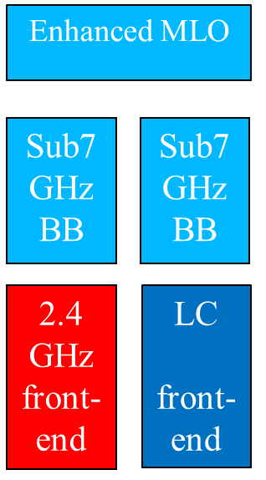
Hybrid use case (RF + LC)
January 2024
Source [2]
Sub-7GHz RF channel is used for control and management of the integrated LC channel.

Slide 6
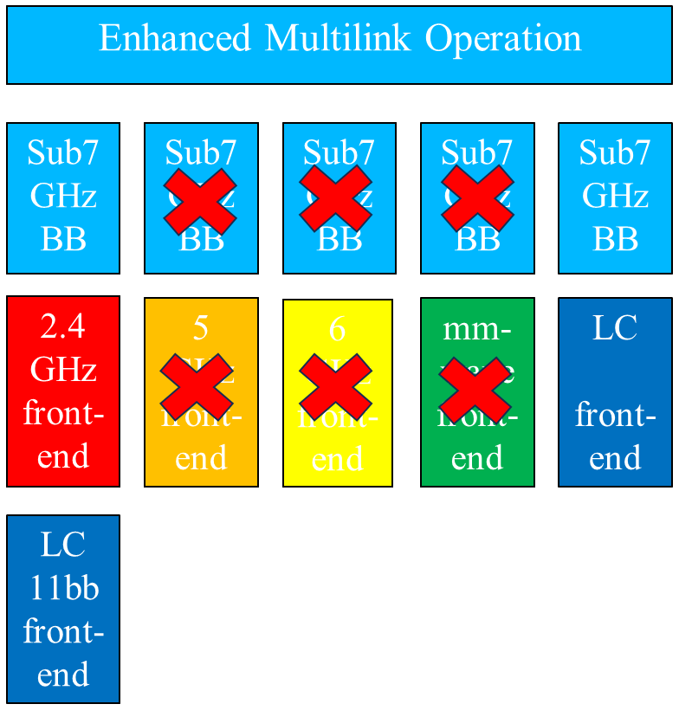
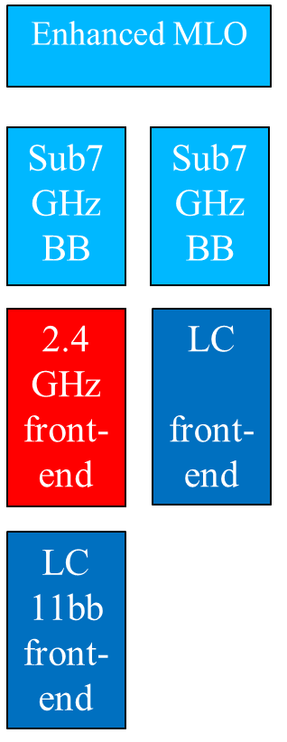
Integrated LC use case (two LC channels) (non-standalone)
January 2024
Source [2]
For this “RF free” use case, an 11bb LC channel is used for control and mgmt. of the second LC channel.

Slide 7
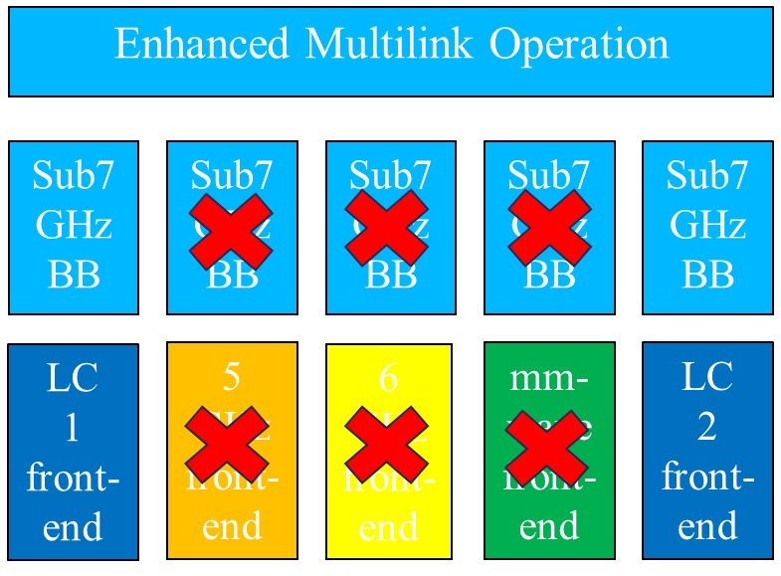
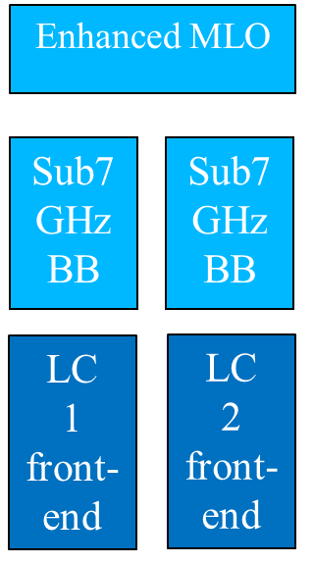
Integrated LC use case (two LC channels) (standalone, FFS)
January 2024
Source [2]
For this “RF free” use case, a first LC channel is used for control and mgmt. of the second LC channel.

Slide 8
Conclusions
January 2024
If IMMW scope is extended to LC, potential use cases must be taken into account. Special configurations for these use cases were pointed out in this contribution. These are the “Hybrid” or “RF-free” use cases, in which a narrowband RF or LC channel is used to control and manage the data transport over the integrated LC channel, respectively.

Slide 9
References
January 2024
[1] IMMW SG November 2023 Meeting Minutes. https://mentor.ieee.org/802.11/dcn/23/11-23-2089-00-immw-immw-sg-meeting-minutes-for-november-plenary-meeting.docx
[2] Extend IMMW scope to include optical bands. https://mentor.ieee.org/802.11/dcn/23/11-23-2016-02-immw-extend-immw-scope-to-include-optical-bands.pptx

