Slide 1
A dRU Design Approach for 20 MHz
Date: 2024-01-29
Authors:
Name | Affiliations | Address | Phone | email
Thomas Handte | Sony Group Corporation |  |  | Thomas.Handte@sony.com
Yusuke Tanaka |  |  |  | Yusuke.YT.Tanaka@sony.com
Salvatore Talarico |  |  |  | Salvatore.Talarico@sony.com
Dana Ciochina
Daniel Verenzuela
Ken Tanaka
Kosuke Aio
Ryuichi Hirata
Qing Xia

Slide 2
Introduction
Distributed Resource Units (dRUs) have been discussed to achieve TGbn PAR goal “Rate-vs-Range” (RvR) [1,2]
The goal of dRU is to design resource units (RUs) with low power spectral density
Lowering power spectral density is key for enhancing transmit power per tone with low number of active carriers [1,4]
Past submissions address various desired properties of dRU tone plans [3-6], e.g.,
dRUs should have same size as regular resource units (rRUs), same DC tones, same guard bands
dRUs tone plans should be ideally uniformly distributed [5,6]
Possibility to schedule dRUs of different size without overlap
In this submission, we present a dRU design approach for 20 MHz
The dRU tone plan designed with this approach…
… meets the above requirements, and
… maximizes the minimum tone separation distance

Slide 3
Comparison to past submissions
Four different tone plan design methods have been discussed and analyzed in [6]
“Global Dtm”, “Tone Group Based”, “Perfect Uniformly Distribution”, “26-tone RU Based”
This approach is closely related to “26-tone RU Based” approach
The tone plan proposed in here …
… has perfectly uniform distribution for 26-tone dRUs
… has near-uniform distribution for dRUs of size > 26 tones
… has very simple notation
… has a hierarchical structure
i.e., a large size dRU can be obtained by combining two small size dRUs
The desired requirements [3-6] of a dRU tone plan are met
On top, we suggest the requirement that each dRU has approximately 50% even indices equally distributed over the entire bandwidth
This requirement is important for pilot placement
Same pilots may be used for 2x and 4x UHR-LTF (as in HE and EHT)

Slide 4
Design approach for 20 MHz (1/2)
Define a tone plan for the least number of dRUs in 20 MHz (i.e. two 106-tone and one 26-tone dRUs)
Start with set of available tone indices > 0 (not including DC and guard tones)
Tone indices < 0 are obtained by mirroring
Select 13 tones with a tone separation distance of 9, resulting in the 26-tone dRU (dRU-A)
Choose starting index such that 13 tones can be obtained
Out of the remaining tones assign alternately 53 tones to two dRUs, resulting in two 106-tone dRUs (dRU-B, dRU-C)
Any leftover tones are set to zero

Slide 5
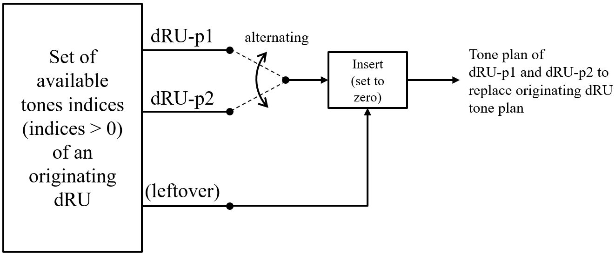
Design approach for 20 MHz (2/2)
Create tone plans for dRUs of smaller size by subsampling of a larger dRU
Start with the set of tones indices >0 of an originating dRU larger than 26 tones
Assign alternately N/2 tones to two dRUs, resulting in two N-tone dRUs (dRU-p1, dRU-p2)
E.g. N=52 or N=26
Any leftover tones may be set to zero at arbitrary position
The placement of leftover tones should consider that any lowest tone index >0 meets the minimum distance requirement after mirroring at DC

Slide 6
Example (1/2)
Boundary conditions to match HE/EHT PPDU format, 20MHz
DC tones -3…3
Guard tones -128…-123, 123…127
Symmetry to DC
Indices of two 106-tone and one 26-tone dRU
Excerpt of positive indices only (complete tone plans see appendix)
dRU-A: 11, 20, 29, …, 110, 119 [=11:9:119] (26 tone)
dRU-B: 4, 6, 8, 10, 13, 15, 17, 19, 22, 24, …, 116, 118, 121 (106 tone)
dRU-C: 5, 7, 9, 12, 14, 16, 18, 21, 23, 25, …, 117, 120, 122 (106 tone)
Properties
About 50% of each dRU tones have even indices
There is a tone separation distance of at least 2 (106 tone) or equal 9 (26 tone)
25% of the tones of the 106-tone dRU have a tone separation distance of 3

Slide 7
Example (2/2)
Creation of smaller dRU sizes
52-tone dRUs
Originating dRU-B: 4, 6, 8, 10, 13, 15, 17, 19, 22, 24, …, 116, 118, 121 (106 tone)
=> dRU-B-p1: 8, 13, 17, 22, 26, …, 116, 121 (52 tone)
=> dRU-B-p2: 6, 10, 15, 19, 24, …, 114, 118 (52 tone)
index 4 of originating dRU-B set to zero (leftover tone)
26-tone dRUs
Originating dRU-B-p1: 8, 13, 17, 22, 26, …, 116, 121 (52 tone)
=> dRU-B-p1-p1: 8, 17, …, 116 [=8:9:116] (26 tone)
=> dRU-B-p1-p2: 13, 22, …, 121 [=13:9:121] (26 tone)
Properties
About 50% of each dRU tones have even indices
There is a tone separation distance of at least 4 (52 tone) or equal 9 (26 tone)
~50% of the tones of the 52-tone dRU have a tone separation distance of 5

Slide 8
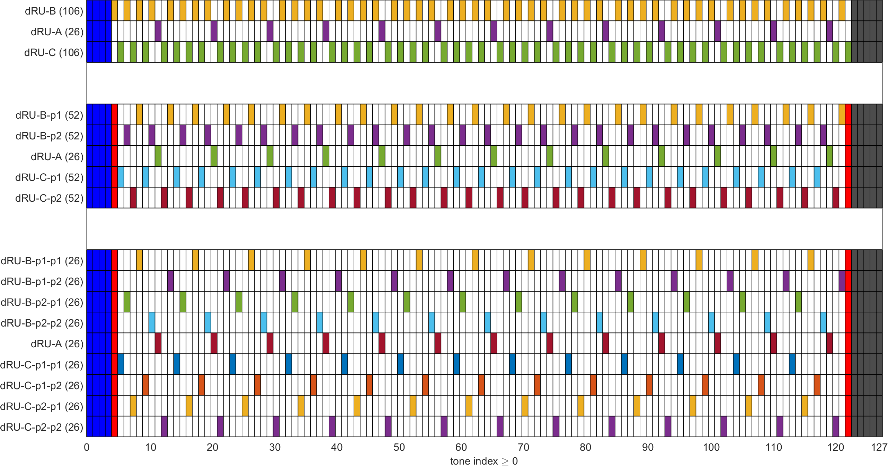
Illustration
DC tones
guard tones
leftover tone
leftover tone

Slide 9
Properties
The tone indices have properties that can be used to simplify notation
26-tone dRU tone indices can be written as $x_{i}:9:y_{i}$
$x_{i}$ and $y_{i}$ depend on dRU index $i$
52-tone dRU tone indices can be written as a combination of two 26-tone dRUs
i.e., $\left\{x_{i}:9:y_{i}∪x_{j}:9:y_{j}\right\}$
106-tone dRU tone indices can be written as a combination of two 52-tone dRUs
However, there is either one different start ($x_{l}^{106}$) or one different stop ($y_{l}^{106}$) index, i.e.,
$\left\{x_{i}:9:y_{i}∪ x_{j}:9:y_{j}∪x_{k}:9:y_{k}∪x_{l}^{106}:9:y_{l}\right\}$ or $\left\{x_{i}:9:y_{i}∪x_{j}:9:y_{j}∪x_{k}:9:y_{k}∪x_{l}:9:y_{l}^{106}\right\}$
$x_{l}^{106}=x_{l}−9$ and $y_{l}^{106}=y_{l}+9$
Starting indices $x$ and stopping indices $y$ can be found in Appendix
The tone indices have implementation-friendly properties
Maximized minimum tone separation distance reduces effect of sidelobes in frequency domain
Achievable gain is larger compared to approaches with tones in immediate vicinity (see Appendix)

Slide 10
Conclusion
We presented a distributed resource unit (dRU) design approach for 20 MHz
The proposed approach is closely related to “26-tone RU Based” design method of [6]
The suggested tone plan meets the following requirements
Same number of tones as regular RUs
dRUs of different size can be scheduled without overlap
Symmetry to DC, same DC tones and guard band as 20 MHz regular RUs
Almost uniform distribution of tones
26-tone dRUs are uniformly distributed
Each dRU has approx. 50% even tones
Can use same pilots for 2xUHR-LTF and 4xUHR-LTF
Maximized minimum tone separation distance
=> minimized power spectral density
The proposed tone plan may act as a reference for dRU development
Tone plan is provided in Appendix

Slide 11
References
[1] 11-23/0480 “UHR proposed PAR”
[2] 11-23/0037 “UHR Feature to Overcome PSD Limitations Distributed-Tone Resource Units”
[3] 11-23/1117 “dRU Signaling for UHR”
[4] 11-23/1919 “dRU Proposal”
[5] 11-23/2020 “High Level Perspective on Distributed Tone RU for 11bn”
[6] 11-23/2021 “Principle and Methodology for dRU Tone Plan Design”

Slide 12
Appendix

Slide 13
Tone plan (1/3)
2x 106 + 1x 26 tones
dRU-A: 11, 20, 29, 38, 47, 56, 65, 74, 83, 92, 101, 110, 119 (26 tone)
= 11:9:119
dRU-B: 4, 6, 8, 10, 13, 15, 17, 19, 22, 24, 26, 28, 31, 33, 35, 37, 40, 42, 44, 46, 49, 51, 53, 55, 58, 60, 62, 64, 67, 69, 71, 73, 76, 78, 80, 82, 85, 87, 89, 91, 94, 96, 98, 100, 103, 105, 107, 109, 112, 114, 116, 118, 121 (106 tone)
= 8:9:116, 6:9:114, 10:9:118, and 4:9:121
dRU-C: 5, 7, 9, 12, 14, 16, 18, 21, 23, 25, 27, 30, 32, 34, 36, 39, 41, 43, 45, 48, 50, 52, 54, 57, 59, 61, 63, 66, 68, 70, 72, 75, 77, 79, 81, 84, 86, 88, 90, 93, 95, 97, 99, 102, 104, 106, 108, 111, 113, 115, 117, 120, 122 (106 tone)
= 9:9:117, 7:9:115, 12:9:120, and 5:9:122
Note: $x(−n)=x(n)$ for $n≥1$

Slide 14
Tone plan (2/3)
4x 52 + 1x 26 tones
dRU-A: 11, 20, 29, 38, 47, 56, 65, 74, 83, 92, 101, 110, 119 (26 tone)
= 11:9:119
dRU-B-p1: 8, 13, 17, 22, 26, 31, 35, 40, 44, 49, 53, 58, 62, 67, 71, 76, 80, 85, 89, 94, 98, 103, 107, 112, 116, 121 (52 tone)
= 8:9:116 and 13:9:121
dRU-B-p2: 6, 10, 15, 19, 24, 28, 33, 37, 42, 46, 51, 55, 60, 64, 69, 73, 78, 82, 87, 91, 96, 100, 105, 109, 114, 118 (52 tone)
= 6:9:114 and 10:9:118
dRU-C-p1: 5, 9, 14, 18, 23, 27, 32, 36, 41, 45, 50, 54, 59, 63, 68, 72, 77, 81, 86, 90, 95, 99, 104, 108, 113, 117 (52 tone)
= 5:9:113 and 9:9:117
dRU-C-p2: 7, 12, 16, 21, 25, 30, 34, 39, 43, 48, 52, 57, 61, 66, 70, 75, 79, 84, 88, 93, 97, 102, 106, 111, 115, 120 (52 tone)
= 7:9:115 and 12:9:120
Note: $x(−n)=x\left(n\right)$ for $n≥1$

Slide 15
Tone plan (3/3)
9x 26 tones
dRU-A: 11, 20, 29, 38, 47, 56, 65, 74, 83, 92, 101, 110, 119 (26 tone)
= 11:9:119
dRU-B-p1-p1: 8, 17, 26, 35, 44, 53, 62, 71, 80, 89, 98, 107, 116 (26 tone)
= 8:9:116
dRU-B-p1-p2: 13, 22, 31, 40, 49, 58, 67, 76, 85, 94, 103, 112, 121 (26 tone)
= 13:9:121
dRU-B-p2-p1: 6, 15, 24, 33, 42, 51, 60, 69, 78, 87, 96, 105, 114 (26 tone)
= 6:9:114
dRU-B-p2-p2: 10, 19, 28, 37, 46, 55, 64, 73, 82, 91, 100, 109, 118 (26 tone)
= 10:9:118
dRU-C-p1-p1: 5, 14, 23, 32, 41, 50, 59, 68, 77, 86, 95, 104, 113 (26 tone)
= 5:9:113
dRU-C-p1-p2: 9, 18, 27, 36, 45, 54, 63, 72, 81, 90, 99, 108, 117 (26 tone)
= 9:9:117
dRU-C-p2-p1: 7, 16, 25, 34, 43, 52, 61, 70, 79, 88, 97, 106, 115 (26 tone)
= 7:9:115
dRU-C-p2-p2: 12, 21, 30, 39, 48, 57, 66, 75, 84, 93, 102, 111, 120 (26 tone)
= 12:9:120
Note: $x(−n)=x(n)$ for $n≥1$

Slide 16
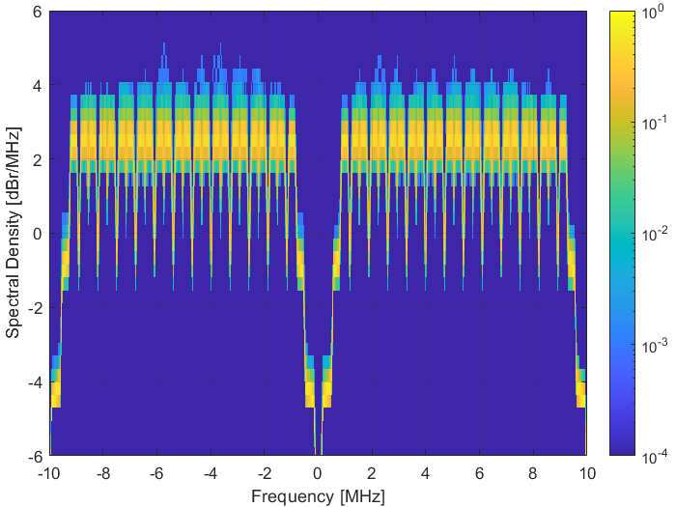
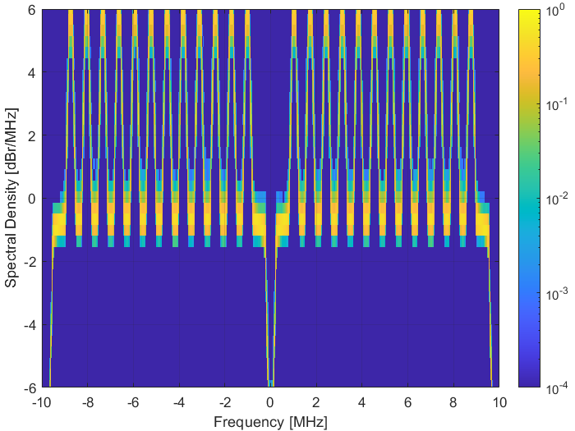
Power Spectral Density of 52-tone dRU
Comparison of design approaches
Left: Maximized minimum tone separation distance, dRU-B-p1 (as defined in slide 14)
Right: Exemplary tone grouping, dRU indices: 8, 9, 17, 18, 26, 27, 35, 36, …, 108, 116, 117
Approach of maximized minimum tone separation distance results in more flat power spectral density and higher gain
Probability of occurrence
Probability of occurrence

